Slide 1

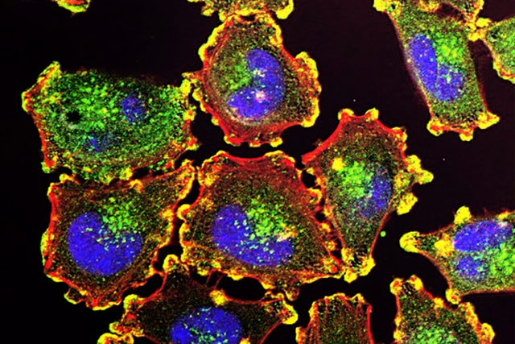

Customer Subgroups
Disease Phenotypes
Website Usage Patterns

Slide 2
Supervised learning
Components
is different from
Unsupervised learning
Object of class "kmeans"
has
is method of
returns
print method
Total intra-cluster variation
mini-mizes
K-Means
imple-ments
R function kmeans()
input of
produces
input of
input of
Data points
assigned to
Clusters
initiali-zation affects
Centroids
input of

Slide 3
Data Clustering
Cohesion
Euclidean
Manhattan
Cosine
Separation
internal
Silhouette
can
be
Evaluation
Distance Measure
Curse of Dimensionality
Jaccard
external
Purity
measures quality of
affects
reduces efficacy of
F1 Measure
reduces
Feature Selection/ Reduction
PCA
Prototype
Set of Clusters
generates
Clustering
Algorithm
t-SNE
may contain
Correlation- based
illustrates
K-means
Agglomerative hierarchical
DBSCAN
scatterplot
dendrogram
Visualization
enables
heatmap
Notes:
Uli Niemann

