Slide 1
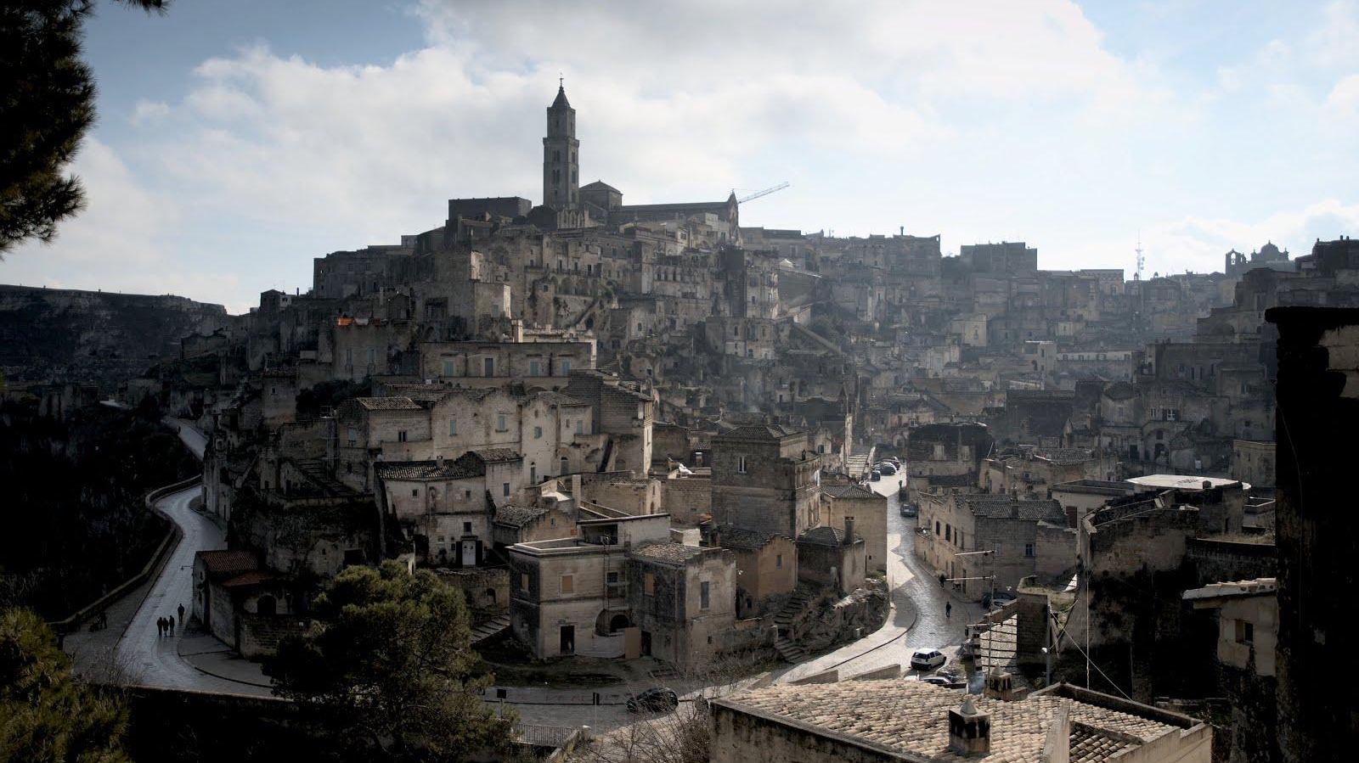
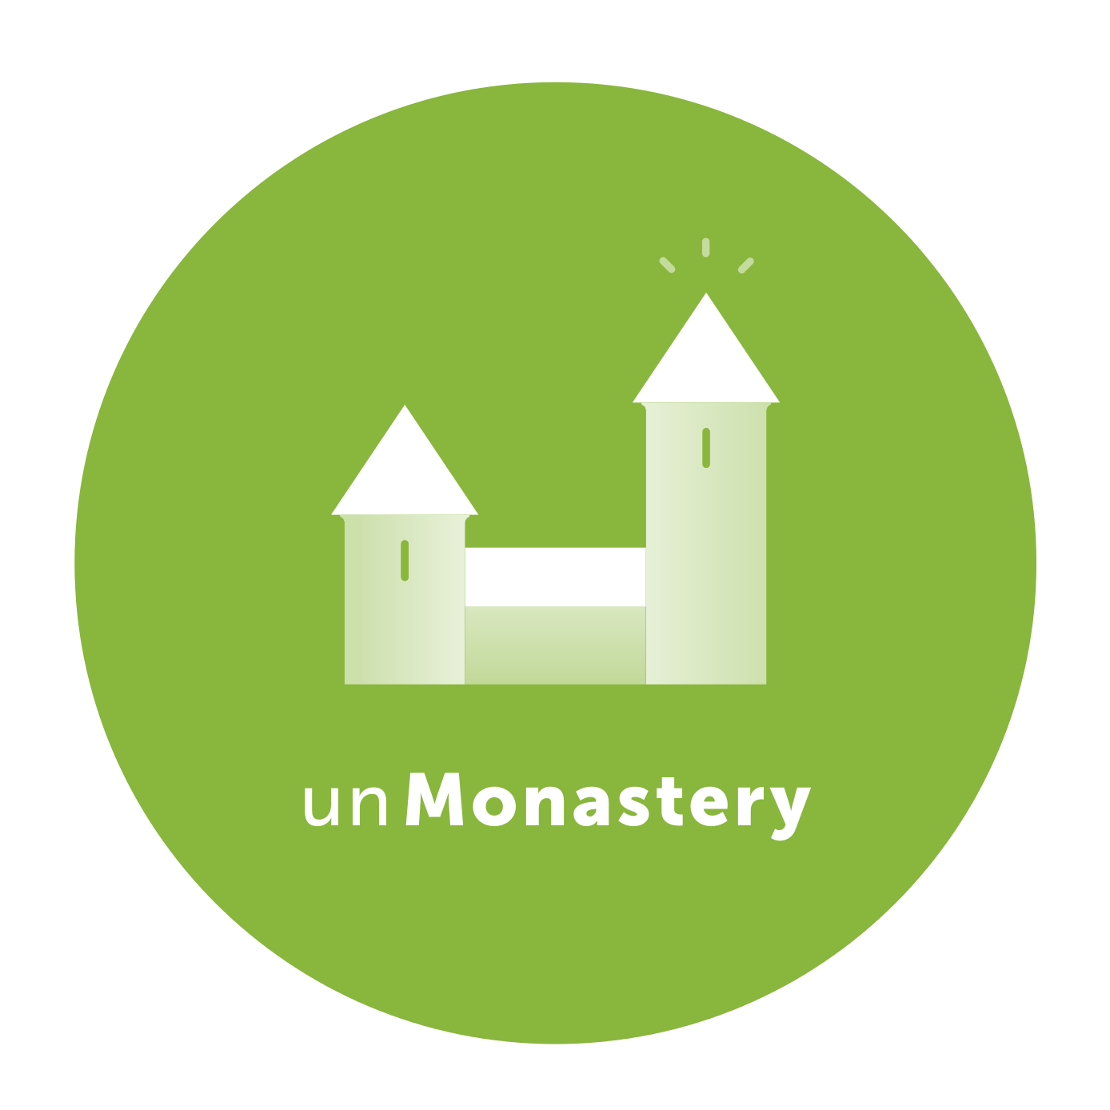

Slide 2
What is unMonastery?
— A group of people working on community-driven projects in a shared living space.
— Physical space for a distributed network.
— unMonastery aims to establish a network of spaces throughout the world, which will work together but autonomously to prototype new solutions to common problems.
— unMonastery draws inspiration from 10th century monastic codes and the concept of hackerspaces, borrowing parts of each model that engage closely with the local community.

Slide 3
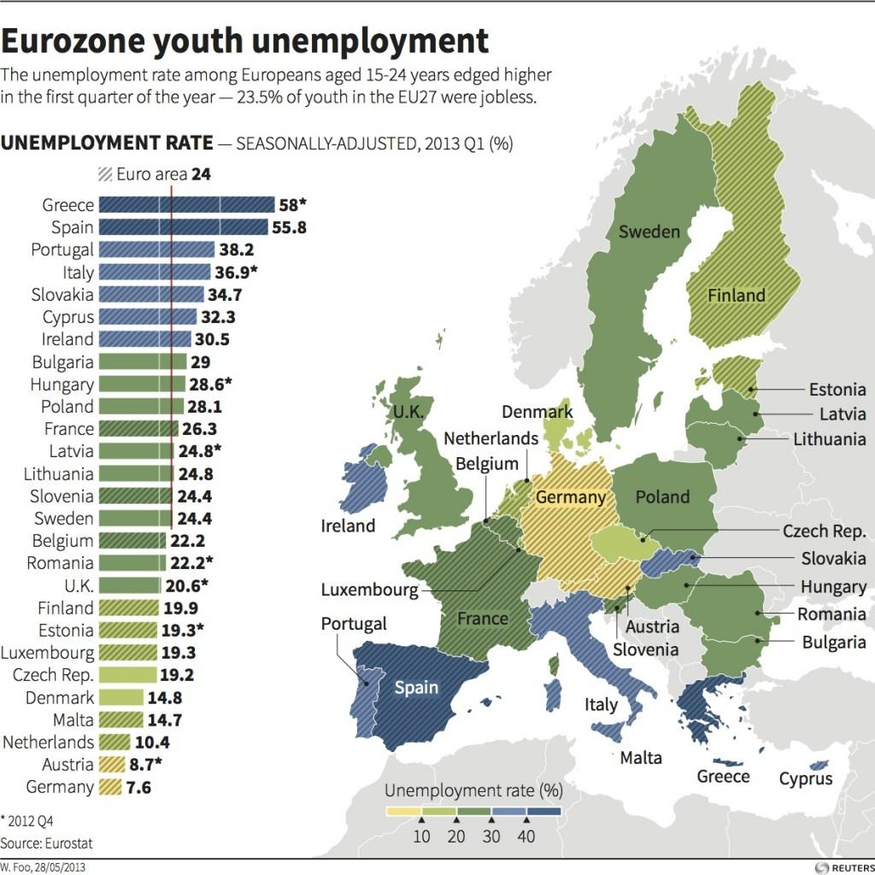
Why Now?
Creating spaces in which residents do not fully rely on the generation of income in order to make a living, unMonastery addresses fundamental contemporary challenges:
(1) Large numbers of empty and disused property.
(2) Austerity: the rollback of state provision.
(3) High unemployment throughout Europe, particularly among young and highly skilled individuals.
Source: Eurostat, 2012

Slide 4
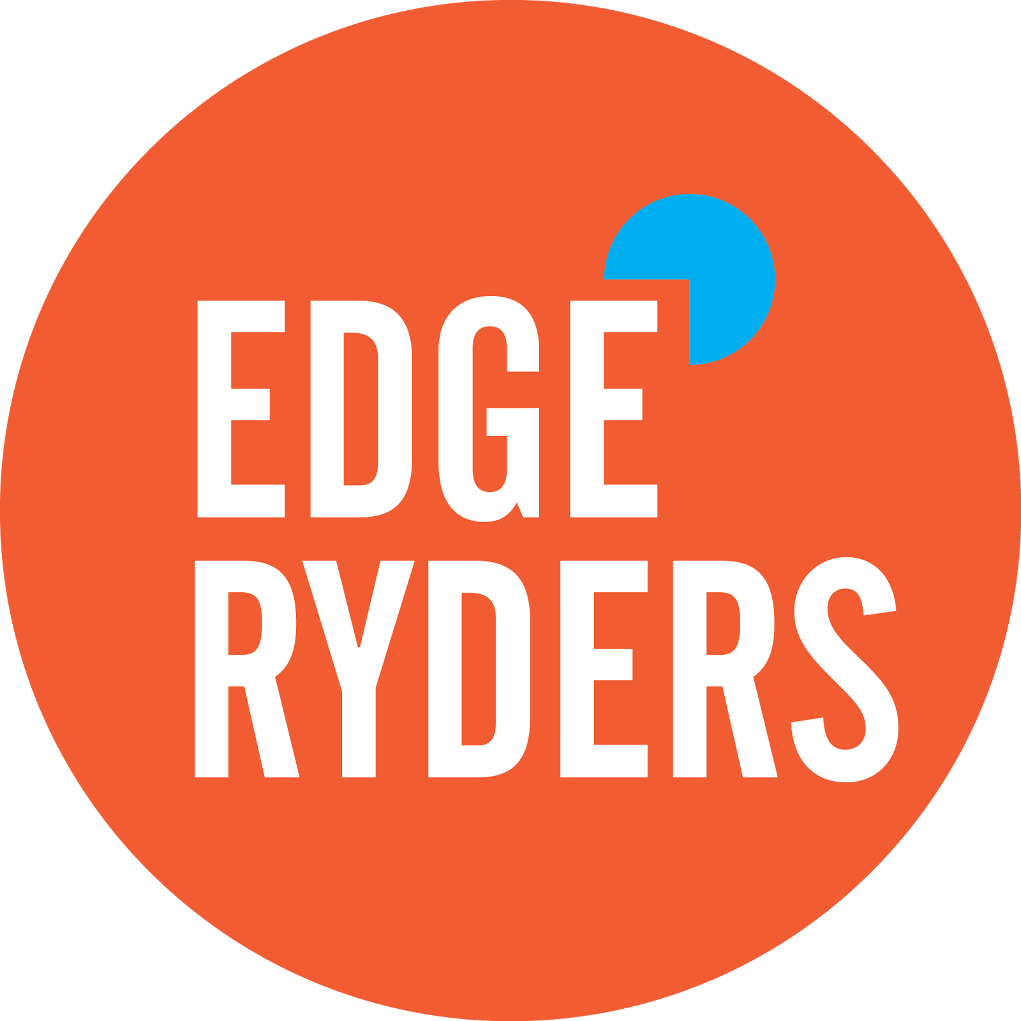
The concept and establishment of unMonastery came out of an annual conference organized by EdgeRyders, a distributed think-tank of citizen experts wielding collective intelligence and consultation.
12 Challenges
4 Months

Slide 5
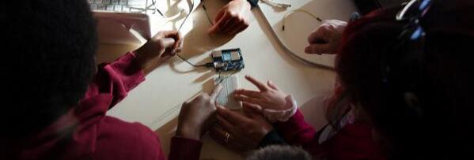
The Materan Prototype
Leveraging international networks for community-driven projects.
CoderDojo Matera + OpenTechSchool Matera: free intergenerational learning spaces.
unTransit: using OpenStreetMap to publish the city’s transit system in real time.
KIDERWIND: open-source project to harness the wind at high energy in order to generate power. Hackathon 22-27 September in Matera.
Mapping the Commons: a web-based tool used to map local cultural assets.

Slide 6
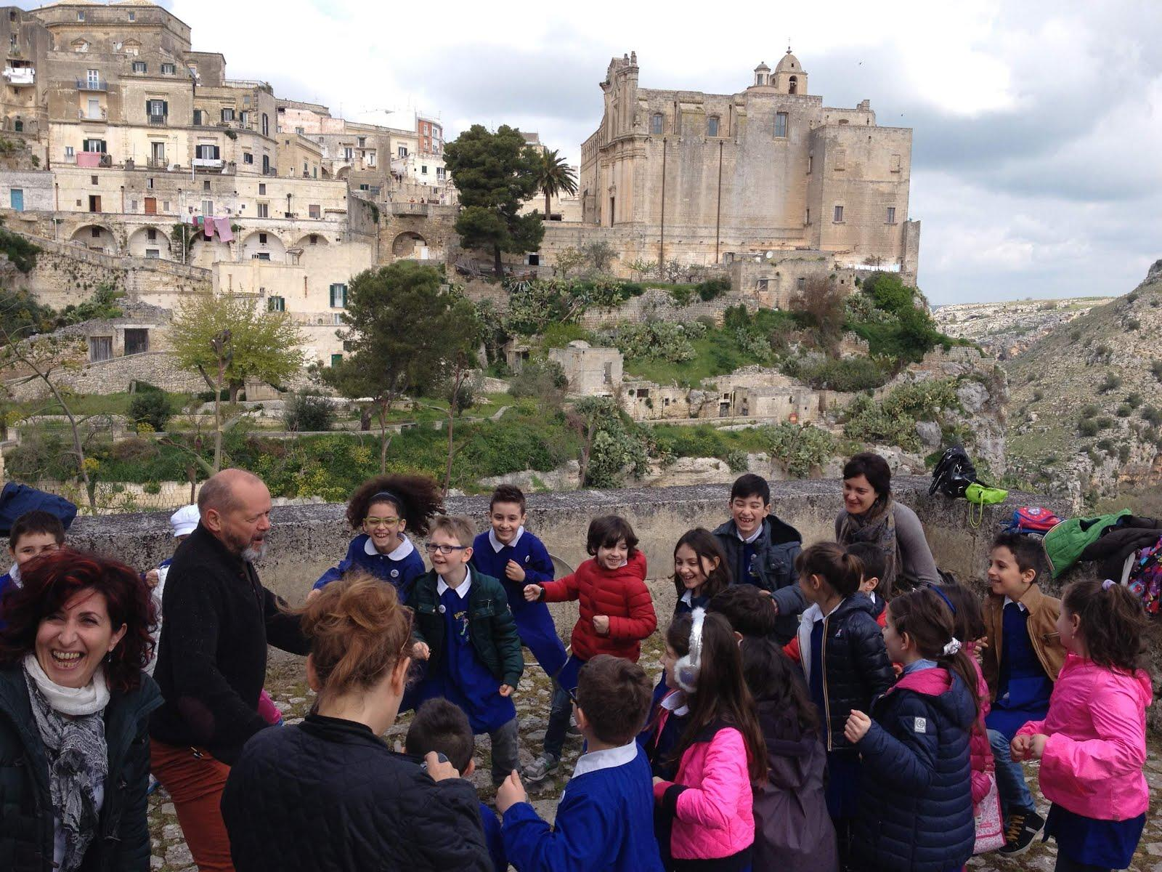
The Contract Co-living spaces working with local communities.
My response to “How do we build community?” is: “Do something useful. Welcome others.”
— Willow Brough MIT Center for Civic Media

Slide 7
The Book of Mistakes A narrative pattern language.
Problem | Proposed solution
12 challenges | Set specific target points to address larger identified challenges.
4-6 month timeframe | Time scale likely too short to build solutions and bootstrap basic infrastructure. 2+ year commitment ideal, not less than 1 year.
1 person = 1 project | Working groups are better than individual projects, providing less overhead and encouraging collaboration.

Slide 8
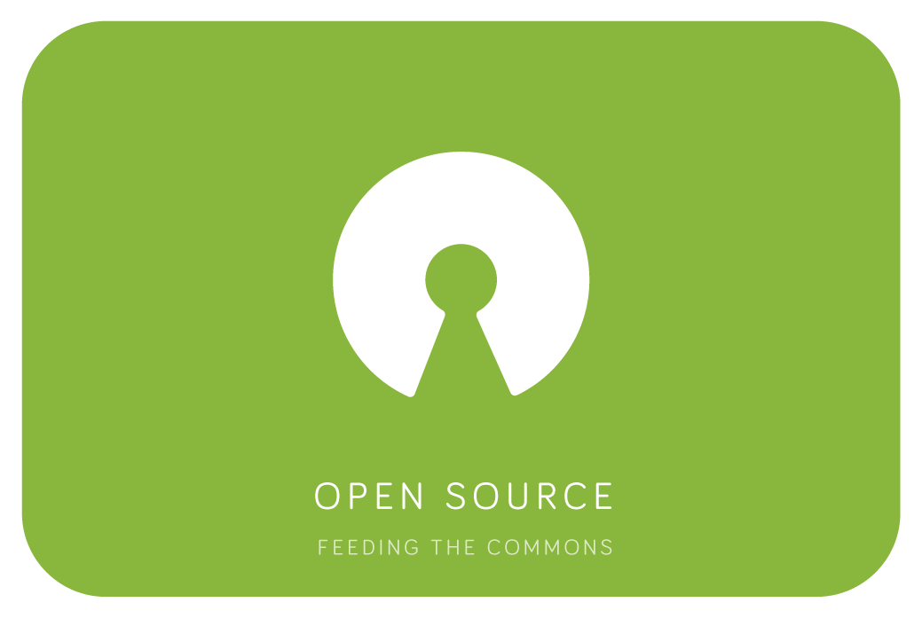
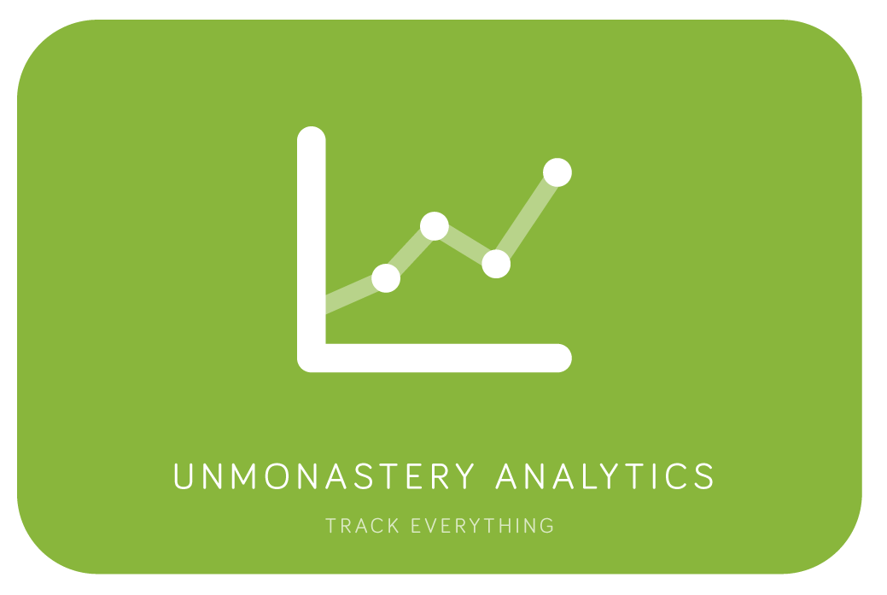



unMonastery in-a-Box
Developed in collaboration with MethodKit
Tools for starting new unMonasteries and evaluating projects throughout their development.
github.com/unmonastery

Slide 9
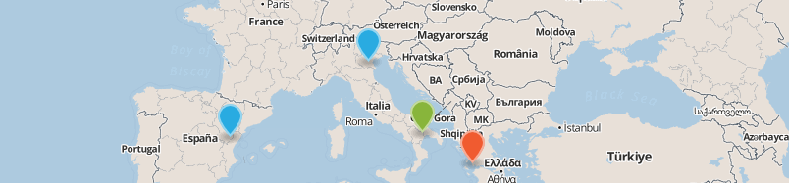

What’s next? Join an unMonastery team or suggest a location globally.
Materan Civic Innovation Network

Slide 10
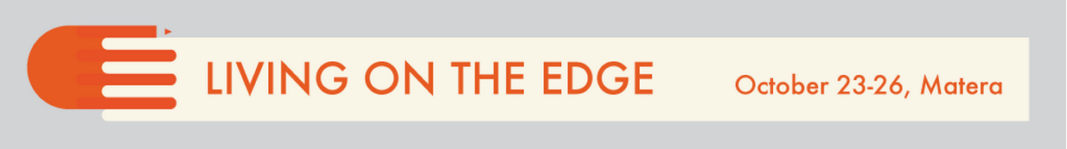
#LOTE4 The Stewardship
The ability to come together to take care of assets in an unstable context is a key skill for surviving and thriving in the future. The gathering is meant as a locus to exchange information and practical knowledge on how we can put the stock of underutilized public assets to a better use.
This is an invitation to participate!
Host a session, join a team, or bring your project to the Hackathon, October 15-23

Slide 11
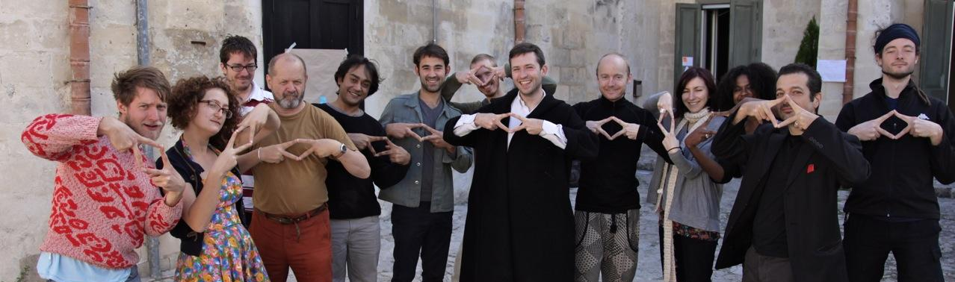
“Follow Us”
unmonastery.org :: edgeryders.eu/unmonastery
Twitter: @unmonastery
Facebook: facebook.com/unmonastery
Email: matera@unmonastery.org

