Slide 1


M3R
First Project Progress Review Presentation
Sem: VI
Year: 3rd
Session: 2023-34
Group Number: | Supervisor Name:
Student Name | Roll Number | Role
Arpit Raj | 2101331550019 | Hardware + Software
Unnati Mishra | 2101331550076 | UI/UX Design + Documentation
Chhatish Kumar | 2101331550024 | Hardware
Avanish Pratap Singh | 2101331550021 | Software
Department of Computer Science and Engineering (Internet of Things)

Slide 2

Index
Introduction
Literature Survey/Existing System (In Tabular Form with references)
Problem Statement
Proposed Methodology (Including DFD/ER Diagrams/ Use case Diagrams)
Hardware /Software Requirements
Live Project Progress
Conclusion and Future Action Plan
References

Slide 3
Introduction
M3R: Monitoring, Metering, Mechanization, Retrofitting.
Mission: Innovate and enhance efficiency in college labs.
Break free from outdated methods; embrace cutting-edge tech.
Transform labs into productive, sustainable hubs of innovation.
Imagine optimized energy, resources, and automated processes.
Achieve unprecedented lab management efficiency with advanced sensors, intuitive apps, and intelligent automation.

Slide 4
Literature Survey
Name | Year | Publisher | Content
Systematic Review Analysis on Smart Building: Challenges and Opportunities | 2020 | MDPI | The review discusses IoT architectures and applications in building management, covering components like sensors, communication protocols, and cloud computing platforms.[1]
Automation Systems in Smart Buildings | 2018 | Springer | The review outlines key services in smart buildings: security, energy management, HVAC monitoring, water management, lighting systems, elder health care, and fire detection.[2]
Advanced Supervision of Smart Buildings | 2019 | Elsevier | The paper introduces signal analysis techniques and proposes an advanced supervision approach for smart building and industrial control systems, implemented on a suitable platform.[3]
Table 1.1

Slide 5
Problem Statement
Current building energy management lacks real-time monitoring and automation, driving inefficiencies and costs. Retrofitting with an IoT-based system enables seamless monitoring, automation, and optimization, boosting efficiency, savings, and comfort.

Slide 6
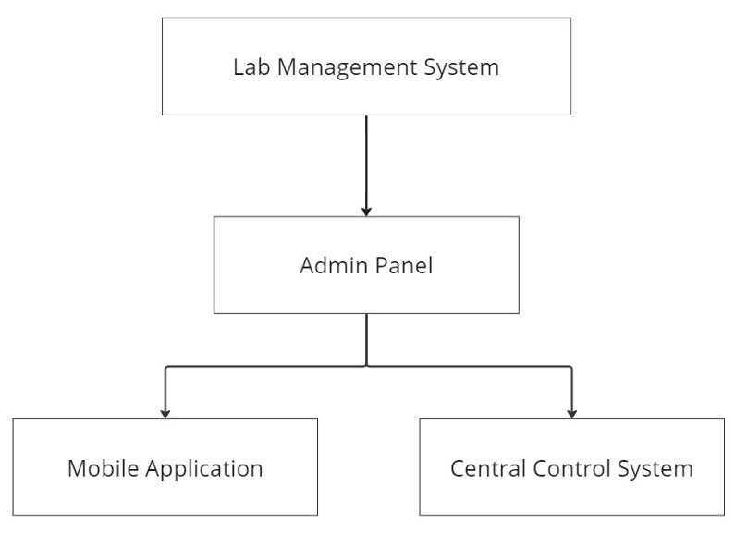
Proposed Methodology
1. Requirement Analysis: Identify building needs and project objectives.
2. System Design: Select hardware and define communication protocols.
3. Hardware Implementation: Assemble and integrate components.
4. Software Development: Develop firmware for data collection and control.
5. Testing and Validation: Ensure functionality and reliability.
6. Deployment and Integration: Install and integrate with existing infrastructure.
7. Data Analysis and Optimization: Analyze data for energy management improvements.
8. Monitoring and Maintenance: Continuously monitor and maintain system performance.
Fig 1.1

Slide 7
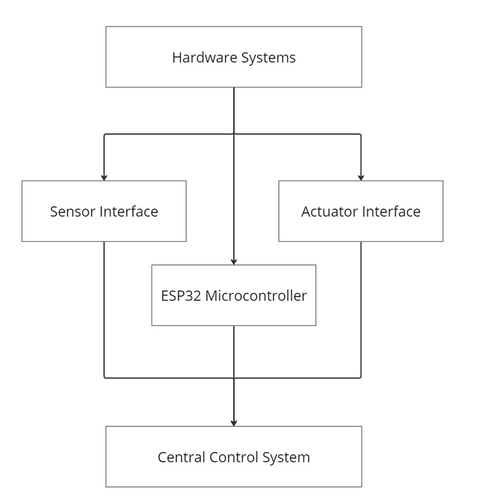
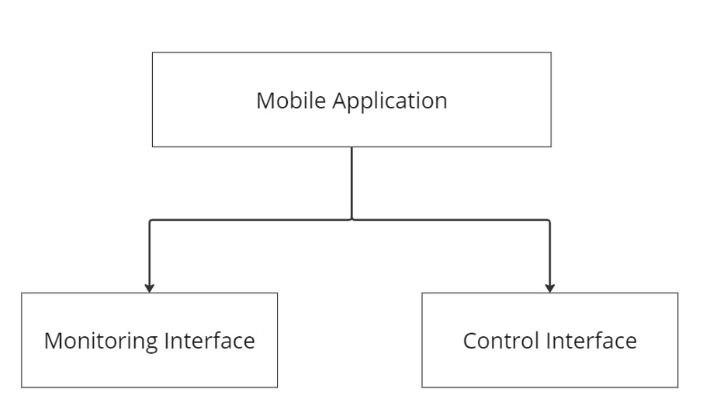
Proposed Methodology
Fig 1.2
Fig 1.3

Slide 8

Hardware and Software Requirements
Hardware
Software
Occupancy Sensor
Energy Consumption Sensors
Environmental Parameter Sensors
SCT013
ZMPT
ESP32
IR
Relay Modules
Fig 1.4
The software component complements the hardware by providing advanced functionalities for data management, analysis, visualization, automation, and remote control. It empowers users to make informed decisions, optimize energy usage, and improve the overall energy efficiency and comfort of the building.
Fig 1.2

Slide 9
Live Project Progress

Slide 10
Conclusion and Future Action Plan
The IoT-based Building Monitoring System project offers a comprehensive solution to energy management challenges in buildings.
It seamlessly integrates metering, monitoring, and mechanization functionalities for real-time energy optimization and remote control.
Building owners and operators benefit from improved energy efficiency, cost savings, and enhanced occupant comfort.
The project enables data-driven decision-making by providing insights into energy consumption patterns.
Retrofitting existing buildings with smart technologies demonstrates the transformative potential of IoT solutions.
Overall, the project advances energy management practices and paves the way for further innovation in energy efficiency and automation.

Slide 11
References
[1] 2021 International Conference on Advance Computing and Innovative Technologies in Engineering
(ICACITE) | 978-1-7281- 7741-0/20/$31.00 ©2021 IEEE | DOI: 10.1109/ICACITE51222.2021.9404551
[2] Priya B. Patel, Viraj M. Choksi, Swapna Jadhav, M.B.Potdar, “Smart Motion Detection System using
Raspberry Pi” International Journal of Applied Information Systems (IJAIS) – ISSN: 2249-0868 Foundation

Slide 12
Feedback from the Panel
Thank You

