Slide 1


M3R
Second Project Progress Review Presentation
Sem: VI
Year: 3rd
Session: 2023-24
Group Number: 28 | Supervisor Name: Mayank Deep Khare
Student Name | Roll Number | Role
Arpit Raj | 2101331550019 | Hardware + Software
Unnati Mishra | 2101331550076 | UI/UX Design + Documentation
Chhatish Kumar | 2101331550024 | Web App
Avanish Pratap Singh | 2101331550021 | Mobile App
Department of Computer Science and Engineering (Internet of Things)

Slide 2

Index
Introduction
Problem Statement
Literature Survey
Proposed Methodology
Hardware /Software Requirements
Live Project Progress
Conclusion and Future Action Plan
References

Slide 3
Introduction
M3R: Monitoring, Metering, Mechanization, Retrofitting.
Mission: Innovate and enhance efficiency in college labs.
Break free from outdated methods; embrace cutting-edge tech.
Transform labs into productive, sustainable hubs of innovation.
Imagine optimized energy, resources, and automated processes.
Achieve unprecedented lab management efficiency with advanced sensors, intuitive apps, and intelligent automation.

Slide 4
Problem Statement
Current building energy management lacks real-time monitoring and automation, driving inefficiencies and costs. Retrofitting with an IoT-based system enables seamless monitoring, automation, and optimization, boosting efficiency, savings, and comfort.

Slide 5

Literature Survey
Name | Year | Publisher | Content
A Low-Cost IoT Based Buildings Management System (BMS) | 2022 | IJECES | The paper introduces a cost-effective IoT-based Building Management System using Arduino Mega and Raspberry Pi for local data processing, employing MQTT for communication and offering various functionalities to enhance energy efficiency and comfort in buildings.[1]
Integration of IoT and Machine Learning for Building Energy Management | 2022 | Energy Reports | This paper provides a review of the integration of IoT and machine learning techniques for building energy management. It discusses algorithms, data analytics, and optimization strategies to improve energy efficiency and reduce costs in buildings.[2]
Smart Buildings and the Internet of Things | 2021 | IEEE Internet of Things Journal | This paper explores the concept of smart buildings and their integration with the Internet of Things. It discusses various IoT-based applications for energy management, including real-time monitoring, predictive maintenance, and adaptive control, to achieve energy efficiency and cost savings.[3]
Table 1.1

Slide 6
Literature Survey
Name | Year | Publisher | Content
A Survey on IoT Applications in Building Energy Management Systems | 2021 | IEEE Access | This survey paper provides an overview of IoT applications in building energy management systems, including sensors, actuators, communication protocols, and data analytics techniques. It discusses challenges, opportunities, and future research directions in this area.[4]
Systematic Review Analysis on Smart Building: Challenges and Opportunities | 2020 | MDPI | The review discusses IoT architectures and applications in building management, covering components like sensors, communication protocols, and cloud computing platforms.[5]
Advanced Supervision of Smart Buildings | 2020 | Elsevier | The paper introduces signal analysis techniques and proposes an advanced supervision approach for smart building and industrial control systems, implemented on a suitable platform.[6]
Table 1.2

Slide 7
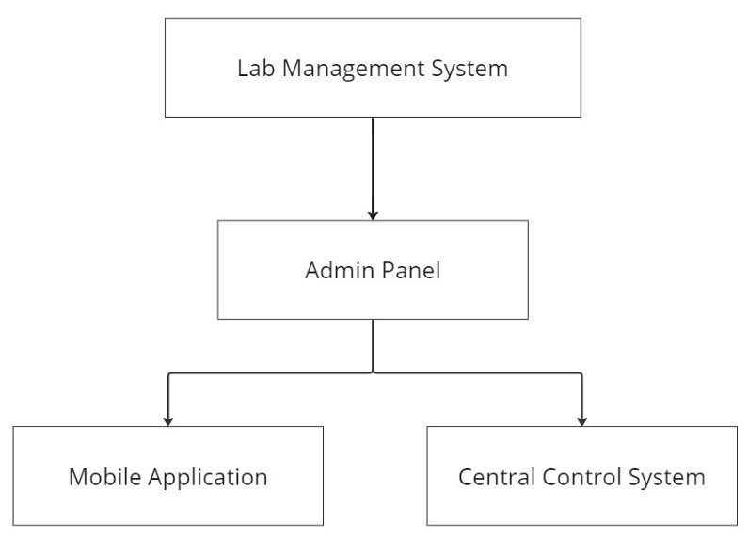
Proposed Methodology
Requirement Analysis: Identify building needs and project objectives.
System Design: Select hardware and define communication protocols.
Hardware Implementation: Assemble and integrate components.
Software Development: Develop firmware for data collection and control.
Testing and Validation: Ensure functionality and reliability.
Deployment and Integration: Install and integrate with existing infrastructure.
Data Analysis and Optimization: Analyze data for energy management improvements.
Monitoring and Maintenance: Continuously monitor and maintain system performance.
Fig 1.1

Slide 8
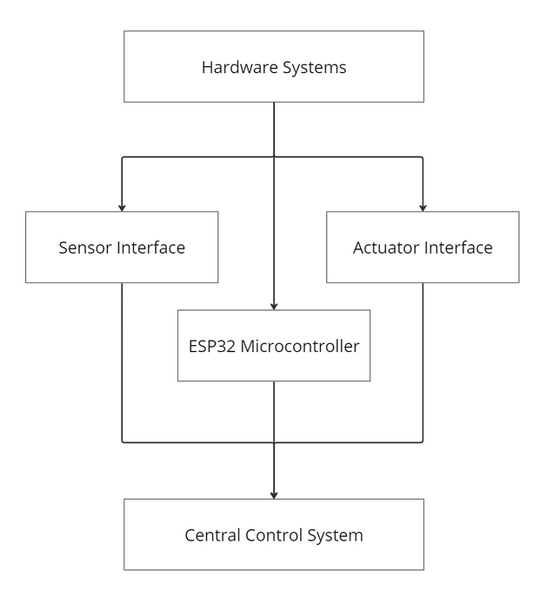
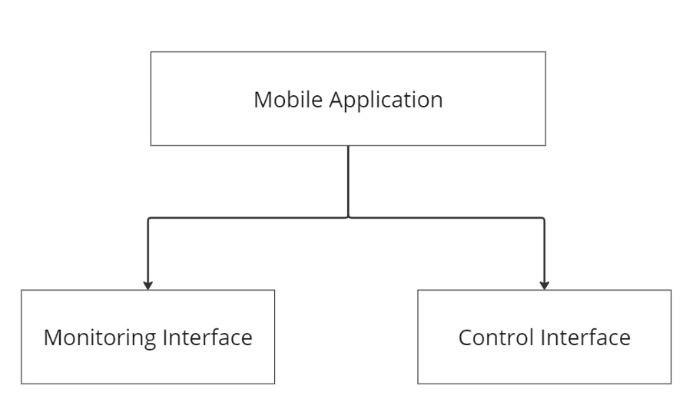
Proposed Methodology
Fig 1.2
Fig 1.3

Slide 9


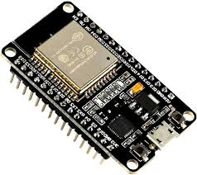
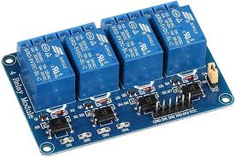


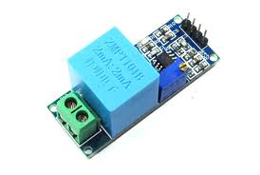

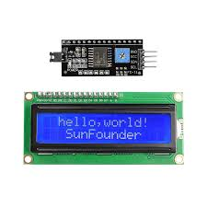



Hardware and Software Requirements
Hardware
Software
4 Channel Relay
ESP 32
ZMPT101B
SCT013
LCD I2C
LEDs
Fig 1.4
Fig 1.5

Slide 10
Live Project Progress

Slide 11
Conclusion and Future Action Plan
The IoT-based Building Monitoring System optimizes energy management in buildings, offering real-time monitoring, optimization, and future potential for advanced analytics and renewable energy integration, enhancing efficiency and sustainability.

Slide 12
References
[1] [Muhammad Uzair, Salah Yacoub Al-Kafrawi, Karam Manaf Al-Janadi, and Ibrahim Abdulrahman Al-Bulushi]. (2022). A Low-Cost IoT
Based Buildings Management System (BMS). International Journal of Electronics and Communication Engineering & Technology
(IJECES).
[2] [K.Aljumaili, M.Gupta, et al]. (2022). Integration of IoT and Machine Learning for Building Energy Management. Energy Reports.
[3] [M. Weitkemper, F. Michahelles]. (2021). Smart Buildings and the Internet of Things. IEEE Internet of Things Journal.
[4] [N.H.A. Kamarudin, M.F.A. Rasid, et al]. (2021). A Survey on IoT Applications in Building Energy Management Systems. IEEE
Access.
[5] [Muhammad Saidu Aliero,Muhammad Asif,Imran Ghani,Muhammad Fermi Pasha andSeung Ryul Jeong]. (2020). Systematic Review
Analysis on Smart Building: Challenges and Opportunities. MDPI
[6] [Peter Minarčík, Hynek Procházka, Martin Gulan]. (2020). Advanced Supervision of Smart Buildings. Elsevier

Slide 13
Feedback from Presentation 1: Add latest research papers, analyze deeply avoid superficial explanation.
Thank You
Feedback for Presentation 2:

