Slide 1

ReferIn
PROJECT REFERIN
TEAM ORI
FIND THE PERSON WHO CAN REFER YOU IN
80% of Jobs Are Filled
Through Referrals
If you don't already know someone inside, you are applying through the slowest door. ReferIn gets you the warm intro.
About 4x more likely to get an offer when referred
Most applicants have no insider to ask
ReferIn finds the right one in seconds
Sources: 85% of roles filled via networking, Lou Adler, LinkedIn (2016). Referred candidates about 4x more likely to get an offer, Jobvite.
01 / 16

Slide 2

ReferIn
THE PROBLEM
Cold Applications Disappear
Everyone knows referrals work. Actually getting one is the hard part.
1
2
3
Finding the right insider is manual and slow
Hundreds of unfiltered profiles, no time to read them.
No signal for who actually fits your background
Follower counts are not fit. You are guessing.
People burn goodwill messaging the wrong people
One bad cold ask and the door closes for good.
02 / 16

Slide 3
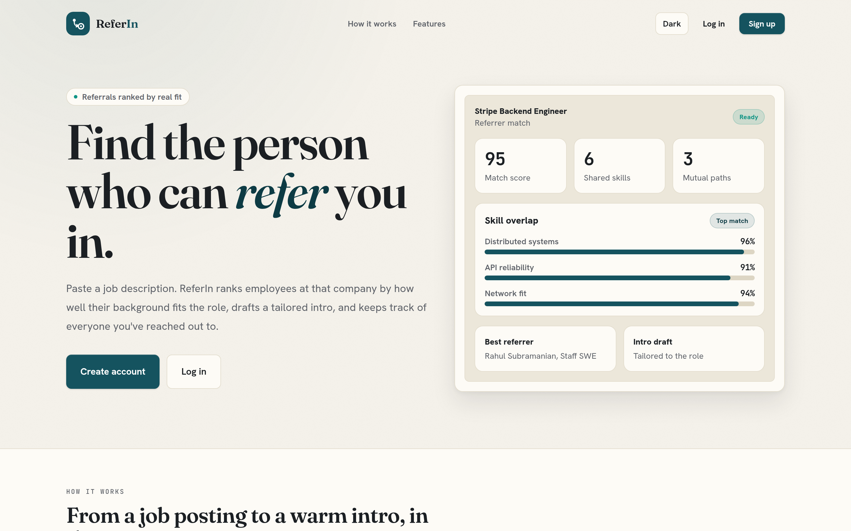
ReferIn
THE SOLUTION
Paste a Job, Meet Your Referrer
ReferIn turns any job posting into a ranked shortlist of people who can refer you, with the message already written.
▸ Ranked insiders in seconds from a pasted job description
▸ Scored by real fit, not follower counts
▸ A tailored intro draft, ready to send
03 / 16

Slide 4
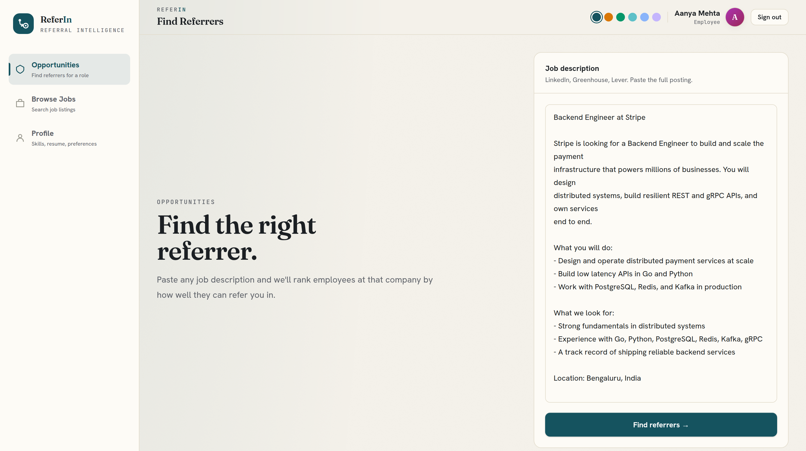
ReferIn
EFFORTLESS SEARCH
Search Is One Paste Away
No boolean filters, no scrolling. Drop in the description and the parsing is done for you.
▸ Auto extracts role, company, skills and location
▸ Works with LinkedIn, Greenhouse, Lever, anywhere
▸ Jump straight from any job listing into its referrers
04 / 16

Slide 5
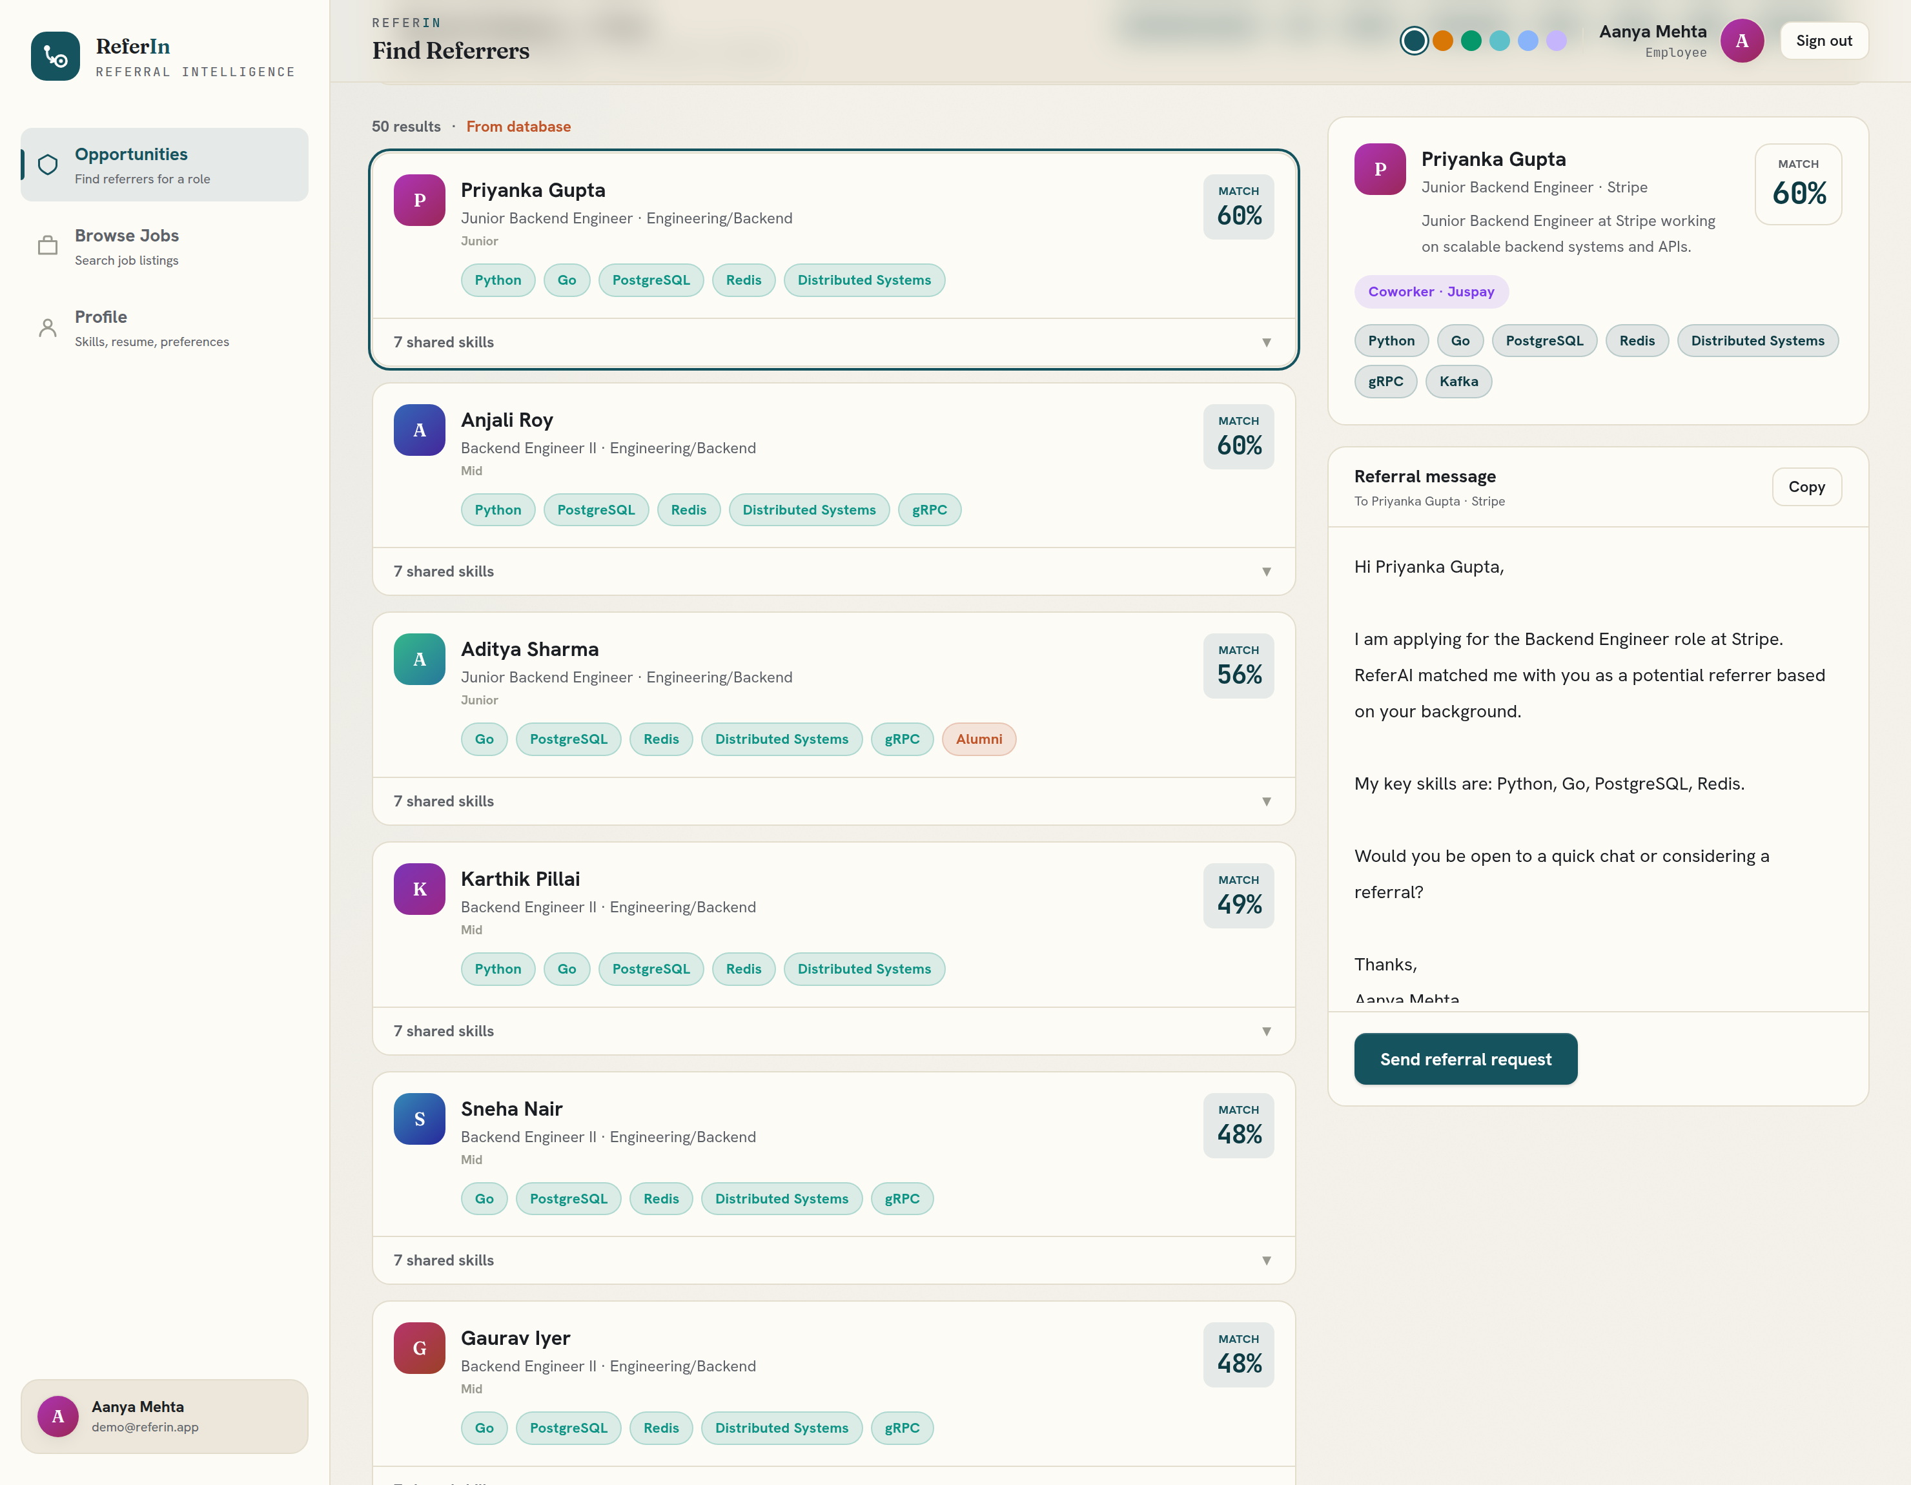
ReferIn
SMART FIT SCORING
Ranked by Real Fit
Every referrer gets a match score from how their background lines up with the role and with you.
▸ Vector similarity across job, person and your profile
▸ Shared skills surfaced and highlighted in green
▸ Alumni, coworker and connection paths boost the score
05 / 16

Slide 6
ReferIn
RELATIONSHIP SOURCING
The People Who Can Actually Vouch
We rank insiders by the warm paths that get referrals accepted: a shared employer or a shared campus, surfaced on every card and labelled by source.
▸ Coworker and Alumni paths, the signals that actually convert
▸ Every card labelled by source, here a curated profile database
▸ Proof of concept now; an official LinkedIn or ATS API makes it production grade
06 / 16

Slide 7
ReferIn
AI OUTREACH
The Message, Already Written
Each referrer comes with a personalised outreach draft built from the job and your profile, fully editable.
▸ Tailored to the role and your background
▸ Edit inline, copy, or send in one click
▸ No more blank page cold messages
07 / 16

Slide 8
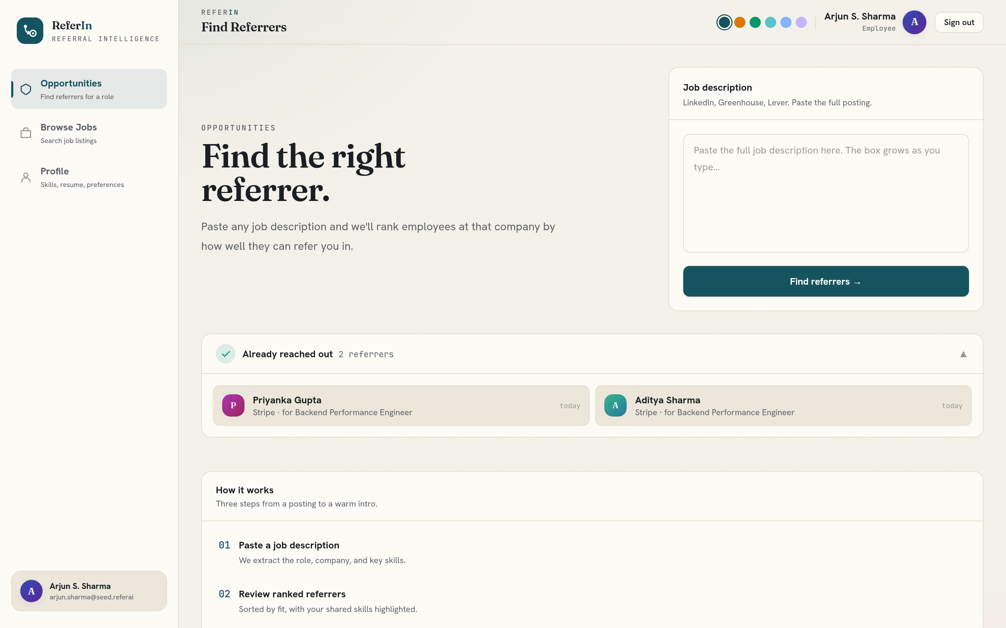
ReferIn
A REAL DIFFERENTIATOR
Never Message the Same Person Twice
ReferIn remembers everyone you have reached out to, protecting relationships and your time.
▸ Sent requests tracked per person
▸ Requested badges plus a hide contacted filter
▸ Recognises someone even across new searches
08 / 16

Slide 9
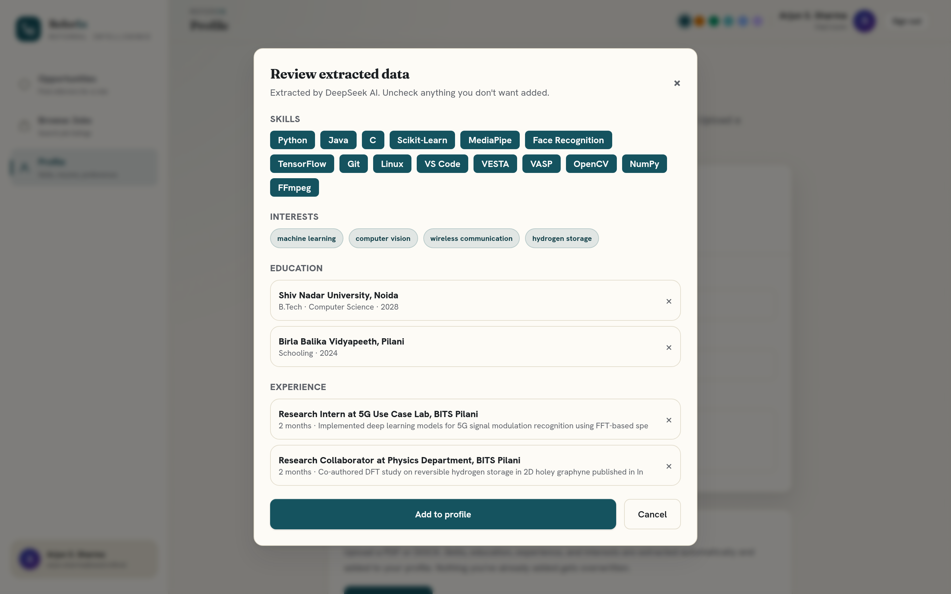
ReferIn
AUTO RESUME TO PROFILE
Resume In, Profile Done
Upload a PDF or DOCX and ReferIn fills your skills, education and experience automatically. You just confirm.
▸ Auto extracts skills, education and experience
▸ Review and confirm before anything saves
▸ Editable profile and photo, matches sharpen instantly
09 / 16

Slide 10
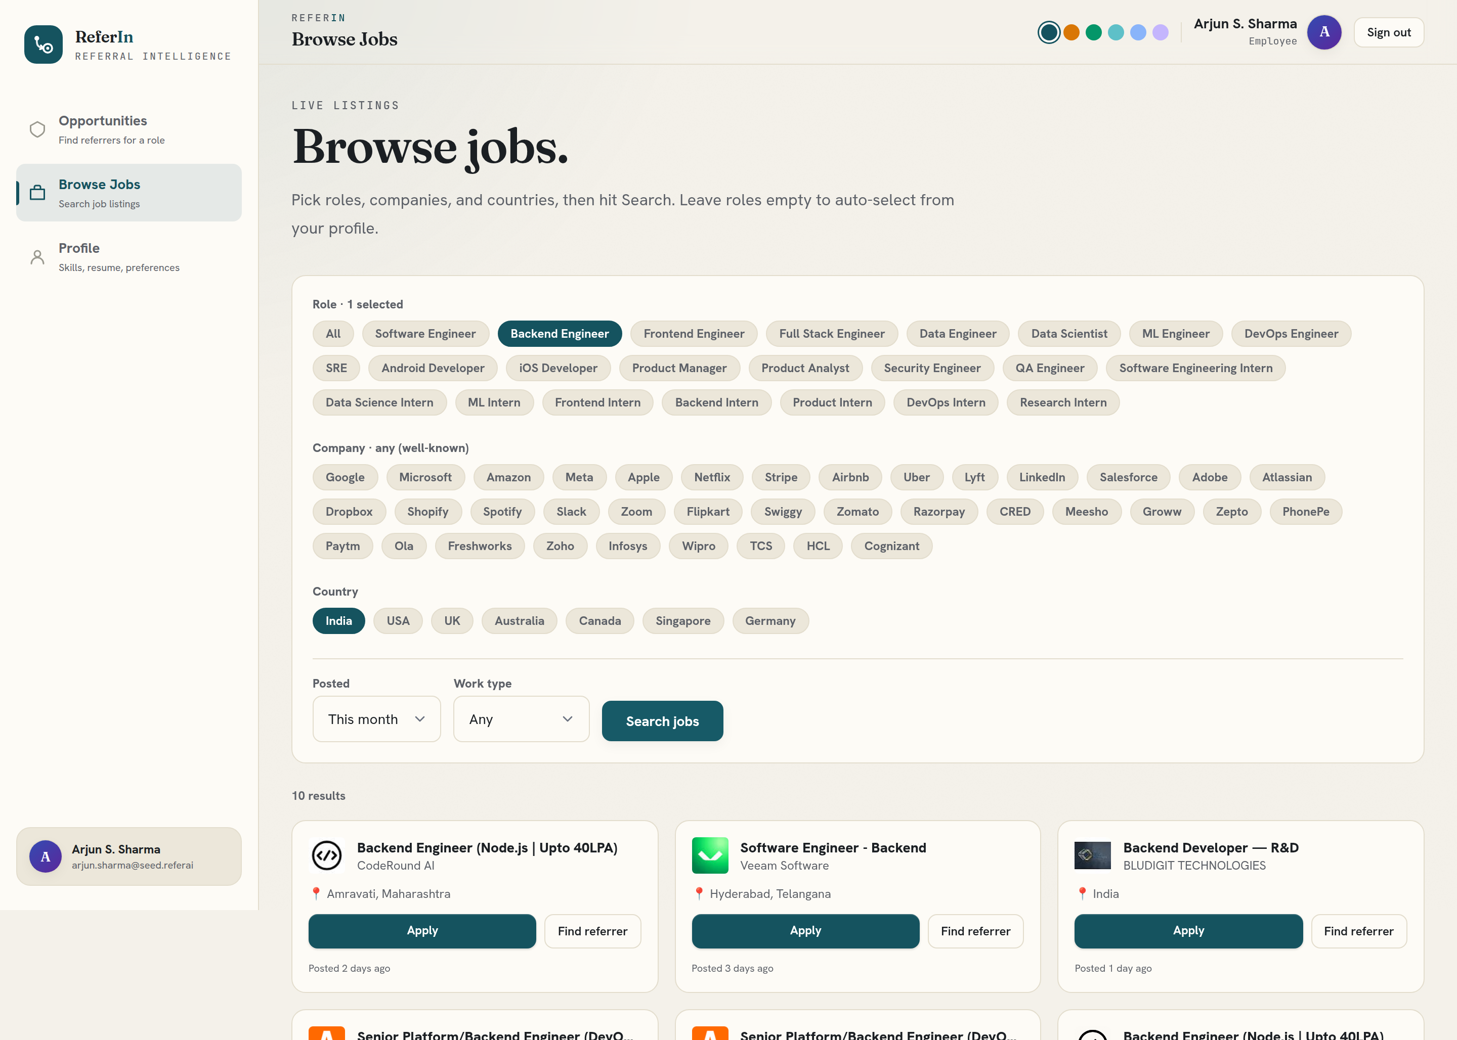
ReferIn
BUILT-IN JOB SEARCH
Find the Jobs, Too
Browse live openings by role, company and country, then jump straight to who can refer you.
▸ Live listings filtered by role, company and country
▸ Roles auto suggested from your profile
▸ Every job links straight into referrer search
10 / 16

Slide 11
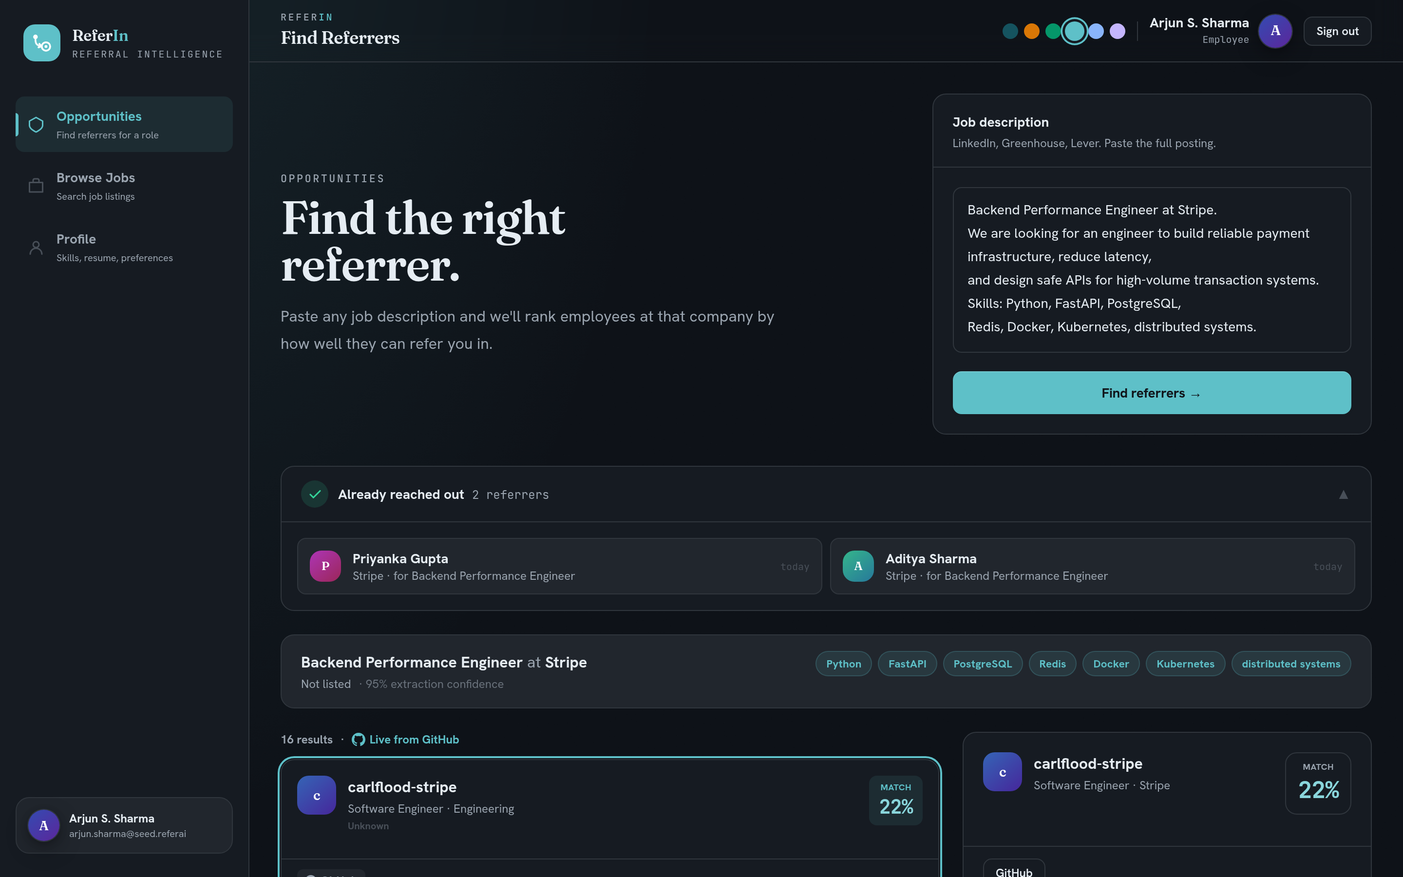
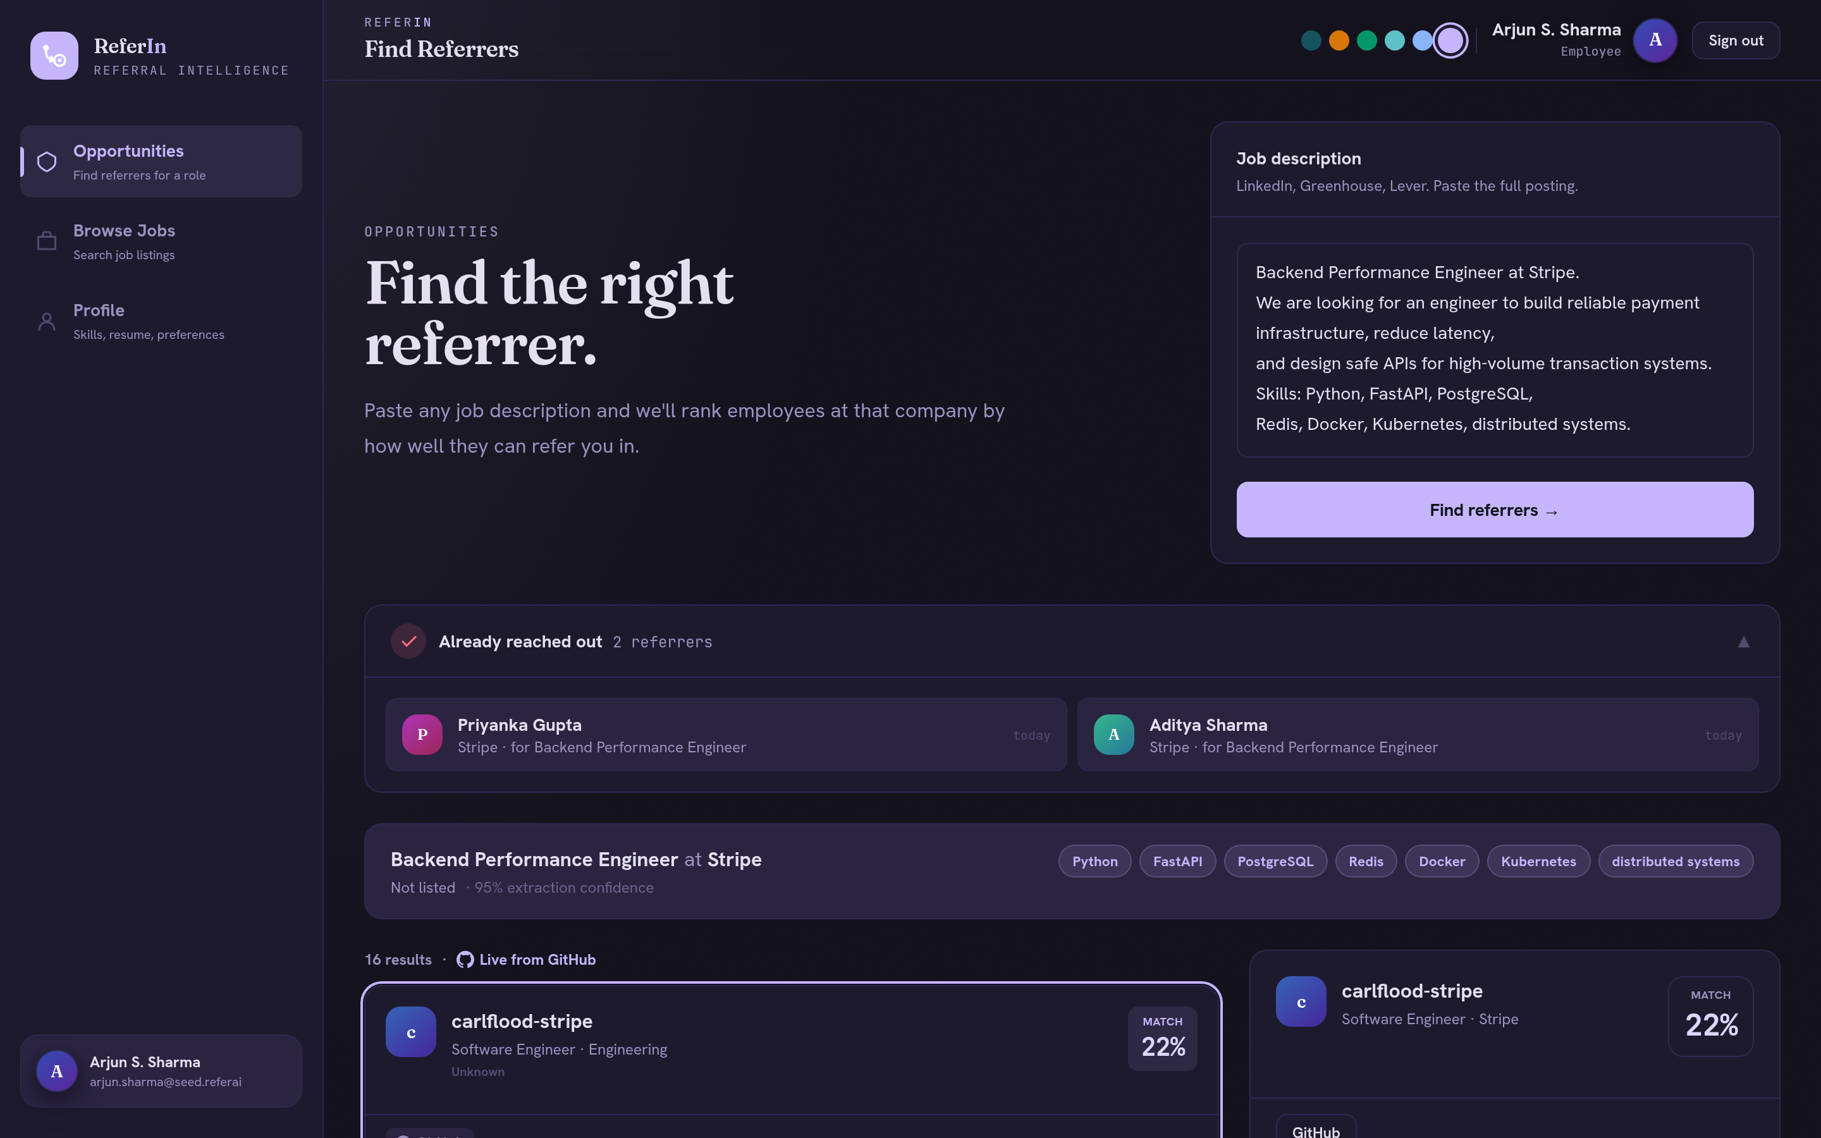
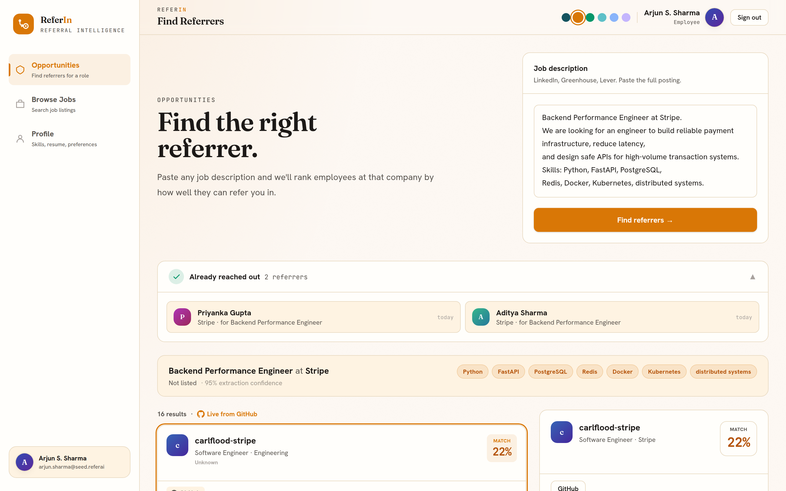
ReferIn
EXPERIENCE AND DESIGN
Built to Feel Effortless
A fast, polished interface with the small details that make a tool genuinely pleasant to use.
MIDNIGHT
VIOLET
SAND
▸ Six light and dark themes, switch in one click
▸ Auto growing inputs, live validation and clean empty states
▸ Editorial design, not your average hackathon UI
11 / 16

Slide 12
ReferIn
HOW IT WORKS
Simple Stack, Swappable Data
A lean React and Flask app wired to a language model and a relationship graph, with no heavy ML dependencies.
Job
description
LLM parse
DeepSeek
Relationship DB
curated, LinkedIn ready
Fit + relationship
scoring engine
Ranked referrers
+ intro draft
▸
▸
▸
▸
▸ React, Vite and Tailwind talking to Flask and SQLite
▸ DeepSeek parses the posting and drafts the intro message
▸ Matching in pure Python: TF-IDF cosine plus shared employer and campus scoring, swap the data source for a LinkedIn API and the engine is unchanged
12 / 16

Slide 13
ReferIn
KEY DIFFERENTIATOR
Not a Job Board. Not LinkedIn Search.
ReferIn is the only tool that ranks insiders by your fit, writes the intro, and stops you contacting them twice.
Capability | ReferIn | LinkedIn search | Cold applying
Finds the right person inside | ✓ Yes | ✗ No | ✗ No
Ranks by how well they fit you | ✓ Yes | ✗ No | ✗ No
Drafts your outreach for you | ✓ Yes | ✗ No | ✗ No
Prevents duplicate outreach | ✓ Yes | ✗ No | ✗ No
13 / 16

Slide 14
ReferIn
MARKET, MODEL AND WHAT IS NEXT
Big Market, Clear Path Forward
ReferIn serves a worldwide pool of job seekers and grows into a two sided referral network.
WHO IT IS FOR
▸ Students, new grads and switchers without an in
▸ A worldwide pool of job seekers, with a strong pull in India
▸ Anyone who would rather get referred than apply cold
ROADMAP
Now
Free product, live search, scoring, drafting and tracking
Next
Pro tier plus employer referral tools
Later
Opt in referrers, verified alumni paths, response tracking
14 / 16

Slide 15
ReferIn
A TWO-SIDED NETWORK
Good for Referrers, Too
ReferIn is not only for job seekers. The employees who refer win as well, and that is what makes the network grow.
FOR CANDIDATES
▸ A warm intro instead of the application void
▸ Ranked by real fit and real relationships
▸ A tailored message, already written
▸ Never the same person contacted twice
FOR REFERRERS
▸ Pre-qualified, high-fit candidates land in their inbox
▸ Companies already pay a referral bonus, often a thousand dollars or more, per successful hire
▸ Less time wasted and less reputation risk on a weak referral
▸ They earn it with one click, so they keep coming back
Every accepted referral pays the employee and opens a door for a candidate. Both sides compound.
15 / 16

Slide 16
ReferIn
TEAM AND CALL TO ACTION
Try ReferIn.
Get Referred In.
Built end to end during the hackathon by Team Ori. Live and working today.
TEAM ORI
Breeti
Bandyopadhyay
Unnati
Joshi
Aishwarya
Mol
Mishti
Kinker
Mohana
Madala
16 / 16

