Slide 1
DETECTARC
Multilingual Undesired Speech Recognition
RA1911033010120 – Shweta Rajan N
RA1911033010114 – Unnati Mishra
RA1911033010126 – BVS Satwika

Slide 2
Problem Statement
To differentiate and recognize the text into desirable or undesirable form, written by a particular user on any social media platform where we exchange our thoughts through medium of text.

Slide 3
Idea behind Detectarc
The idea behind this project was to develop something which is very easy to use and easy to develop as well, cause as students we have some financial as well time constraints if we are taking up any project. So we used one of the best classification algorithm – SVM for the job, and the results were highly satisfactory. After successful development of the algorithm, we selected streamlit for GUI which is currently the suitable tool for the job.

Slide 4
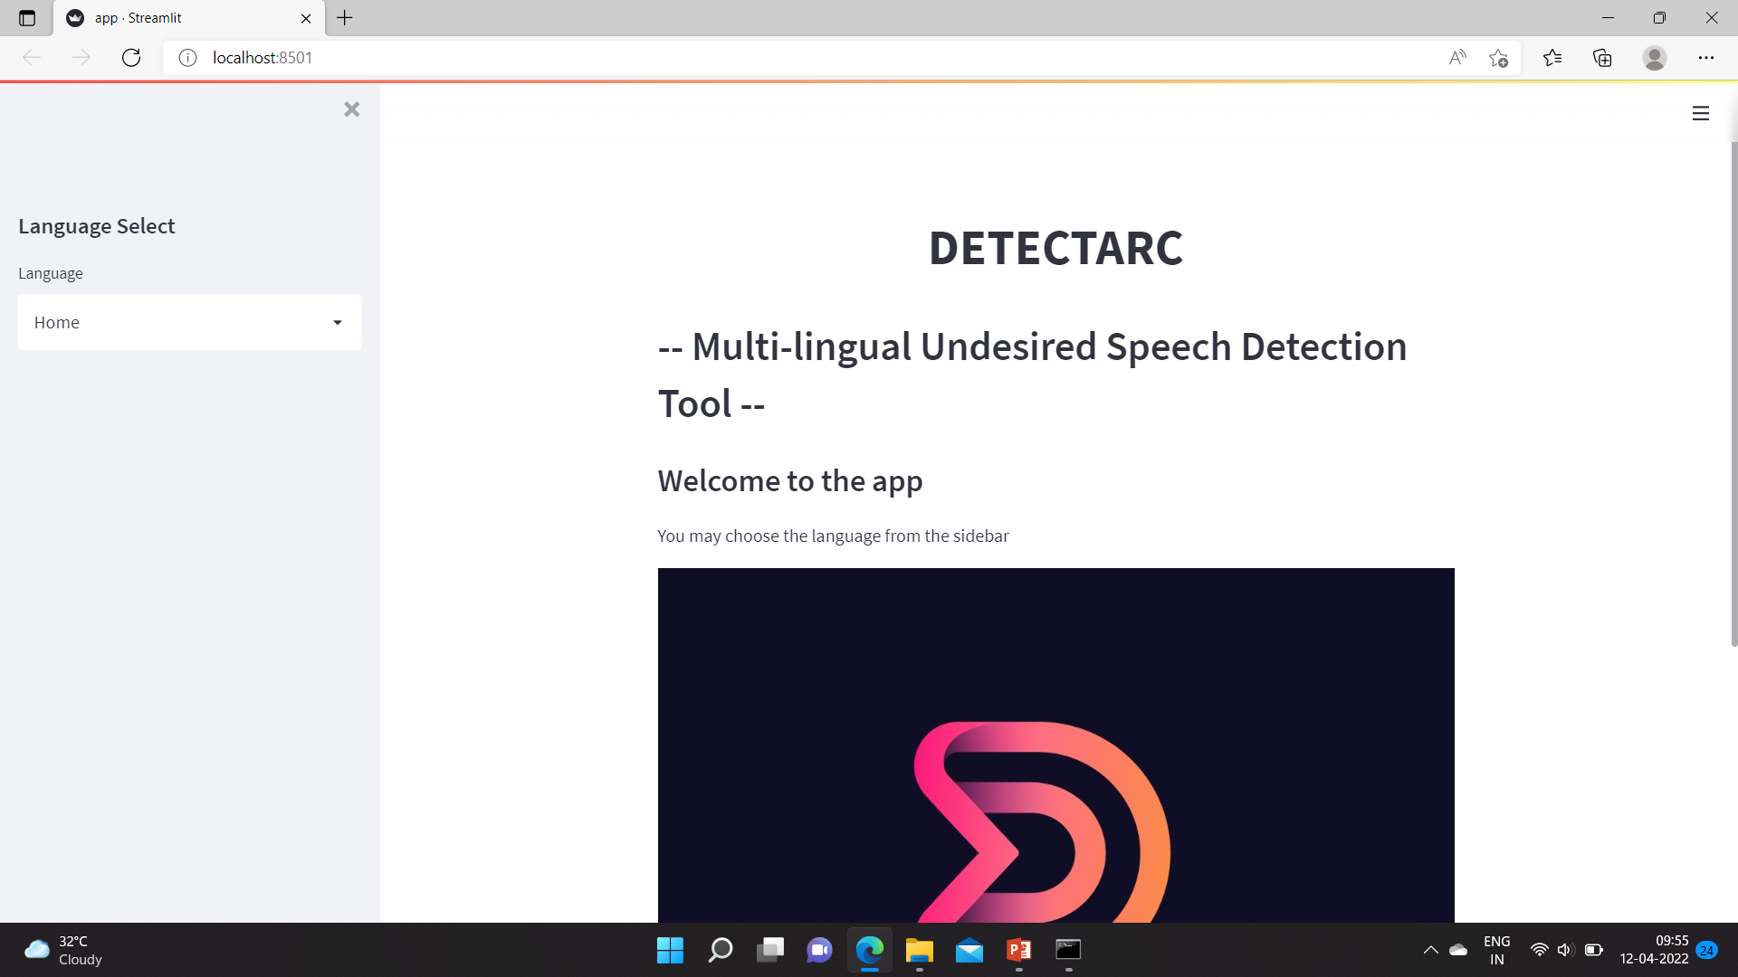
Application Screenshot (Home Page)

Slide 5
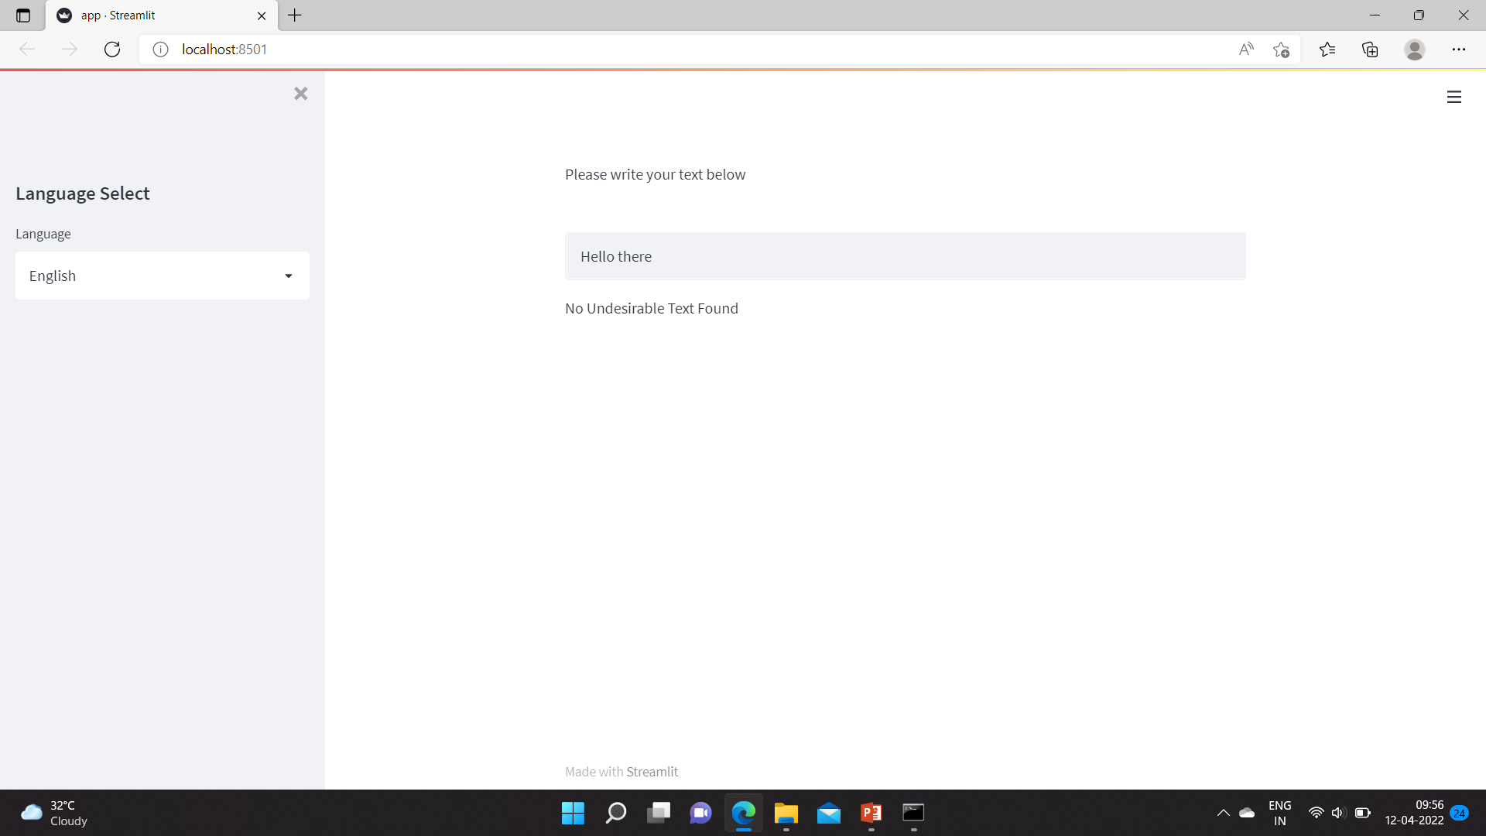
Application Screenshot (English - Desirable)

Slide 6
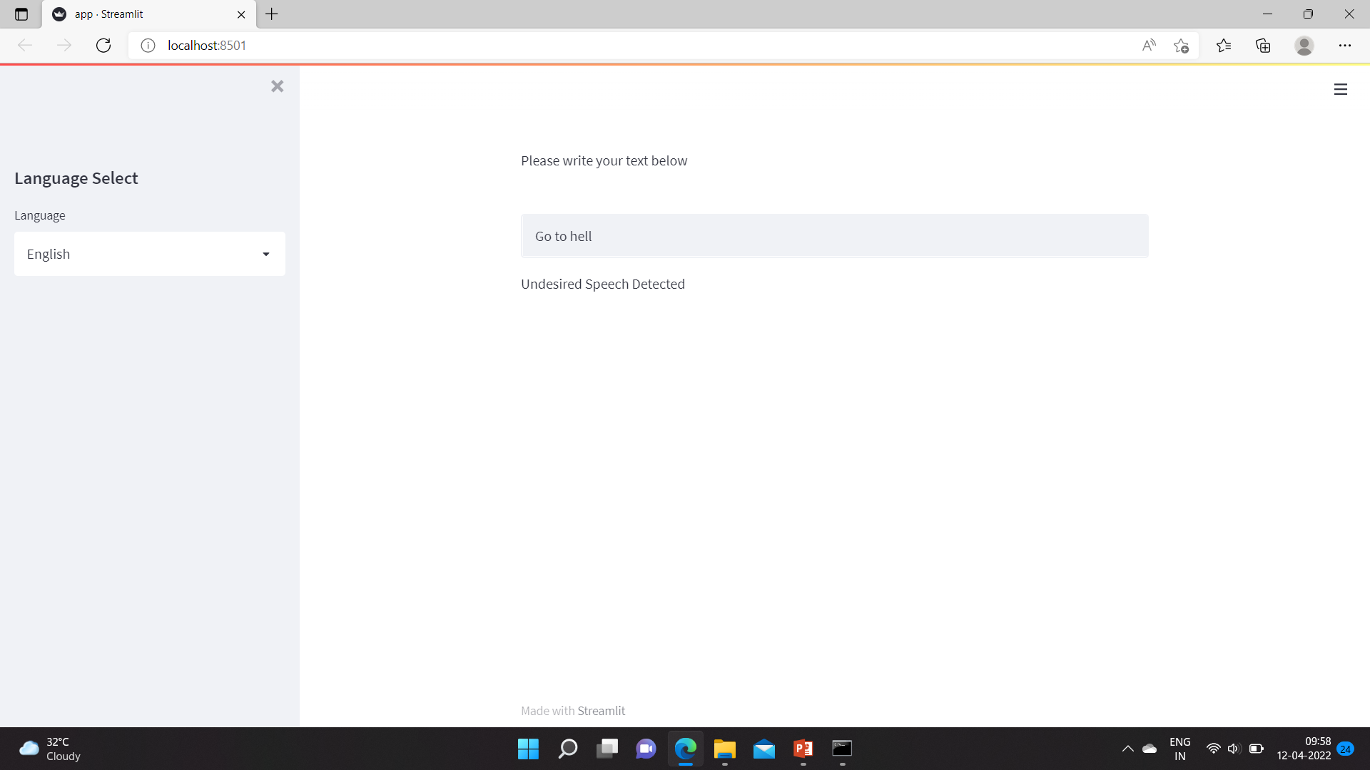
Application Screenshot (English - Undesirable)

Slide 7
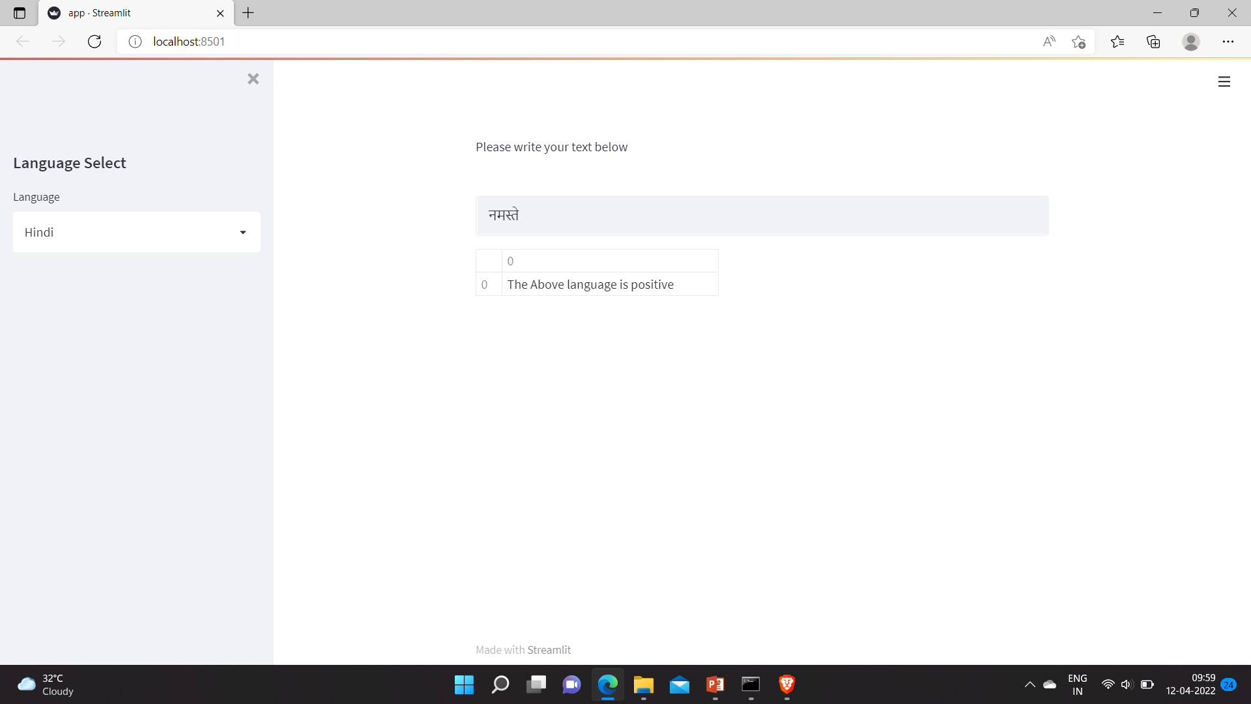
Application Screenshot (Hindi - Desirable)
नमस्ते

Slide 8

Application Screenshot (Hindi - Undesirable)
पागल

Slide 9
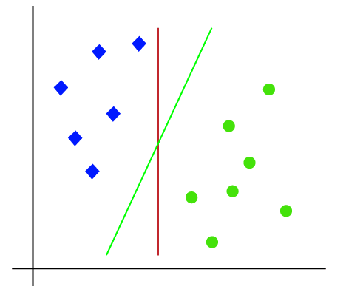
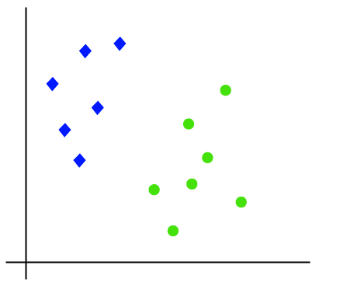
SVM

Slide 10
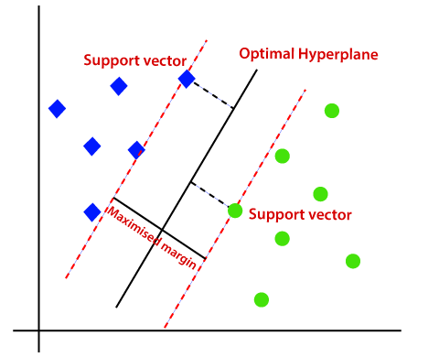
SVM (continue)

Slide 11
Thank You

