Slide 1

Google
Data Analytics Professional Certificate Capstone Project
Case Study:
Cyclistic Bike Share
How does a bike-share navigate speedy success?
BY- Unnati Singh

Slide 2
Phase 1 - Ask
To design marketing strategies converting casual riders into annual members, the goal is to determine:
“How do annual members and casual riders use Cyclistic bikes differently?”

Slide 3
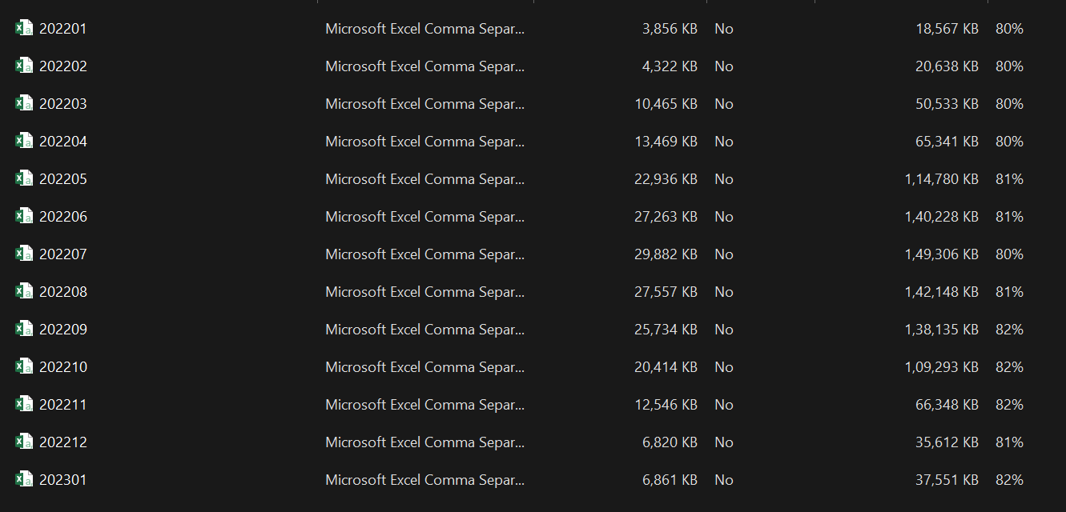
Phase 2 - Prepare
Using Cyclistic’s historical trip data to analyze and identify trends:

Slide 4
Phase 3 - Process
- Checked the data for errors using Python.
- Transformed the data into a unique Data Frame to work with it effectively.
- Documented the cleaning process.

Slide 5
Phase 4 - Analyze
We have analyzed the data from four major plots
1. Proportion of Users
2. Trip Count by Day of Week and Member Type
3. Count of trips started per month
4. Mean Trip Duration by Month and User Type
5. Top Stations by Casual Users

Slide 6
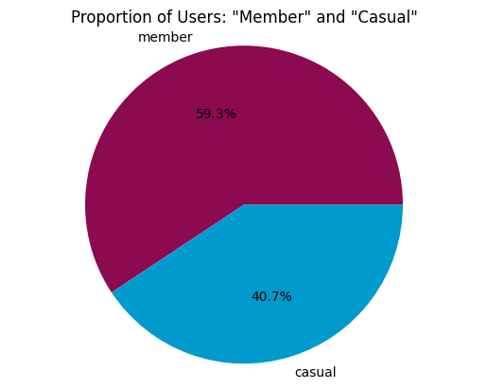
Phase 5 - Share
How can we revert some of the 40,7% casual users into members?

Slide 7
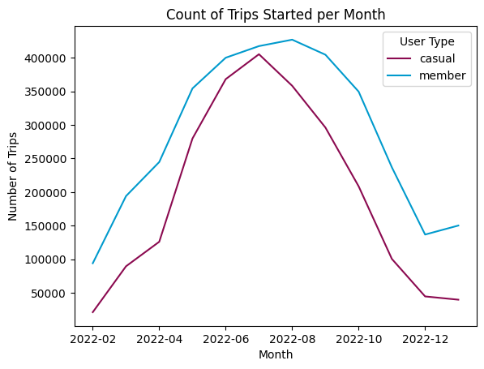
Phase 5 - Share
A marketing action to convert casual users into members should be more effective in the summer, especially in June and July.

Slide 8
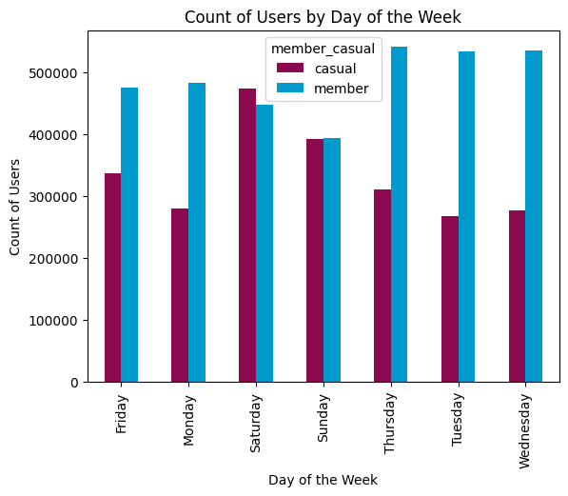
Phase 5 - Share
Weekends seem like the best days to reach casual users.

Slide 9
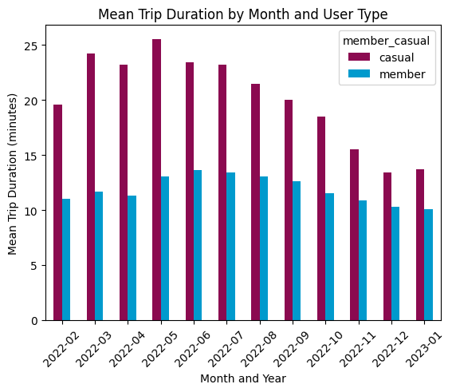
Phase 5 - Share
Casual users clearly tend to ride longer. Members uses the bikes for shorter periods.

Slide 10
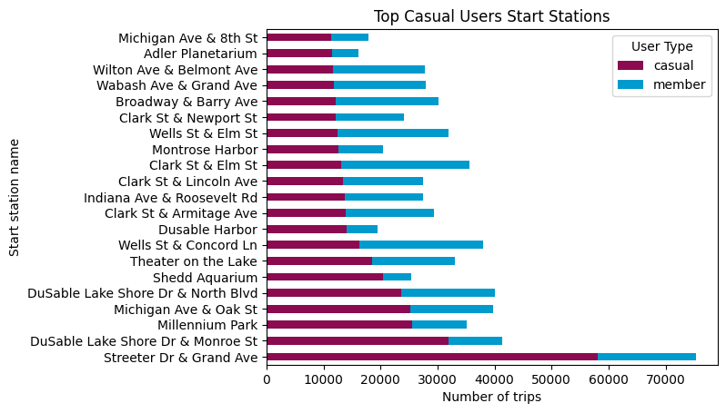
Phase 5 - Share
In addition to the quantity, it is interesting to note the proportions between user types.

Slide 11
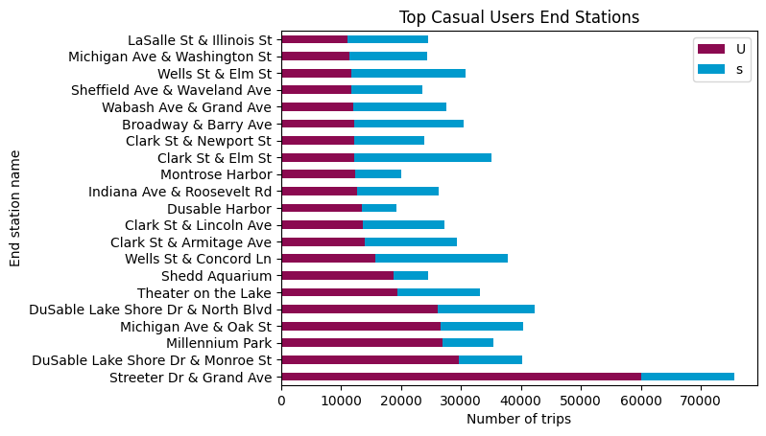
Phase 5 - Share
Stations with a big quantity and proportion of casual users may be the best ones to focus the marketing strategies.

Slide 12
Phase 6 - Act
40,7% are casual users.
Usage increases a lot in the summer.
Weekends seem like the best days to reach casual users.
Casual users clearly tend to ride longer.
Marketing strategies should focus in the top casual user stations.

Slide 13
Phase 6 - Act
This study helped us better understand “How do annual members and casual riders use Cyclistic bikes differently”.
Now we know when and where to focus marketing actions.
It is suggested to carry out a survey at the main stations to understand the casual user's profile and the reasons for not becoming a member.

Slide 14
Google
Data Analytics Professional Certificate Capstone
Thank You

