Slide 1



iplbi
View in Power BI
Last data refresh:
7/9/2023 8:01:17 PM UTC
Downloaded at:
7/9/2023 8:24:09 PM UTC

Slide 2
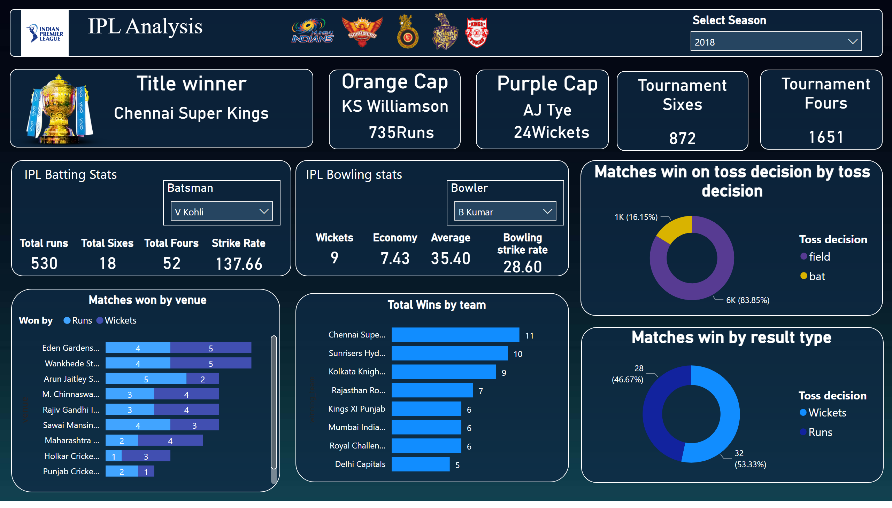
Page 1
Notes:
shape
No alt text provided
textbox
No alt text provided
slicer
No alt text provided
Title winner
No alt text provided
shape
No alt text provided
Orange Cap
No alt text provided
Orange Cap
No alt text provided
Purple Cap
No alt text provided
Purple Cap
No alt text provided
shape
No alt text provided
shape
No alt text provided
shape
No alt text provided
Tournament Sixes
No alt text provided
shape
No alt text provided
Tournament Fours
No alt text provided
shape
No alt text provided
shape
No alt text provided
Batsman
No alt text provided
Total runs
No alt text provided
Total Sixes
No alt text provided
Total Fours
No alt text provided
Strike Rate
No alt text provided
textbox
No alt text provided
Bowler
No alt text provided
Wickets
No alt text provided
Economy
No alt text provided
Average
No alt text provided
Bowling strike rate
No alt text provided
textbox
No alt text provided
shape
No alt text provided
Matches win on toss decision by toss decision
No alt text provided
shape
No alt text provided
Matches win by result type
No alt text provided
shape
No alt text provided
Matches won by venue
No alt text provided
Total Wins by team
No alt text provided
shape
No alt text provided
image
No alt text provided
image
No alt text provided
image
No alt text provided
image
No alt text provided
image
No alt text provided
image
No alt text provided
image
No alt text provided

