Slide 1


AI-Based Multivariate Risk Prediction System for Early Detection of Myopia in School-Aged Children
Team Members:
Nency Pansuriya(23AIML043)
Unnati Tank(23AIML069)

Slide 2
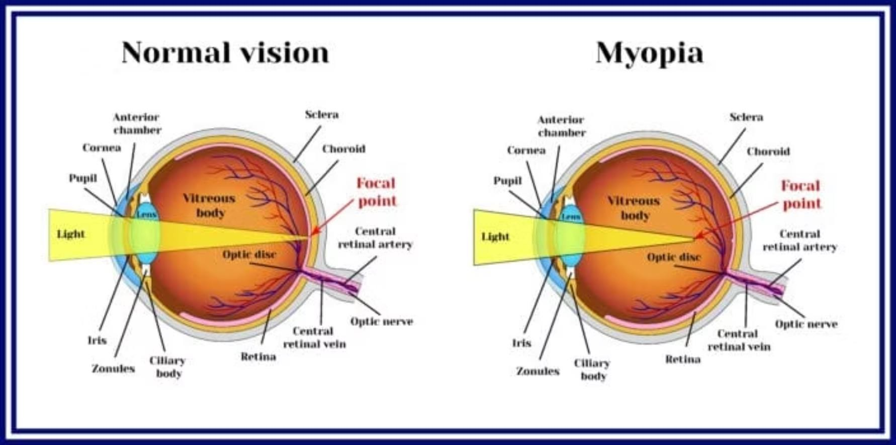
Myopia: A Growing Pediatric Health Crisis
Myopia prevalence in school-aged children has increased dramatically, with projections indicating 50% of the global population will be myopic by 2050. Current detection methods rely on symptomatic presentation, missing critical intervention windows.
Our AI Solution: A predictive risk stratification system leveraging multivariate clinical, behavioral, and demographic features to identify high-risk children before symptom onset. This enables proactive intervention and personalized monitoring protocols.

Slide 3
Project Objectives
Predict presence of myopia (Yes/No)
Analyze key risk factors:
Screen time
Outdoor activity
Family history
Classify severity level
Build a simple and interpretable ML model
Provide insights for early prevention

Slide 4
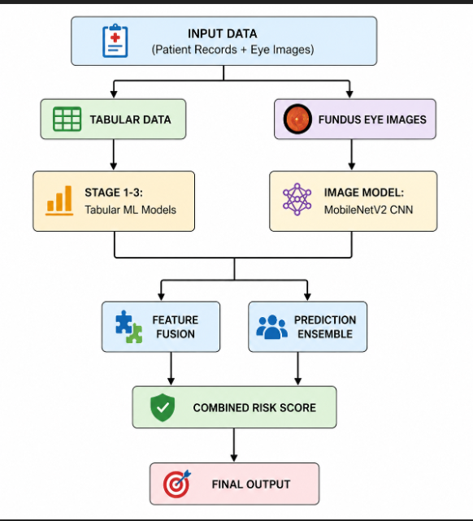
SYSTEM ARCHITECTURE

Slide 5
MODELS USED
XGBoost Classifier
Target: Detect presence of refractive error
Accuracy: 94.51% (AUC)
Method: Gradient boosting with decision trees
Role: Primary screening model
2: Gradient Boosting Classifier
Target: Classify progression risk (High/Low-Moderate)
Accuracy: 81.2%
Method: Disease progression pattern detection
Role: Risk stratification & intervention planning
Random Forest Regressor
Target: Predict diopter value (severity)
Accuracy: R² = 0.827
Method: Multiple decision trees for regression
Role: Numerical severity estimation
4. MobileNetV2 CNN (Image Model)
Target: Classify myopia from fundus images
Accuracy: 99.71%
AUC: 0.9998
Method: Transfer learning with ImageNet weights
Role: Image-based diagnosis support

Slide 6
DATASET DESCRIPTION
Tabular clinical data:
Dataset size: 5,000 records
Train/Test split: 4,000 / 1,000
Age group: school children (5 to 18 years)
Key features include:
BMI , Screen time and near-work hours, Outdoor time and sports participation, Family history and parental myopia
Targets:
Presence_of_RE (classification), Progression_Risk (classification), Degree_RE_Diopters (regression)
Image data:
124,794 blue-channel fundus images
63,294 myopia images and 61,500 normal images.
Training Images: 99836
Test Images: 24958

Slide 7
REQUIREMENTS
Hardware Requirements:
For normal running/inference:
Dual-core CPU or better 8 GB RAM minimum, 16 GB recommended10 GB free storage minimum
Internet connection for login, API calls, and package install
For model training:
Quad-core CPU or better 16 GB RAM recommended
Optional NVIDIA GPU for faster CNN training 20 GB+ free storage for datasets, checkpoints, and logs
Software Requirements:
Windows 10/11, Linux, or macOS
Python 3.11+
Node.js 18+
React
Git
Project Stack
Frontend: React 18, TypeScript, Vite, Tailwind CSS
Backend: Flask, Node js
ML: scikit-learn, XGBoost, Image mode
Training: TensorFlow/Keras
PDF generation: jsPDF

Slide 8
Team Roles & Responsibilities
Team Member 1: Team Member 2:
Data cleaning and preprocessing
Feature engineering and model training
Evaluation and metric analysis
Backend prediction pipeline integration
Frontend development and visualization
API integration and testing
Deployment setup
Documentation and presentation preparation

Slide 9
APPLICATIONS AND BENEFITS
Applications:
School health screening programs
Eye clinics for early triage
Preventive pediatric health platforms
Research support for myopia progression studies
Benefits:
Early detection support at low cost
Non-invasive screening approach
Fast and scalable prediction workflow
Better awareness for preventive interventions

Slide 10
RESULTS:
Model Performance:
Stage 1 (Has RE): AUC = 0.9451
Stage 2 (Risk progression): AUC = 0.8941, Accuracy = 81.2%
Stage 3 (Diopter regression): MAE = 1.71 D
Image Model Performance:
Accuracy: 99.71%
AUC: 0.9998 (Exceptional)
Loss: 0.0081
Key Findings:
Higher screen and near-work exposure increase risk
Lower outdoor activity strongly increases risk
Family history and parental myopia are major predictors
Fundus images provide strong diagnostic signal
System Output:
Risk percentage and risk class
Refractive error probability
Estimated severity for clinical follow-up guidance
Image classification confidence score
Multimodal prediction

Slide 11
FUTURE WORK
Train with larger multi-center clinical datasets
Improve stage 3 regression performance for diopter estimation
Expand image model to include OCT (Optical Coherence Tomography) data
Integrate slit-lamp and anterior segment imaging
Deploy mobile-first screening workflow with image capture
Develop edge AI solution for offline image analysis
Enable longitudinal tracking and personalized intervention alerts
Combine multiple eye imaging modalities

Slide 12
CONCLUSION
The project successfully implements a practical 3-stage ML pipeline for myopia risk screening.
It identifies important lifestyle and genetic contributors to myopia progression.
The web-based deployment makes the solution usable in real-world school and clinic workflows.
AI can significantly support preventive eye-health monitoring in children.

Slide 13

THANK YOU

