Slide 1


AI-Based Multivariate Risk Prediction System for Early Detection of Myopia in School-Aged Children
Team Members:
Nency Pansuriya(23AIML043)
Unnati Tank(23AIML069)

Slide 2
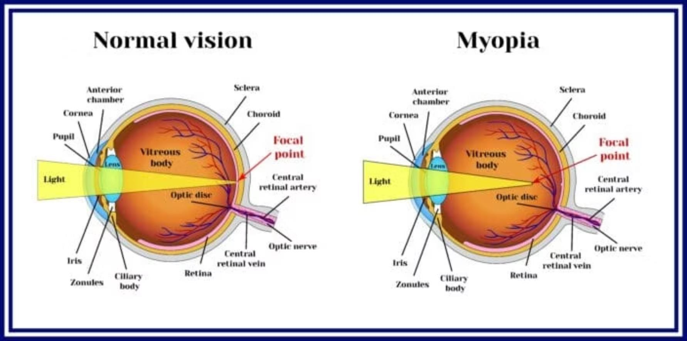
Myopia: A Growing Pediatric Health Crisis
Myopia prevalence in school-aged children has increased dramatically, with projections indicating 50% of the global population will be myopic by 2050. Current detection methods rely on symptomatic presentation, missing critical intervention windows.
Our AI Solution: A predictive risk stratification system leveraging multivariate clinical, behavioral, and demographic features to identify high-risk children before symptom onset. This enables proactive intervention and personalized monitoring protocols.

Slide 3
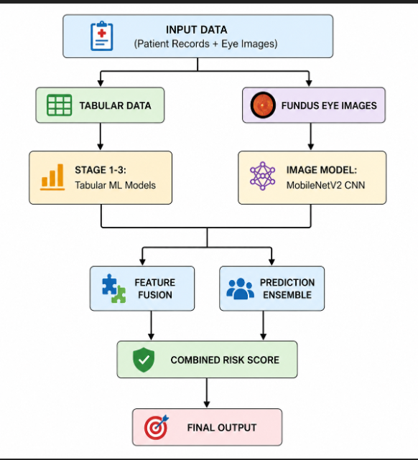
Project Objectives
Predict presence of myopia (Yes/No)
Analyze key risk factors:
Screen time
Outdoor activity
Family history
Classify severity level
Build a simple and interpretable ML model
Provide insights for early prevention
SYSTEM OVERVIEW / ARCHITECTURE

Slide 4
MODELS USED
XGBoost Classifier
Target: Detect presence of refractive error
Accuracy: 94.51% (AUC)
Method: Gradient boosting with decision trees
Role: Primary screening model
2: Gradient Boosting Classifier
Target: Classify progression risk (High/Low-Moderate)
Accuracy: 81.2%
Method: Disease progression pattern detection
Role: Risk stratification & intervention planning
Random Forest Regressor
Target: Predict diopter value (severity)
Accuracy: R² = 0.827
Method: Multiple decision trees for regression
Role: Numerical severity estimation
4. MobileNetV2 CNN (Image Model)
Target: Classify myopia from fundus images
Accuracy: 99.71%
AUC: 0.9998
Method: Transfer learning with ImageNet weights
Role: Image-based diagnosis support

Slide 5
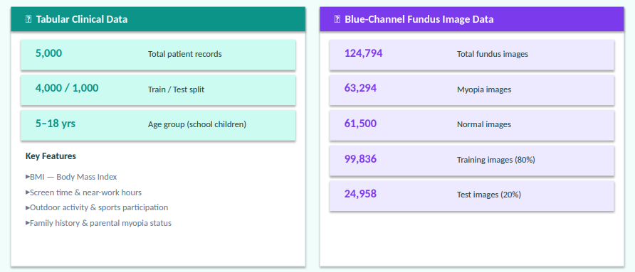
DATASET DESCRIPTION
Image data:
124,794 blue-channel fundus images
63,294 myopia images and 61,500 normal images.
Training Images: 99836
Test Images: 24958

Slide 6
REQUIREMENTS
Hardware Requirements:
For normal running/inference:
Dual-core CPU or better 8 GB RAM minimum, 16 GB recommended10 GB free storage minimum
Internet connection for login, API calls, and package install
For model training:
Quad-core CPU or better 16 GB RAM recommended
Optional NVIDIA GPU for faster CNN training 20 GB+ free storage for datasets, checkpoints, and logs
Software Requirements:
Windows 11
Python 3.11+
Node.js 18+
React
Git
Project Stack
Frontend: React 18, TypeScript, Vite, Tailwind CSS
Backend: Flask, Node js
ML: scikit-learn, XGBoost, Image mode
Training: TensorFlow/Keras
PDF generation: jsPDF

Slide 7
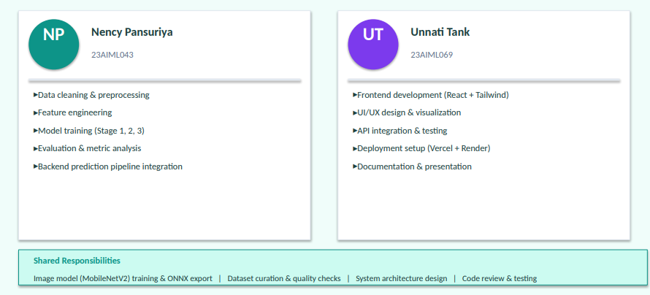
Team Roles & Responsibilities
Data cleaning and preprocessing
Feature engineering and model training
Evaluation and metric analysis
Backend prediction pipeline integration
Frontend development and visualization
API integration and testing
Deployment setup
Documentation and presentation preparation

Slide 8
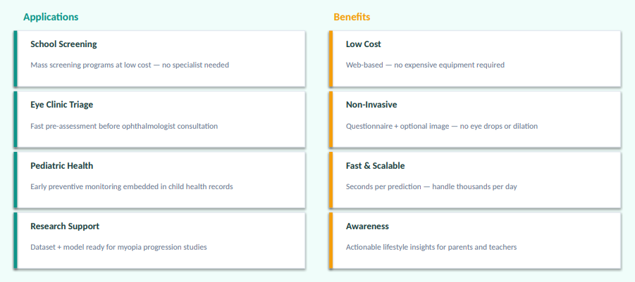
APPLICATIONS AND BENEFITS
Applications:
School health screening programs
Eye clinics for early triage
Preventive pediatric health platforms
Research support for myopia progression studies
Benefits:
Early detection support at low cost
Non-invasive screening approach
Fast and scalable prediction workflow
Better awareness for preventive interventions

Slide 9
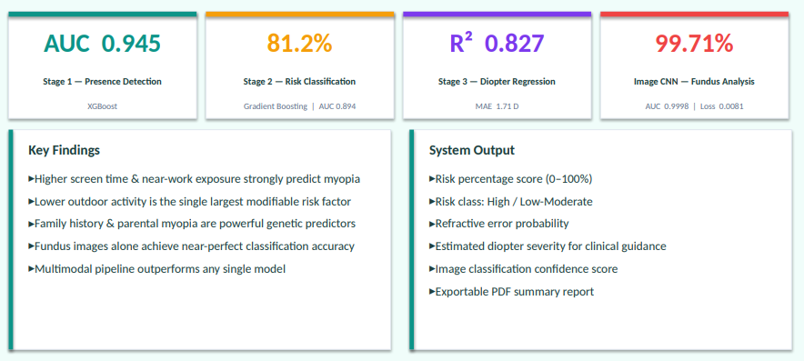
RESULTS:
Model Performance:
Stage 1 (Has RE): AUC = 0.9451
Stage 2 (Risk progression): AUC = 0.8941, Accuracy = 81.2%
Stage 3 (Diopter regression): MAE = 1.71 D
Image Model Performance:
Accuracy: 99.71%
AUC: 0.9998 (Exceptional)
Loss: 0.0081
Key Findings:
Higher screen and near-work exposure increase risk
Lower outdoor activity strongly increases risk
Family history and parental myopia are major predictors
Fundus images provide strong diagnostic signal
System Output:
Risk percentage and risk class
Refractive error probability
Estimated severity for clinical follow-up guidance
Image classification confidence score
Multimodal prediction

Slide 10
FUTURE WORK
Expand to multi-center, multi-modal datasets (fundus + OCT) and run prospective clinical validation.
Optimize and quantize models for on-device/edge inference with CI/CD, monitoring, and drift detection.
Implement mobile-first guided image capture, explainability (saliency/calibration), and active-learning retraining.
CONCLUSION
Implementation: Delivers a practical three-stage ML pipeline with web deployment for real-world school and clinic workflows.
Findings: Identifies key lifestyle and genetic contributors and produces clinically meaningful risk predictions.
Impact: Shows AI can support preventive eye‑health in children and is ready for multi‑site validation and deployment.

Slide 11

THANK YOU

