Slide 1
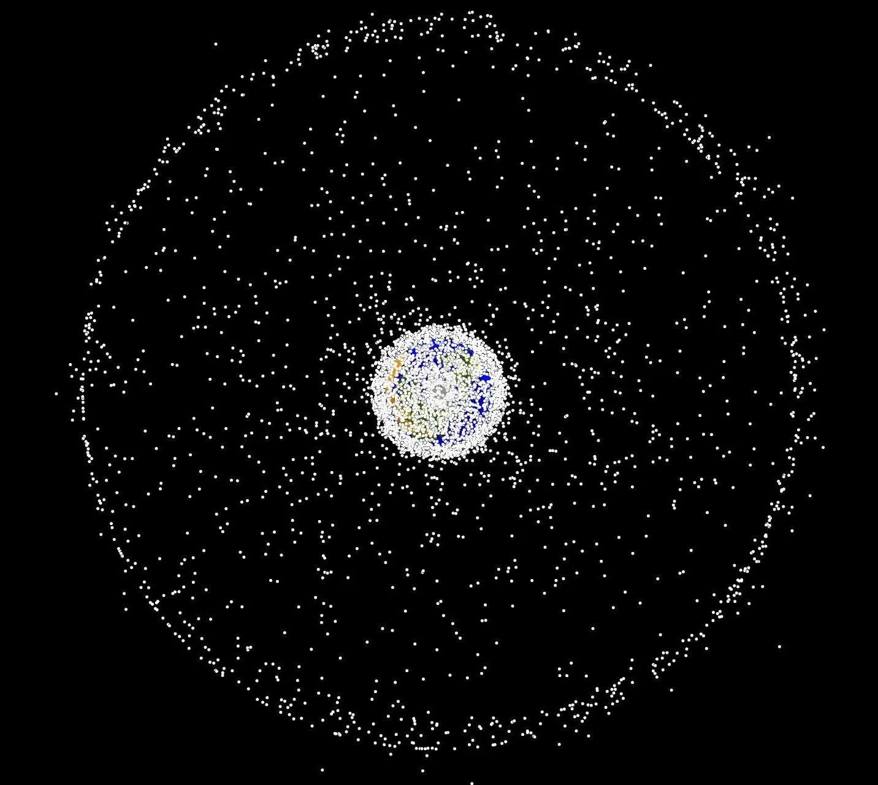
Solving The Problem Of Space Debris
ADITYA SINGH GANGWAR, 2021CSM1001
UNNAYAN SHARMA, 2021CSM1009

Slide 2
Contents
Introduction
Related Work
Methodology
Results
Conclusion
References

Slide 3
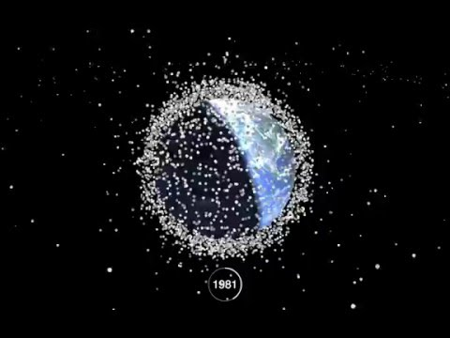

Slide 4
Introduction
With the growing space sector of countries, the space environment is becoming crowded, Collision of space targets caused a large amount of space debris.
As of data of 2019, there are about 900,000 pieces of debris of size between 1 and 10 cm and there are more than 128 million debris of size less than 1 cm traveling at the rate of 20 times the speed of the bullet.
To solve this problem, the main satellite carries several small propulsive satellites. These sub-satellites to visit all the identified debris in one mission at the lowest weighted sum of energy and time and return to the main satellite after pushing the debris in lower earth orbit.

Slide 5
Related Work
The problem of calculating an efficient route for satellites to remove space debris can be formulated as a travelling salesman problem.
Previous work involves use of two orbital distance techniques, Hörmann orbital rendezvous and Double elliptical maneuver and a novel approach of RouteBreak chromosome pairing with the genetic algorithm to find the minimum cost of satellites to remove the space debris in an efficient way.
We have proposed a method that will calculate the minimum number of satellites required for efficient path of space debris calculation also it will try to evenly distribute debris to each satellite.

Slide 6
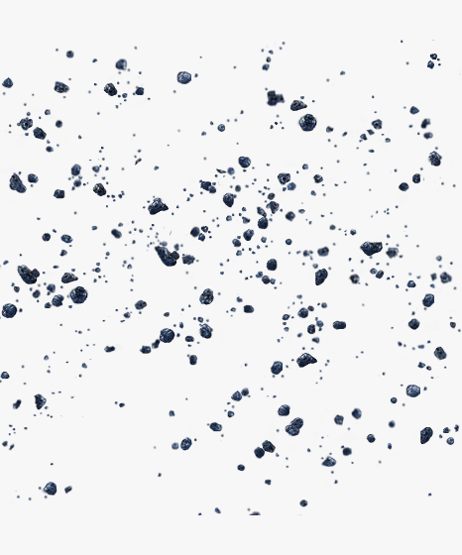
Methodology
Genetic Algorithm:
Initial Population: An initial population of multiple chromosomes is created. Each chromosome represents the ordering in which the space debris will be removed. Each gene in a chromosome represent the debris that is going to be removed next.

Slide 7
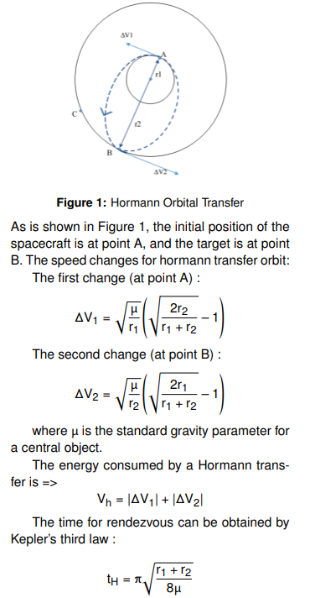
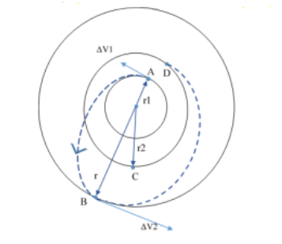
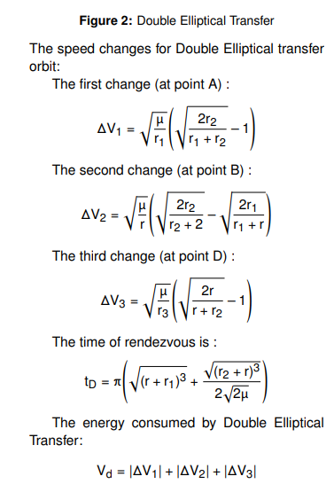
Fitness function
A fitness function able us to determine how fit an individual is.
Fitness function here is described as a linear function of change in velocity and change in time.
F(x,y)=α∆V + β∆T, where α + β = 1, α and β are energy and time impact factor and F is fuel consumed from orbit x to orbit y.
To calculate change in velocity and time ,two different orbit transfer strategy are used depending on the ratio of the target orbital radius to the original orbital radius.
So, for economical ΔV and ΔT mainly two techniques are used, Hörmann orbital transfer and Double elliptical transfer.

Slide 8
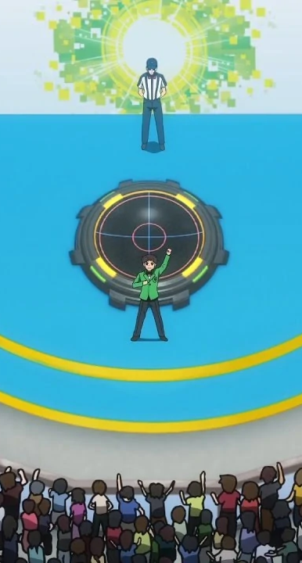
Selection
Here we have used “Tournament Selection” approach for selecting the best candidates among the population.
A tournament is conducted between the different populations and the best populations are selected based on the fitness value.
In a M-way tournament selection, M fittest candidates are selected based on a tournament among them.

Slide 9
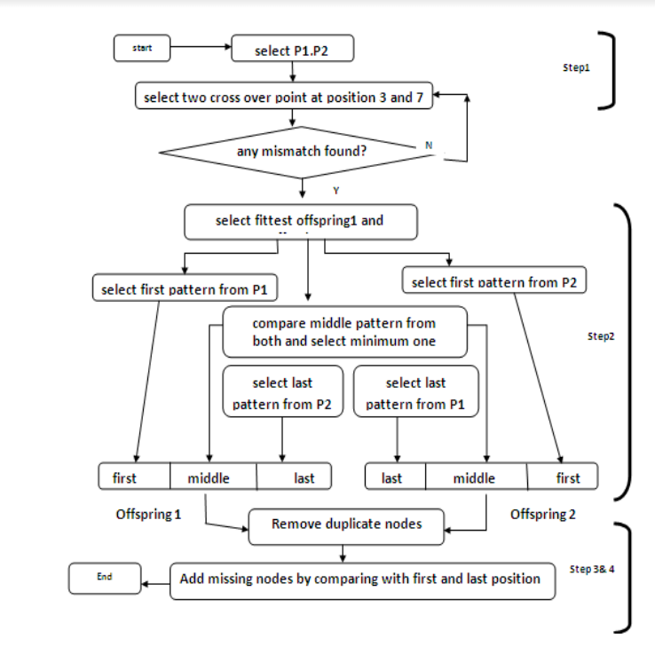
CrossOver
Crossover is a genetic operator used to vary the programming of a chromosome or chromosomes from one generation to the next.
The Crossover function that we have used is a novel approach discussed in paper "A New Crossover Technique to Improve Genetic Algorithm and Its Application to TSP - 2019”.

Slide 10

Mutation
Mutation is a small change performed randomly in the chromosome to get a new solution which is used to maintain diversity in the genetic population.
Mutation helps in maintaining diversity within the population and prevents from falling in local minima.
From a population of genes, we will choose a gene randomly and mutate it.

Slide 11
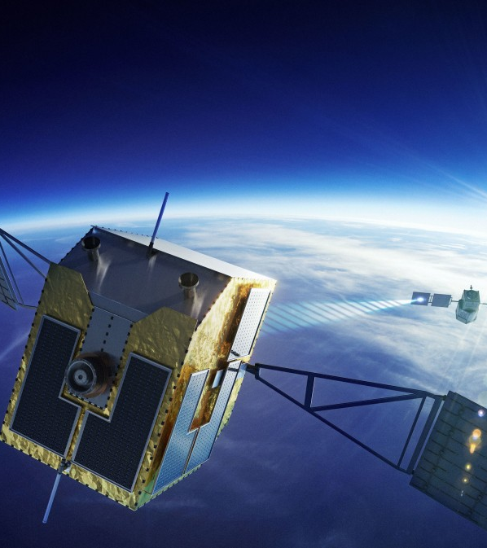
Finding number of satellites
The small satellite leaves the main satellite in search for a debris. After moving one debris to the lower earth orbit it should have enough fuel to go back to the main satellite.
So once the fuel has been filled in the satellite, it will always conserve enough fuel to go back to the main satellite also it will try to cover maximum amount of debris for removal.
Firstly, the fuel tank of a satellite has been filled to give it initial propulsion.
After that at every debris position the remaining fuel is calculated such that it will have enough fuel to reach the main satellite.
If the fuel remaining is not enough to go to other debris then a new satellite will be launched from the main satellite.

Slide 12
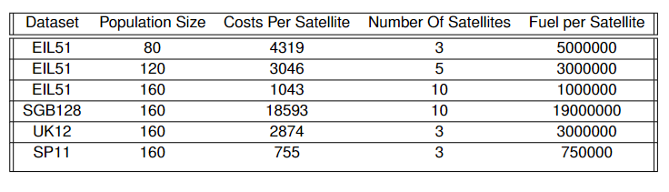
Results
DataSets Used :
EIL-51 : EIL51 is a dataset of 51 coordinates that can be interpreted as a debris position. The dataset is available at here.
SP-11 : The data is an artificial integer distance matrix for 11 objects. The dataset is available at here.
UK-12 : This dataset includes the travel times between 12 cities in the United Kingdom. The dataset is available at here.
SGB-128 : This dataset contains 128 cities in the continental US and lower Canada are considered. The dataset is available at here.

Slide 13
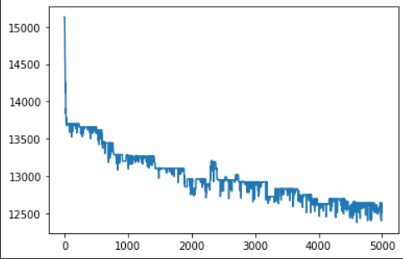
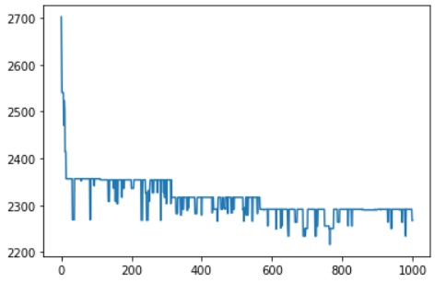
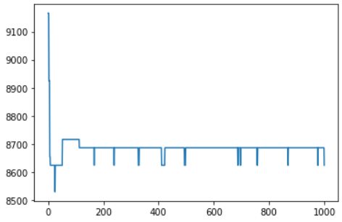
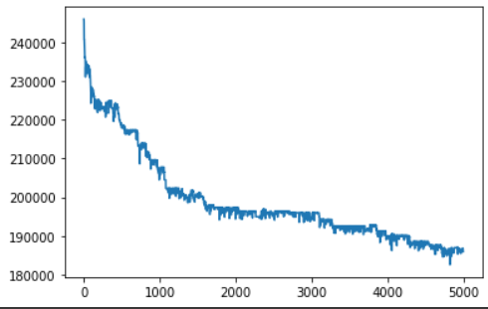
EIL-51
SP-11
UK-12
SGB-128

Slide 14
References
Wang, Dongmei, Lin Li, and Long Chen. "An efficient genetic algorithm for active space debris removal planning." 2019 IEEE Congress on Evolutionary Computation (CEC). IEEE, 2019.
Akter, Shamima, et al. "A new crossover technique to improve genetic algorithm and its application to TSP." 2019 International Conference on Electrical, Computer and Communication Engineering (ECCE). IEEE, 2019.

