Slide 1
GPU Programming with Google colaboratory

Slide 2
Steps
Step1: Getting Started: Use google Colab with your gmail id
Step 2: Using GPU (Accelerator)
Step 3: Tour of the User Interface
Step 4: Install GCC 10: Required for OpenMP 5.0
Step 5: Use (not install) CUDA 10.0
Step 6: Compiling OpenMP program : Example
Step 7: Profiling GPU with nvprof.
A Demo at the end.

Slide 3
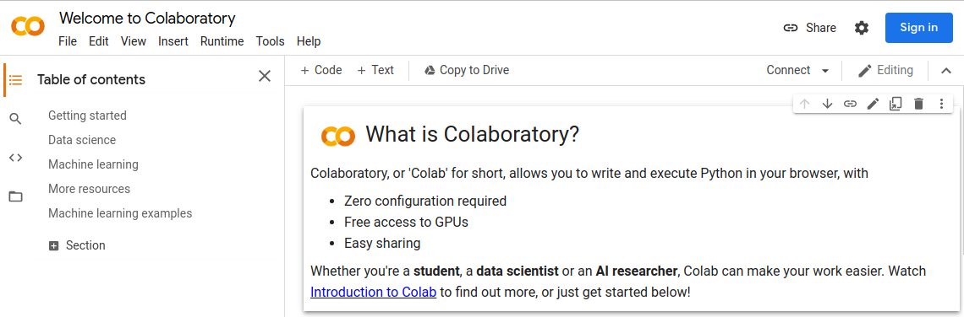
Step 1 - Getting Started
Go to Google Colab - https://colab.research.google.com
Login with your Google Account

Slide 4
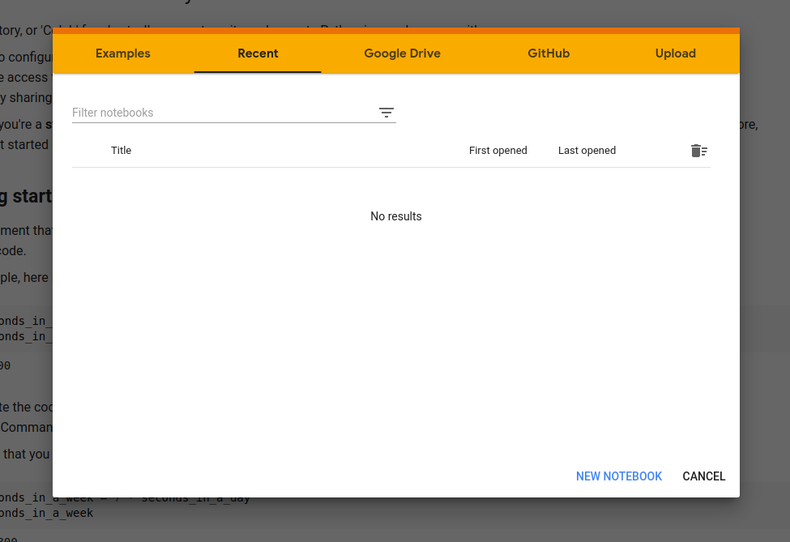
Step 1 - Getting Started
Click on NEW NOTEBOOK

Slide 5
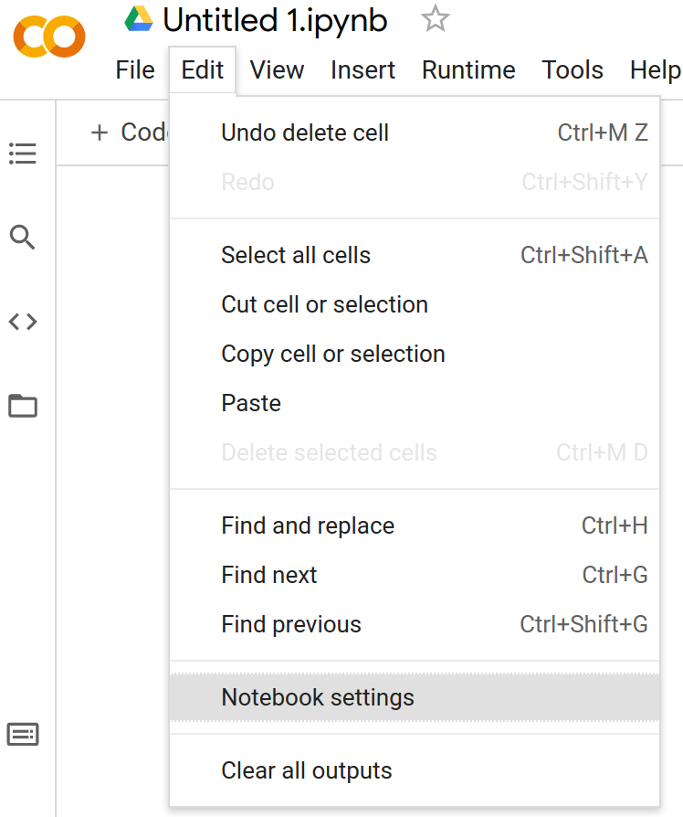
Step 2 - Choose GPU Accelerator
First, you'll need to enable GPUs for the notebook:
Navigate to Edit
Click on Notebook Settings

Slide 6
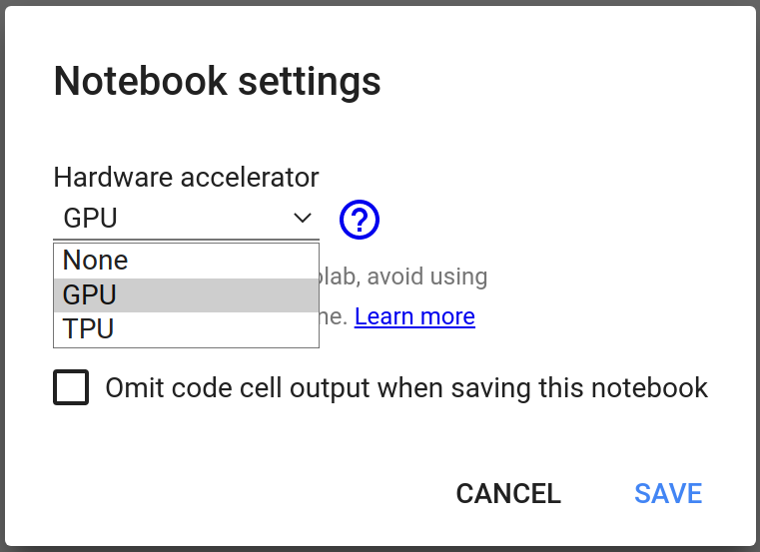
Step 2 - Choose GPU Accelerator
Select GPU in the Hardware accelerator drop-down menu
Click on SAVE

Slide 7

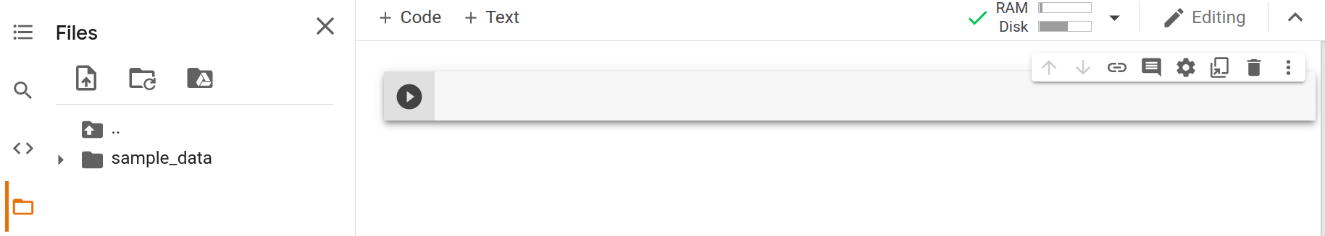
Step 3 - Tour
Hover over to see your allocated runtime.
Creates a new Code Cell.
Contents of the Code Cell go here.
Executes the contents of the Code Cell.
Deletes a Code Cell.
Click Here to see your files in the current session.

Slide 8
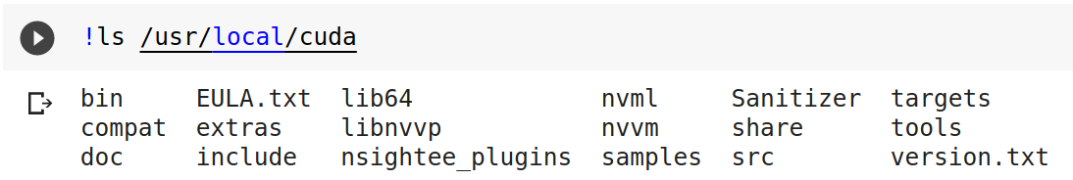
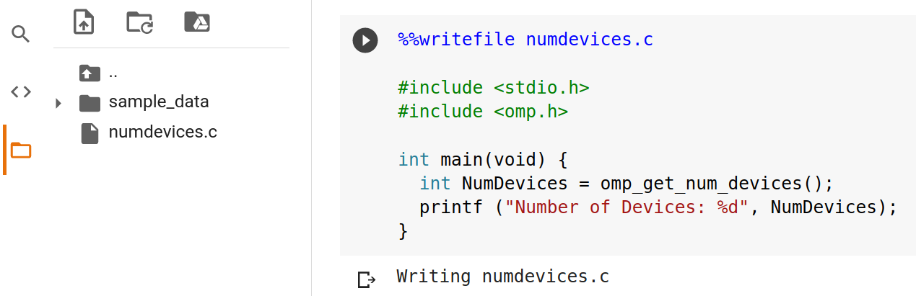
Step 3 - Tour
shell commands are prefixed with !
The writefile magic writes the contents of the cell into a named file, in our case, numdevices.c
Type the contents of numdevices.c
numdevices.c after executing the above cell

Slide 9
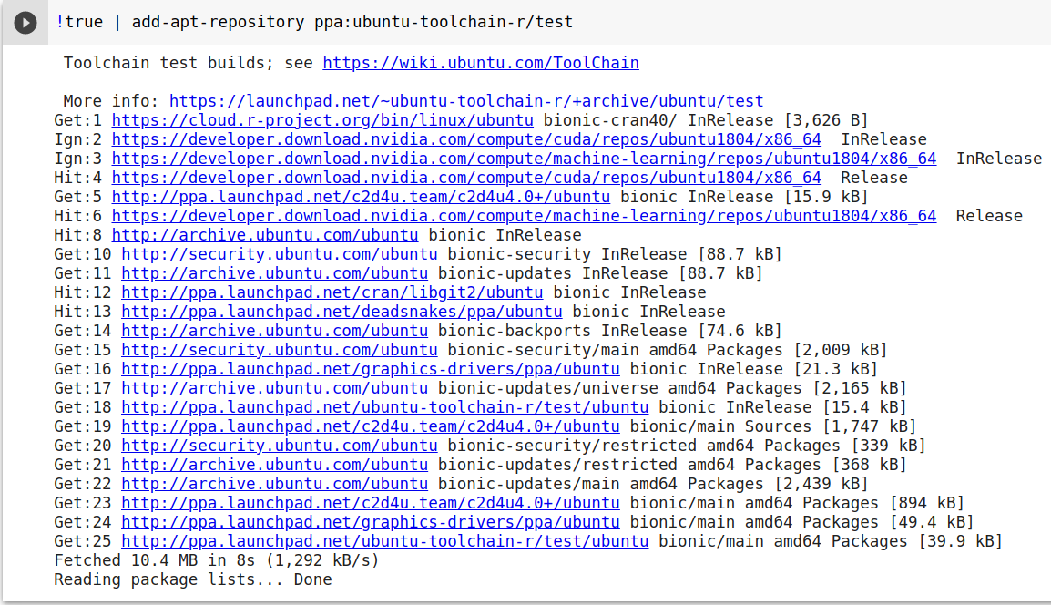
Step 4 - Install GCC with OpenMP offload support
Add an extra repository to fetch newer GCC compiler.

Slide 10
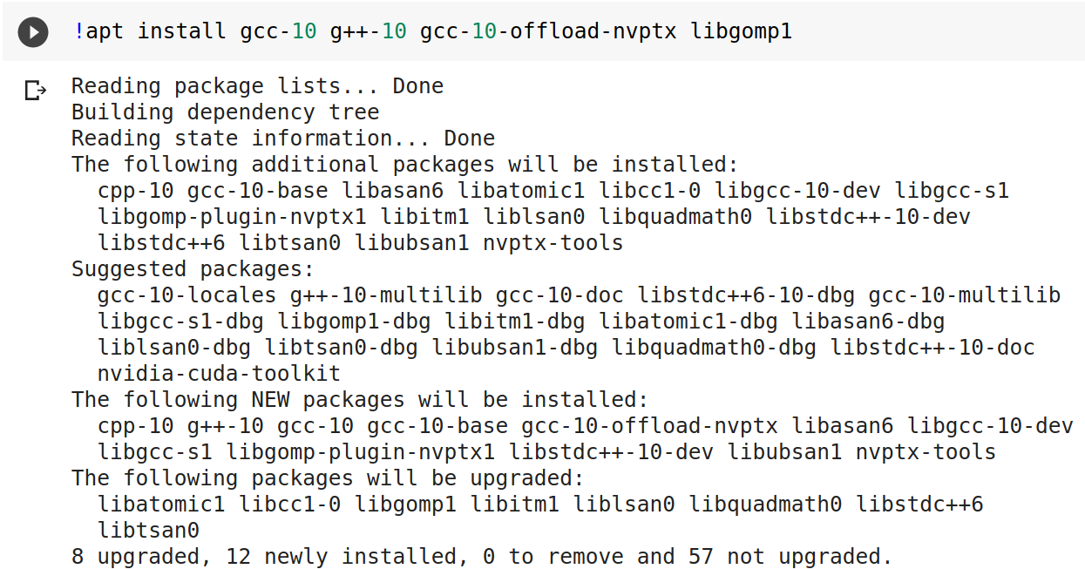
Step 4 - Install GCC with OpenMP offload support
Install GCC 10 C/C++ compiler, OpenMP Support Library, and NVPTX offload support.

Slide 11
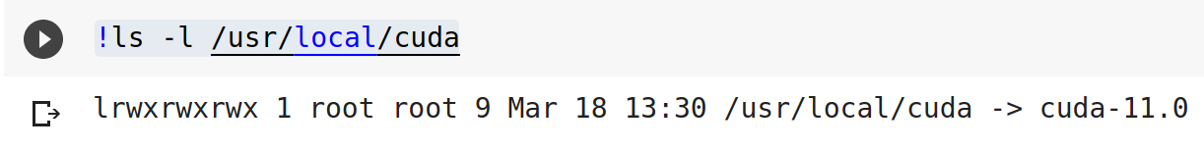
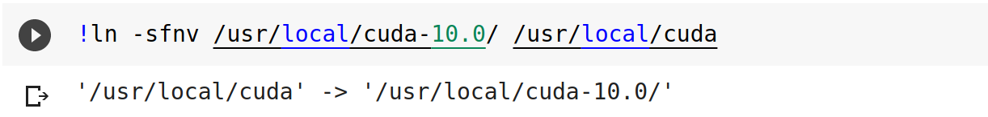
Step 5 - Use CUDA 10.0
The default CUDA SDK in use is 11.0.
Google Colab supplies CUDA SDK 10.0, 10.1 and 11.0 in the allocated instance.
Only CUDA 10.0 works correctly with GCC 10 offloading compiler out of the box.

Slide 12
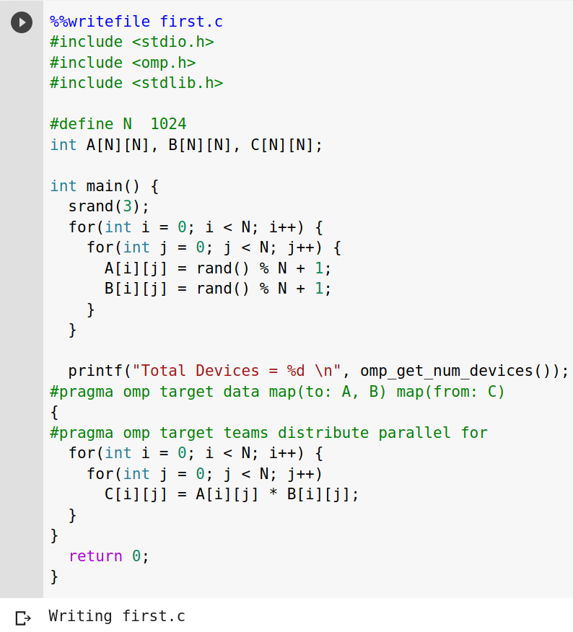
Step 5 - Compiling an OpenMP program with Offloading support
Write the example program into first.c

Slide 13
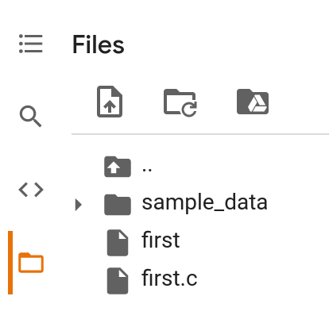
Step 5 - Compiling an OpenMP program with Offloading support
Executable
The source program

Slide 14
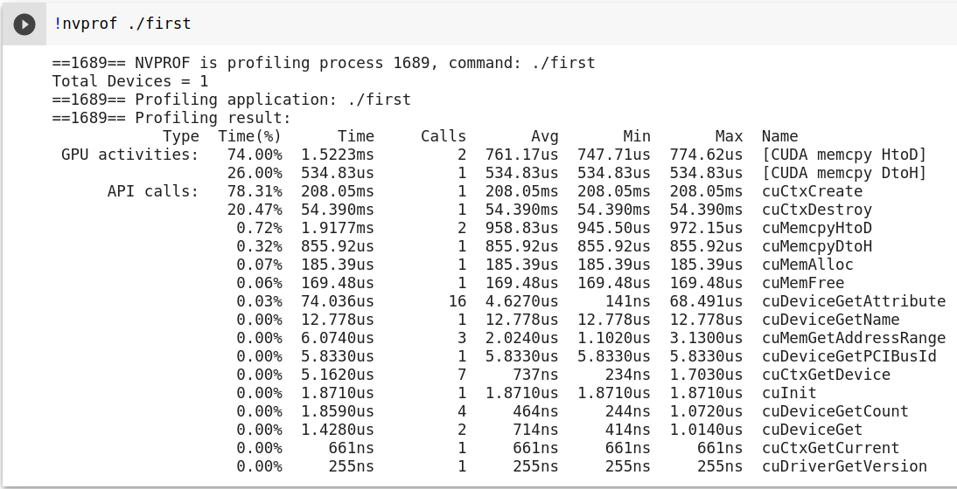
Step 6 - Execution with nvprof

