Slide 1
LUMA
Loan User Management Application
Capstone Project (Team-4)

Slide 2
Team
Vinod M
Unnikrishnan P V
Yash Gandhi
Suraj Arun Kaple
A.K.Karthik

Slide 3
Technology
Databases: MySQL
Presentation or View Layer: React
Backend processing: Spring and Springboot
Database Connectivity: Spring data JPA
Version control systems: Git
Build Tools: Maven

Slide 4
functionalities
It should allow the user to login and validate the credentials.
It should allow the users to apply loan for a particular item
It should allow the users to view all the loan cards availed
It should allow the users to view all the items purchased on loan cards

Slide 5
Use-case diagram
Apply loan
Login
User
view all the loan cards
Register
view all the items purchased

Slide 6
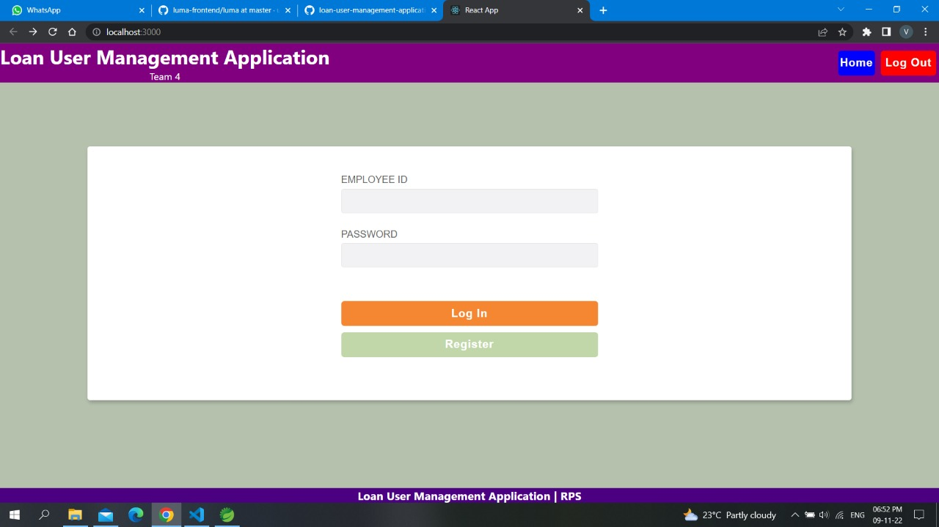
Interface
Login Page

Slide 7
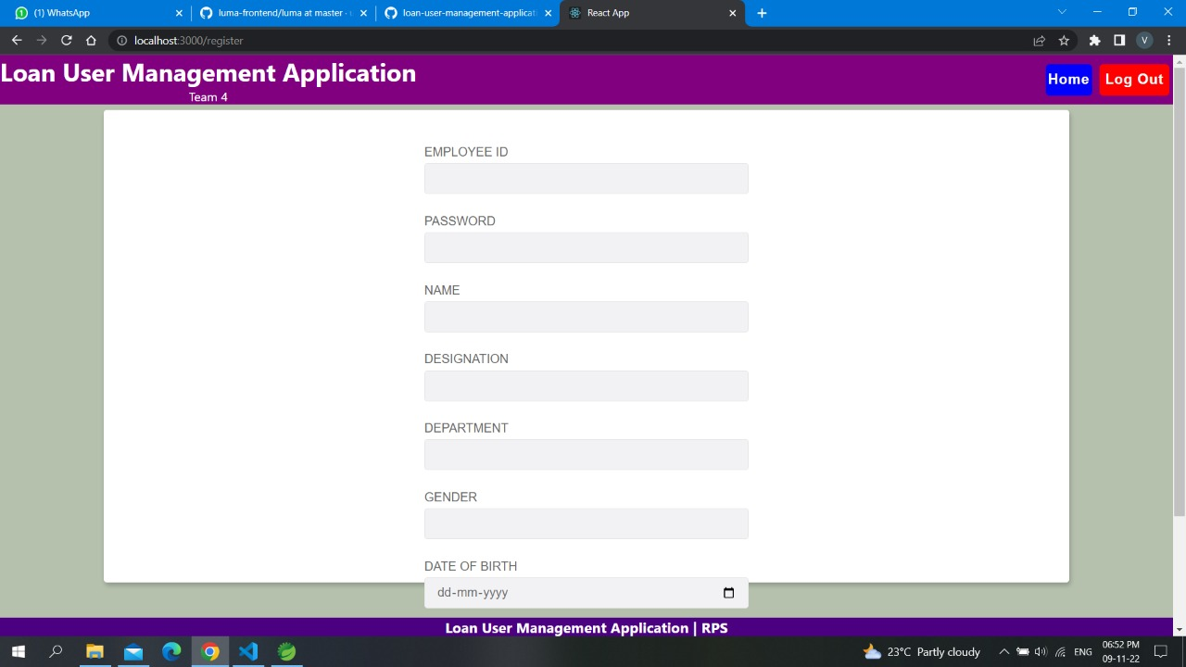
Interface
Regester Page

Slide 8
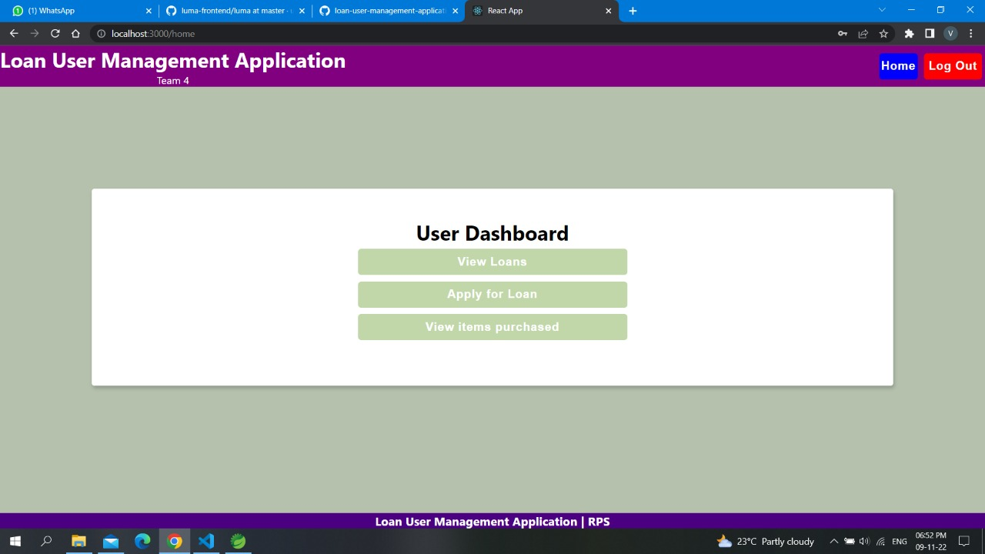
Interface
Home page

Slide 9
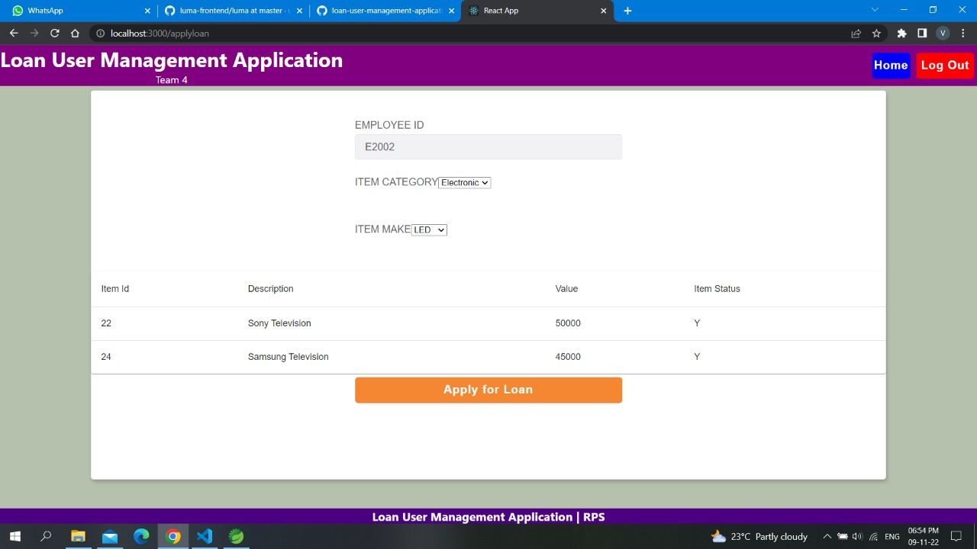
Interface
Loan application page

Slide 10
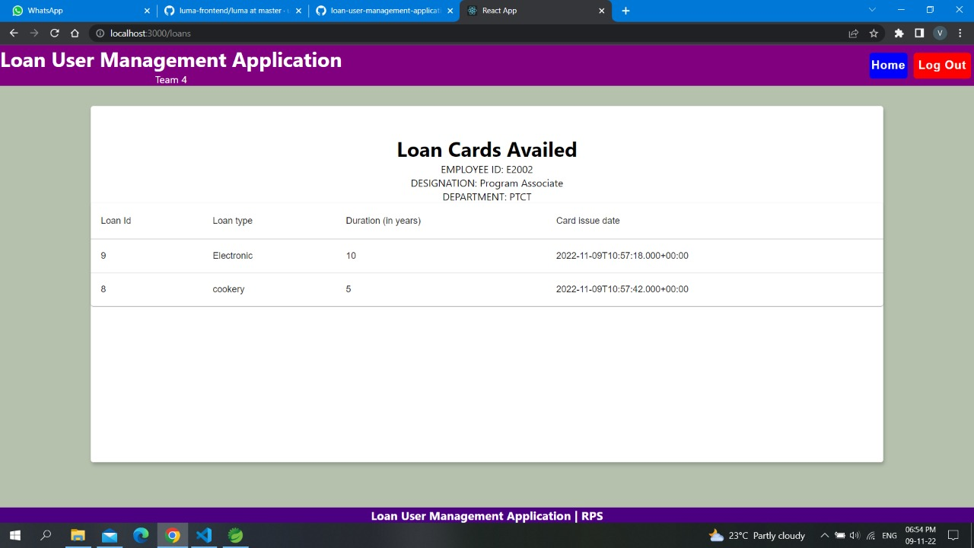
Interface
Employee loan cards page

Slide 11
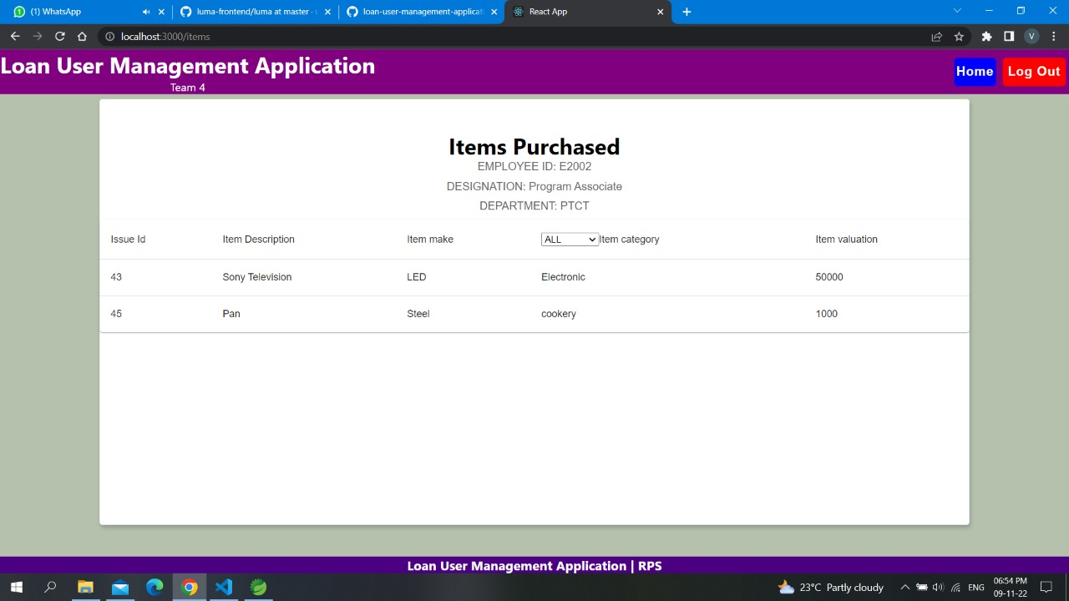
Interface
All items purchased page

Slide 12
Thank You

