Slide 1
Research Lab
Management System (RLMS)
Conceptual Design – ER Diagram

Slide 2
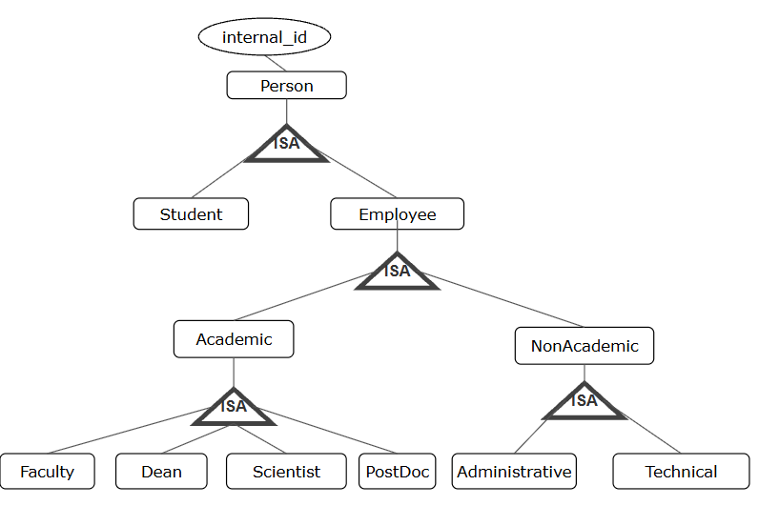
People

Slide 3
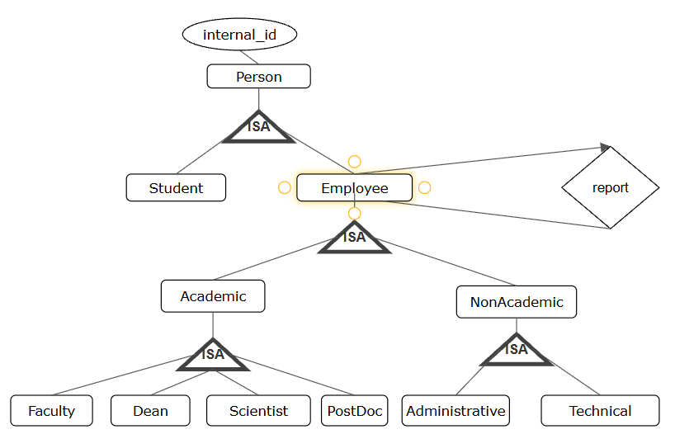
People

Slide 4
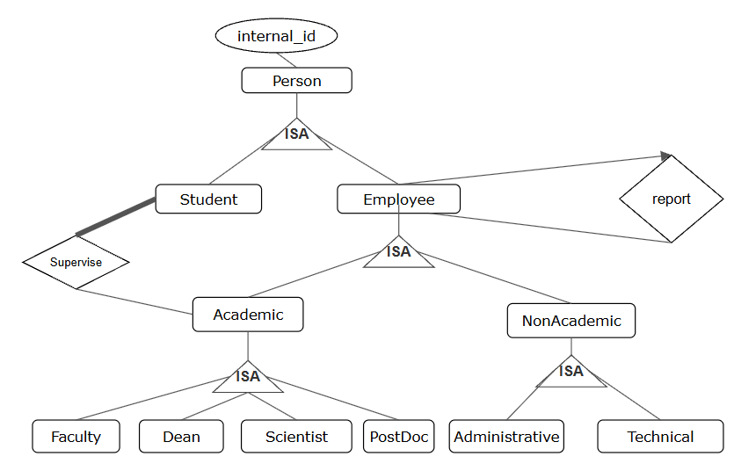
People

Slide 5
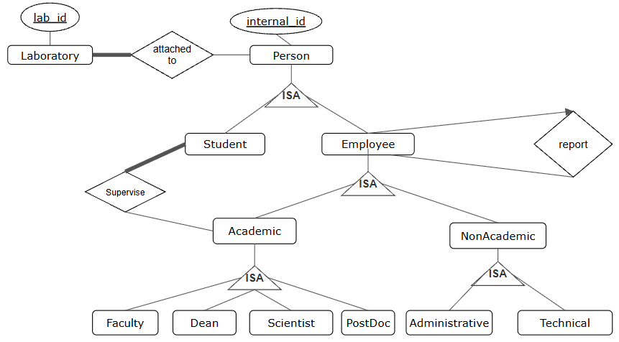
II. Laboratories

Slide 6
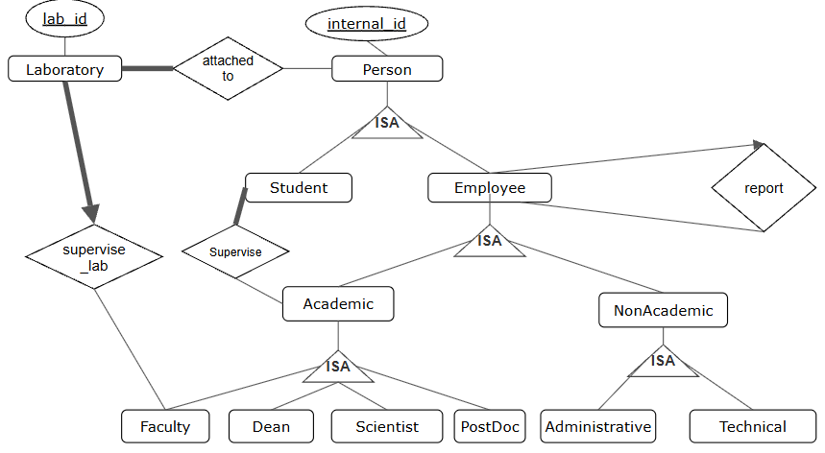
II. Laboratories

Slide 7
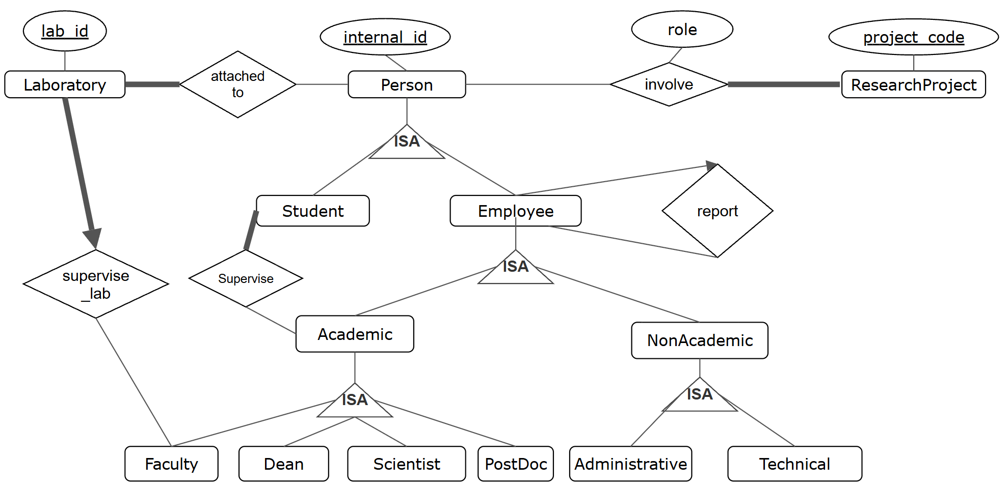
III. Research projects

Slide 8
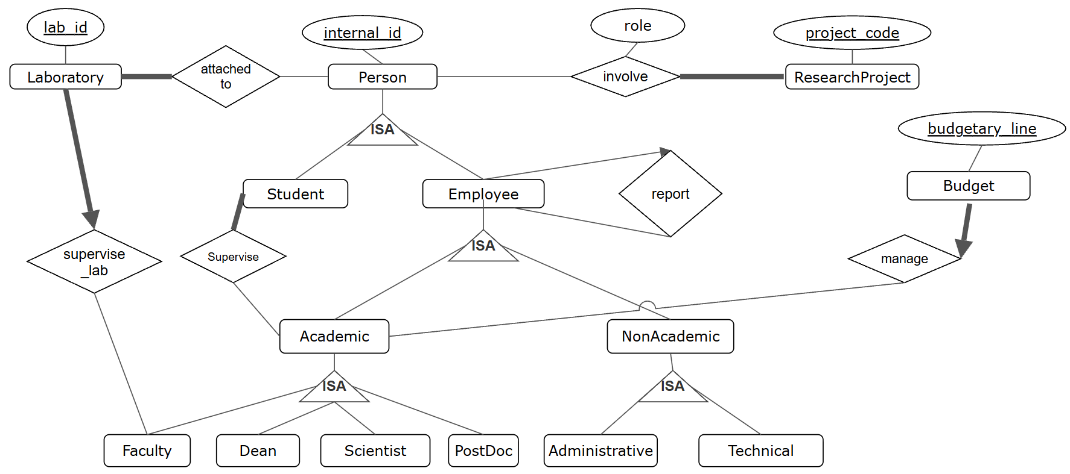
IV. Budgets

Slide 9
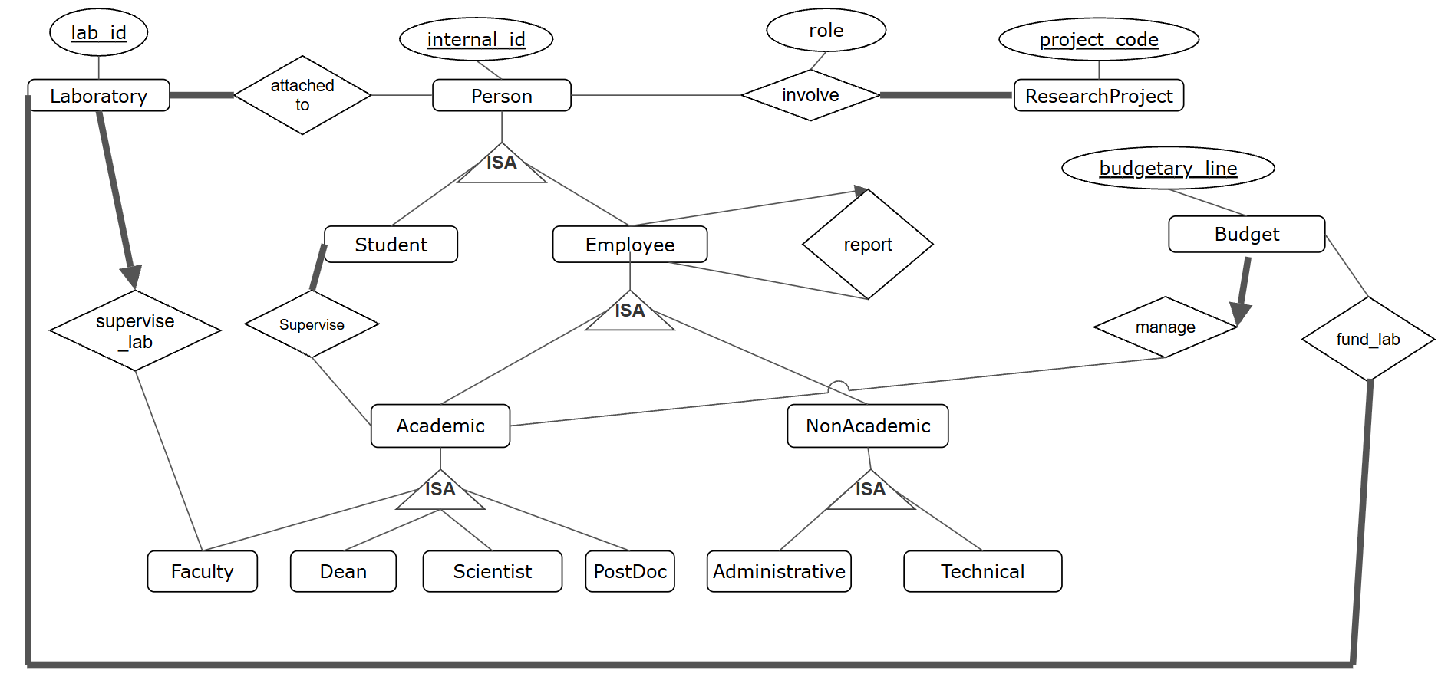
IV. Budgets

Slide 10
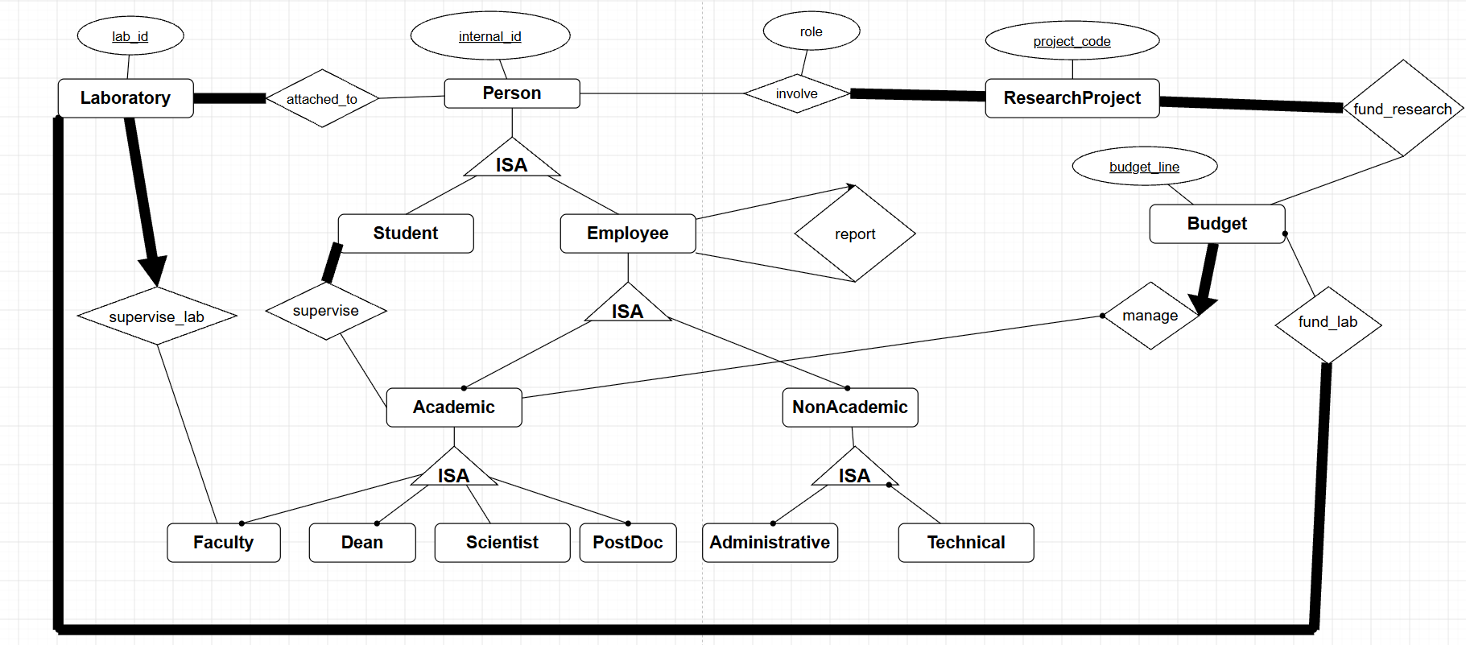
IV. Budgets

Slide 11
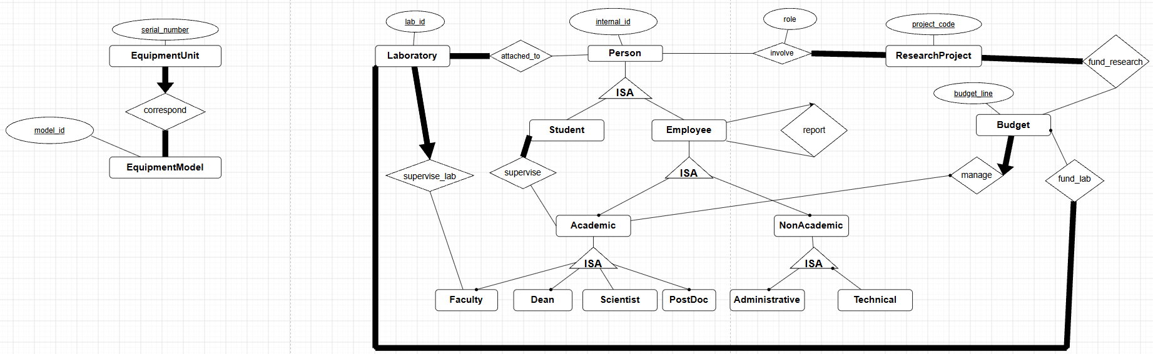
V. Equipment Models and Equipment Units

Slide 12
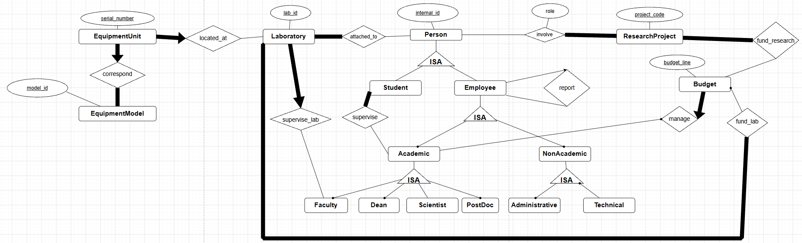
V. Equipment Models and Equipment Units

Slide 13
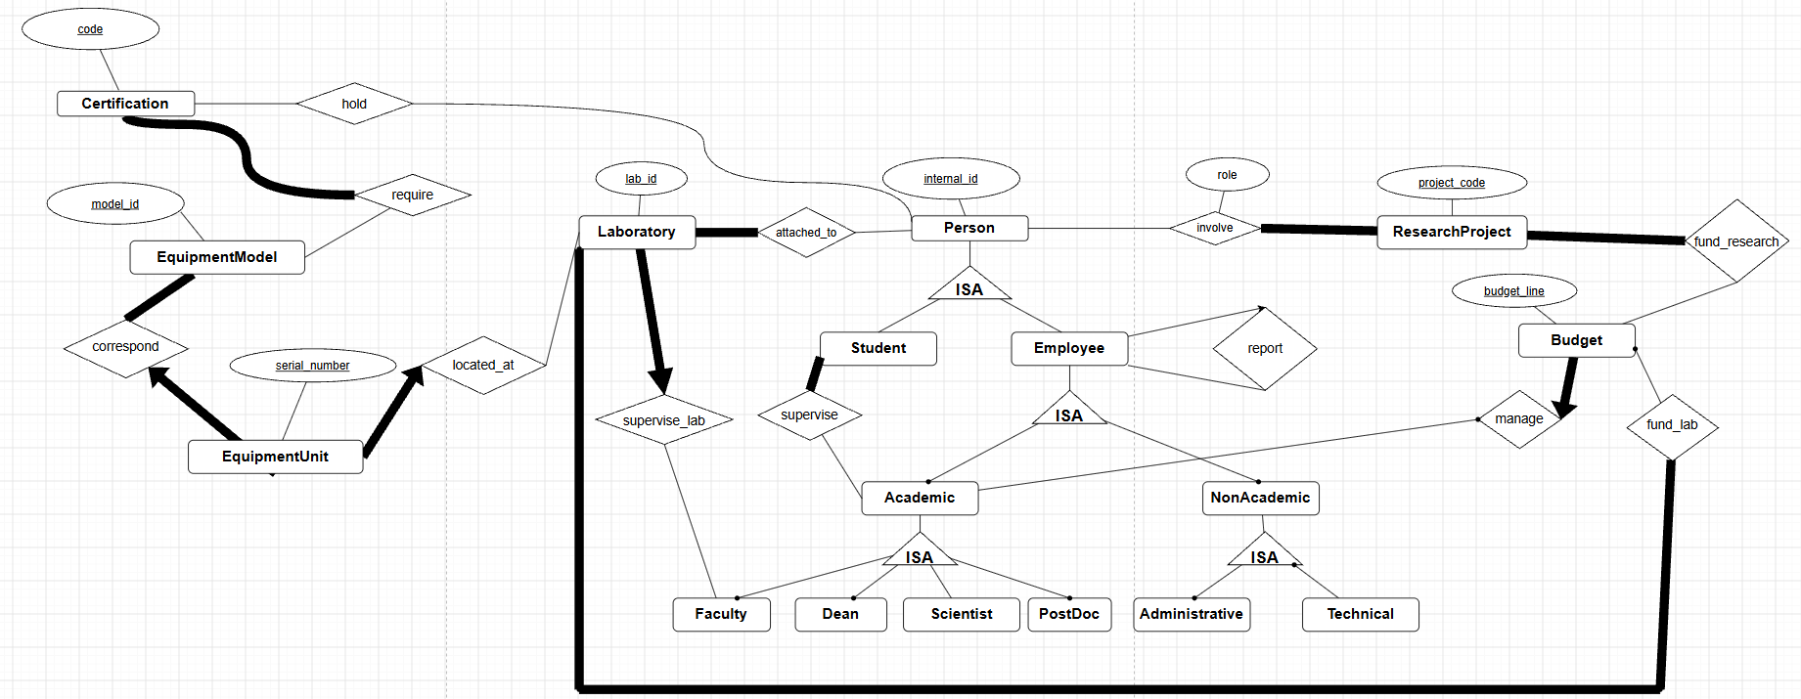
VI. Certifications and Authorizations

Slide 14
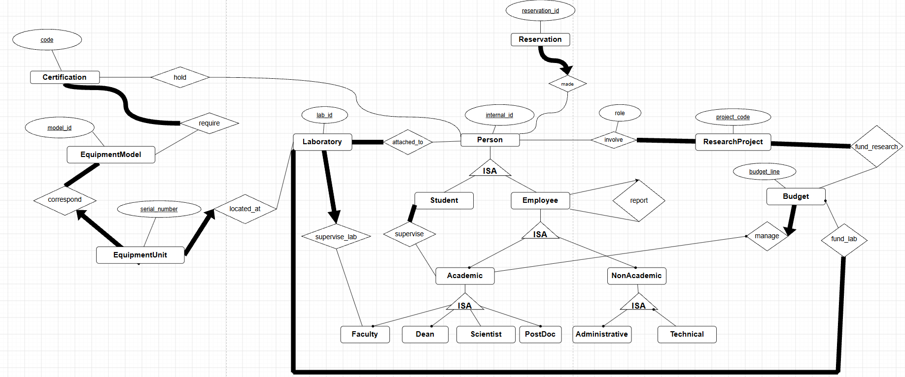
VII. Reservations

Slide 15
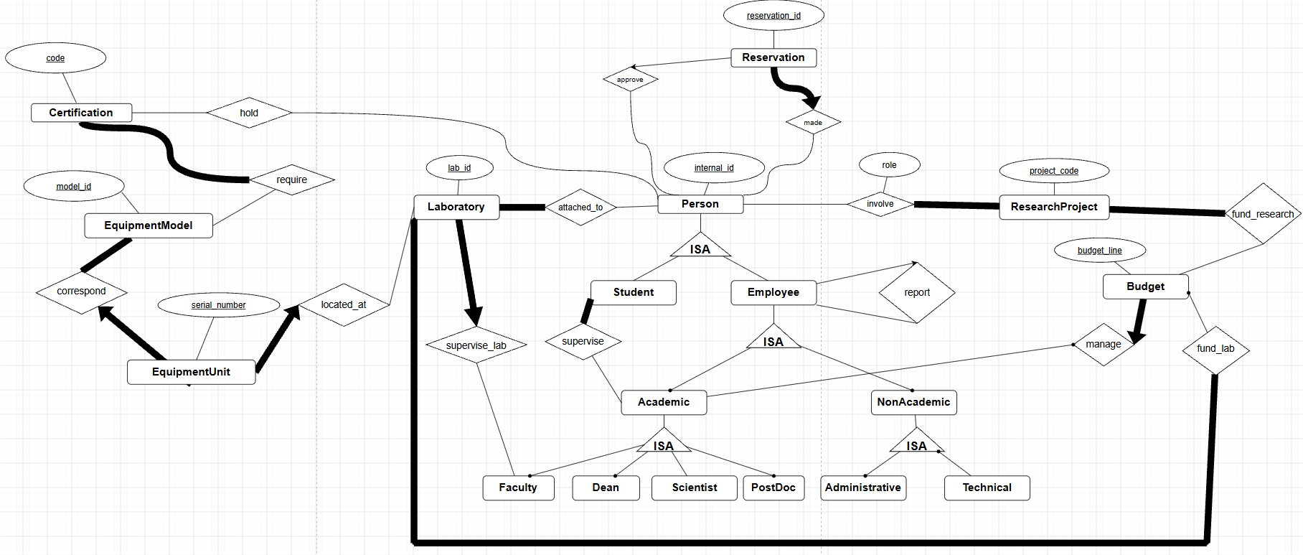
VII. Reservations

Slide 16
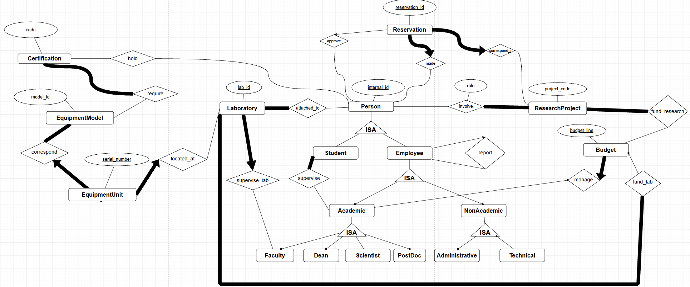
VII. Reservations

Slide 17
In the next slides, we made a mistake associating EquipmentModel to Reservation through the relationship correspond_e, it should have been an association between EquipmentUnit and Reservation through the same relationship

Slide 18
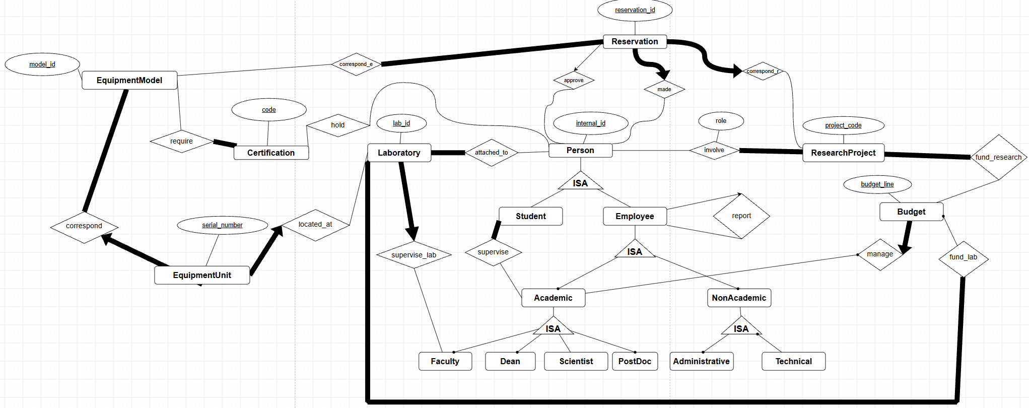
VII. Reservations

Slide 19
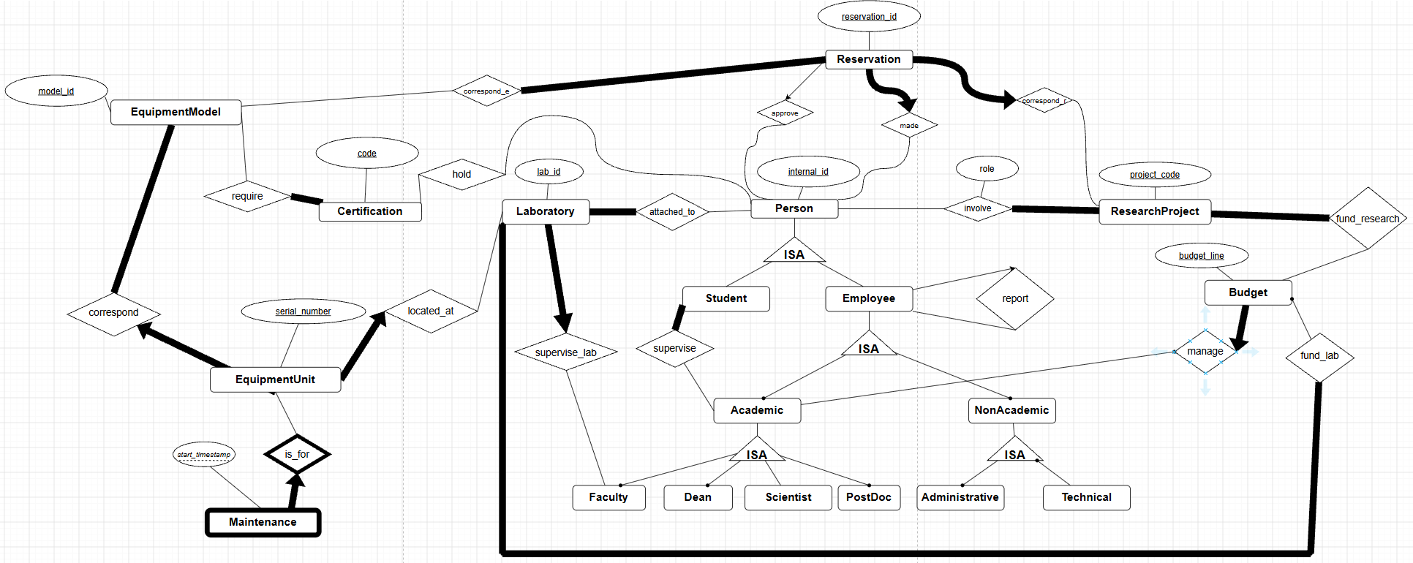
VIII. Maintenance

Slide 20
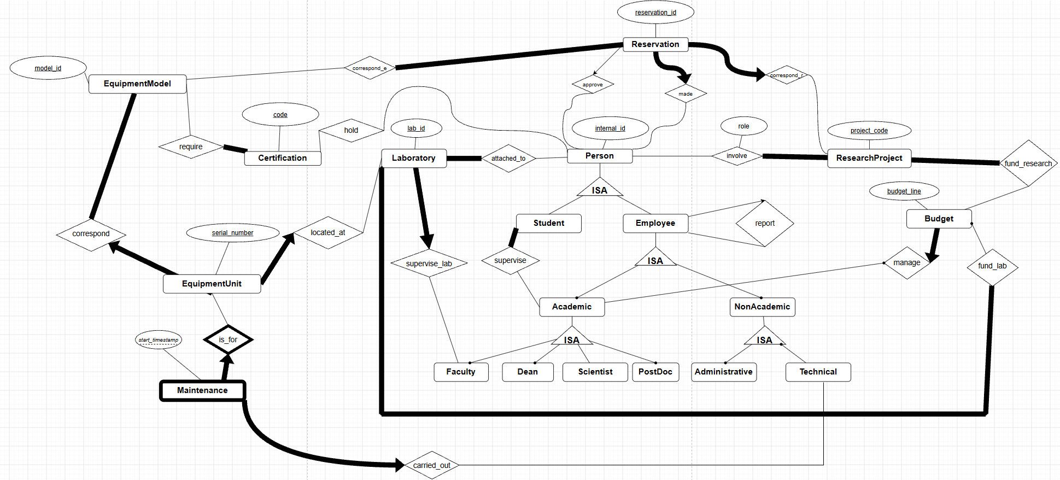
VIII. Maintenance

Slide 21
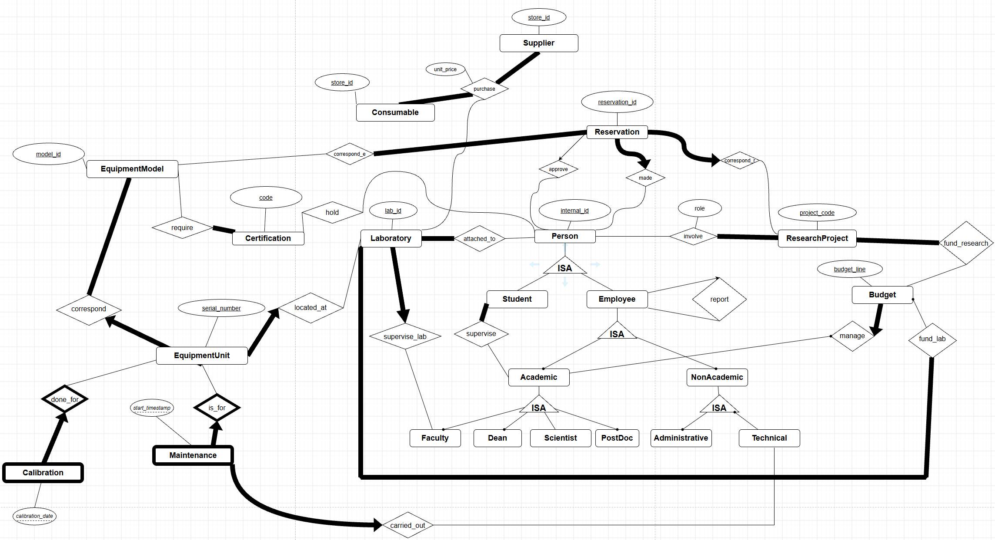
IX&X. Calibration records & Consumables

Slide 22
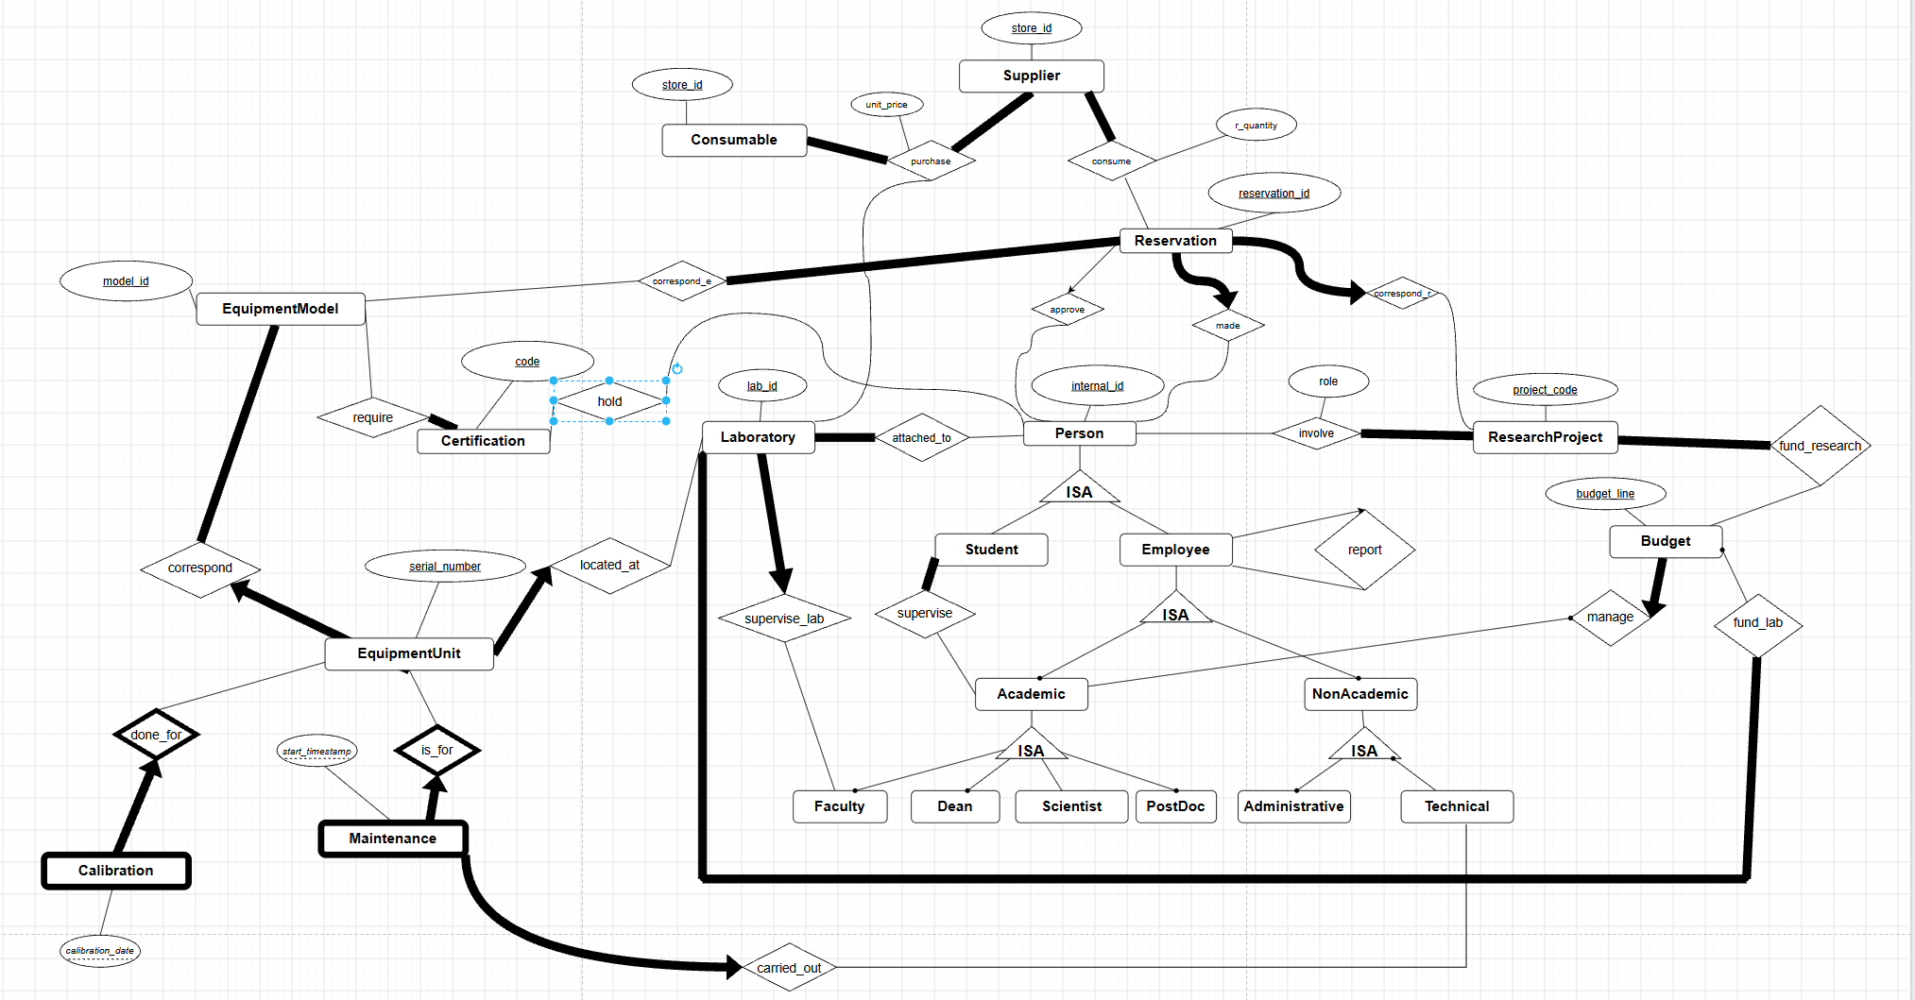
X. Consumables

Slide 23
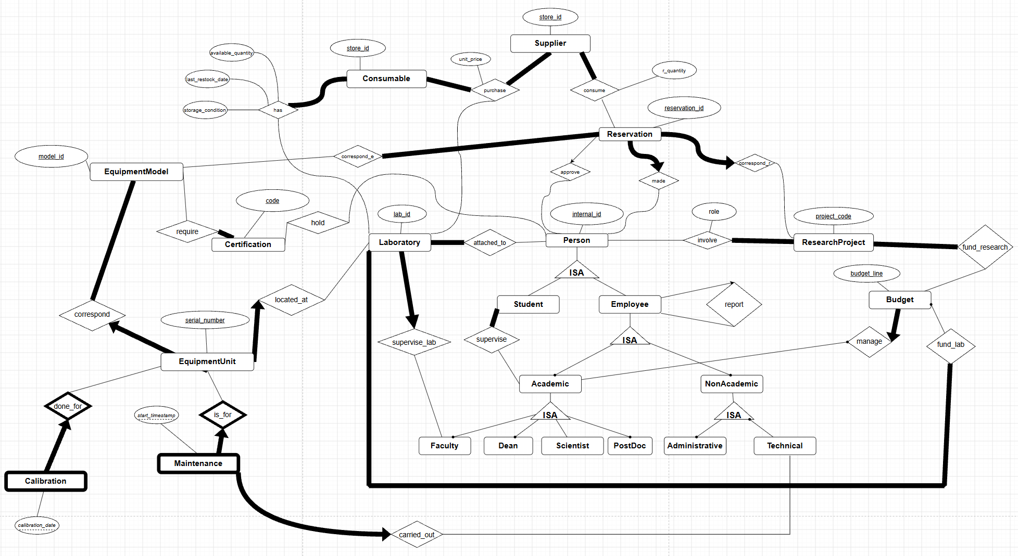
X. Consumables

Slide 24
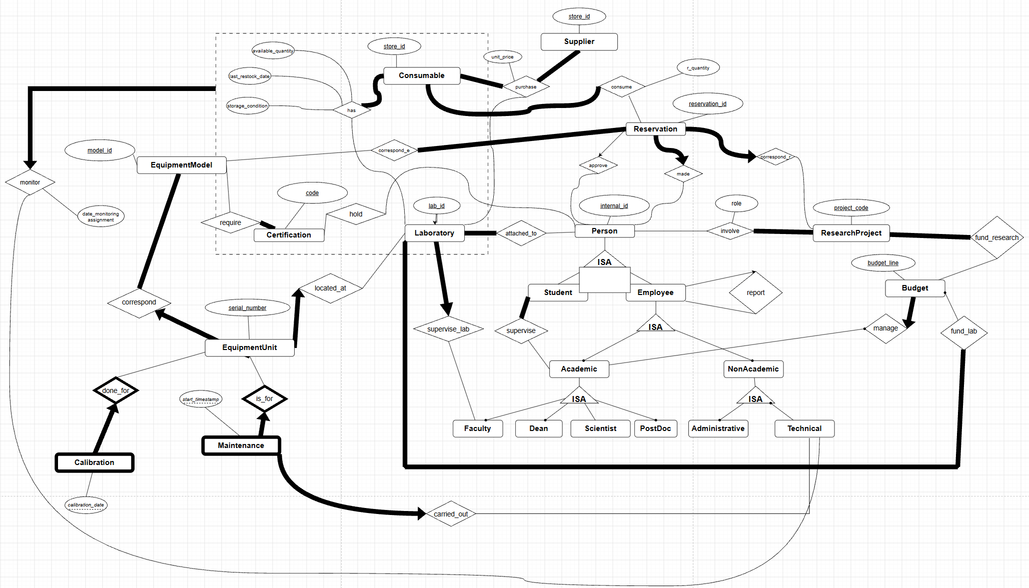
X. Consumables

Slide 25
The aggregation on the next slide is built over the has relationship set (Consumable–Laboratory) and is linked to Technical through monitor. The box may visually overlap other entities because of the diagram layout, but it encloses only has and its two participating entities.

Slide 26
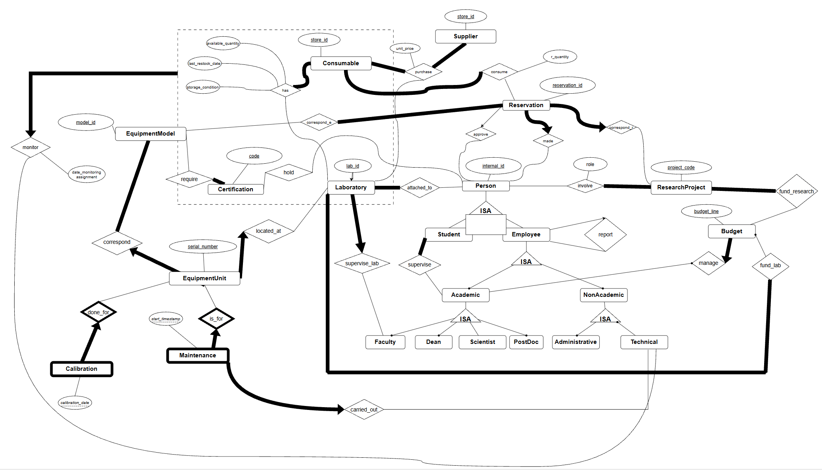
X. Consumables

