Slide 1
THE SNAKE GAME
Created By
Mohit
24
MCA 1

Slide 2
Introduction Objectives Requirement ERROR Control Feasibility Design Screenshots of game Future scope Conclusion
Overview

Slide 3
The game called “SNAKE" or “SNAKE GAME" typically involve the player controlling a line or snake, there is no official version of the game, so gameplay varies. The most common version of the game involves the snake or line eating items which make it longer, with the objective being to avoid running into a border or the snake itself for as long as possible.
INTRODUCTION

Slide 4
OBJECTIVES
IN THIS PROJECT, YOU CAN PLAY THE POPULAR "SNAKE GAME" JUST LIKE YOU PLAYED IT ELSEWHERE. YOU HAVE TO USE THE W, S, D OR A KEYS TO MOVE THE SNAKE. FOODS ARE PROVIDED AT THE RANDOM CO-ORDINATES OF THE SCREEN FOR THE SNAKE TO EAT. EVERY TIME THE SNAKE EATS THE FOOD, ITS LENGTH WILL BY INCREASED BY ONE ELEMENT ALONG WITH THE SCORE.

Slide 5
1.Software: OS: Window 7,8,8.1,10 Mac Os and Linux IDE: TURBO C++ 2.Hardware: Processor :Pentium 4 or Above Ram:2GB or Above Monitor Keyboard
Requirement

Slide 6
DATA STRUCTURES USED
ARRAY
LINKED LIST
FILE HANDLING

Slide 7
ERROR CONTROLS USED:
USER CAN NOT ENTER NAME LONGER THAN 8 CHARACTERS.
USER’s NAME SHOULD NOT BE STARTED WITH INTEGER.
USER’s NAME SHOULD NOT BE STARTED WITH SYMBOL.
SNAKE SHOULD NOT TOUCH BOUNDRIES.

Slide 8
Technically Feasible : Technically ,this project is feasible because of use OF Proper Software and latest techniques. Financially Feasible: Financially ,It is also very feasible it is made up in very low cost. Operationally Feasible: Very easy to use.
Feasibility

Slide 9
GAME TITLE
INFORMATION
NEW GAME
HELP
Basic Design
SCORE
EXIT
INFORMATION

Slide 10
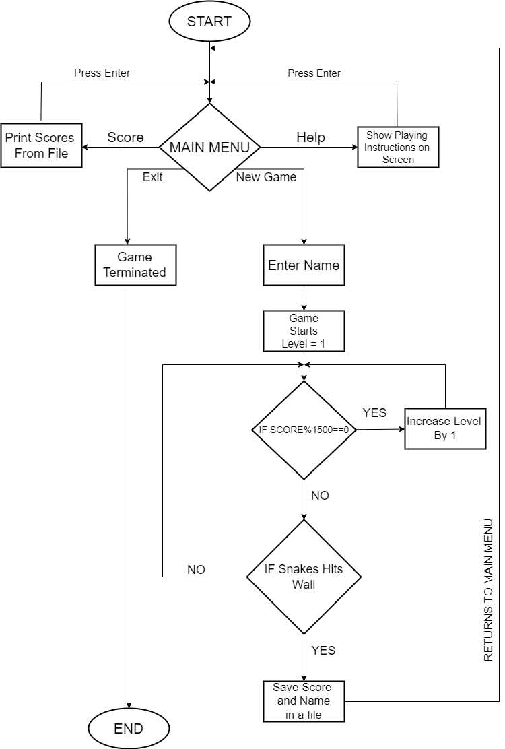
FLOW CHART

Slide 11
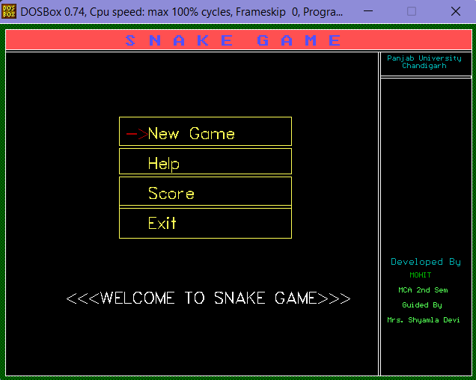
MAIN Menu

Slide 12
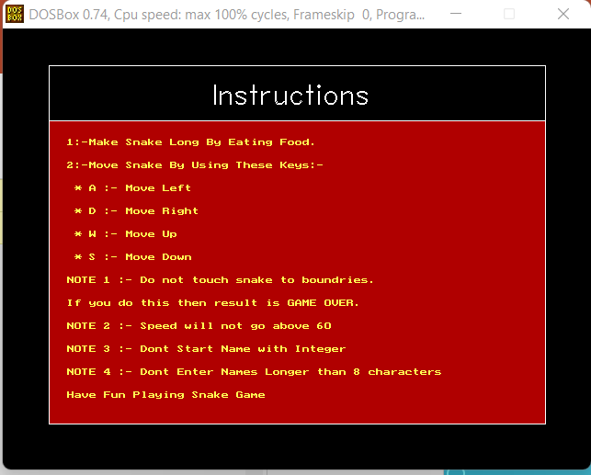
HELP

Slide 13
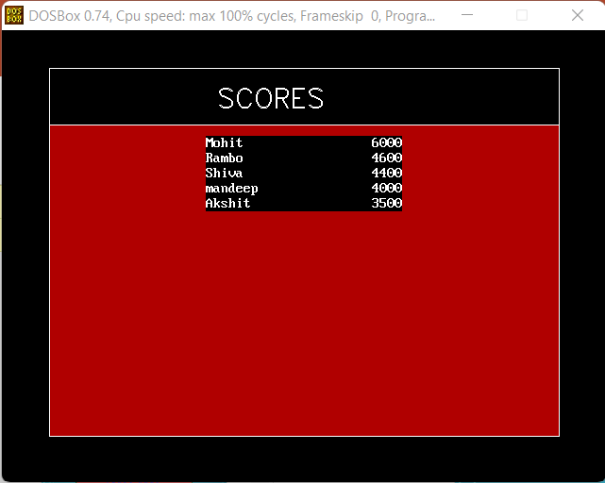
SCORE

Slide 14
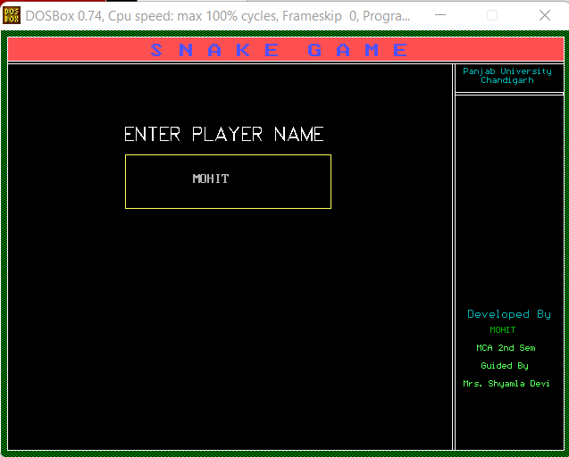
ENTER NAME

Slide 15
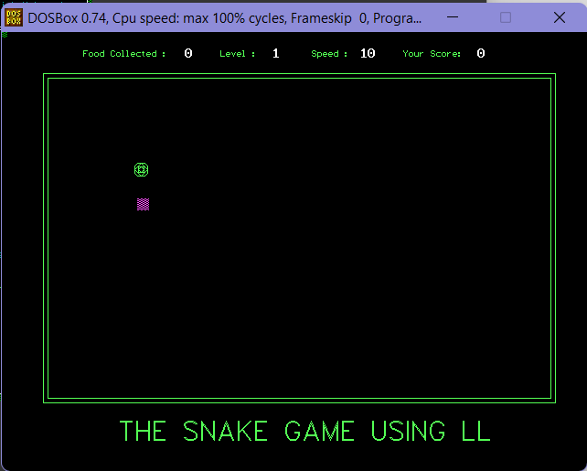
GAMEPLAY(L1)

Slide 16
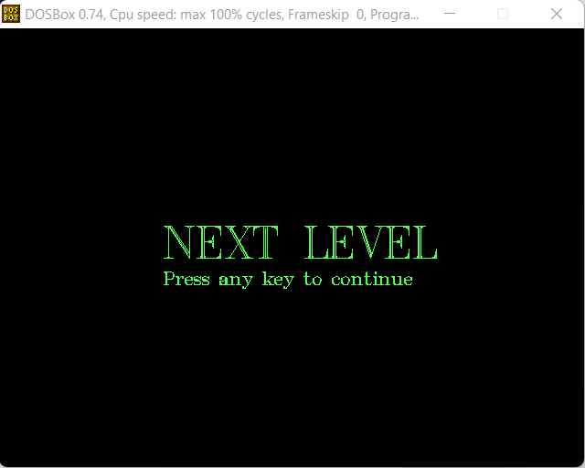
LEVEL UP

Slide 17
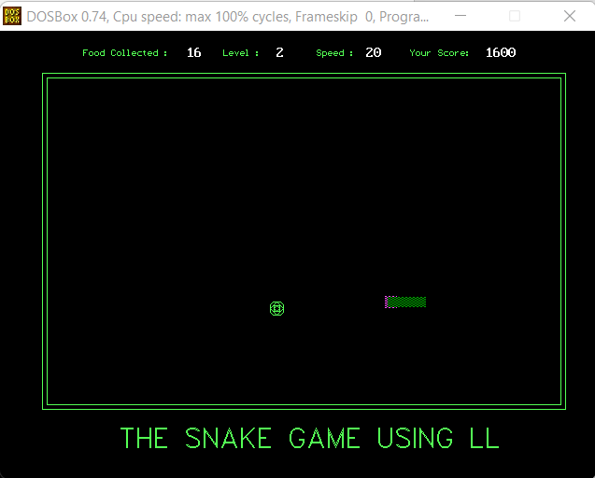
GAMEPLAY (L2)

Slide 18
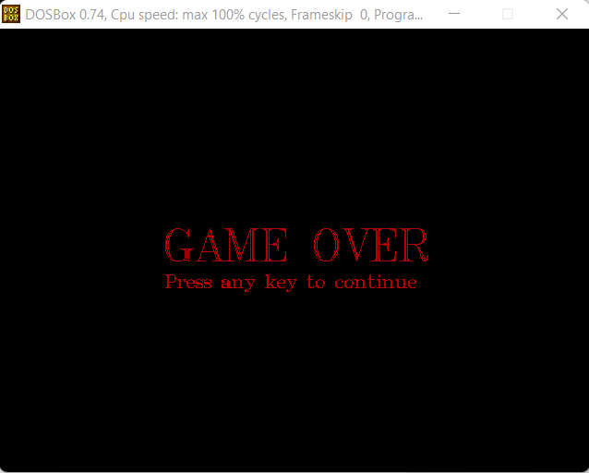
GAME OVER

Slide 19
This project will be able to implement in future after making some changes and modifications as we make our project at a very low level. So, the modifications that can be done in our project are: 1.It can be made with better graphics. 2.We can add more options like Top scores and Player Profile. 3.We can add multiplayer option.
Future Scope

Slide 20
The main aim of this project is to Create a Game Which we can play When we are getting bored. This project increased my knowledge about C Graphics. I also get proper knowledge about some data structure concepts like, Arrays, Linked List, etc. This Project was quite complex during snake designing phase using linked list. I felt very happy after completing this Project under given time.
CONCLUSION

Slide 21
YOU
THANK

