Slide 1


Restricted Mean Survival Time in Practice:
An Easy-to-Understand Approach
Angel Cronin, Xiang Meng, and Hajime Uno
Department of Data Science
Dana-Farber Cancer Institute
November 5 and 12, 2025
Data Science Training 2025
Notes:
Part 1: 120 min
Part 2: 120 min
#=====================================================
# Part 1 --- aim to finalize the slide by 10/16 Thursday (11am meeting)
#=====================================================
Introduction - motivation and background -- 10 min [Hajime] (10:05- 10:15)
Issues of HR -- 25 min [Xiang] (10:15 – 10:40)
RMST definition etc. -- 20 min [Xiang] (10:40 – 11:00)
[break] 10min
Show practical examples in clinical literatures -- 10 min [Xiang]
Demo and exercise -- 30 min (2-sample comparison) [Angel]
Feedback and Q&A -- 10 min [All]
#=====================================================
# Part 2 --- aim to finalize the slide by 10/27 Monday (1pm meeting)
#=====================================================
Quick recap from Part 1 (5 min) [Hajime]
How to choose tau -- 10 min [Hajime]
Equivalence trial -- 5 min [Hajime]
Power comparison of RMST vs HR/Logrank (show simulation results) -- 10 to 15 min [Xiang]
- For PH patterns, RMST ~ HR
- For delayed difference pattern ---> HR > RMST
- For early difference pattern ---> RMST > HR
Study design based on RMST --- 30 min (incl. demo and exercise) [Xiang]
[BREAK] 10 min
Regression Analysis with RMST -- 20 min (incl. demo and exercise) [Angel]
RMST for stratified analysis of survival data -- 20 min (incl. demo and exercise) [Angel]
Wrap-up other applications (some more advanced topic) and QA --- 10 min [all]
#--- will not cover this time ---
Empirical choice of a truncation time for RMST
Power comparison between HR-based tests and RMST-based tests
RMST in the presence of competing risks
Generalization of RMST for recurrent event time data analysis
RMST to assess duration of response
RMST to quantify long-term survival benefit

Slide 2
Welcome!

Slide 3
Methods for time-to-event data
TEST
1966
Log-rank test
1960
1970
1980
1990
2000
2010
2020
Now
1958
Kaplan-Meier
1972
Cox regression
(hazard ratio)
GRAPH
ESTIMATION
>95% of cancer RCTs (ph3) were using this Test/Estimation method
(Uno et al. 2020, Oncologist)

Slide 4

Near universal use of log-rank/HR
Is this tradition reasonable?
Clinical research are highly variable with respect to their characteristics and research questions. One method does not fit all.
No method is perfect. Log-rank/HR is not an exception.

Slide 5

Signs of change

Slide 6
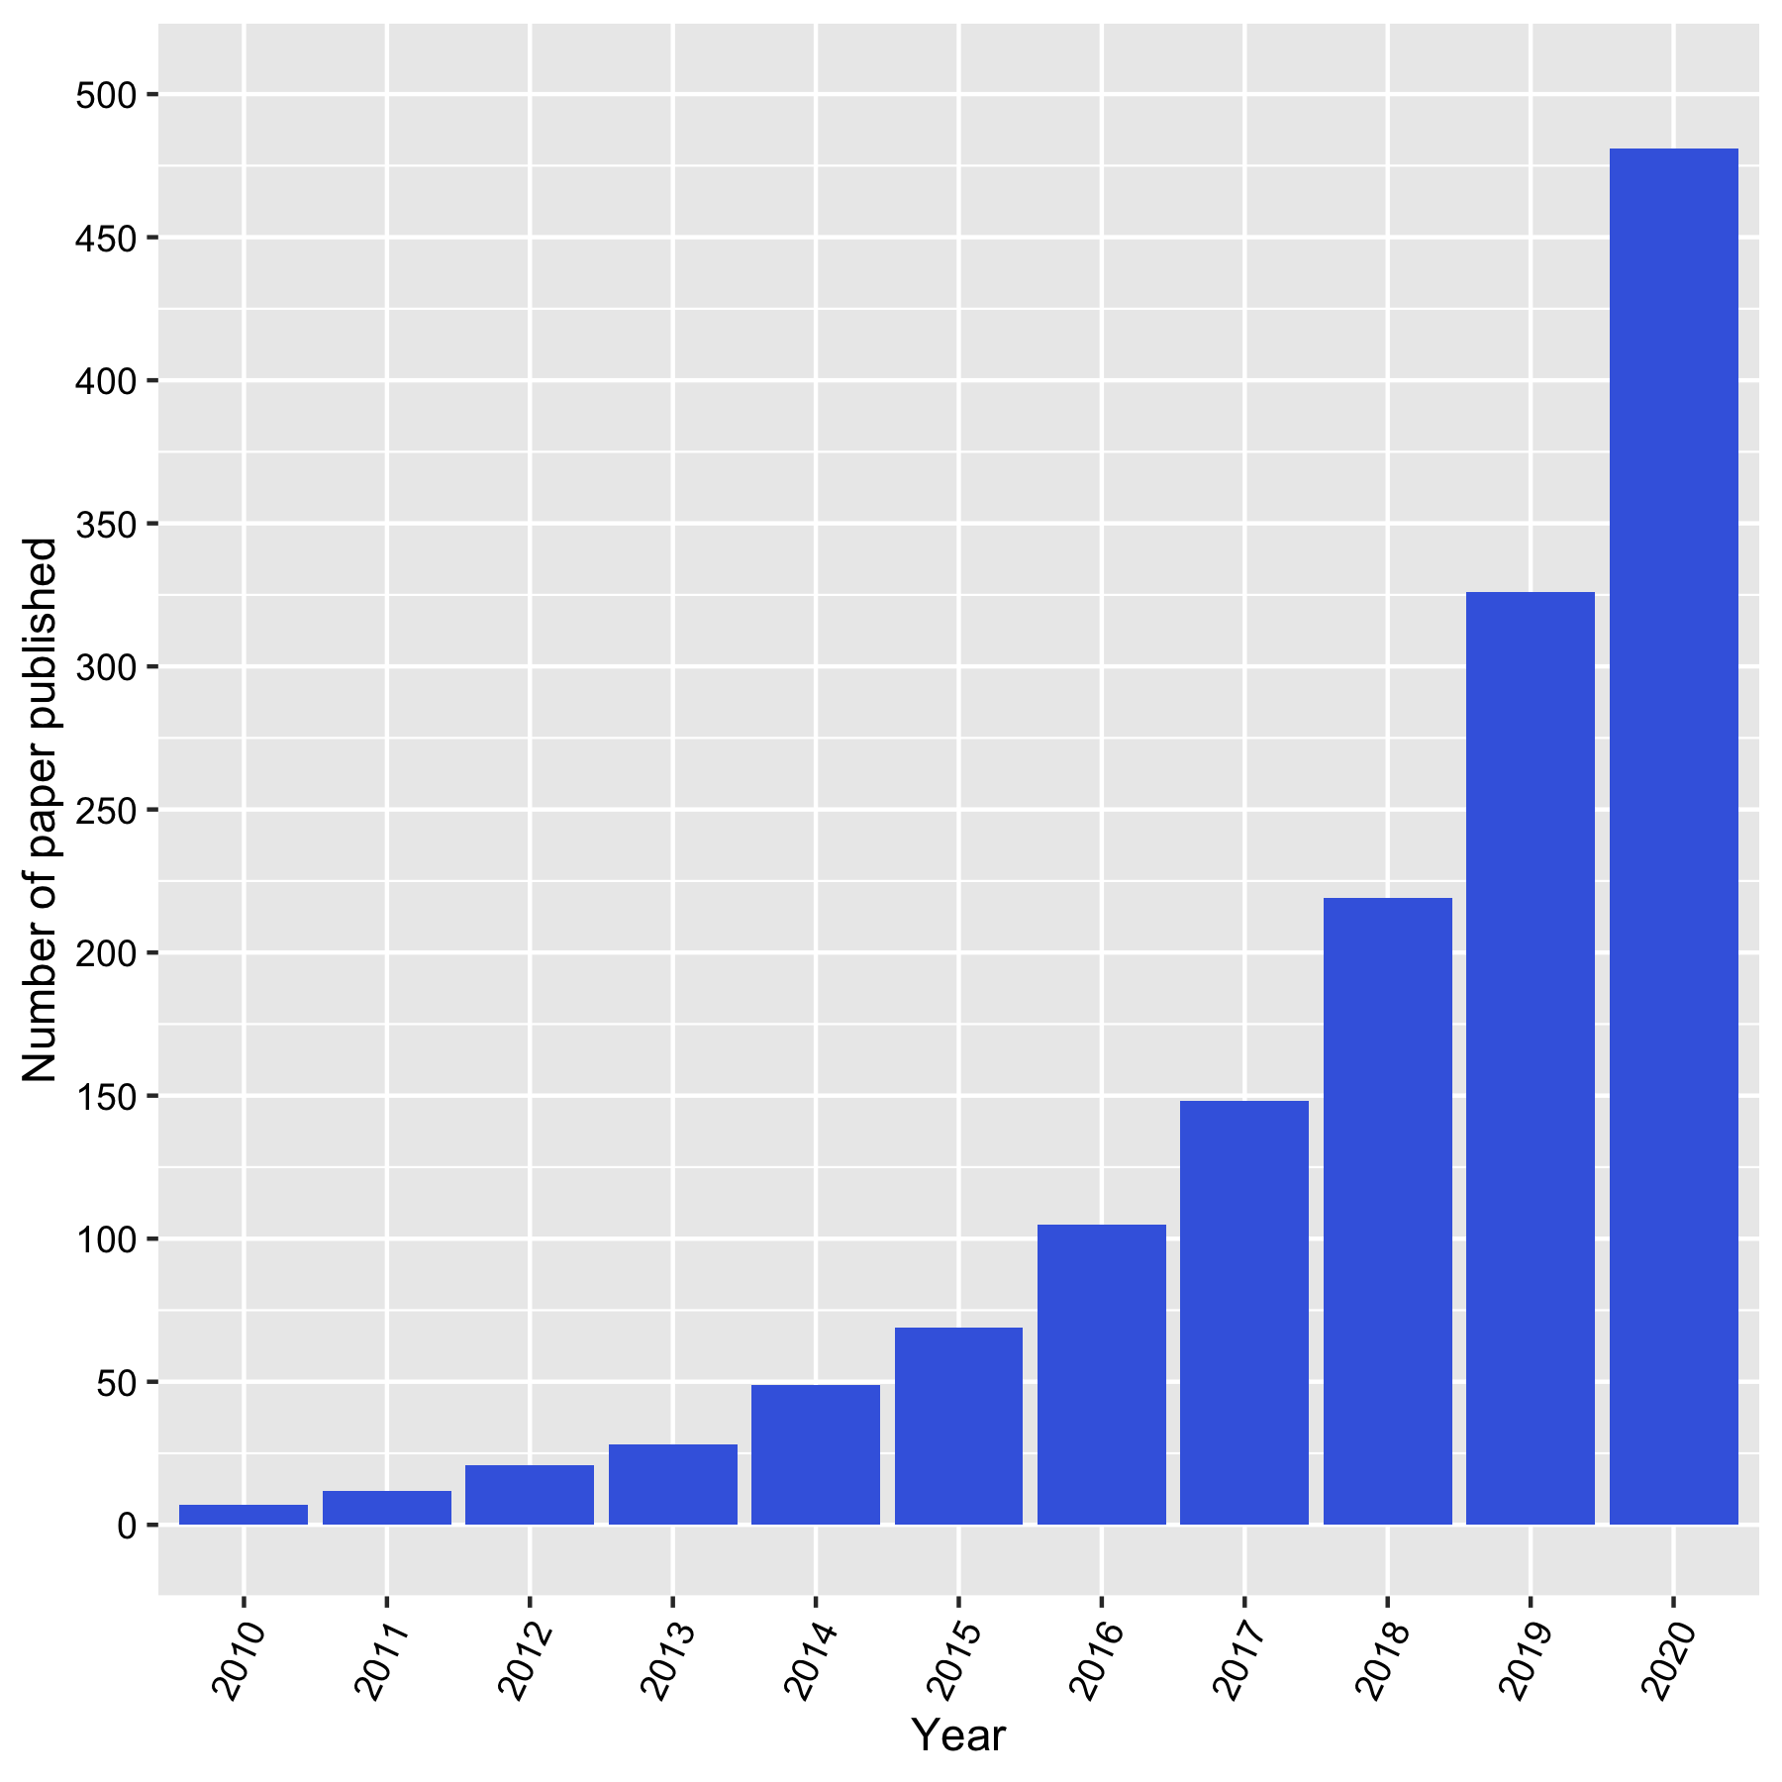
RMST is getting popular…
First publication using RMST-based analysis as a primary method (NEJM).
SAS Inc. released the RMSTREG procedure.
We provided a short RMST course at the FDA.
We released Stata commands for RMST analysis (strmst2 and strmst2pw).
We released
the survRM2 R package and SAS macro (%rmst2) for RMST-based analyses.
the SSRMST package for designing studies using RMST-based methods.
We published a paper introducing RMST-based analysis to the clinical research community (Uno et al. JCO).
Glasziou, Simes, Gelber (1990)
Partitioned survival curve
(Quality Adjusted Survival)
RMST was proposed
by Irwin (1947)
Karrison
(1997, Cont.Clin.Trial)
Notes:
@ARTICLE{Glasziou1990-ru,
title = "Quality adjusted survival analysis",
author = "Glasziou, P P and Simes, R J and Gelber, R D",
journal = "Stat. Med.",
publisher = "Wiley",
volume = 9,
number = 11,
pages = "1259--1276",
month = nov,
year = 1990,
language = "en"
}

Slide 7

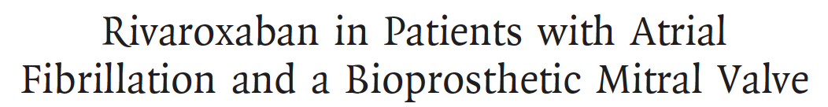
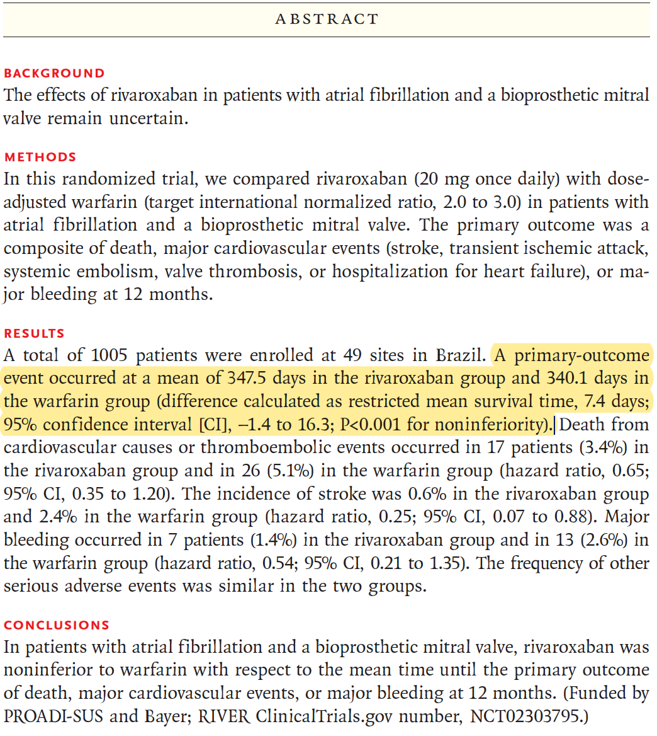
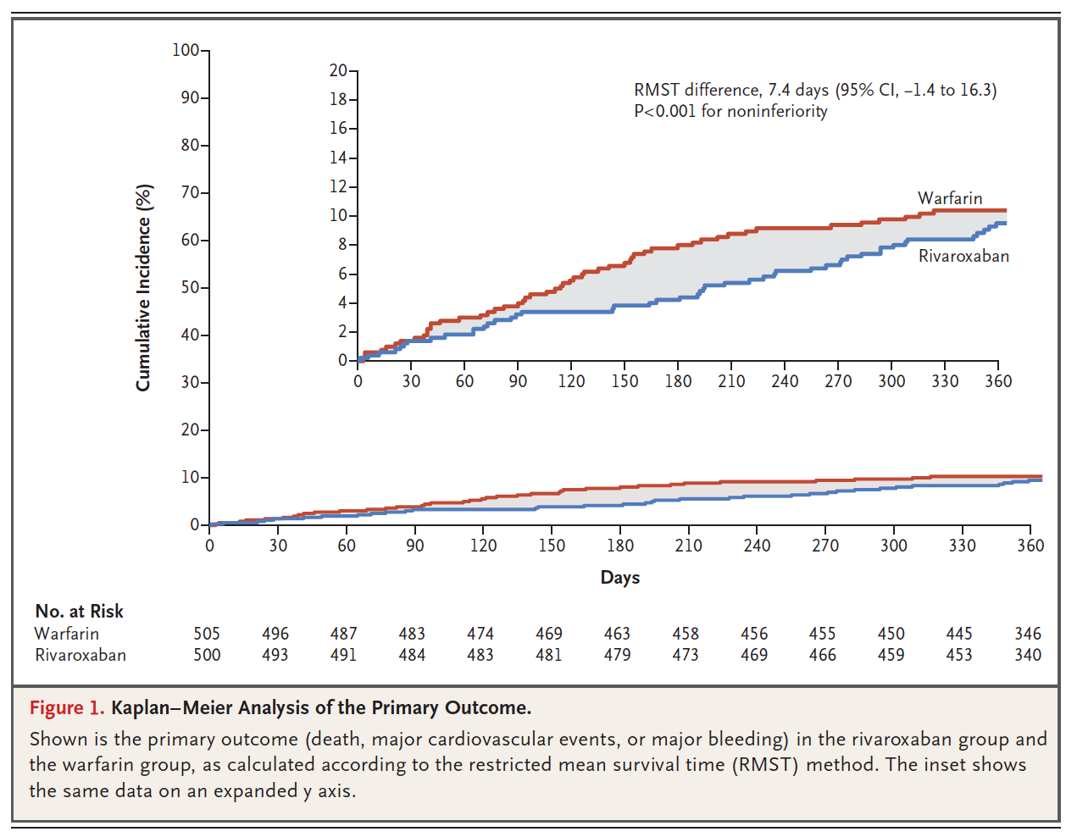
Guimarães et al. (November 14, 2020)
RMST was used as
the primary analysis

Slide 8
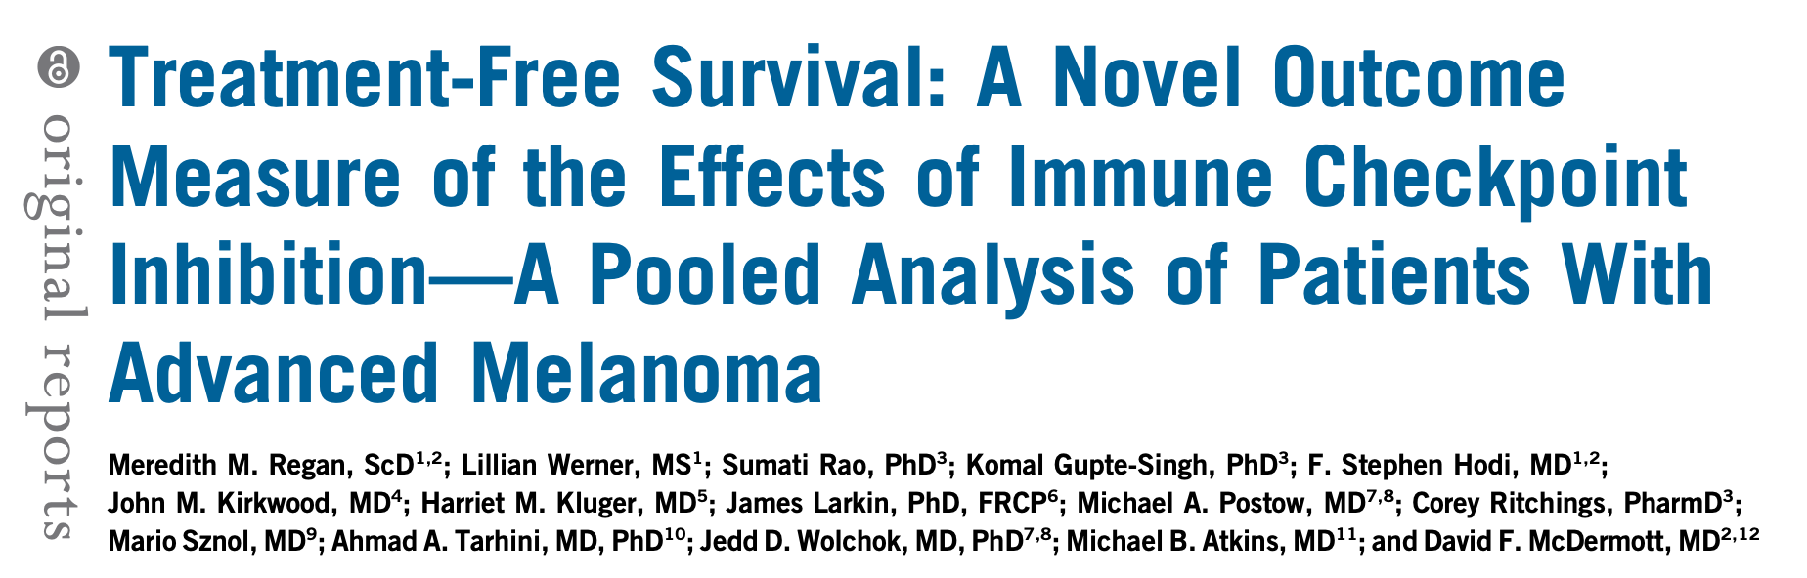
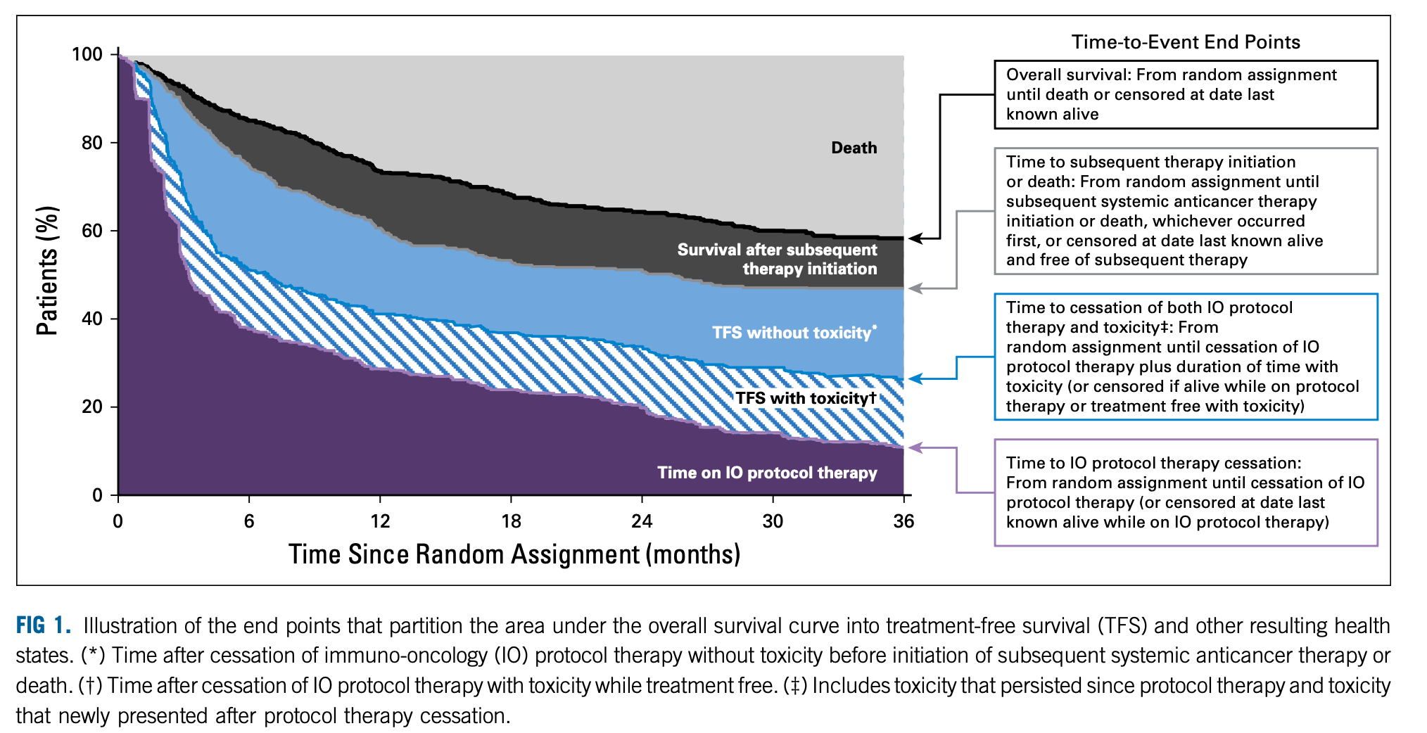
Regan et al. 2019 JCO

Slide 9
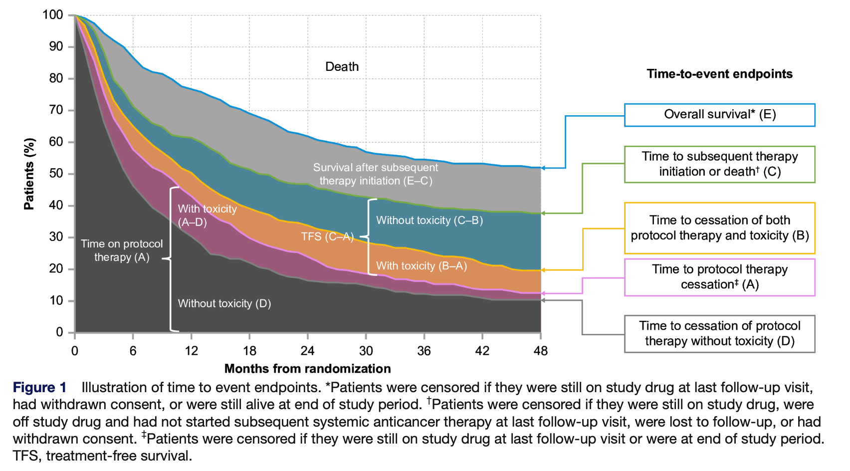
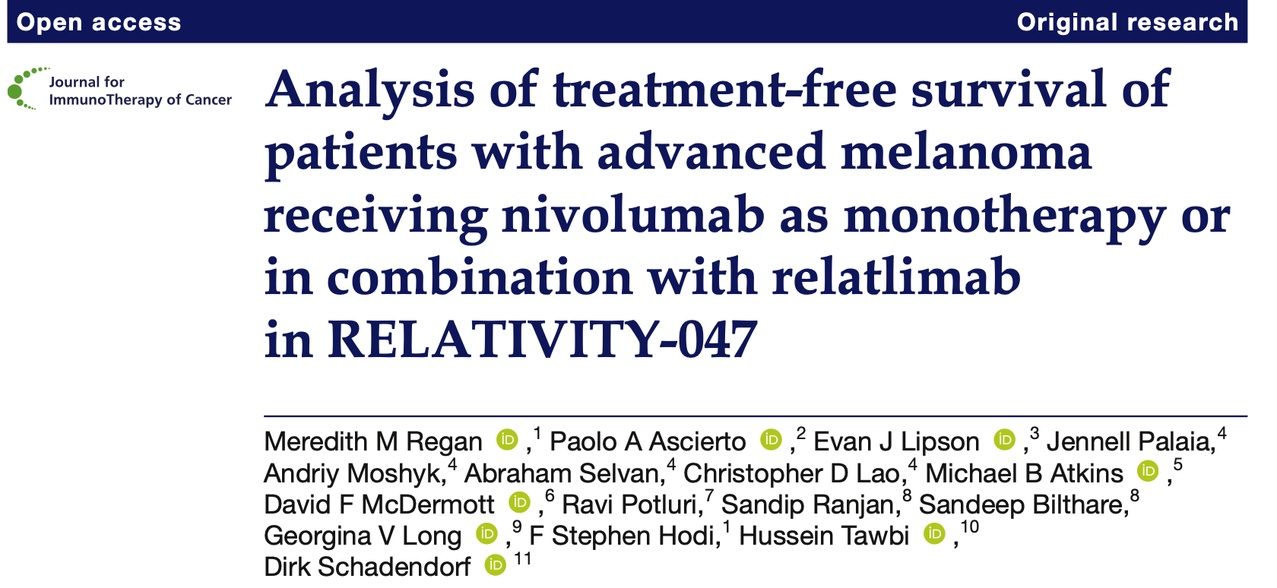
Regan et al. 2025 Journal for Immuno Therapy of Cancer

Slide 10
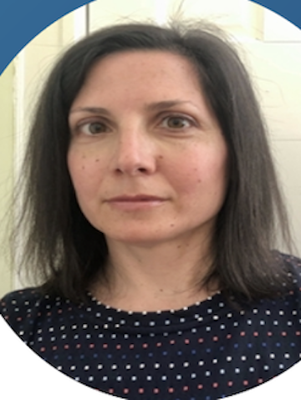


Overview of the course
Goal: Participants can immediately apply the RMST methods in practice when appropriate.
Instructors:
Angel Cronin
Xiang Meng
Hajime Uno
Notes:
Each session pairs clear concepts with worked examples and R code, enabling participants to apply the methods immediately. This training session is designed for clinical researchers, seeking interpretable, modern tools for time-to-event data.

Slide 11

Schedule
Date | Contents
2025-11-05 (120 min) | Part 1: Estimation of between-group difference Limitation of Hazard Ratio RSMT definition Examples
2025-11-12 (120 min) | Part 2: More on RMST Power considerations Study design Regression analysis Stratified analysis Other applications of RMST
Each includes
10 min break
Demo and exercise using R (all materials are on the DS Training webpage)
Feedback and Q&A

