Slide 1
Chapter-2-NameServices

Slide 2
Introduction
In a distributed system, names are used to refer to a wide variety of resources such as: Computers, services, remote objects, and files, as well as users. Basic design issues for name services, such as the structure and management of the spaces of names recognized by the service and the operations that the name service supports, are outlined and discussed in the context of the Internet Domain Name Service.
Couloris,Dollimore and Kindberg Distributed Systems: Concepts & Design Edn. 4 , Pearson Education 2005

Slide 3
Introduction
Resources are accessed using identifier or reference An identifier can be stored in variables and retrieved from tables quickly. Identifier includes or can be transformed to an address for an object. E.g. NFS file handle, CORBA remote object reference.
Couloris,Dollimore and Kindberg Distributed Systems: Concepts & Design Edn. 4 , Pearson Education 2005

Slide 4
Introduction
A name is human-readable value (usually a string) that can be resolved to an identifier or address. Internet domain name, file pathname, process number E.g ./etc/passwd, http://www.cdk3.net/
Couloris,Dollimore and Kindberg Distributed Systems: Concepts & Design Edn. 4 , Pearson Education 2005

Slide 5
Introduction
URL
http://www.cdk3.net:8888/WebExamples/earth.html
DNS lookup
Resource ID (IP number, port number, pathname)
138.37.88.61
8888
WebExamples/earth.html
ARP lookup
file
(Ethernet) Network address
2:60:8c:2:b0:5a
Socket
Web server
Figure 1. Composed naming domains used to access a resource from a URL
Couloris,Dollimore and Kindberg Distributed Systems: Concepts & Design Edn. 4 , Pearson Education 2005

Slide 6

Introduction
You need to name an entity in order to use it.
If you don’t have a name or don’t know a name you should be able to describe its characteristics in order to identify it.
According to these two requirements we have two services:
  Naming service
  Directory service

Slide 7
Naming Service
Given the name of a resource, returns the information about the resource.
For example consider the white pages(http://www.whitepages.com/ ): given the name of a person you get the address/telephone number of that person.
Other examples: LDAP (Lightweight Directory Access Protocol) a person on UB(University of Buffalo http://ldap.buffalo.edu/ ) computers gives you information about the person’s email, campus address, phone number, position held etc.

Slide 8

Directory Service
Given a description, find a service or resource that matches the description.
For example consider the yellow pages( http://www.yellowpages.com/ ): when you want to rent a car, it may give a list of car rental agencies.

Slide 9
Directory Services
A more powerful service than naming where you look up for names using the attributes than the other way.
Clients can Lookup for services by providing their attributes rather the name.
A discovery service provides registry and lookup for spontaneous networking.
Registry is used by server to publish a service and lookup is used by a client to locate a service.

Slide 10
Overview of Domain Name System
Domain Name System is a hierarchical distributed database
DNS is the foundation of the Internet naming scheme
DNS supports accessing resources by using alphanumeric names
InterNIC(network information center) is responsible for managing the domain namespace
DNS was created to support the Internet’s growing number of hosts

Slide 11
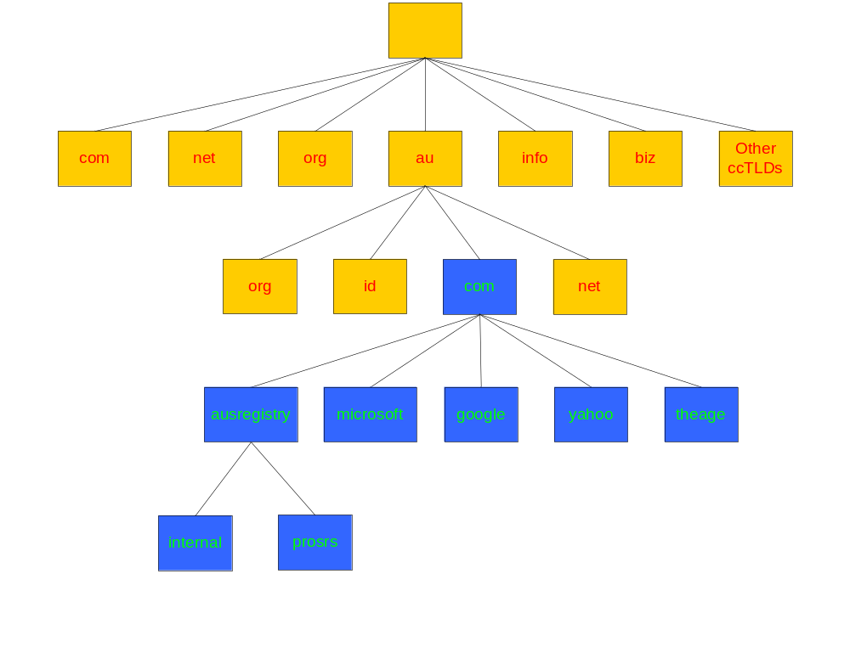
Domain com.au
The ausregistry.com.au sub-domain of com.au

Slide 12
Name Spaces
A name space is a collection of all valid names
recognized by a particular service
Allow simple but meaningful names to be used
Potentially infinite number of names
Structured
  to allow similar subnames without clashes/conflict
  to group related names
Allow re-structuring of name trees
  for some types of change, old programs should continue to work
Management of trust

Slide 13

What Is a Domain Namespace?
Root Domain
Top-Level Domain
net
com
org
Second-Level Domain
nwtraders
Subdomain
west
south
east
sales
FQDN(fully qualified domain name ):
SERVER1.sales.south.nwtraders.com
Host: SERVER1

Slide 14
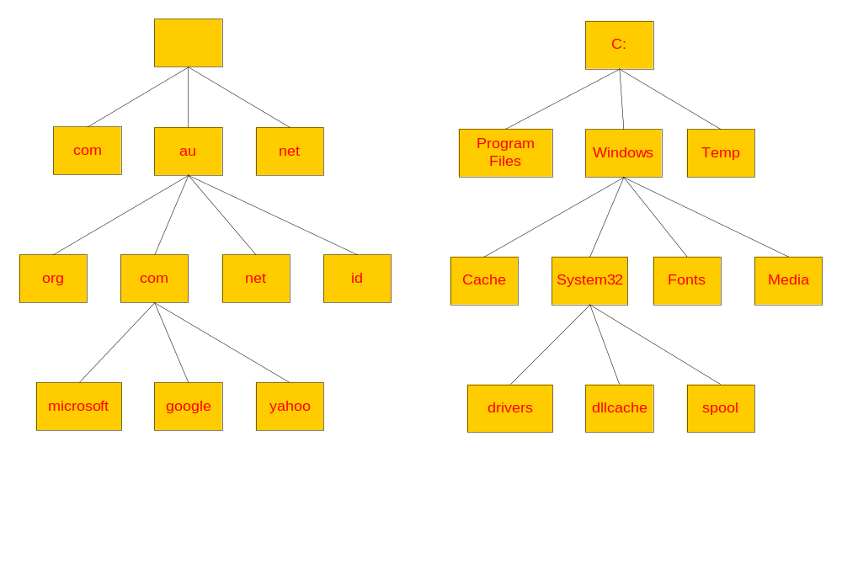
DNS vs File System

Slide 15
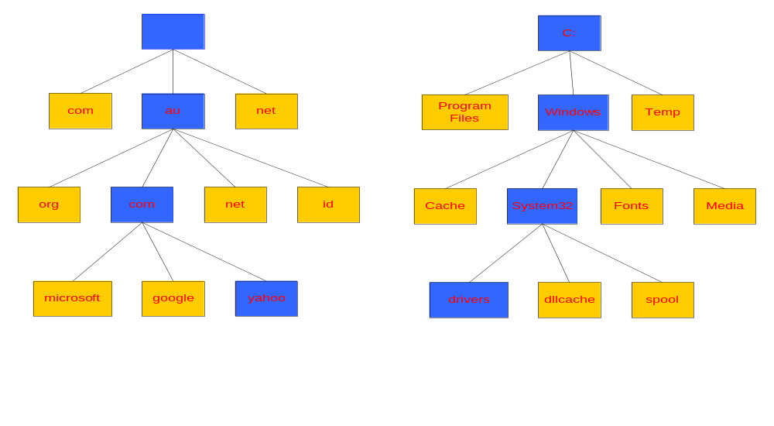
Naming a Domain Naming a Directory
Start Here
Start Here
C:\windows\system32\drivers\
yahoo.com.au.
A “.” is used as separator
A “\” is used as separator

Slide 16
Standards for DNS Naming
The following characters are valid for DNS names:
A through Z
a through z
0 through 9
Hyphen (-)
The underscore (_) is a reserved character
Nameservers are provided by web hosts, and they’re key to your website being visible on the web.

Slide 17








What Are the Components of a DNS Solution?
DNS Clients
DNS Servers
DNS Servers on the Internet
Resource
Record
Root “.”
.com
.edu
Resource
Record

Slide 18
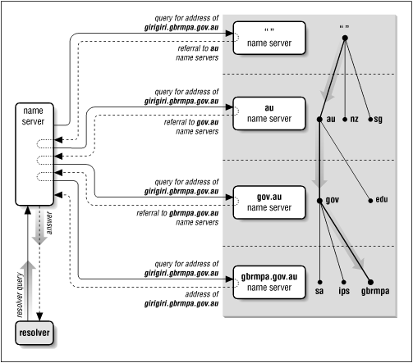
DNS – How it works?

Slide 19
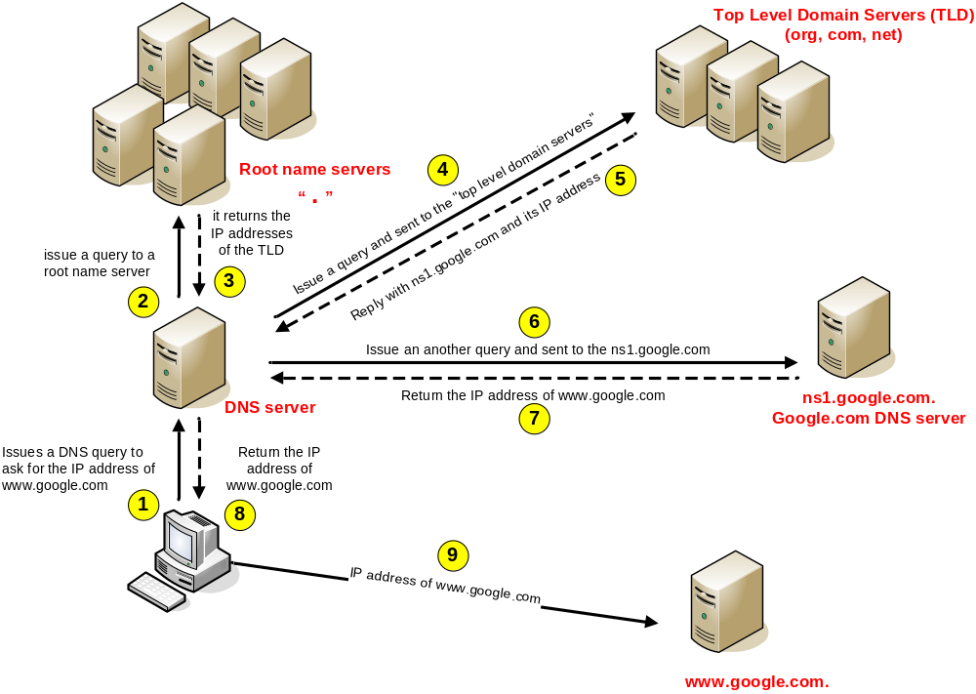
DNS – How it works (mechanism)

Slide 20
What Is a DNS Query?
A query is a request for name resolution and is directed to a DNS server
Queries are recursive or iterative
DNS clients and DNS servers both initiate queries
DNS servers are authoritative or nonauthoritative for a namespace
An authoritative DNS server for the namespace will either:
  Return the requested IP address
  Return an authoritative “No”
A nonauthoritative DNS server for the namespace will either:
  Check its cache
  Use forwarders ( external dns names to the server outside of that network.)
  Use root hints
  they have a cache file that is constructed from all the DNS lookups it has performed in the past for which it has gotten an authoritative response
Resolution is an iterative process whereby a name is repeatedly presented to the naming contexts

Slide 21



How Recursive Queries Work
A recursive query is sent to a DNS server and requires a complete answer
mail1.contoso.msft
Database
172.16.64.11)
DNS Client
Local DNS Server

Slide 22



How Iterative Queries Work
An iterative query directed to a DNS server may be answered with a referral to another DNS server
Local
DNS Server
Root Hint (.)
Iterative Query
Ask .com
Iterative Query
.com
Ask nwtraders.com
Recursive Query
mail1.nwtraders.com
172.16.64.11
Iterative Query
Authoritative Response
Nwtraders.com
Client Server

Slide 23

How Forwarders Work
A forwarder is a DNS server designated to resolve external or offsite DNS domain names
Iterative Query
Forwarder
Root Hint (.)
Ask .com
Iterative Query
Ask nwtraders.com
.com
Recursive Query
172.16.64.11
Iterative Query
172.16.64.11
Authoritative Response
Recursive query for
mail1.nwtraders.com
Nwtraders.com
Local
DNS Server
Client Server

Slide 24




How Root Hints Work
Root hints contain the IP addresses for DNS root servers
Root (.) Servers
DNS Servers
Root Hints
com
DNS Server
microsoft
Client

Slide 25


How DNS Server Caching Works
DNS server cache
Host name | IP address | TTL
ServerA.contoso.msft | 192.168.8.44 | 28 seconds
Where’s ServerA?
ServerA is at 192.168.8.44
ServerA
Client1
ServerA is at 192.168.8.44
Where’s ServerA?
Client2

Slide 26
What is a resource record?
A domain contains resource records
Resource records are analogous to files
Classified into types
Some of the important types are SOA, NS, A, CNAME and MX
Normally defines in “zone files”

Slide 27
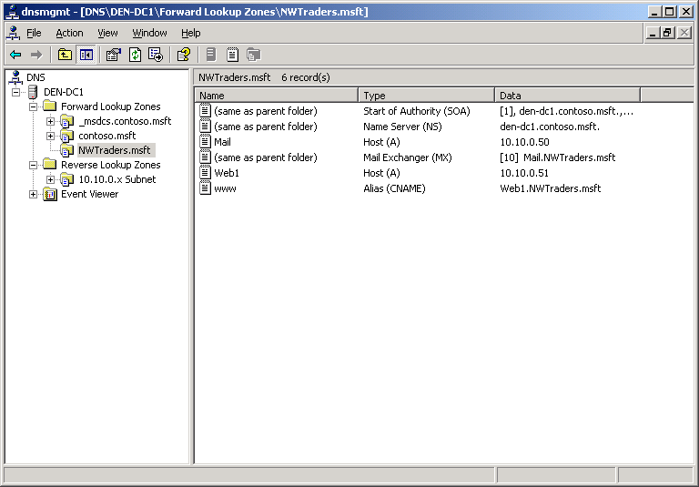
What Are Resource Records and Record Types?
Type | Description
A(address) | Resolves a host name to an IP address
PTR | Resolves an IP address to a host name(same as reverse lookup)
SOA(start of authority) | The first record in any zone file
SRV | Resolves names of servers providing services
NS(name server) | Identifies the DNS server for each zone
MX(mail exchange) | The mail server
CNAME(cannonical name) | Resolves an alias to a host name

Slide 28
The “A” Record
The “Address” record
To which ip address it should be forwarded
One or more normally defines a host
Contains an IPv4 Address (the address computers use to uniquely identify each other on the internet)
Eg. For example, you could enter the IP address 216.168.224.69 in your Web browser to reach the Network Solutions® website, or you could simply enter www.NetworkSolutions.com.

Slide 29
The “CNAME” Record
A CNAME defines an alias
The alias will then be resolved, if another CNAME is encountered then the process continues until an A record is found
Eg. The record:
You have a website with the domain name mywebsite.nl. This domain name is hooked up to an A-record which translates the domain name to the appropriate IP address, i.e 11.22.33.444.
You also have several subdomains, like www.mywebsite.nl, ftp.mywebsite.nl, mail.mywebsite.nl etc. and you want this sub domains to point to your main domain name mywebsite.nl. In stead of creating A-records for each sub domain and binding it to the IP address of your domain, you create an alias, a CNAME-record. See the table below, in case your IP address changes, you only have to edit 1 A-record and all subdomains follow automatically because de CNAMES point to the main domain with the A-record.

Slide 30
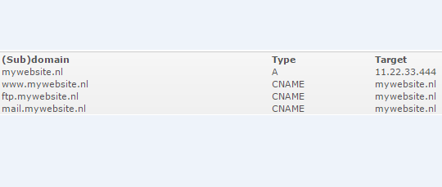

Slide 31
The “MX” Record
An MX record defines the mail servers for a particular domain
Mail eXchange records hold the name of hosts, and their priorities, able to deliver mail for the domain.
Eg. The record:
ausregistry.com.au MX 10 mail
In the ausregistry.com.au domain, defines the host mail to be the priority 10 mail server for the “ausregistry.com.au” domain

Slide 32
The “NS” Record
An NS record defines the authoritative Name servers for the domain.
The “Name Server” records also define the name servers of children domains
Eg. The record:
internal NS ns1.hosting.com.au.
In the ausregistry.com.au domain, defines the host “ns1.hosting.com.au” to be a name sever for the “internal.ausregistry.com.au” sub-domain

Slide 33
What is a zone?
A DNS zone is any distinct, contiguous portion of the domain name space in the Domain Name System (DNS) for which administrative responsibility has been delegated to a single manager.
A zone file is a small set of instructions for resolving specified Internet domain names to the appropriate number form of an Internet Protocol address (an IP address). These instructions are ordinarily quite simple and reside in a file on the server that administers a site.
The total of all DNS zones, which are organized in hierarchical tree like order of cascading lower level domains for the DNS namespace.

Slide 34
What is a zone?
Its records are held in a database (“zonefile”) and served from an authoritative name server
Zone refers to all the resource records in a domain but not its sub domains, the com.au zone contains delegations records for ausregistry.com.au, but not the resource records for ausregistry.com.au, however all of these records are part of the com.au domain

Slide 35
What Are DNS Zone Types?
Zones | Description
Primary | Read/write copy of a DNS database
Secondary | Read-only copy of a DNS database
Stub | Copy of a zone that contains only records used to locate name servers. They don’t contain entire copy of primary zone DNS database
Active Directory integrated | Zone data is stored in Active Directory rather than in zone files

Slide 36



What Are Forward and Reverse Lookup Zones?
Namespace: training.nwtraders.msft
Forward zone (common name to ip ) | Training | DNS Client1 | 192.168.2.45
 |  | DNS Client2 | 192.168.2.46
 |  | DNS Client3 | 192.168.2.47
Reverse zone( ip to common name) | 2.168.192.in-addr.arpa | 192.168.2.45 | DNS Client1
 |  | 192.168.2.46 | DNS Client2
 |  | 192.168.2.47 | DNS Client3
DNS Server Authorized
for training
DNS Client2 = ?
192.168.2.46 = ?
DNS Client3
DNS Client1
DNS Client2

Slide 37
What is a Delegation?
Delegation refers to the act of putting NS records in a domain name “delegating” control of a sub-domain to another entity
This entity then has the ability to control the resource records in this sub-domain and delegate further children domains to other entities.
Eg. IANA( Internet assign number authority ) delegating control of a country code domain to the country.

Slide 38
How DNS Zone Transfers Work
A DNS zone transfer is the synchronization of authoritative DNS zone data between DNS servers
1
SOA query for a zone
2
SOA query answered
3
IXFR or AXFR query for a zone
4
IXFR or AXFR query answered
(zone transferred)
Secondary server
IXFR: incremental zone transferred
AXFR(asynchronous transfer full range): mechanism for replicating DNS data across DNS servers
Primary and
master server

Slide 39
How DNS Notify Works
A DNS notify is an update to the original DNS protocol specification that permits notification to secondary servers when zone changes occur
Resource record is updated
1
Destination Server
Source Server
2
SOA serial number is updated
3
DNS notify
4
Zone transfer
Secondary Server
Primary and
Master Server

Slide 40




How to Secure Zone Transfers
Restrict zone transfer to specified servers
Encrypt zone transfer traffic
Consider using Active Directory integrated zones
Primary Zone
Secondary Zone

