Slide 1
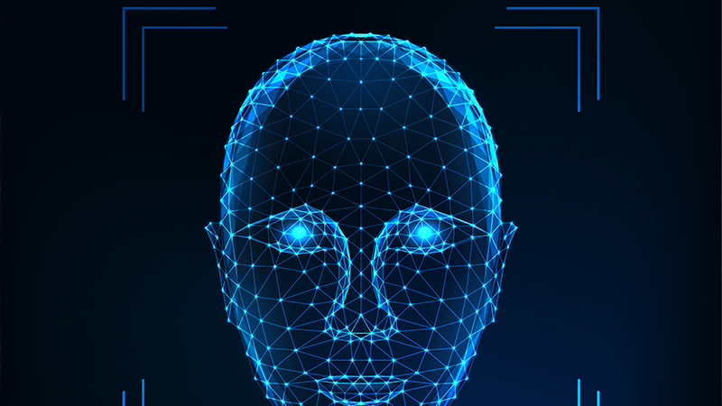
Face Recognition based Attendance System

Slide 2
Table of Content
Introduction
Models Used
Working
Applications

Slide 3
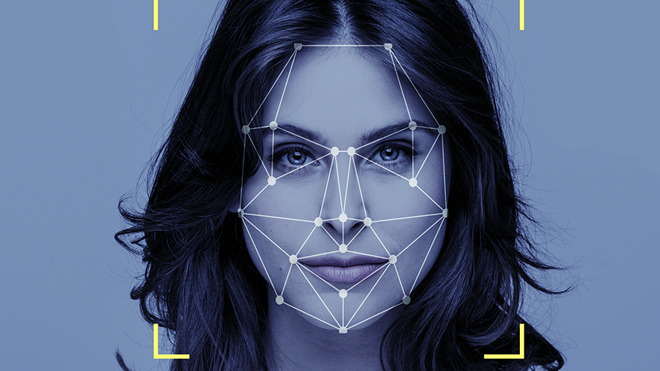
Introduction
The program takes input from the camera and detects the faces in then frame and marks the time of detection, if and only if the faces are real.

Slide 4
Technologies Used
Face Detection Uses Multi Task Cascaded Convolution Neural Networks for Feature Extraction and Detection The model is trained on Widerface-Retinaface Dataset, which contains over 30000 faces.
Anti Spoofing A Similar CNN model is used which detects light intensity, small facial features like pores and depths etc. using fourier spectrum.

Slide 5
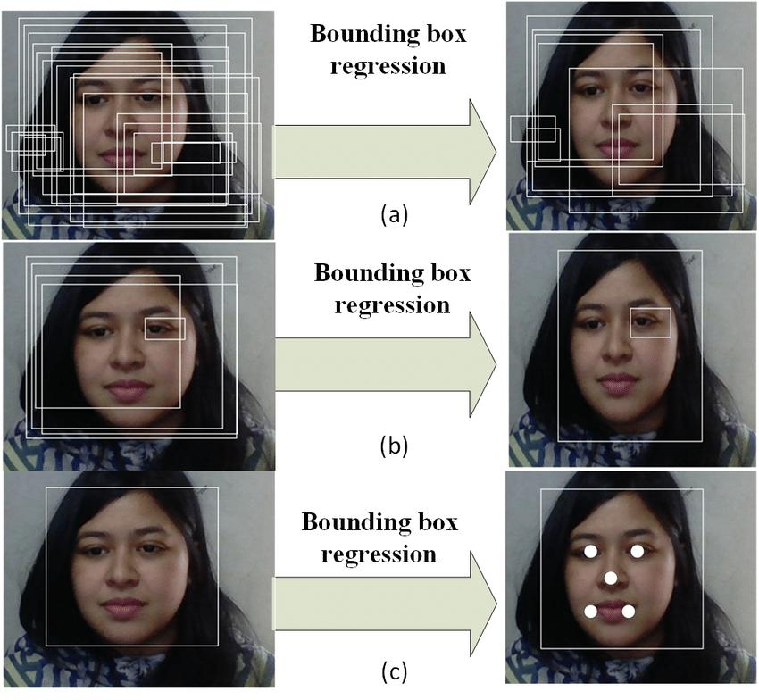
MTCNN
First stage: The P-Net (Proposal Network) is the first subnet of MTCNN. It performs bounding box regression to find suitable candidate frame.
Second stage: The full name of R-Net is Refine-network. Here, the constraint conditions are mainly added, and the face prediction frame is screened again by the added constraints. The frames with low scores are discarded.
Third stage: The O-network (Output) performs the final refinement of the bounding boxes. It is similar to R-Net. It selects the best candidate frame and outputs the 5 facial features namely Left Eye, Right Eye, Nose, Left Mouth Corner and Right Mouth Corner.

Slide 6
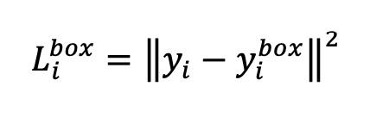
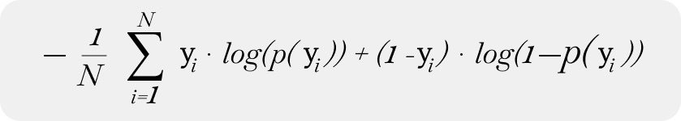
Loss Functions
Euclidean Loss Function: Used for bounding box regression.
Cross Entropy Loss Function: Used for Classification.

Slide 7
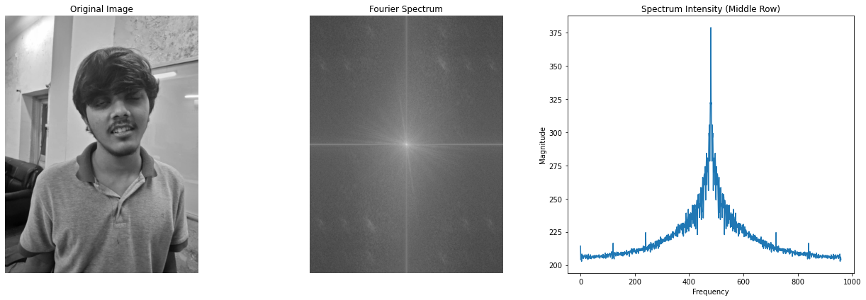
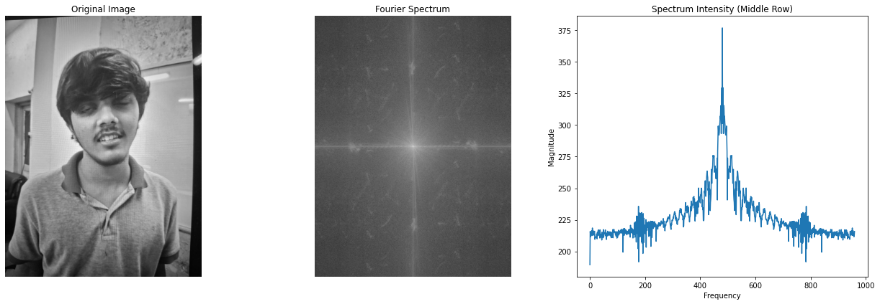
How Anti Spoofing Works
We are using fourier spectrum to detect if the given image is real or fake.
The CNN captures both high and low frrequency components and uses them to distinguish between real or fake images. The high frequency components represent sharp edges which spoofed image don't have(because they have no depth).
Also the intensitites of frequencies in Spoofed images are higher than the actual image mainly because of reflections.
It also uses micro-texture analysis to identify if given image has appropriate inconsistency in texture or not. Papers and screens generally tend to have consistent texture.

Slide 8
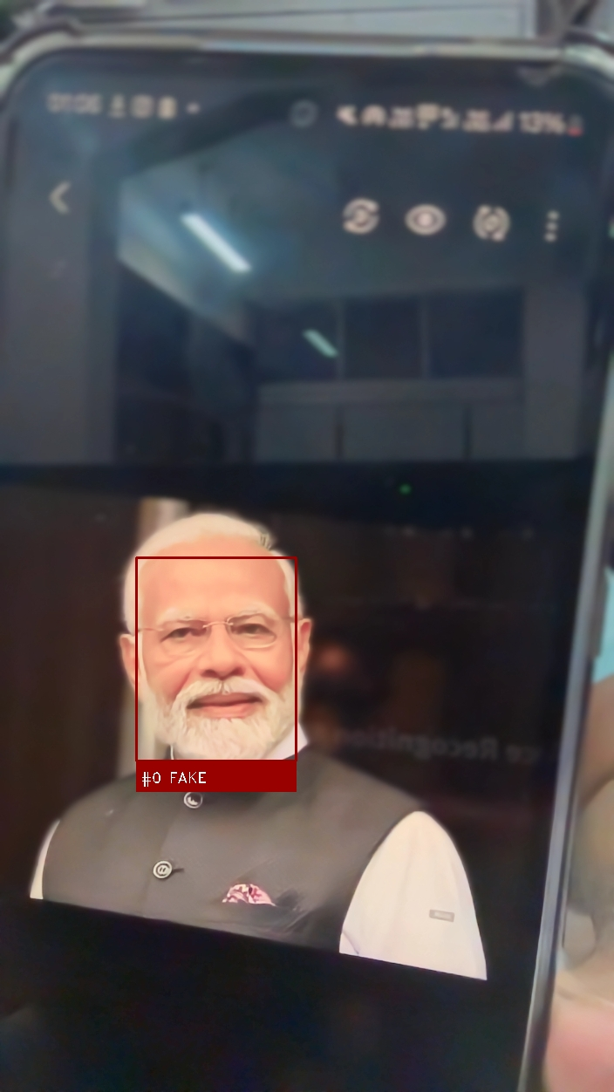
Applications
Educational Institutions: Secure attendance tracking in classrooms.
⁠Corporate Environments: Monitoring employee attendance accurately.
⁠Event Management: Ensuring authenticity in guest registrations.
Security: Keeps record of every known person and may raise alarm if somone unauthorised access the premises.

Slide 9

Thank you
TEAM: AUM
Name: 1. Aryan Dhankhar 2. Utkarsh Narayan Pandey 3. Mayank Jain

