Slide 1
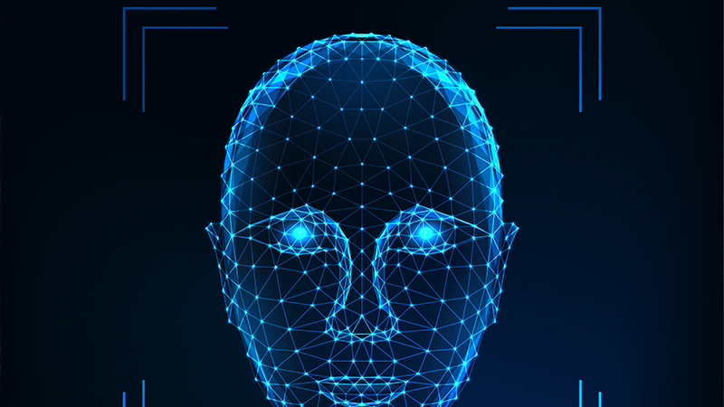
Face Recognition based Attendance System

Slide 2
Table of Content
Introduction
Models Used
Working
Applications

Slide 3
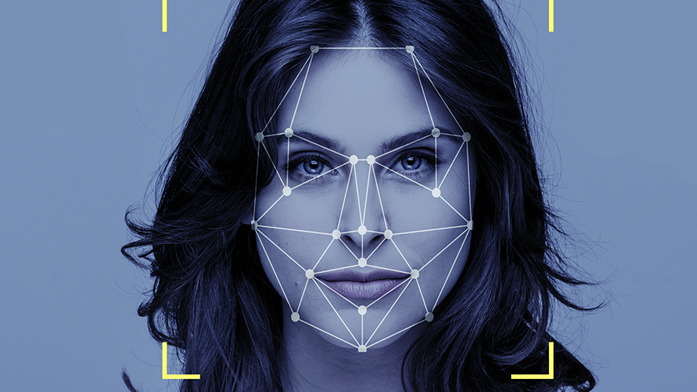
Introduction
The program takes input from the camera and detects the faces in then frame and marks the time of detection, if and only if the faces are real.

Slide 4
Technologies Used
Face Detection Uses Convolution Neural Networks for Feature Extraction and Detection The model is trained on Widerface-Retinaface Dataset, which contains over 30000 faces.
Anti Spoofing A Similar CNN model is used which detects light intensity, small facial features like pores and depths etc. using fourier spectrum.

Slide 5
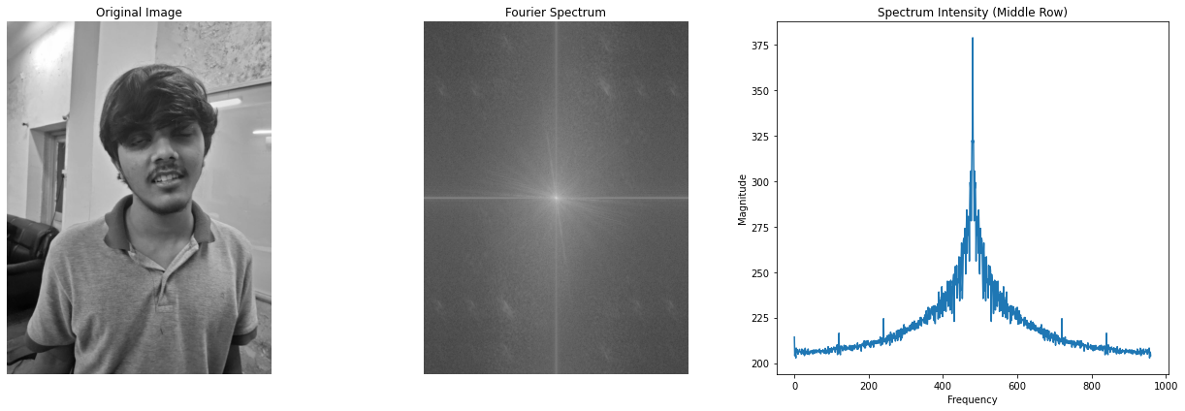
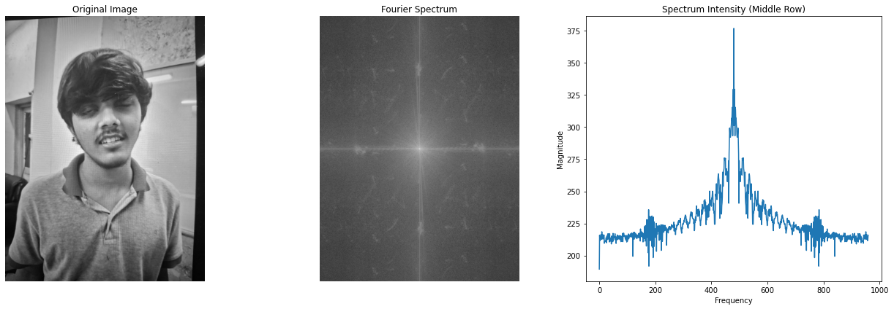
How Anti Spoofing Works
We are using fourier spectrum to detect if the given image is real or fake.
The CNN captures both high and low frrequency components and uses them to distinguish between real or fake images. The high frequency components represent sharp edges which spoofed image don't have(because they have no depth).
Also the intensitites of frequencies in Spoofed images are higher than the actual image mainly because of reflections.
It also uses micro-texture analysis to identify if given image has appropriate inconsistency in texture or not. Papers and screens generally tend to have consistent texture.

Slide 6
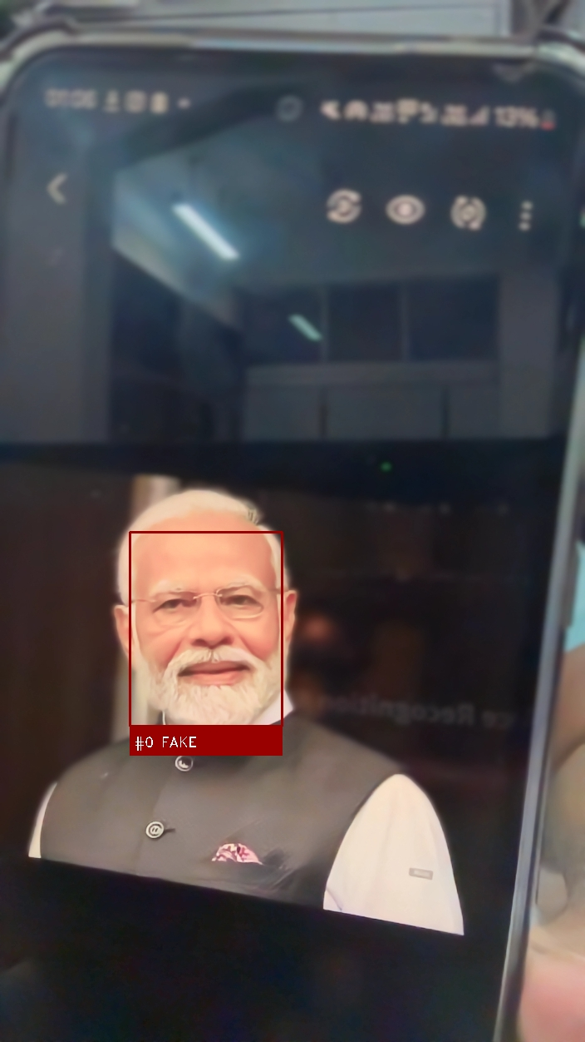
Applications
Educational Institutions: Secure attendance tracking in classrooms.
⁠Corporate Environments: Monitoring employee attendance accurately.
⁠Event Management: Ensuring authenticity in guest registrations.
Security: Keeps record of every known person and may raise alarm if somone unauthorised access the premises.

Slide 7

Thank you
TEAM: AUM
Name: 1. Aryan Dhankar 2. Utkarsh Narayan Pandey 3. Mayank Jain

