Slide 1
Intro Week
Blockchain Intuition 🤷🏽‍♀️👩‍🦯

Slide 2
Blockchain Intuition
Hashing
🔢🧮🤯

Slide 3
Good News First 🥳🎊🎉
No math needed for understanding blockchain
Only 1 “math-like” concept:
Hashing
But we don’t need to understand the algorithm behind, just get a general intuition …

Slide 4
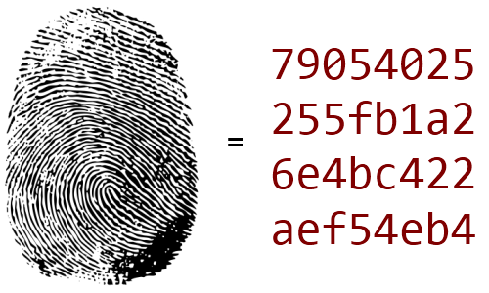
Hashes are like fingerprints 🤞🏻 for data
every 👱🏼 has a 🤞🏻
🤞🏻 don’t change over time (🤞🏻👶 = 🤞🏻👨‍🦳)
only very very few 👩🏽‍🦰👨‍🦲👵🏻 have same 🤞🏻
wouldn’t it be cool if we had the same for data? 🧐
… as you might guess 🤓, we have: 🕺
sha256: Bitcoin network
sha3 (kecca256): Ethereum network

Slide 5
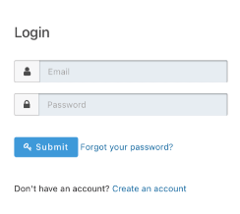
Think about Passwords
Setup
Server stores:
 | user_name | salt | hash
🧑🏼‍🦰 | jane | c674dh | f56086b5cf01f8aaeb80d573f7d6f852d53eabdae5bed449f371fa99a5f59798
👨‍🦳 | john | xg8923 | c0ad5411b19cfcba9d674d21411a970159f6ae4e180831ddd6a91797be547752
… | … | … | …
Login
1. 👨‍🦳 types: “john” & “1234” 👨‍💻
2. Server: hash(“1234”+xg8923) = c0ad5411b19cfcba9d674d21411a970159f6ae4e180831ddd6a91797be547752 ?
3. If True: let 👨‍🦳 in. Otherwise: “Sorry 👨‍🦳, your password is wrong.”
… and in case of Database Hack 🦹🏼
No passwords were stolen 💪

Slide 6
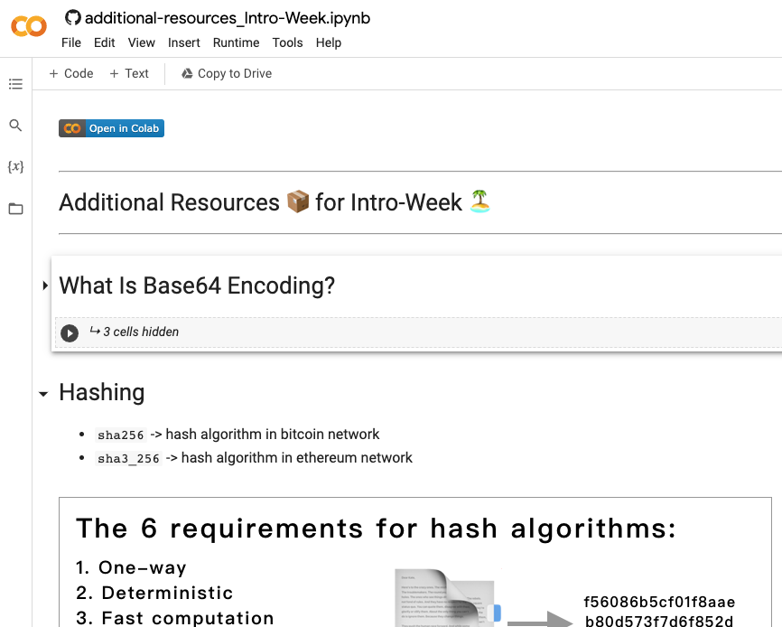

Live Coding 👨‍💻
Hashing
Notes:
Jupyter Notebook on Github 👉🏻 click on Colab Badge (or: https://colab.research.google.com/github/unpackAI/BL101/blob/main/course_notebooks/Week_1_Hello_Blockchain/mentors/additional-resources_Intro-Week.ipynb)
Go to chapter HASHING in notebook
No setup of libraries
You can go thru the 6 requirements of hash algorithms and show it with running the cells

Slide 7
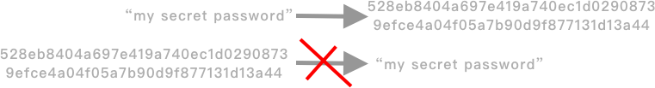

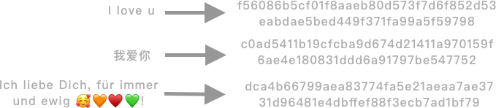
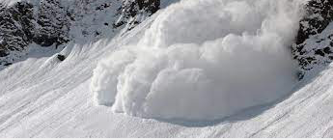
6 Requirements for Hash Algorithms
1. One-Way
2. Deterministic
3. Fast Computation
4. Always same output format
Current Bitcoin Global Hashrate
197.83 ExaHash/sec
( ≈ 200,000,000,000,000,000,000 Hash / sec)
5. Avalanche Effect
6. Must withstand collision
🚗💥🚙
Notes:
“Any hashing algorithms should have a few useful characteristics.”
5. “The Avalanche Effect means that a tiny little change in the input value should result in a completely different hash value”
6. One example here:

Slide 8
Blockchain Intuition
Mining
⛰⛏

Slide 9
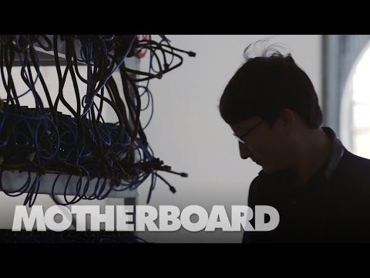
Inside a secret Chinese Bitcoin Mine (2014)
Source: https://www.youtube.com/watch?v=K8kua5B5K3I
🌏 Changcheng, Dalian 🇨🇳
📆 Oct 2014
💰 4k BTC (1.5 Mio$) / Month
🍰 ca. 3% of all BTC

Slide 10
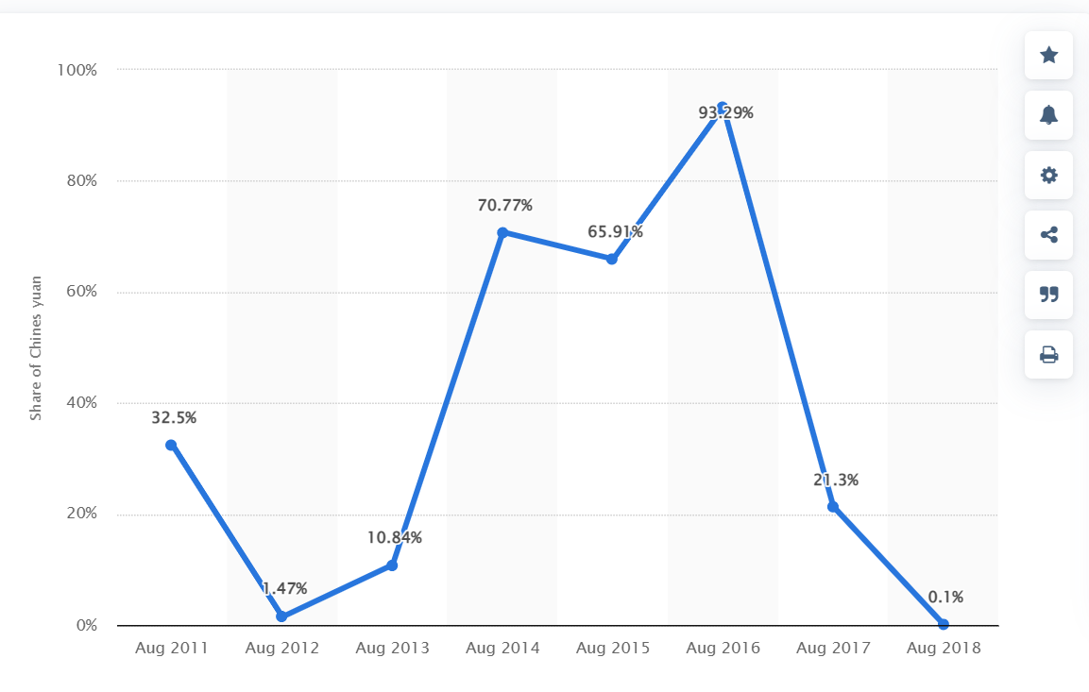
Crypto Ban in China 🇨🇳👮🏼‍♀️✋🏻🏔⛏
China's share in Bitcoin transactions declined 80% post crackdown
Food Delivery = environmentally unfriendly
S
💥
(Source: Statista)

Slide 11

Inside the Largest Bitcoin Mine in U.S. (2021)
Source: https://www.youtube.com/watch?v=x9J0NdV0u9k
🌏 Rockdale, Texas 🇺🇸
📆 2021
💰 60 Mio$ Revenue / Month
⚡️750 Megawatts Capacity
🍰 ca. 0.8% of all BTC
👷‍♀️ 120 Employees (three 8h-shifts per day)

Slide 12
Live Coding 👨‍💻
Mining
Notes:
Jupyter Notebook on Github 👉🏻 click on Colab Badge (or: https://colab.research.google.com/github/unpackAI/BL101/blob/main/course_notebooks/Week_1_Hello_Blockchain/mentors/additional-resources_Intro-Week.ipynb)
The code shows sample algorithm of mining blocks for bitcoins -> you can show how the mining success depends on the “leading zeros” for the hash.

