Slide 1

Agricultural Automated Irrigation System
-Unmesh Phaterpekar
1

Slide 2
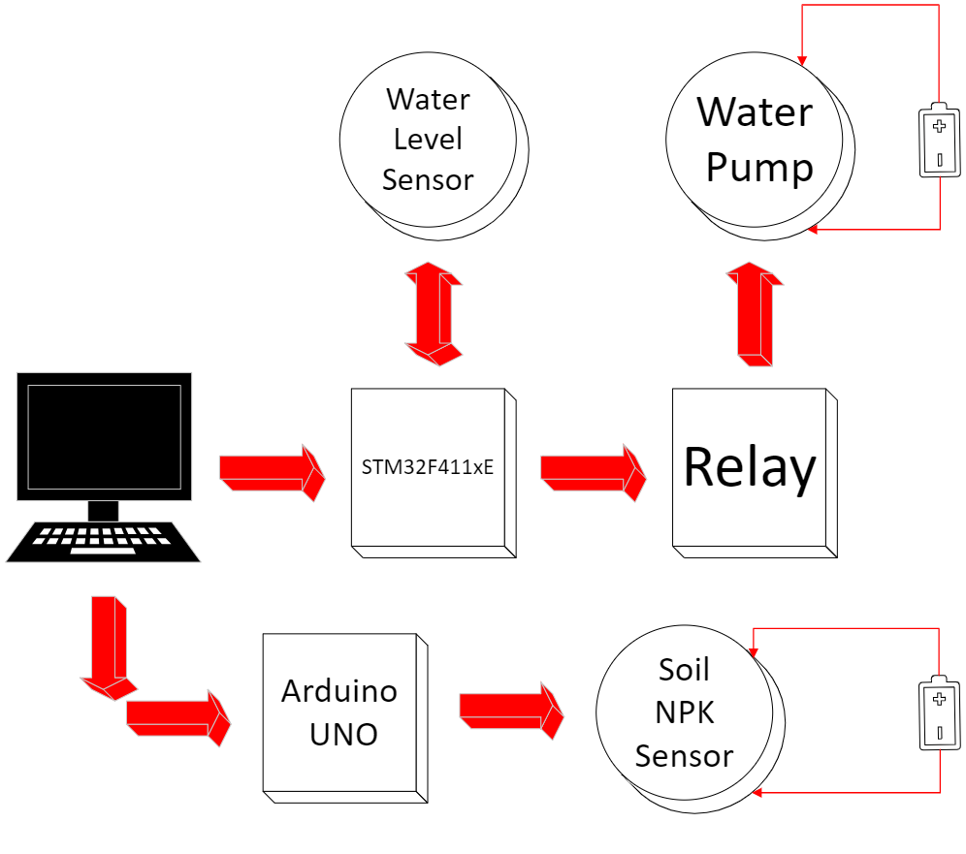
Overview
The primary goal of the project is to implement automated irrigation systems that detect soil moisture content and determine if sufficient water is present for optimal plant growth, or if external watering is necessary. Additionally, the detection of nutrient content, including nitrogen, phosphorus, and potassium, plays a significant role.
-Unmesh Phaterpekar
2

Slide 3
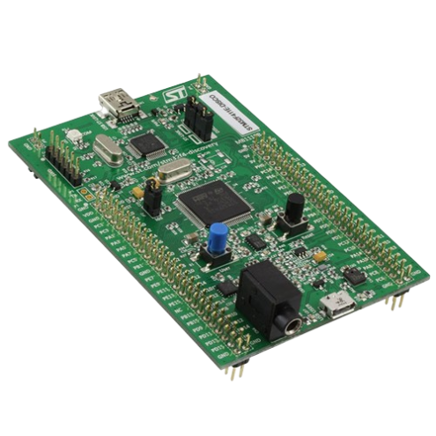
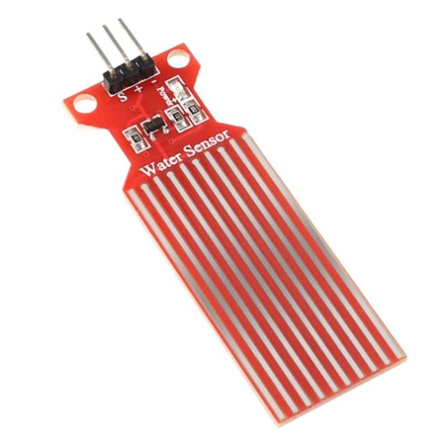
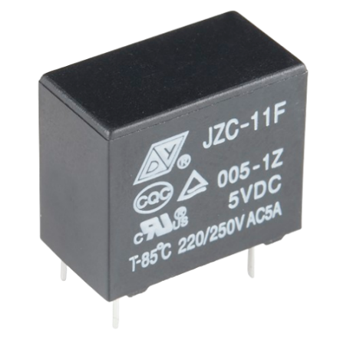
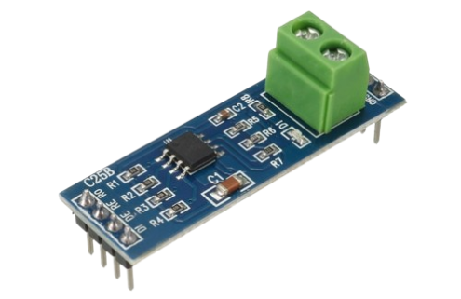
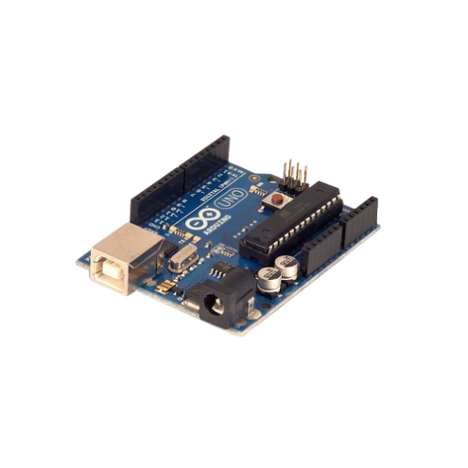
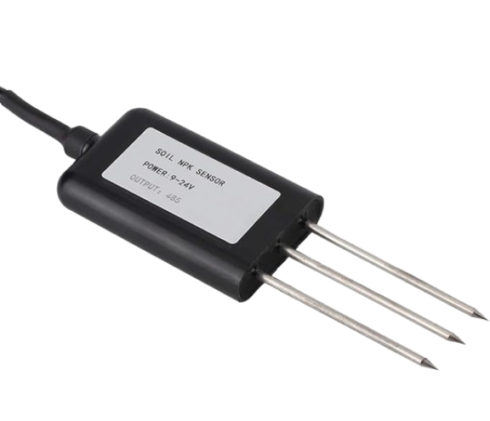
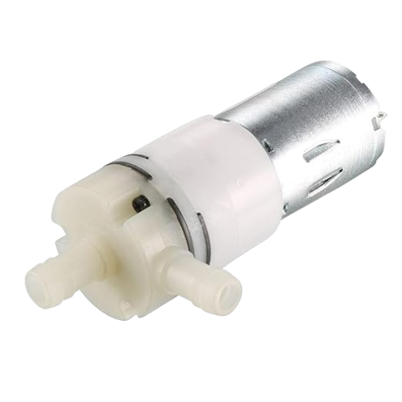
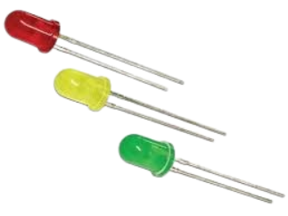
Hardware Components
5V Dc Relay
RS485 to TTL converter
Water Level Sensor
STM32F411xE
Soil NPK Sensor
Arduino UNO
12V Dc Water Pump
LEDS
-Unmesh Phaterpekar
3

Slide 4
Software Features
GPIO Initializations : For controlling the relay which is used to drive the water pump along with an external power source
ADC Initialization : Configured the ADC to read Analog values from the water level sensor and convert them into a digitally readable format
UART INITIALIZATION : To display the contents from the sensors onto the terminal window
MODBUS PROTOCOL : To interface with the soil NPK sensor which works on RS485 electrical standard
TIMER LIBRARIES : Used for implementing safety features like shutting off the pump after a certain time for periodic soil moisture checks
-Unmesh Phaterpekar
4

Slide 5
Challenges and Future Scope
CHALLENGES :
Initializing the ADC presented some difficulties
Encountered challenges in communicating with the STM32 using the Modbus Protocol; however, successful implementation of the protocol was achieved on Arduino
Although sending data to the STM32 sensor was feasible, receiving accurate data from it proved to be challenging
FUTURE SCOPE :
Interface with an LCD Screen or OLED Display to display the NPK contents
Add sensors for pH and temperature detection in the soil
Implement a GSM module to receive data directly on the phone and generate a command interface for automatic control of the water pump's power
-Unmesh Phaterpekar
5

Slide 6
Thank you!
-Unmesh Phaterpekar
6

