Slide 1
Retrieval-Augmented Generation for Universities
An AI-Powered Solution for Knowledge Management

Slide 2
Problem Statement
Universities manage vast amounts of knowledge stored across PDFs, text files, and documents.
Retrieving information quickly for students and faculty is challenging.
Lack of efficient tools leads to wasted time and productivity.

Slide 3
Why Do We Need RAG?
1. RAG combines retrieval of relevant data with generative models for precise answers.
2. Provides quick, context-based responses to queries.
3. Reduces manual search efforts for students and professors.

Slide 4
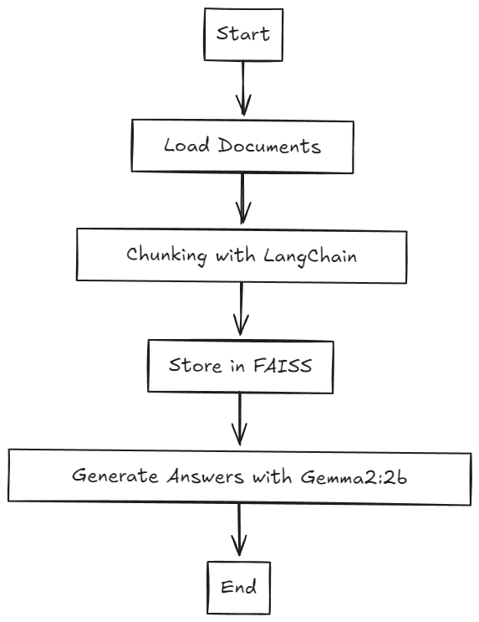
Workflow Diagram

Slide 5
Code Workflow Explanation
1. Documents are loaded using LangChain (PDFs, Texts, etc.).
2. Data is split into manageable chunks for efficient embedding.
3. FAISS stores vector embeddings of text using Ollama Embeddings.
4. Queries are retrieved, and answers are generated using Gemma2:2b.

Slide 6
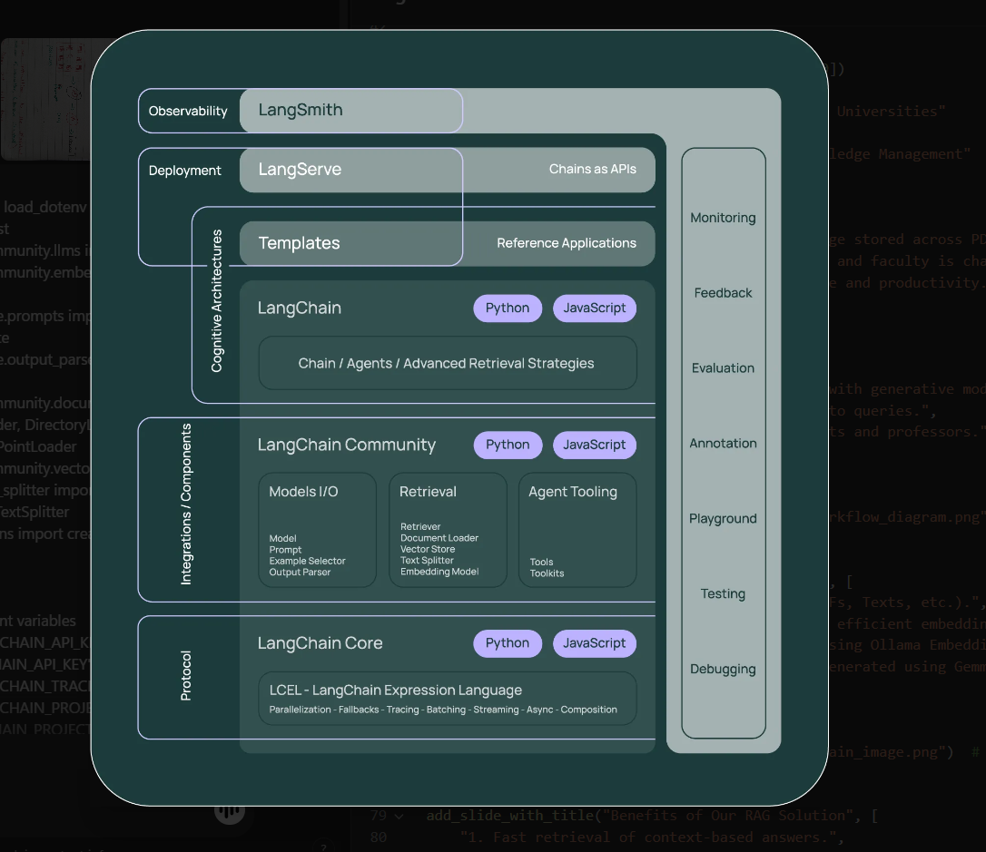
LangChain Integration

Slide 7
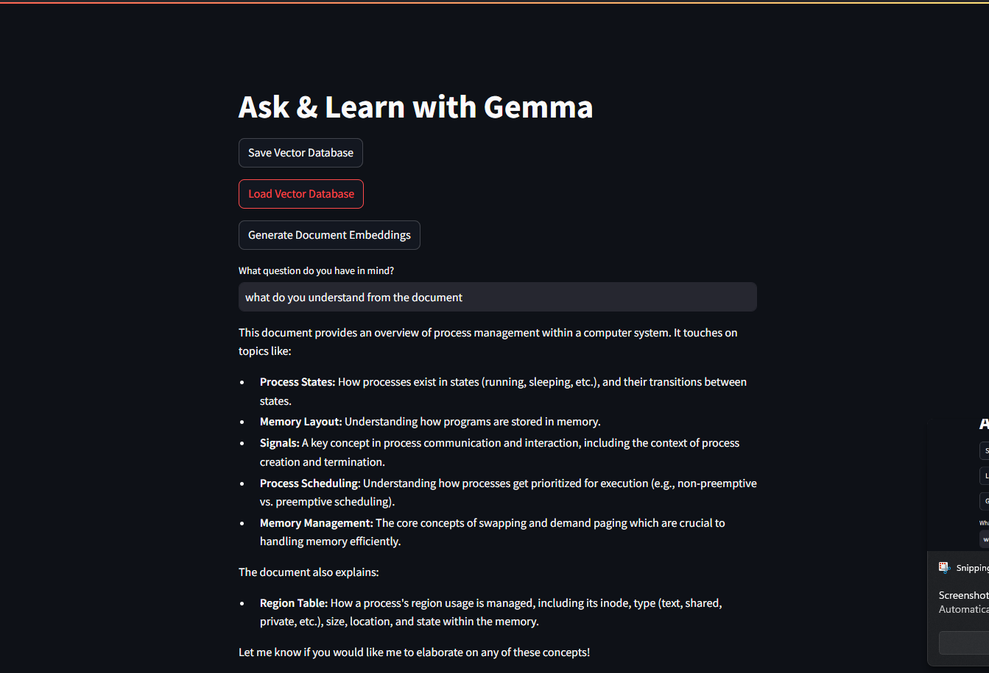
Benefits of Our RAG Solution
1. Fast retrieval of context-based answers.
2. Scalable for large document sets.
3. Saves time for research and study.
4. Integrates easily with modern LLMs.

Slide 8
Conclusion
Our RAG application for universities simplifies knowledge management.
It reduces time spent searching for information and provides precise, AI-generated answers.

