Slide 1
Lab 8 Analog to Digital Converter

Slide 2
What is an ADC?
Analog to digital converter.
Takes an analog values between 0-5V and convert it to a 10 bit unsigned int (0-1023).
Two serial ports 0-15 for reading analog input.
We can read the value from an analog inputs using all 16 pins or both analog ports.
We will be using ADCSRA, ADCSRB and ADMUX registers.

Slide 3
ADCSRA
Analog to digital register A.
Used for enabling and disabling ADC mode using ADEN.
Start Conversion using ADSC.
Use ADFR to select the free running mode or single conversion mode(use single conversion mode).
We will not be using interrupt in this lab.
Use the minimum pre-scaler.

Slide 4
ADCSRB
We will be using bit 3:0
Bit 3 (MUX5) is used for selecting the channel and gain bits.
Bits 2:0 to set free running mode.

Slide 5
ADMUX
Bit 7:6 are used for voltage reference ( use internal reference)
Reset the ADLAR for right adjustment.
Bit 2:0 is used for selecting the input channel(pin).
To select channel between 0-7 use MUX5 (ADCSRB) should be 0 and bit 2:0 should be assigned the value between 0-7.
To select channel 8-15 set the MUX5 (ADCSRB) and bit 2:0 should be assigned the value between 0-7.

Slide 6
ADC Read
Takes the channel as a argument
Assign the appropriate value to MUX5 and Admux bits 2:0.
Start the conversion by setting ADSC (ACDSRA).
Wait for the conversion to finish.
Return the value in ADC_DATA register.

Slide 7
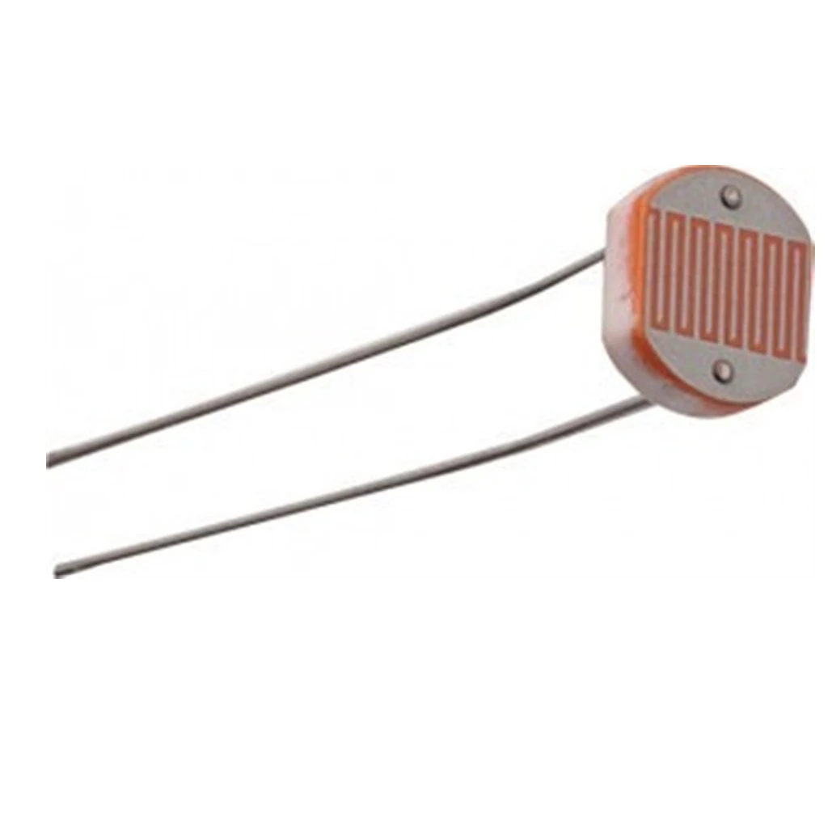
Photo-resistor
Light controlled variable resistor.
Resistance decreases with increase in light intensity.
Make a voltage divider using a coaxial resistor and connect it with your arduino.
Circuit diagram in lab manual.

Slide 8
What we are expecting
Full understanding of the ADC registers.
Functional code and circuit.
Should function with different input channels.

Slide 9
Tips
Important page 281- 289

