Slide 1
CPE 301
LAB #1

Slide 2
LAB #1
Lab reports will be due on the Monday following the lab
Lab report format
No more than 3 to a group, 2 is preferred
Individual work
Build your own circuits
Take your own pictures
Write your own reports

Slide 3
Lab Safety Quiz

Slide 4
Lab Equipment
Power Supply
Function Generator
Oscilloscope
Probes/Leads

Slide 5
Power Supply
3 fixed outputs, 1 Variable Input
Use the right leads

Slide 6
Function Generator
Generates waveforms
Sine, square, triangle
Two outputs
TTL
50 Ohm
Used for…
Diagnostics
Clock Sources
References
Use the right leads

Slide 7
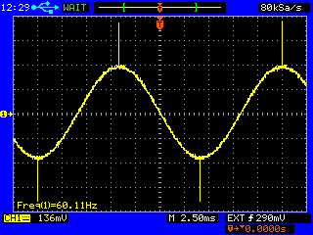
Oscilloscope
Generates a two dimensional plot of a signal, usually voltage over time
What is a signal?
Digital/Analog
Uses:
Shape/Amplitude/Frequency
Timing between two events
Observing noise

Slide 8
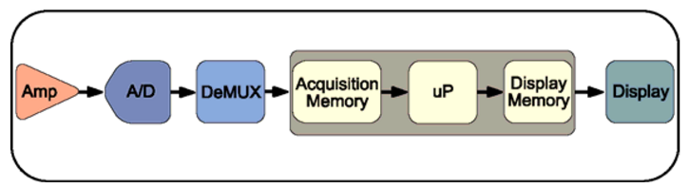
Oscilloscope
Acquiring a waveform:
Signal conditioning
A/D Conversion
Storing the samples in memory
Displaying the samples

Slide 9
Oscilloscope Characteristics
Bandwidth
Frequency range
Bandwidth > 5x the highest frequency that needs to be measured
Rise time
Edge speed
Scope rise time < (signal rise time / 5)
Sample rate
Nyquist –> sample rate = 2x highest signal frequency (minimum)
Tektronix–> sample rate = 5x highest signal frequency (marketing?)
Analog Engineers –> sample rate = 10x highest frequency (rule-of-thumb)
Record length
Number of samples stored for one waveform

Slide 10
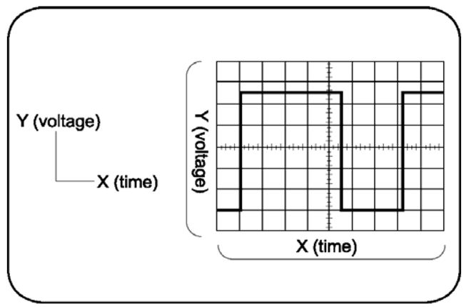
Oscilloscope Display

Slide 11
Oscilloscope Demo

