Slide 1
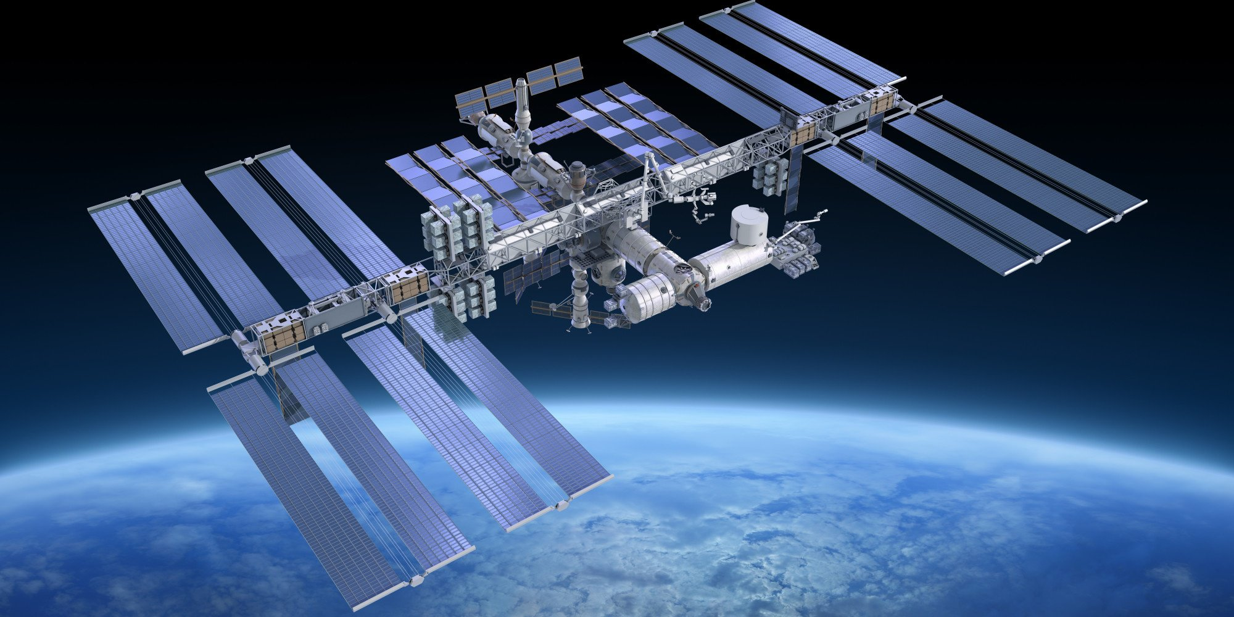
SRFP INTERNSHIP PRESENTATION
Deep Dielectric Charging in Spacecraft Solar Panels:
A Geant4 Simulation Study
[Tanishka Doiphode]
Indian Institute of Technology Indore
Guide: [Dr. Sandeep Kumar Kataria]
Department of Space, Planetary and Astronomical Sciences & Engineering (SPASE)
Indian Institute of Technology Kanpur
Department of Space, Planetary and Astronomical Sciences & Engineering · IIT Kanpur
Notes:
Introduce yourself briefly, state the project title, and mention this work was carried out as a B.Tech internship under [Guide Name] in the SPASE department. Keep this to a few sentences — the audience is technical, so move quickly to content.

Slide 2
INTRODUCTION
Motivation
The near-Earth space environment contains energetic electron populations, particularly within the Van Allen radiation belts and during geomagnetic storms.
These electrons range from surface-stopping keV energies to penetrating MeV energies capable of depositing charge deep within spacecraft materials.
Accumulated charge inside dielectric layers builds internal electric fields that are absent in ordinary surface charging.
If the internal field exceeds the material's breakdown strength, it can trigger an electrostatic discharge (ESD) event.
ESD events couple transient currents into spacecraft electronics, causing anomalies ranging from single-event upsets to permanent hardware failure.
Solar panels are especially exposed: large surface area, multilayer dielectric stack, and direct, continuous exposure to the space radiation environment.
SPASE · IIT KANPUR
02
Notes:
Set up the problem: energetic electrons in the space environment penetrate spacecraft materials and accumulate inside dielectric layers over time. Emphasize that this internal charge builds an electric field that can lead to dielectric breakdown or ESD, and that solar panels are particularly exposed due to their large area and multilayer construction. This slide motivates why the simulation study matters — keep it conceptual, not numerical.

Slide 3
SCOPE OF WORK
Objectives
01
02
Develop a Geant4-based simulation geometry representing a simplified multilayer satellite solar panel.
Model monoenergetic electron irradiation of the panel across a broad energy range (1 keV – 5 MeV).
03
04
Record primary interaction statistics and secondary particle production within each layer.
Extract total and layer-wise energy deposition, NIEL, and Total Ionizing Dose (TID) from simulation output.
05
06
Implement post-processing (ROOT-based) to convert deposited energy into charge accumulation, charge density, internal electric field, and potential difference.
Establish a reusable simulation-and-analysis framework for future deep dielectric charging studies.
SPASE · IIT KANPUR
03
Notes:
Walk through each objective as something that was actually accomplished during the internship: building the geometry, running the energy sweep, extracting the standard Geant4 outputs, and implementing the ROOT-based post-processing chain that converts energy deposition into charge, field, and potential. Frame this as the internship's engineering scope, not a research contribution.

Slide 4
FUNDAMENTALS
Spacecraft Charging: Background
Spacecraft charging refers to the accumulation of electric charge on or within spacecraft materials due to interaction with the space plasma and radiation environment. It is broadly classified into two regimes.
Surface Charging
Deep Dielectric Charging
Caused by low-energy plasma electrons and ions (eV – keV range).
Charge deposits on exterior conductive and dielectric surfaces.
Time scale: seconds to minutes.
Discharge typically occurs at or near the surface.
Caused by penetrating, high-energy electrons (tens of keV – several MeV).
Charge accumulates internally, within bulk dielectric layers.
Time scale: hours to days — charge builds up gradually.
Discharge can occur deep inside the material, often undetected until failure.
This project focuses specifically on deep dielectric charging, which is potentially more damaging to embedded electronics and solar cell structures.
SPASE · IIT KANPUR
04
Notes:
Distinguish surface charging from deep dielectric charging using the two cards: energy scale, charging location, timescale, and how each type discharges. Make clear that this project's focus is the deep dielectric case, since it is less directly observable through routine surface monitoring but can be more damaging.

Slide 5
UNDERLYING PHYSICS
Deep Dielectric Charging: Conceptual Picture
1
2
3
4
5
6
Electron
Penetration
→
Energy
Loss
→
Trapping
→
Charge
Accumulation
→
Electric Field
Formation
→
Electrostatic
Discharge
Electrons above a threshold energy penetrate beyond the surface and stop within the bulk of the dielectric layers.
As electrons lose energy via inelastic collisions, they are trapped at defect sites and grain boundaries within the material.
Trapped charge builds a local space-charge density, which in turn establishes an internal electric field.
If the field exceeds the dielectric breakdown strength, a rapid electrostatic discharge can occur, releasing energy into surrounding structures.
SPASE · IIT KANPUR
05
Notes:
Take the audience through the six-step conceptual chain: electrons penetrate the material, lose energy through collisions, become trapped at defect sites, and the resulting charge builds an internal field. If that field exceeds the material's breakdown strength, an electrostatic discharge results. Keep this at a conceptual level — no equations — since the audience already knows the underlying radiation physics.

Slide 6
WORKFLOW
Simulation Methodology
Electron
Beam
Particle
Transport
Material
Interactions
1
2
3
→
→
↓
Charge
Density
Charge
Accumulation
Energy
Deposition
6
5
4
←
←
↓
Electric
Field
Potential
Failure
Assessment
7
8
9
→
→
Geant4 handles beam definition through energy deposition; charge, field and potential are derived in post-processing.
SPASE · IIT KANPUR
06
Notes:
Present the nine-step methodology as the actual simulation-to-analysis pipeline: from electron beam definition through Geant4's particle transport and material interaction modelling, to energy deposition, and then into the post-processing stages (charge accumulation, charge density, electric field, potential) that ultimately inform a failure assessment. Clarify which stages happen inside Geant4 versus in the ROOT-based post-processing scripts.

Slide 7
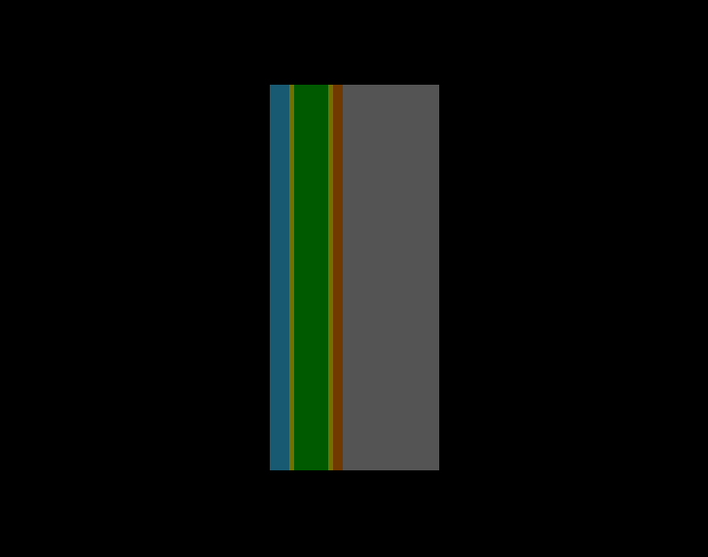
SIMULATION SETUP
Solar Panel Geometry
[Placeholder: Insert geometry schematic figure]
Layer | Material | Thickness
1 | SiO₂ Cover Glass | 100 μm
2 | Silicone Adhesive | 25 μm
3 | Silicon Solar Cell | 180 μm
4 | Silicone Adhesive | 25 μm
5 | Kapton Insulation | 50 μm
6 | Aluminium Substrate | 500 μm
 | Total thickness | 0.88 mm
Panel dimensions: 2 mm × 2 mm · Beam incidence: along +X, centered on panel
SiO₂ Adhesive Silicon Kapton Aluminum
SPASE · IIT KANPUR
07
Notes:
Describe the six-layer panel stack in beam order: SiO2 cover glass, silicone adhesive, silicon solar cell, a second silicone adhesive layer, Kapton insulation, and an aluminium substrate, with the table giving exact thicknesses. Mention the panel's lateral dimensions and that the beam is centered and starts upstream of the cover glass. The schematic placeholder will hold the actual geometry rendering.

Slide 8
SIMULATION SETUP
Simulation Parameters
INCIDENT ELECTRON ENERGIES
Parameter | Value
Primary particle | Electron
Number of primaries | 2000 per simulation
Beam size | 1 mm × 1 mm, centered on panel
Beam direction | +X, starting before SiO₂ layer
Beam distance from panel | 1.5 mm
Number of energies simulated | 15, from 1 keV to 5 MeV
1 keV
5 keV
10 keV
20 keV
30 keV
50 keV
75 keV
100 keV
150 keV
200 keV
300 keV
500 keV
1 MeV
2 MeV
5 MeV
Energy range spans from surface-stopping (1 keV) to fully penetrating (5 MeV)
electrons, covering both surface and deep dielectric charging regimes.
SPASE · IIT KANPUR
08
Notes:
Go through the simulation parameters table: electron primaries, beam size and direction, and the software used. Then point to the energy chips and note that the sweep spans 1 keV to 5 MeV across 15 discrete energies — deliberately covering both surface-stopping and fully penetrating regimes so the same framework captures both charging mechanisms.

Slide 9
SIMULATION SETUP
Simulation Outputs
Quantity | Why it matters
Secondary particle production | Characterizes delta rays / bremsstrahlung generated during transport.
Primary interaction statistics | Quantifies scattering and energy-loss events along the primary track.
Total energy deposition | Overall energy absorbed by the panel per incident electron.
Layer-wise energy deposition | Identifies which layer absorbs the dose — input to charge profiling.
Non-Ionizing Energy Loss (NIEL) | Relates to displacement damage in solar cell material.
Quantity | Why it matters
Total Ionizing Dose (TID) | Standard metric for radiation-induced degradation risk.
Charge accumulation | Net trapped charge per layer, derived from deposition data.
Charge density | Spatial distribution of trapped charge within each layer.
Electric field | Internal field computed from the accumulated charge density.
Potential difference | Indicates proximity to the dielectric breakdown threshold.
SPASE · IIT KANPUR
09
Notes:
Summarize everything the simulation records, split across the two tables. For each quantity, briefly explain why it is useful — e.g., layer-wise deposition tells you where charge builds up, NIEL and TID relate to degradation risk, and charge density, field, and potential are the derived quantities that ultimately indicate how close the panel is to a discharge event. This sets up the results to be shown in later slides.

Slide 10
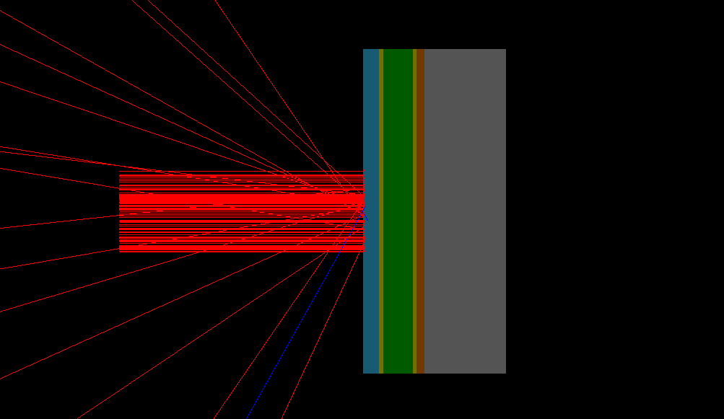
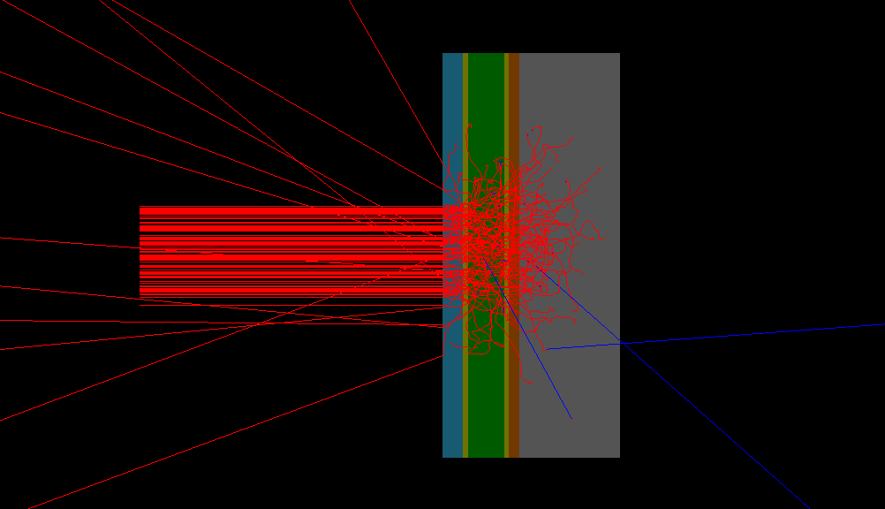
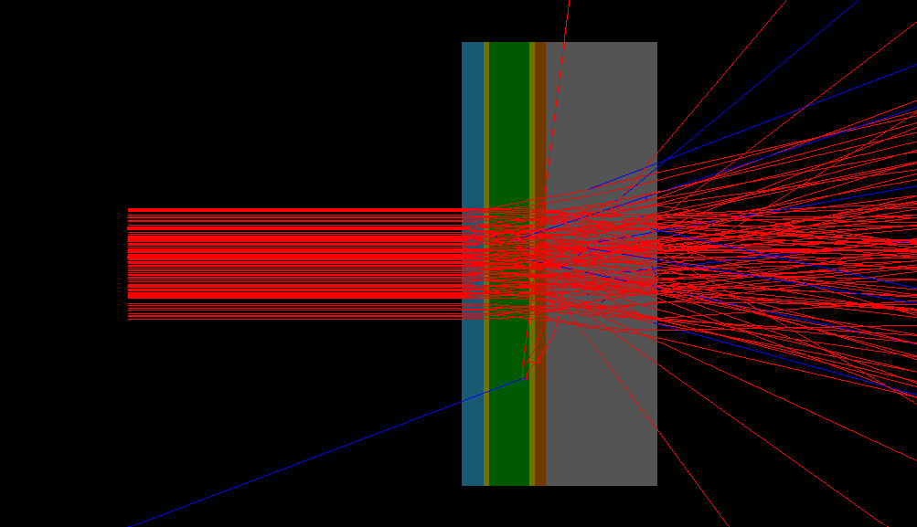
RESULTS
Analysis Display
Primary electrons (red trajectories) undergo multiple scattering and progressively penetrate deeper with increasing incident energy. Secondary gamma particles (blue trajectories), generated through electromagnetic interactions, are produced only in small numbers and contribute minimally to the overall transport.
The three cases illustrate the effect of increasing incident energy:
50 keV: interactions remain confined to the upper SiO2 layer.
500 keV: electrons penetrate through multiple material interfaces.
5 MeV: most primaries traverse the entire panel with comparatively lower energy deposition per unit depth.
[Placeholder: Insert graph here]
[Placeholder: Insert graph here]
[Placeholder: Insert graph here]
50 keV
500 keV
5 MeV
SPASE · IIT KANPUR · RESULTS
10
Notes:
Explain that secondary particles arise from primary electron interactions and are tracked because they redistribute energy away from the primary track, affecting layer-wise deposition and downstream charging estimates. Introduce the five recorded quantities. For the graphs: if the totals show an increasing or non-monotonic trend with incident energy, note that this reflects how higher-energy primaries can produce more energetic secondary showers up to a point. Compare electron vs. gamma secondaries to indicate the relative importance of ionization versus bremsstrahlung channels at each energy — without asserting which dominates until the plotted data is available.

Slide 11
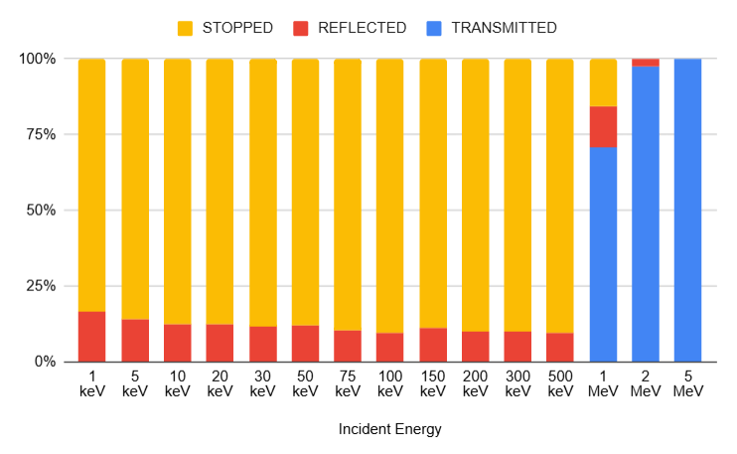
RESULTS
Primary Interaction Statistics
These fractions describe how incident energy governs electron penetration and escape from the multilayer panel.
Transmitted
Primary electrons that pass completely through the multilayer structure.
Reflected
Primary electrons backscattered out of the panel without full transmission.
ABSORBED VS ENERGY
[Placeholder: Insert graph here]
Absorbed
Primary electrons that stop and deposit their energy within the structure.
SPASE · IIT KANPUR · RESULTS
11
Notes:
Define transmission, reflection, and absorption as the three possible fates of a primary electron in the panel. Note that at low incident energies, electrons are expected to be absorbed within the first layers since they cannot penetrate far; at high energies, transmission becomes more relevant depending on whether the electron range exceeds the total panel thickness. Depending on what the graphs show, point out the energy at which the transmitted fraction becomes significant, and use the reflected-fraction plot to discuss backscatter contribution. Avoid stating specific crossover energies until the plots are inserted.

Slide 12
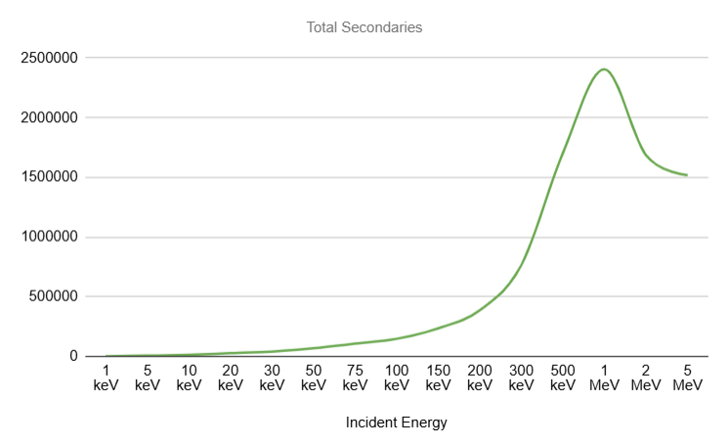
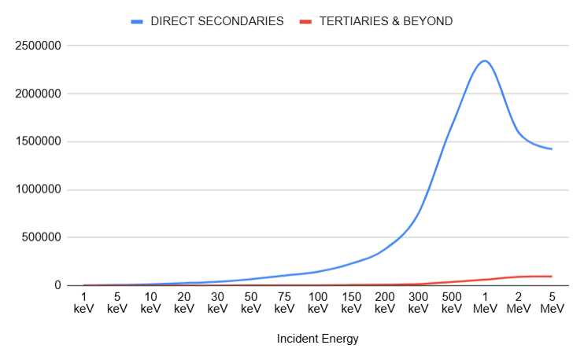
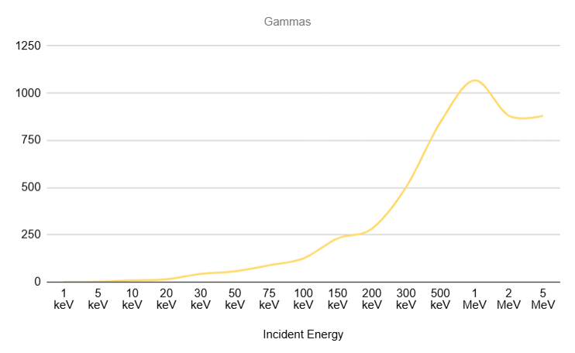
RESULTS
Secondary Particle Production
Secondary particles are electrons, photons, and further-generation particles produced as the primary electron beam interacts with the multilayer structure. Their yield and type influence how energy and charge are distributed within the panel.
Total Secondaries
Electron Secondaries
Gamma Secondaries
Direct Secondaries
Tertiary Particles
[Placeholder: Insert graph here]
[Placeholder: Insert graph here]
[Placeholder: Insert graph here]
TOTAL SECONDARIES VS ENERGY
DIRECT SECONDARIES & TERTIARIES VS ENERGY
GAMMA SECONDARIES VS ENERGY
SPASE · IIT KANPUR · RESULTS
11
Notes:
Explain that secondary particles arise from primary electron interactions and are tracked because they redistribute energy away from the primary track, affecting layer-wise deposition and downstream charging estimates. Introduce the five recorded quantities. For the graphs: if the totals show an increasing or non-monotonic trend with incident energy, note that this reflects how higher-energy primaries can produce more energetic secondary showers up to a point. Compare electron vs. gamma secondaries to indicate the relative importance of ionization versus bremsstrahlung channels at each energy — without asserting which dominates until the plotted data is available.

Slide 13
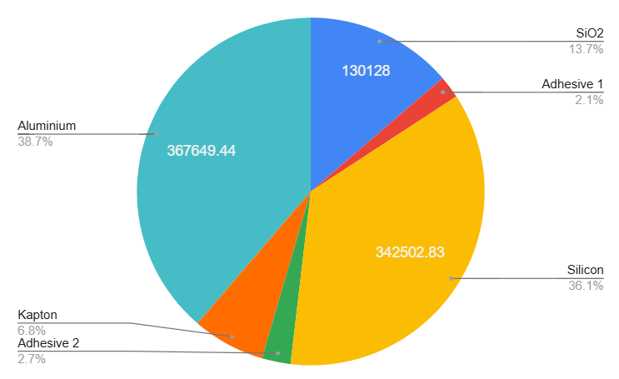
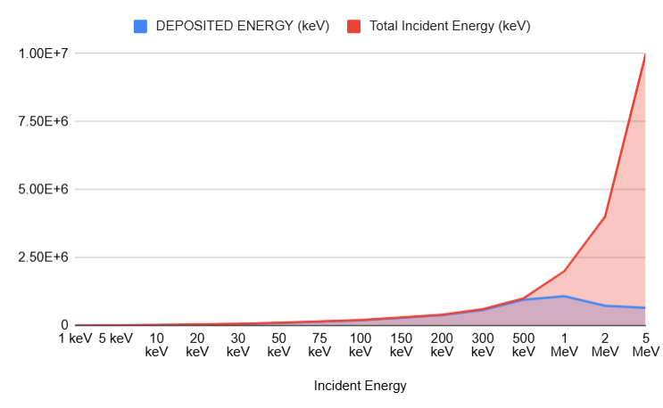
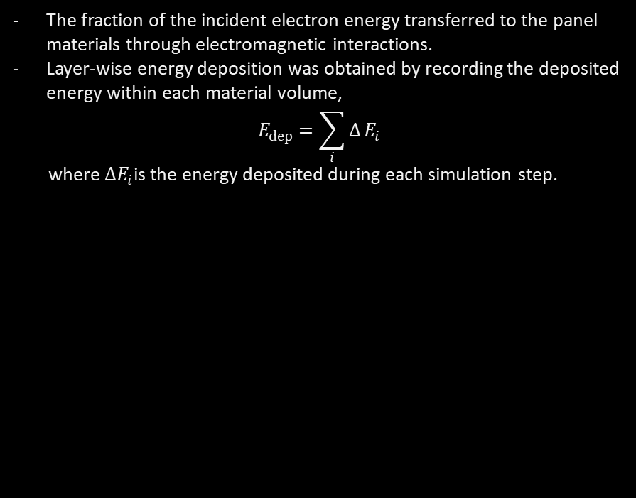
RESULTS
Energy Deposition
LAYER-WISE ENERGY DEPOSITION
The fraction of the incident electron energy transferred to the panel materials through electromagnetic interactions.
Layer-wise energy deposition was obtained by recording the deposited energy within each material volume,
$$E_{dep}=\sum_{i}{Δ}E_{i}$$
where $ΔE_{i}$is the energy deposited during each simulation step.
Energy | 500 keV
Number of primaries | 2000
Total incident energy | 1,000,000 keV
Energy deposited | 949,769 keV
The results identify the dominant absorbing layers and show how the location of maximum energy deposition shifts with increasing incident electron energy.
12
13
Notes:
Explain energy deposition as the fraction of incident energy retained in the panel, and why it underlies every downstream quantity in this study (dose, NIEL, charge). Clarify that the total deposition plot gives one number per energy, while the layer-wise plot resolves the same quantity per layer. When presenting the layer-wise plot, invite the audience to compare which layer dominates deposition at low versus high incident energy — this plot allows comparison across layers without needing to state a conclusion here.

Slide 14
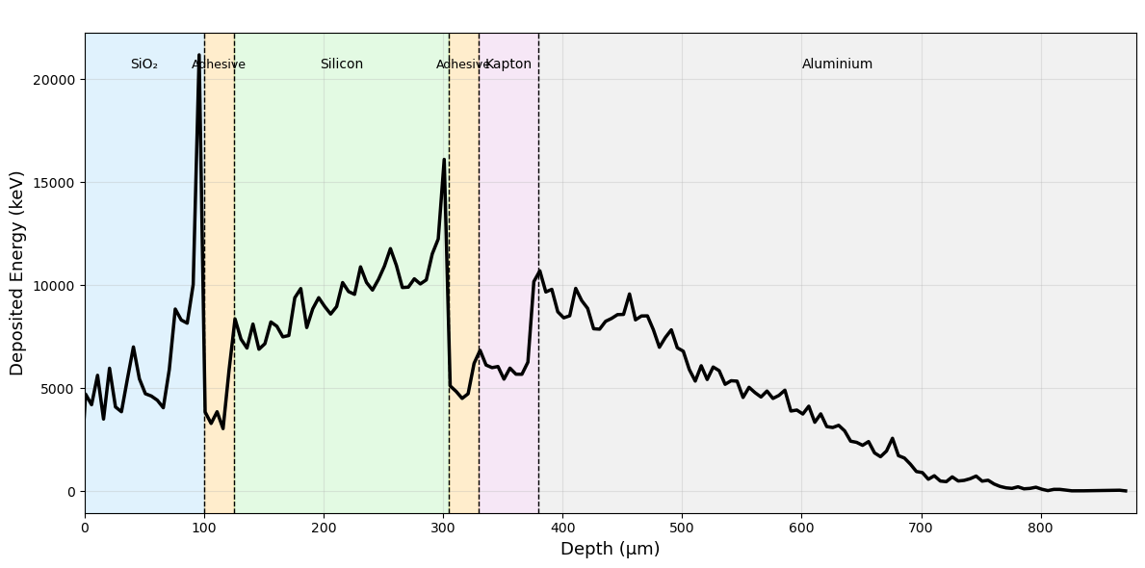
RESULTS
Depth Dose Profile
A depth-dose profile resolves deposited energy as a function of depth into the panel, rather than as a single integrated value.
Comparing profiles across energies shows which layers are exposed to peak dose under different space-environment conditions.
SPASE · IIT KANPUR · RESULTS
13
Notes:
Explain that a depth-dose profile shows how deposited dose varies with depth into the panel, rather than being collapsed into a single number. Note that electron range — and therefore the depth of peak dose — increases with incident energy, so profiles for different energies are expected to peak at different depths. When the representative plots are shown, guide the audience to compare where the peak dose falls relative to the layer boundaries for a few selected energies, without stating specific depths in advance.

Slide 15
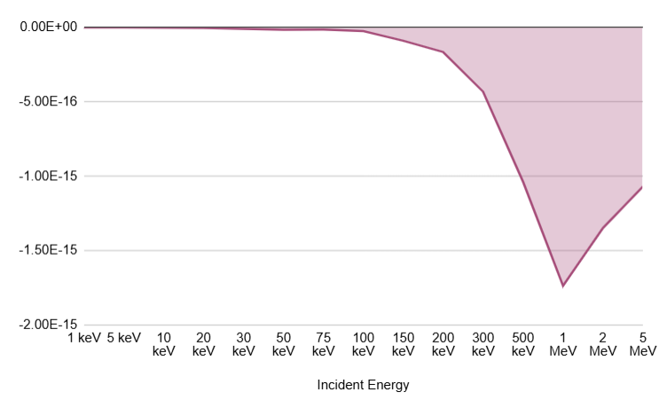
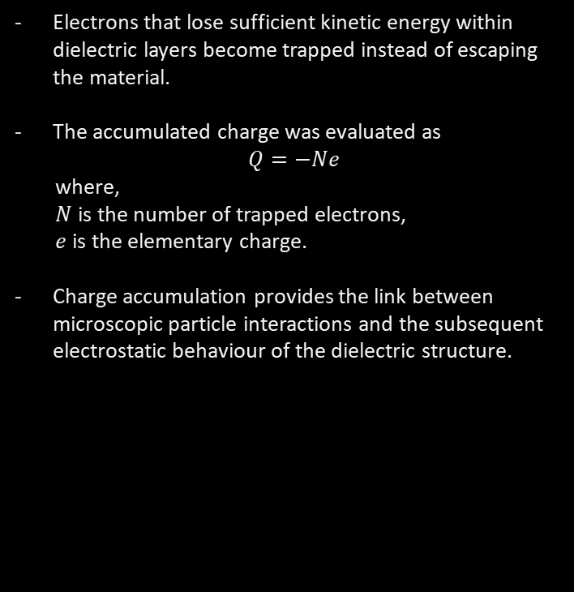
RESULTS
[Placeholder: Insert graph here]
Charge Accumulation
CHARGE ACCUMULATION VS INCIDENT ENERGY
Electrons that lose sufficient kinetic energy within dielectric layers become trapped instead of escaping the material.
The accumulated charge was evaluated as
$$Q=−Ne$$
where,
$N$is the number of trapped electrons,
$e$is the elementary charge.
Charge accumulation provides the link between microscopic particle interactions and the subsequent electrostatic behaviour of the dielectric structure.
Energy (keV) | 1 | 5 | 10 | 20 | 30 | 50 | 75 | 100 | 150 | 200 | 300 | 500 | 1000 | 2000 | 5000
Trapped electrons | 8 | 14 | 22 | 33 | 67 | 102 | 93 | 161 | 565 | 1038 | 2703 | 6479 | 10841 | 8420 | 6680
SPASE · IIT KANPUR · RESULTS
14
Notes:
Explain that charge accumulation results from electrons trapped within the dielectric after losing their energy, and that this is the quantity that directly feeds into deep dielectric charging behaviour. Note its importance as the source term for the internal electric field discussed on a later slide. When the plot is available, this allows the audience to see which incident energies contribute most to internal charge buildup, without asserting a specific trend here.

Slide 16
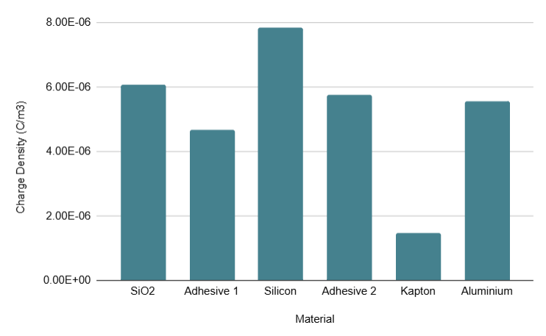
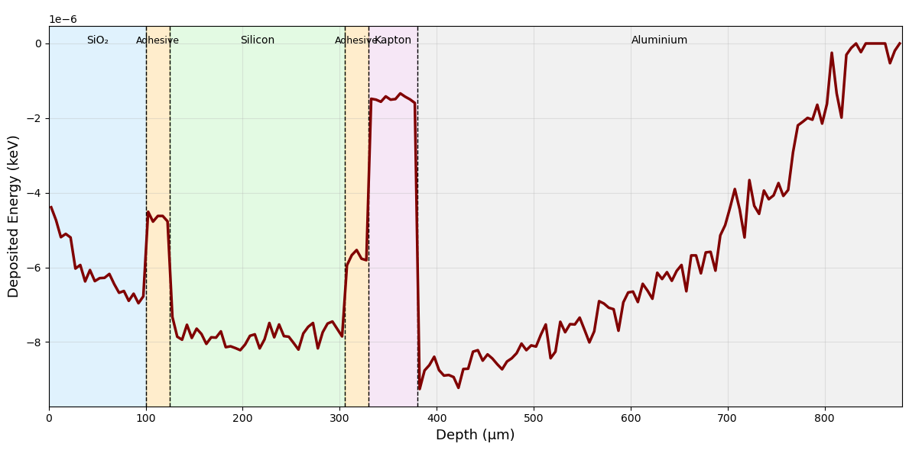
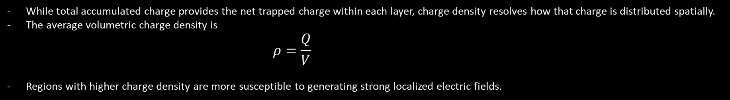

RESULTS
Charge Density
While total accumulated charge provides the net trapped charge within each layer, charge density resolves how that charge is distributed spatially.
The average volumetric charge density is
$$ρ=\frac{Q}{V}$$
Regions with higher charge density are more susceptible to generating strong localized electric fields.
{ }
$Q$is the trapped charge
$V$is the material volume.
LAYER-WISE CHARGE DENSITY
DEPTH-WISE CHARGE DENSITY
SPASE · IIT KANPUR · RESULTS
15
Notes:
Clarify the distinction between total accumulated charge (an integrated quantity) and charge density (its spatial distribution). Explain that layer-wise density shows which material holds the highest concentration of trapped charge, and that a depth-wise view, if available, would resolve this further within a single layer. Emphasize that localized concentrations matter because they can produce strong local fields even when the total charge is unremarkable.

Slide 17
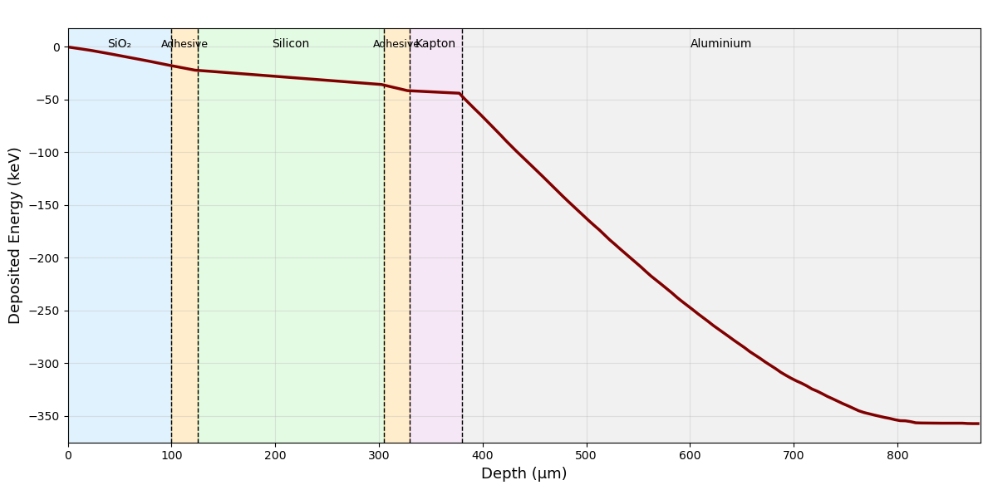
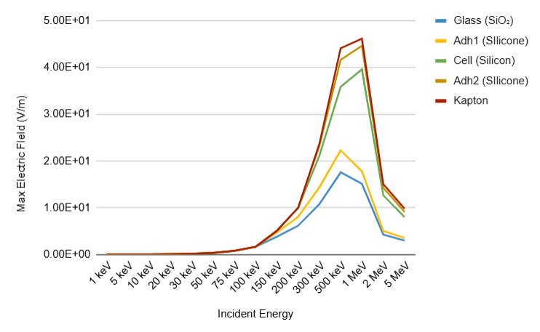
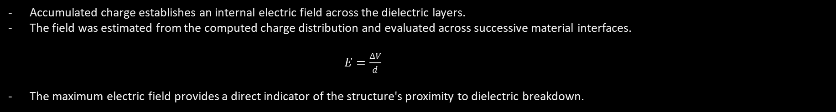

RESULTS
Electric Field
Accumulated charge establishes an internal electric field across the dielectric layers.
The field was estimated from the computed charge distribution and evaluated across successive material interfaces.
$E=\frac{ΔV}{d}$
The maximum electric field provides a direct indicator of the structure's proximity to dielectric breakdown.
{ }
$ΔV$is the potential difference
$d$is the separation distance
ELECTRIC FIELD PROFILE
MAXIMUM ELECTRIC FIELD COMPARISON
[Placeholder: Insert graph here]
[Placeholder: Insert graph here]
SPASE · IIT KANPUR · RESULTS
16
Notes:
Explain that the internal electric field follows directly from the charge density distribution, and that its magnitude is what determines proximity to the material's dielectric breakdown strength. When the electric field profile is available, it allows the audience to see where within the structure the field peaks; the maximum-field comparison plot allows the same comparison to be made across incident energies.

Slide 18
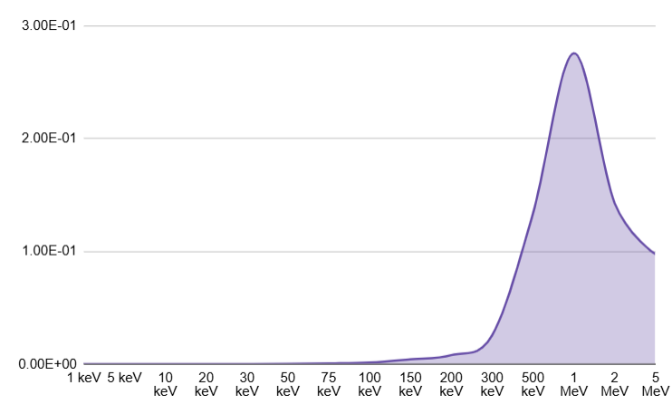
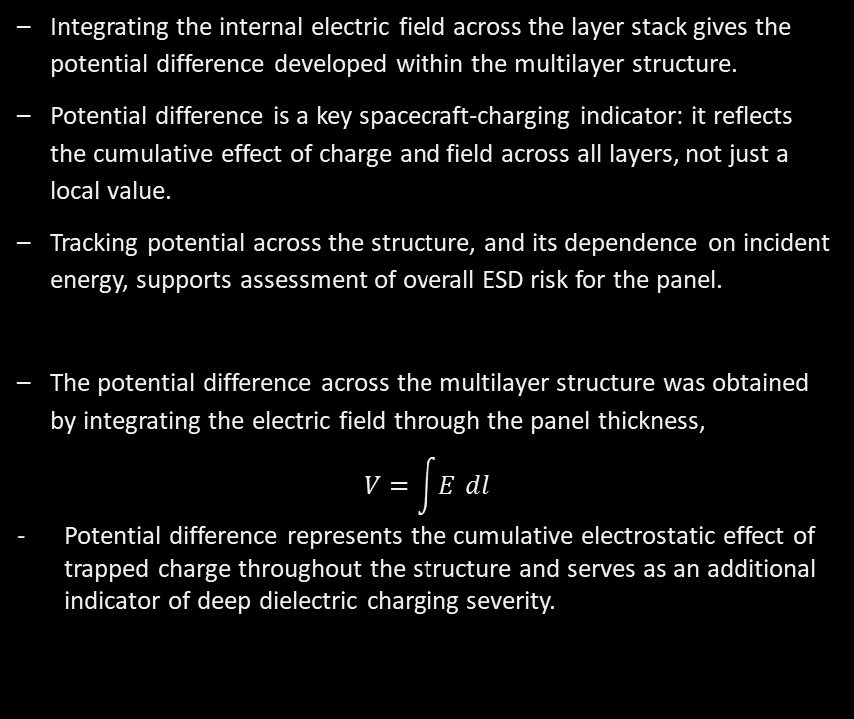
RESULTS
Potential Difference
Integrating the internal electric field across the layer stack gives the potential difference developed within the multilayer structure.
Potential difference is a key spacecraft-charging indicator: it reflects the cumulative effect of charge and field across all layers, not just a local value.
Tracking potential across the structure, and its dependence on incident energy, supports assessment of overall ESD risk for the panel.
The potential difference across the multilayer structure was obtained by integrating the electric field through the panel thickness,
$$V=\int{E} dl$$
Potential difference represents the cumulative electrostatic effect of trapped charge throughout the structure and serves as an additional indicator of deep dielectric charging severity.
POTENTIAL DIFFERENCE VS ENERGY
SPASE · IIT KANPUR · RESULTS
17
Notes:
Explain that integrating the electric field across the panel thickness gives the potential difference developed across the structure, and that this integrated quantity is often used as a practical spacecraft-charging risk indicator. Note that the potential profile shows how potential builds up layer by layer, while the potential-difference-vs-energy plot allows comparison of the overall charging severity across the simulated energy range.

Slide 19
RESULTS
Summary of Simulation Results
Analysis | Purpose | Output Generated | Engineering Significance
Secondary particle production | Characterize particles generated during transport | Total / electron / gamma / direct / tertiary counts | Basis for shower and deposition analysis
Primary interaction statistics | Track the fate of primary electrons | Transmitted / reflected / absorbed fractions | Describes penetration behaviour vs. energy
Total energy deposition | Quantify overall energy absorbed | Deposited energy per incident electron | Baseline input to dose and charging calculations
Layer-wise energy deposition | Localize energy absorption by layer | Deposited energy per layer | Identifies layers most exposed to charging risk
Analysis | Purpose | Output Generated | Engineering Significance
Depth dose profile | Resolve dose distribution with depth | Dose vs. depth curves per energy | Shows how peak dose location shifts with energy
Charge accumulation | Quantify trapped charge | Accumulated charge vs. energy | Input to internal electric field estimation
Charge density | Resolve spatial charge concentration | Layer-/depth-wise charge density | Identifies localized high-charge regions
Electric field | Derive internal field from charge distribution | Field profile per energy | Indicates proximity to breakdown conditions
Potential difference | Derive potential across the structure | Potential profile / difference per energy | Key indicator for overall ESD risk
SPASE · IIT KANPUR · RESULTS
18
Notes:
Use this table to recap, in one place, everything that has been measured across the simulation campaign — what each analysis captures, what output it produces, and why it matters from an engineering standpoint. This is a measurement summary only; do not draw conclusions here, since that will follow separately.

Slide 20
DISCUSSION
Engineering Interpretation of Results
1
2
3
4
5
Electron
Transport
→
Energy
Deposition
→
Charge
Trapping
→
Electric Field
Generation
→
Potential
Development
The implemented analyses collectively span the full physical chain from primary electron interaction to electrostatic response, rather than isolated quantities.
Energy deposition, obtained directly from Geant4 transport, provides the link between incident electron energy and the charge subsequently trapped within each dielectric layer.
Charge trapping and its spatial distribution (charge density) determine the internal electric field, which is then integrated to yield the potential difference across the multilayer structure.
Because each stage is derived from the previous one within a single framework, the simulation captures the complete charging chain — from particle interaction through to electrostatic response — for any incident electron energy in the simulated range.
SPASE · IIT KANPUR
19
Notes:
Walk through the five-step chain shown on screen and emphasize that every stage was implemented and evaluated within this internship, not assumed. Electron transport and energy deposition come directly from Geant4; charge trapping, electric field, and potential are derived in the ROOT-based post-processing. The key engineering point is that the framework is end-to-end: it goes from a physical interaction to an electrostatic quantity without gaps. This sets up the following slides on scope and limitations, since it is important to be clear about what "complete" means here — complete in terms of the physical chain modelled, not complete in terms of realism of the space environment.

Slide 21
DISCUSSION
Current Scope and Limitations
The present framework was deliberately scoped to establish and validate a complete charging-analysis pipeline before increasing model complexity. Its current boundaries are summarized below.
Monoenergetic electron irradiation, rather than a continuous energy spectrum
A finite number of incident primary electrons per simulation
A simplified planar multilayer geometry representing the solar panel stack
Static, single-exposure irradiation conditions
No representation of the full, time-varying space radiation environment
No time-dependent charge accumulation across multiple exposures
These choices were made intentionally to establish a working computational framework before extending it in scope and physical complexity.
SPASE · IIT KANPUR
20
Notes:
Present these points neutrally, as deliberate scoping decisions rather than shortcomings. Each simplification — monoenergetic beam, finite primaries, planar geometry, static exposure — was chosen to keep the first version of the framework tractable and verifiable. Make clear that none of these represent a flaw in the physics implemented; they define the boundary of the present study and motivate the future-scope slides that follow directly after this one.

Slide 22
FUTURE SCOPE I
Time-Dependent Charging
Replacing single-shot irradiation with continuous electron irradiation at a realistic particle flux.
Tracking charge accumulation as a function of exposure time rather than as a single instantaneous value.
Correspondingly evolving the electric field and potential difference as charge builds up over the exposure period.
Extending exposure duration to represent realistic long-duration spacecraft operation in orbit.
FUTURE SCOPE II
Maximum Allowable Operating Limit
Determining the dielectric breakdown threshold for each material in the panel stack.
Tracking electric field evolution as accumulated charge increases with continued exposure.
Predicting the allowable exposure duration before the field approaches the breakdown threshold.
Estimating safe operating limits for spacecraft dielectric insulation under a given environment.
SPASE · IIT KANPUR
21
Notes:
Introduce this as the first and most direct extension: moving from a single instantaneous exposure to continuous irradiation over time. Explain that this requires tracking charge, field, and potential as evolving quantities rather than single computed values, and that it introduces real computational challenges — repeated transport simulations coupled with periodic updates to the accumulated charge state. Frame this as the extension that would let the framework predict long-term charging behaviour, which is the natural next step after the present, single-shot study.

Slide 23
FUTURE SCOPE III
Realistic Space Environment
The monoenergetic beam used in this study can be replaced with representations of the actual, time-varying space electron environment:
Electron Energy Spectra
Differential Flux Models
Each of these environments differs in electron energy spectrum and flux intensity, which in turn governs the depth and rate of charge deposition within the panel.
Replacing the monoenergetic beam with these spectra is a direct extension of the current energy-sweep methodology.
Solar Storm Conditions
Substorm Events
GEO Environment
LEO Environment
Space Weather Models
Long-Term Mission Profiles
SPASE · IIT KANPUR
22
Notes:
Explain that the current monoenergetic sweep is a methodological simplification, and that real spacecraft experience a continuous, time-varying electron spectrum that depends on orbit (GEO, LEO) and space-weather conditions (quiet, storm, substorm). Note that replacing the monoenergetic beam with these spectra is methodologically straightforward given the existing energy-sweep framework — it is primarily a change in the source definition, not the analysis chain. This is what would make the charging estimates representative of an actual mission environment.

Slide 24
FUTURE SCOPE IV
Advanced Physics
Beyond nominal electron irradiation, the framework can be extended to a broader range of space radiation phenomena:
Solar Flares
Coronal Mass Ejections
Incorporating these particle types and events would allow the framework to predict charging and damage response under extreme, transient space-weather conditions.
And to couple radiation-induced material degradation with the charging analysis already implemented.
Heavy Ions
Mixed Radiation Fields
Solar Energetic Particles
Proton Irradiation
Radiation Damage Evolution
Coupled Charging – Degradation
SPASE · IIT KANPUR
23
Notes:
Extend the discussion from electrons alone to the broader space radiation environment: solar flares, CMEs, solar energetic particles, protons, and heavy ions. Note that these bring different transport physics and, potentially, coupled degradation effects that evolve alongside charging. Frame this as a longer-term extension relevant to predicting spacecraft behaviour under extreme, transient space-weather events, rather than routine background exposure.

Slide 25
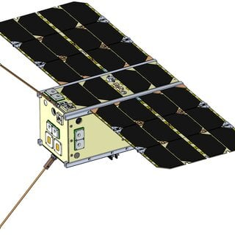
FUTURE SCOPE V
Improved Spacecraft Modelling
CAD-BASED SPACECRAFT GEOMETRY
Importing detailed CAD models in place of the simplified planar slab geometry used in this study.
Representing complete spacecraft geometry, including solar array deployment structures and antennas.
Including dielectric coatings, connectors, and other multi-material surface features.
Modelling multi-material spacecraft structures with complex internal geometries.
G4chargeit supports import of externally defined CAD-derived geometries, allowing detailed spacecraft design models to be used directly within the same simulation and analysis framework developed in this work.
SPASE · IIT KANPUR
24
Notes:
Explain that the planar multilayer slab used in this study is a deliberate simplification, and that real spacecraft geometry — deployed solar arrays, antennas, connectors, dielectric coatings — introduces shadowing and material-interface effects that a slab cannot capture. Mention that Geant4 supports import of CAD-derived geometry, so this extension reuses the same transport and analysis framework already built, applied to a more realistic geometry.

Slide 26
CONCLUSIONS
Conclusions
Framework developed
A Geant4-based simulation framework for deep dielectric charging studies was successfully developed and implemented.
Solar panel model implemented
A simplified, six-layer multilayer solar panel geometry was modelled across a fifteen-point electron energy sweep from 1 keV to 5 MeV.
Radiation response analyses completed
Secondary particle production, interaction statistics, energy deposition, NIEL, TID, and depth-dose behaviour were evaluated for the modelled geometry.
ROOT-based analysis tools developed
Post-processing tools were built to convert Geant4 output into charge, charge density, electric field, and potential difference quantities.
Electrostatic response evaluated
Charge accumulation and the resulting electrostatic quantities were successfully computed within the scope of the present, single-exposure simulations.
Designed for future expansion
The framework's modular structure supports extension toward time-dependent charging, realistic space environments, and more detailed spacecraft geometries.
SPASE · IIT KANPUR
25
Notes:
Summarize the six conclusion points directly from the slide, in a measured research tone. Emphasize what was actually accomplished: a working Geant4 simulation and ROOT-based analysis framework spanning particle transport through electrostatic response, evaluated across a systematic energy sweep, and built with future extension in mind. Avoid overstating the results — the framework's value at this stage is as a validated foundation, not as a final predictive tool for spacecraft breakdown risk.

Slide 27
ACKNOWLEDGEMENTS
IAS-INSA-NASI
Summer Research Fellowship Programme (SRFP)
Department of Space, Planetary and
Astronomical Sciences & Engineering (SPASE)
Indian Institute of Technology Kanpur
Guide: [Dr. Sadeep Kumar Kataria]
Faculty Members: [Prof. Soumyabrata Charkraborty]
Research Scholars: [Mr. M Yousuf]
THANK YOU
Questions?
SPASE · IIT KANPUR
27
Notes:
Thank the department, institute, supervisor, faculty, and any research scholars who supported the internship, and acknowledge funding support if applicable. Close by inviting questions from the audience.

