Slide 1
ARXIV:2602.17332V1 [PHYSICS.APP-PH] · 19 FEB 2026
g4chargeit: Geant4-based kinetic Monte Carlo simulations of charging in dielectric materials
Code availability: github.com/kgandhi63/g4chargeit

Slide 2

Motivation: Why Spacecraft Charging Matters
Airless bodies and spacecraft are continuously exposed to a harsh radiation environment. Charge accumulation in dielectric materials creates strong electric fields with significant operational consequences.
The Radiation Environment
Dielectric Charge Trapping
Solar UV photons → photoelectron emission
Solar-wind plasma
Solar energetic particles
Galactic cosmic rays
Conductors: surface charge redistributes rapidly
Dielectrics: charge trapped internally
Low conductivity → persistent field buildup
Micro-cavities between grains amplify local fields
Operational Consequences
Electrostatic discharge (ESD) and dielectric breakdown
Sensor damage and instrument failure
Dust adhesion to solar panels, spacesuits, optics
Spacecraft anomalies and mission risk

Slide 3
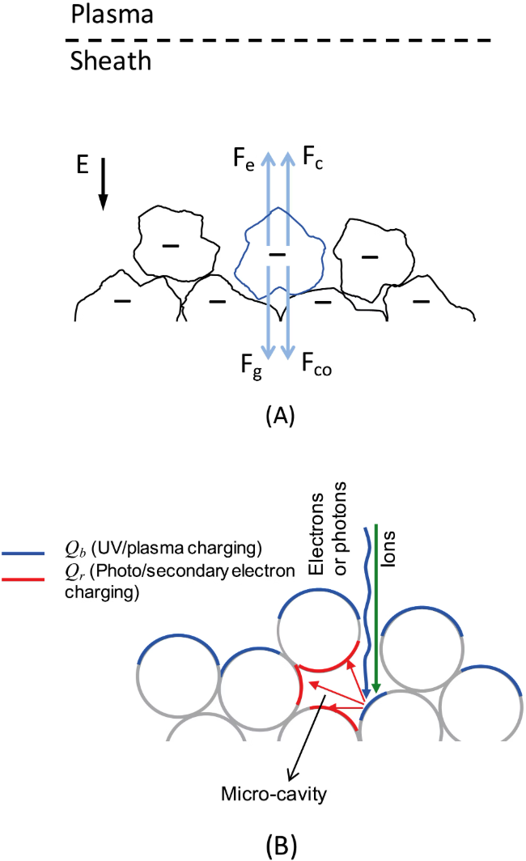
Physical Background
Several physical mechanisms govern charge accumulation on airless planetary surfaces. The interplay of these processes produces spatially heterogeneous surface charge distributions.
Governing Physics
Coulomb potential from a deposited point charge qᵢ at rᵢ in a dielectric:
Photoelectric energy relation:
Charge relaxation follows the continuity equation:

Slide 4
Limitations of Previous Models
Existing analytical and numerical approaches capture key physics but are fundamentally limited in geometry, stochasticity, and field self-consistency.
Prior Approaches
g4chargeit Advantages
Zimmerman et al. (2016)
Capability
Traditional Models
g4chargeit
Analytical model for hexagonally packed spheres. Predicts MV/m fields in <1 lunar day but assumes isotropic 1 eV PE emission and cannot handle irregular geometries.
Arbitrary grain geometry
❌ Spheres only
✅ GDML / CAD import
Stochastic PE production
❌ Prescribed yield
✅ Geant4 cross-sections
Self-consistent E-field
❌ Static / analytical
✅ Iterative feedback loop
Patched-Charge Model (Wang et al., 2016)
Emphasizes micro-cavity role in charge accumulation. Relies on idealized grain shapes; neglects stochastic electron trajectories and transient fluctuations.
Material composition
❌ Fixed
✅ Arbitrary dielectrics
Micro-cavity resolution
⚠️ Approximate
✅ Explicit nm-scale tracking

Slide 5
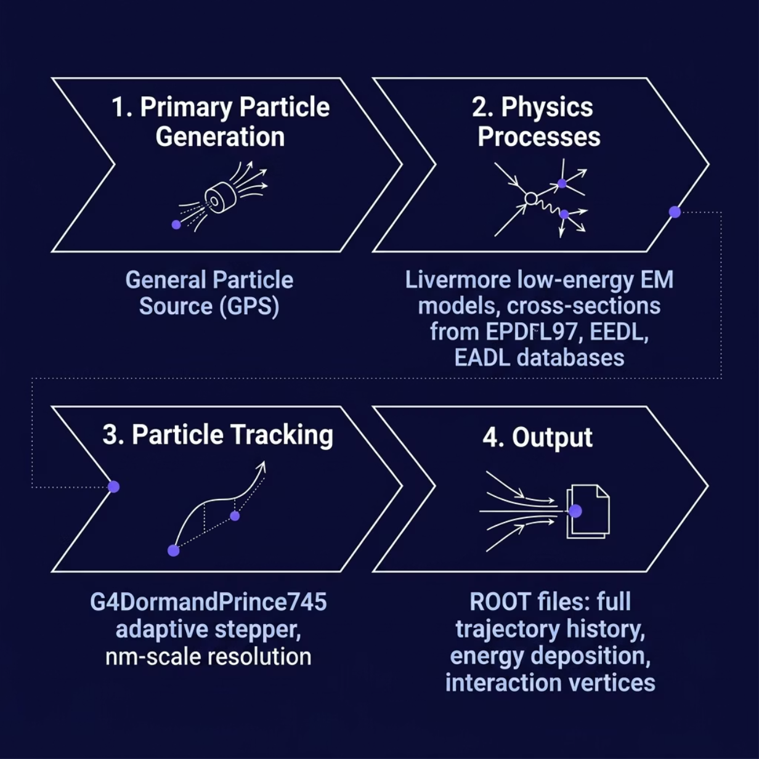

What is Geant4 and Why Use It?
Geant4 is an open-source, C++-based particle transport toolkit originally developed for high-energy physics (CERN). It tracks individual particles through matter, handling scattering, ionization, energy loss, and secondary particle production using validated cross-section databases.
Key Advantages for This Application
Stochastic Transport
Each interaction sampled probabilistically from evaluated databases
Validated Cross-Sections
EPDL97, EEDL, EADL, EPICS2017 — benchmarked against SRIM and CASINO.
Arbitrary Geometry
GDML import supports CAD-derived structures, X-ray microtomography data, and periodic boundary conditions (g4pbc).
Low-Energy Accuracy
Livermore EM models resolve processes down to a few eV for electrons, 10 eV for hadrons.

Slide 6

Core Idea: Self-Consistent Iterative Framework
The central innovation of g4chargeit: Geant4's static particle transport is extended to a time-evolving, self-consistent electrostatic simulation. Each iteration's deposited charges modify the field seen by subsequent particles.
Initialize
Transport
Aggregate
Compute Field
Update & Loop
The custom class AdaptiveSumRadialFieldMap.cc bridges Geant4's particle transport with electrostatic field evolution, overriding the default field class at each iteration.
Microscopic
Mesoscopic
Macroscopic
Individual ionization, photoemission, and scattering events resolved at nm scale
Surface charge density σ(r,t) evolved via continuity equation
Electric pressure, field patches, and grain-scale forces emerge self-consistently

Slide 7


Electric Field Calculation
Superposition of Deposited Charges
At iteration n, the total potential is the superposition of all N previously deposited charges:
For bins containing multiple materials, an effective dielectric constant is computed:
where w_i is the volume fraction of material i in the bin.
Computational challenge: Direct summation over millions of charges scales as O(N²). For lunar fluences (~10¹⁵ m⁻²), this becomes intractable without optimization.

Slide 8
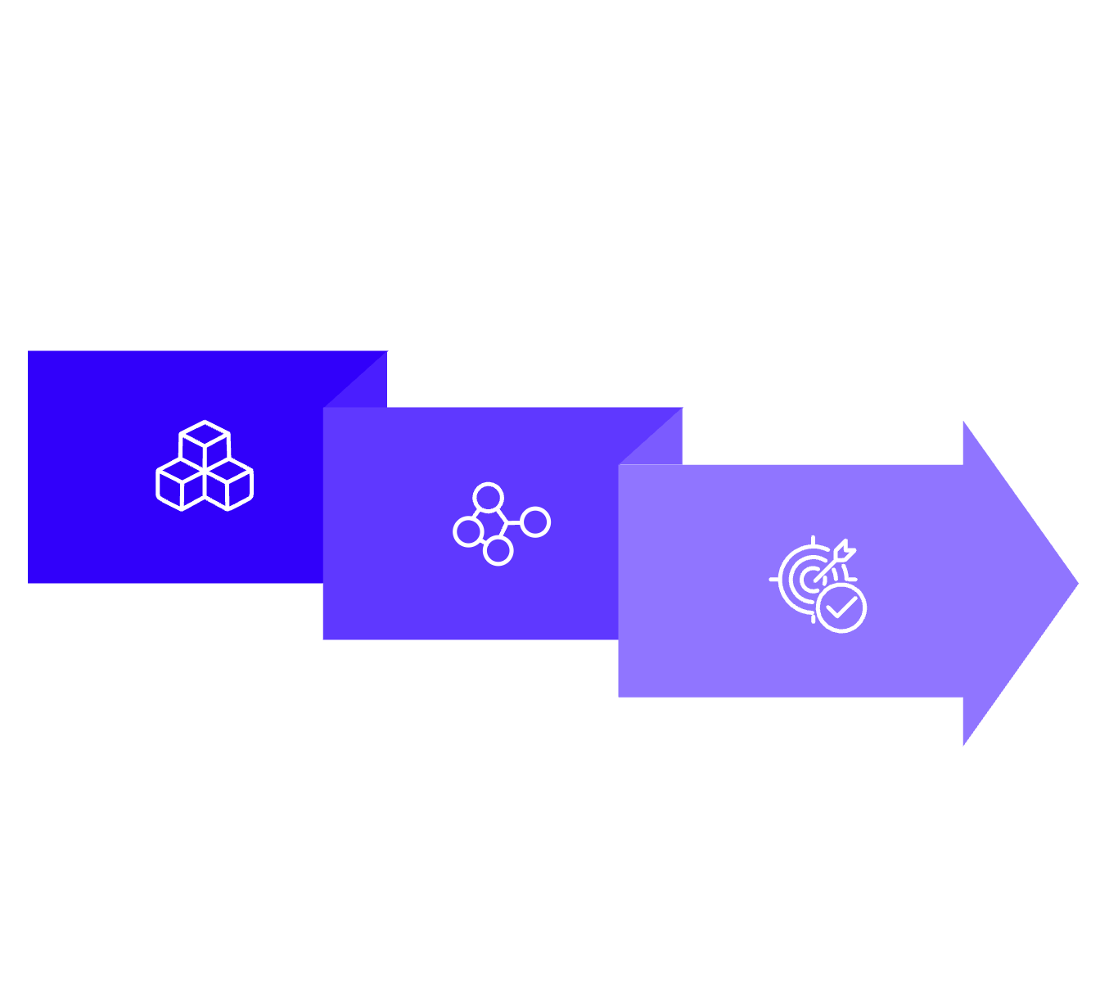
Computational Optimization
Two adaptive octrees and a Barnes–Hut approximation reduce field computation from O(N²) to O(N log N), enabling simulations with millions of deposited charges.
Ocharge Build
Adaptive Refine
Ofield Barnes–Hut
Adaptive Octree Strategy
1
Ocharge — Charge Storage
2
Ofield — Field Evaluation
3
Gradient-Driven Refinement
Voxels split until one integer charge remains or minimum size reached. Encodes full charge distribution history.
Barnes–Hut approximation treats distant clusters as multipole moments. Initial uniform grid refined where |∇E| ≥ ΔE_th.
Non-uniform mesh concentrates resolution in micro-cavities — precisely where field gradients are strongest and physics most sensitive.

Slide 9
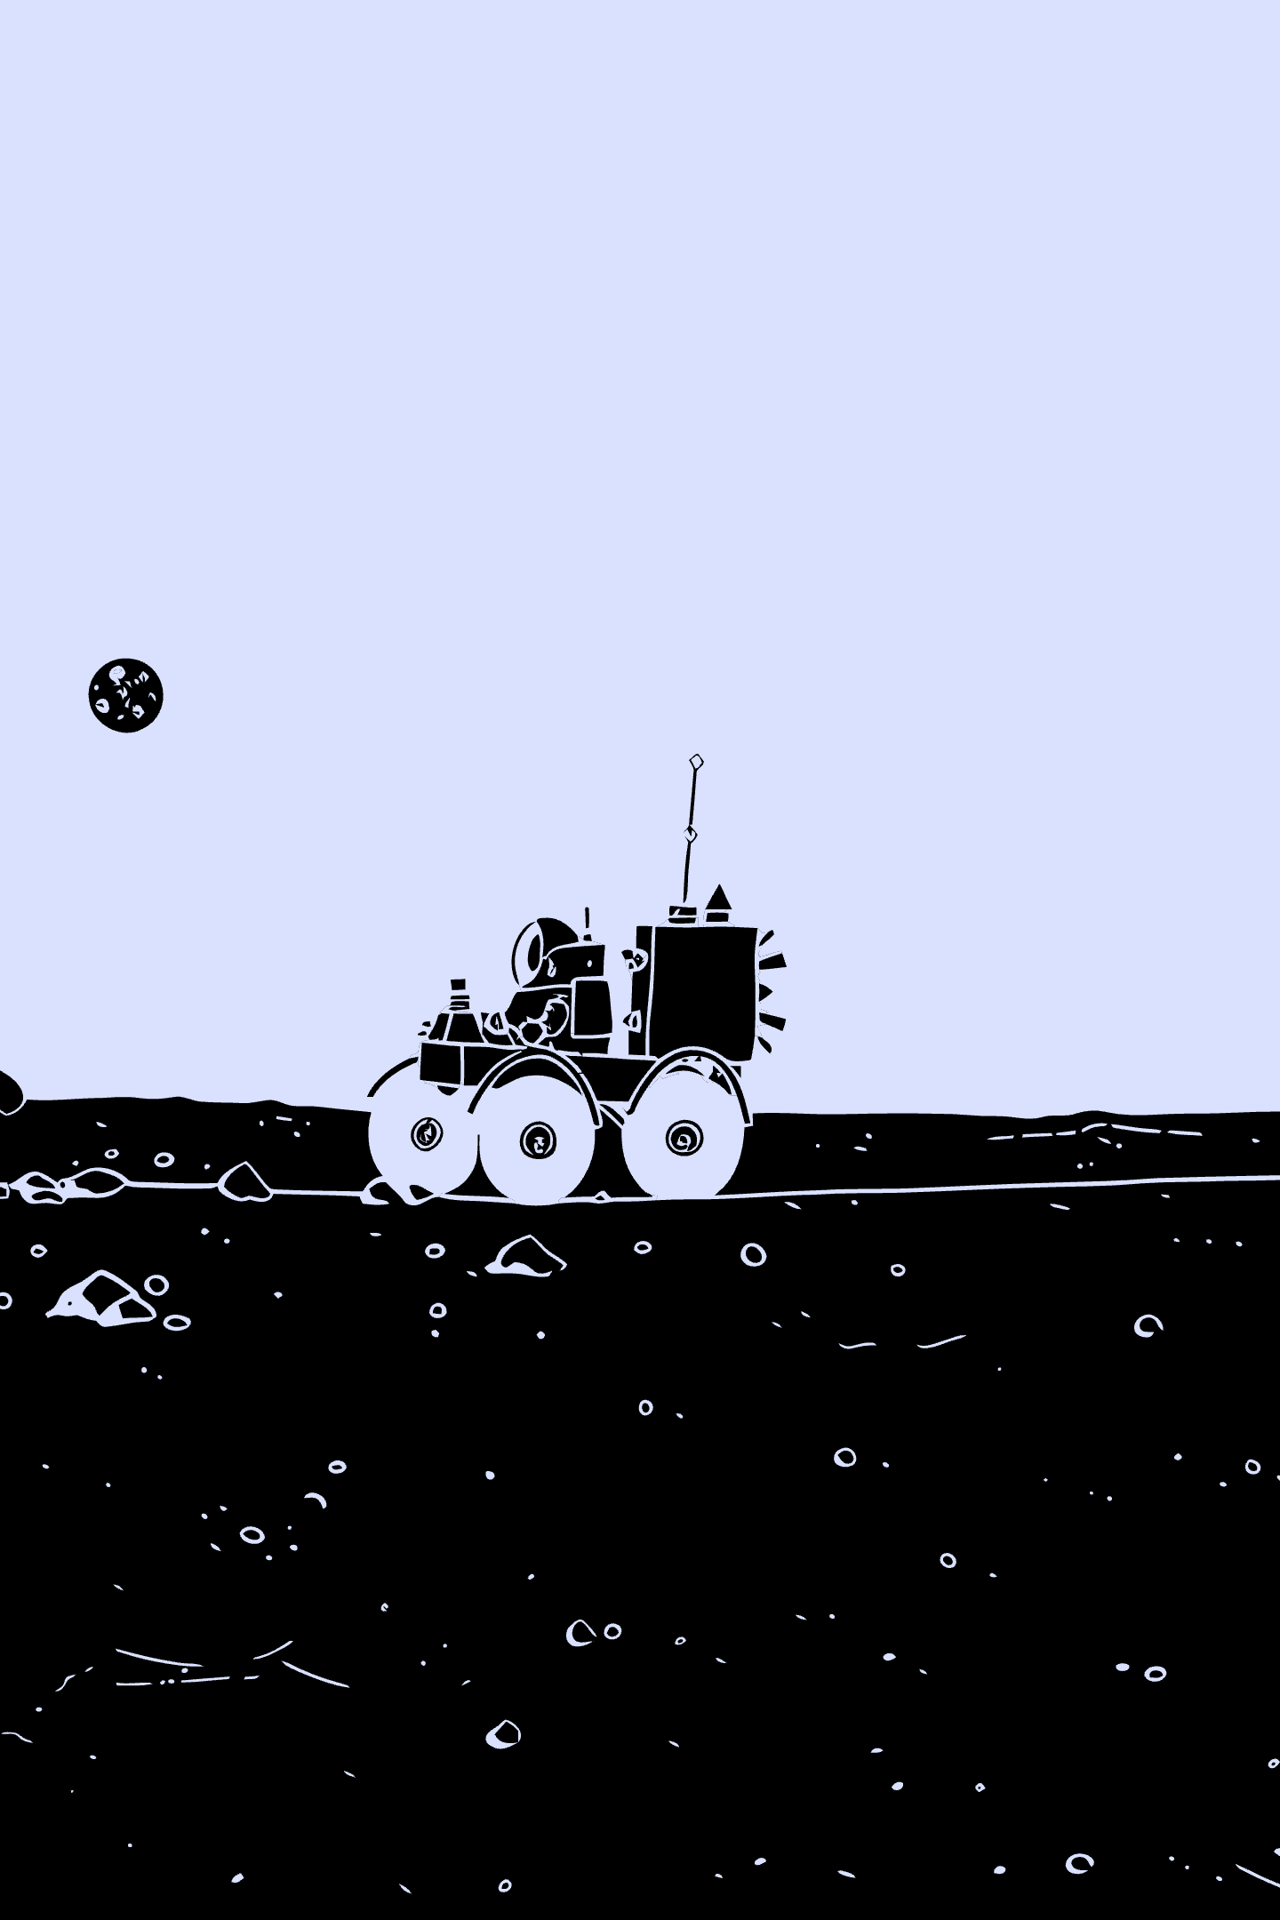
g4chargeit: Simulation Results & Physical Interpretation
g4chargeit is a kinetic Monte Carlo framework built on Geant4 for self-consistent simulation of time-dependent electrostatic charging in dielectric materials. This section presents simulation results, physical interpretation, and implications for spacecraft charging environments.

Slide 10
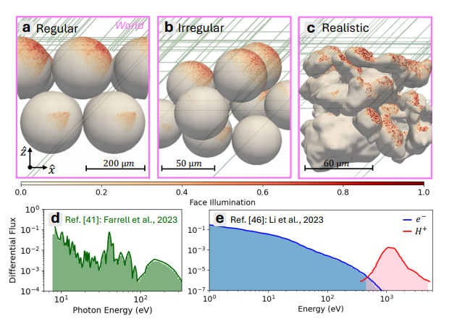
Particle Transport Results
LUNAR DAYSIDE CONDITIONS · SIO₂ SPHERES (100 ΜM) · ΕR = 3.9
Photoelectron Trajectories
~85% of incident photons undergo the photoelectric effect. Three dominant outcomes:
~97% — PE stops near the surface (e.g., 233 eV photon → 129 eV PE, range 0.5 nm)
~2% — PE scatters into neighboring sphere (cavity-trapped)
~1% — PE backscatters and escapes the simulation volume
Solar Wind Protons (1 keV)
Implant at ~18 nm depth, consistent with SRIM (~22 ± 13 nm). Some scatter between grains; others backscatter after depositing up to 950 eV.
Thermal Electrons (<80 eV)
By iteration n=17, ~80% are deflected by the accumulated electric field without interacting with SiO₂ — direct evidence of field-mediated feedback.
Photoelectric Effect
Backscattering
Field-Mediated Deflection
Dominant charging mechanism. PE energy = Eγ − φ (work function ~8 eV). PEs up to ~340 eV.
~1% of PEs and a fraction of protons escape. Contributes to net surface charge deficit.
Accumulated charge deflects incident electrons — self-consistent feedback loop captured by g4chargeit.

Slide 11
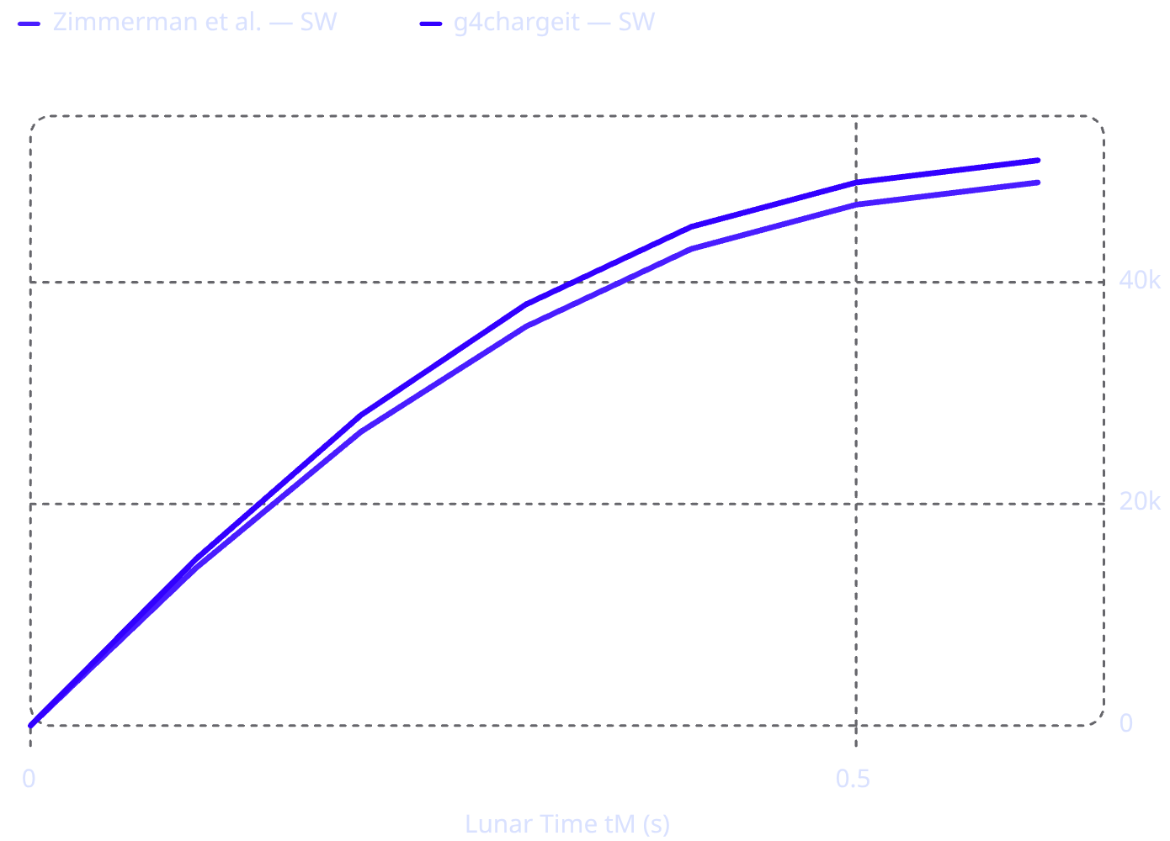

Regularly Packed Grains: Benchmarking Results
HEXAGONAL PACKING · 100 ΜM SIO₂ SPHERES · PBCS
Key Findings
Electric field evolves self-consistently until convergence with analytical model
Photon case saturates at 8.4 × 10⁵ V/m at tM = 120 s — ~2× higher than Zimmerman et al. due to explicit PE spectrum (up to ~340 eV vs. assumed 1 eV)
Electric pressure reveals net attractive force between adjacent spheres (red–blue opposing regions)
Consistent with Zimmerman et al. (2016) but conflicts with experimental observations of repulsive forces in micro-cavities
Critical insight: Regular hexagonal packing produces symmetric pressure patterns that induce attraction — not the repulsion observed experimentally. Geometry matters.

Slide 12
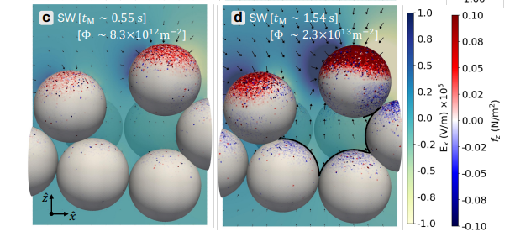
Irregularly Packed Grains: Micro-Cavity Charging
25 ΜM SPHERES · LUNAR SIMULANT DENSITY · REPULSIVE FORCES EMERGENT
Why Geometry Changes Everything
Irregular packing breaks the symmetry of hexagonal arrangements, creating micro-cavities where charged particles become trapped. Unlike regular packing, these cavities generate localized strong electric fields and repulsive electrostatic regions between neighboring grains.
Charge Trapping
Repulsive Pressure (fz)
Consistent with Experiment
PEs and SW electrons scatter into cavities and cannot escape — surface charge density builds locally.
SW case reaches ~0.1 N/m² within micro-cavity (Fc ~10⁻¹³ N). Same-sign pressure regions (red–red, blue–blue) confirm repulsion.
Qualitatively agrees with Wang et al. (2016) patched-charge model: charged particle exposure generates repulsion; photons alone produce weaker cavity fields.

Slide 13
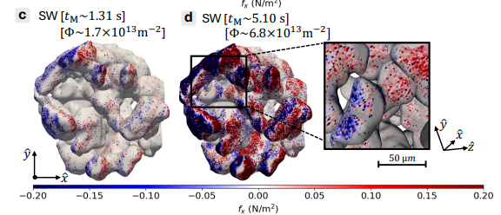
Realistic Grain Configuration: Broken Symmetries
SYNCHROTRON X-RAY MICROTOMOGRAPHY · 52% POROSITY · JSC-1A LUNAR SIMULANT
Complex Geometry, Complex Charging
The realistic grain-stack configuration (107 × 121 × 100 µm) is derived from synchrotron X-ray microtomography of a planetary simulant. Broken symmetries and sharp morphological features introduce micro-cavities that generate:
Localized regions of shearing and cohesion
Strong repulsive interactions at grain contact points
Highly non-uniform electric pressure — no opposing pressure-pair structures
Field enhancement along protrusions and recessed regions
Implications
Heterogeneous electric-pressure patterns promote dielectric breakdown
Localized repulsion could increase porosity of grain stacking over longer timescales
Charge accumulation consistent with patched-charge model — but now in arbitrary, realistic geometries
Photon Irradiation
SW Irradiation
Porosity
tM ~1.56 s · Φ ~4.0 × 10¹⁵ m⁻²
tM ~5.10 s · Φ ~6.8 × 10¹³ m⁻²
~52% — matches lunar soil measurements

Slide 14

Key Scientific Conclusions
SUMMARY OF FINDINGS
Self-consistent KMC
Realistic geometry
Micro-cavity charging
Stochastic transport
g4chargeit establishes a multiscale bridge connecting microscopic scattering physics to macroscopic dielectric charging evolution — a capability absent in previous grain-scale models.
Broader Impact
What g4chargeit Achieves
Validates and extends the patched-charge model to realistic geometries
Explains experimentally observed repulsive forces via micro-cavity charging
Applicable to photovoltaics, semiconductor devices, DNA electrostatics, and spacecraft charging
Self-consistent, time-evolved electric field
Stochastic particle transport with validated Geant4 cross-sections
Arbitrary geometries via GDML / CAD import
Adaptive octree meshing for efficient field computation
Open-source, community-accessible framework

Slide 15

Connection to Spacecraft Insulation Charging
FUTURE EXTENSION · INTERNSHIP PROJECT RELEVANCE
Target Applications
From Regolith to Spacecraft
Space telescopes — charged dust contamination on optical surfaces
Spacecraft electronics — deep dielectric charging and electrostatic discharge (ESD)
Thermal insulation systems — MLI blanket charging in GEO and interplanetary environments
The g4chargeit framework demonstrated here for lunar regolith charging is directly extensible to spacecraft dielectric insulation charging — a critical concern for long-duration missions.
Current Work (This Paper)
Future Extension
SiO₂ regolith grains · Solar UV + SW plasma · Micro-cavity charge accumulation · Electrostatic lofting precursors
Gold (metal) + Kapton (dielectric) multilayer insulation · Deep dielectric charging · Trapped internal charge · ESD risk assessment
Deep dielectric Charging

Slide 16
THANK YOU
- Tanishka Atul Doiphode
SRFP Intern
Guide: Dr. Sandeep Kumar Kataria

