Slide 1
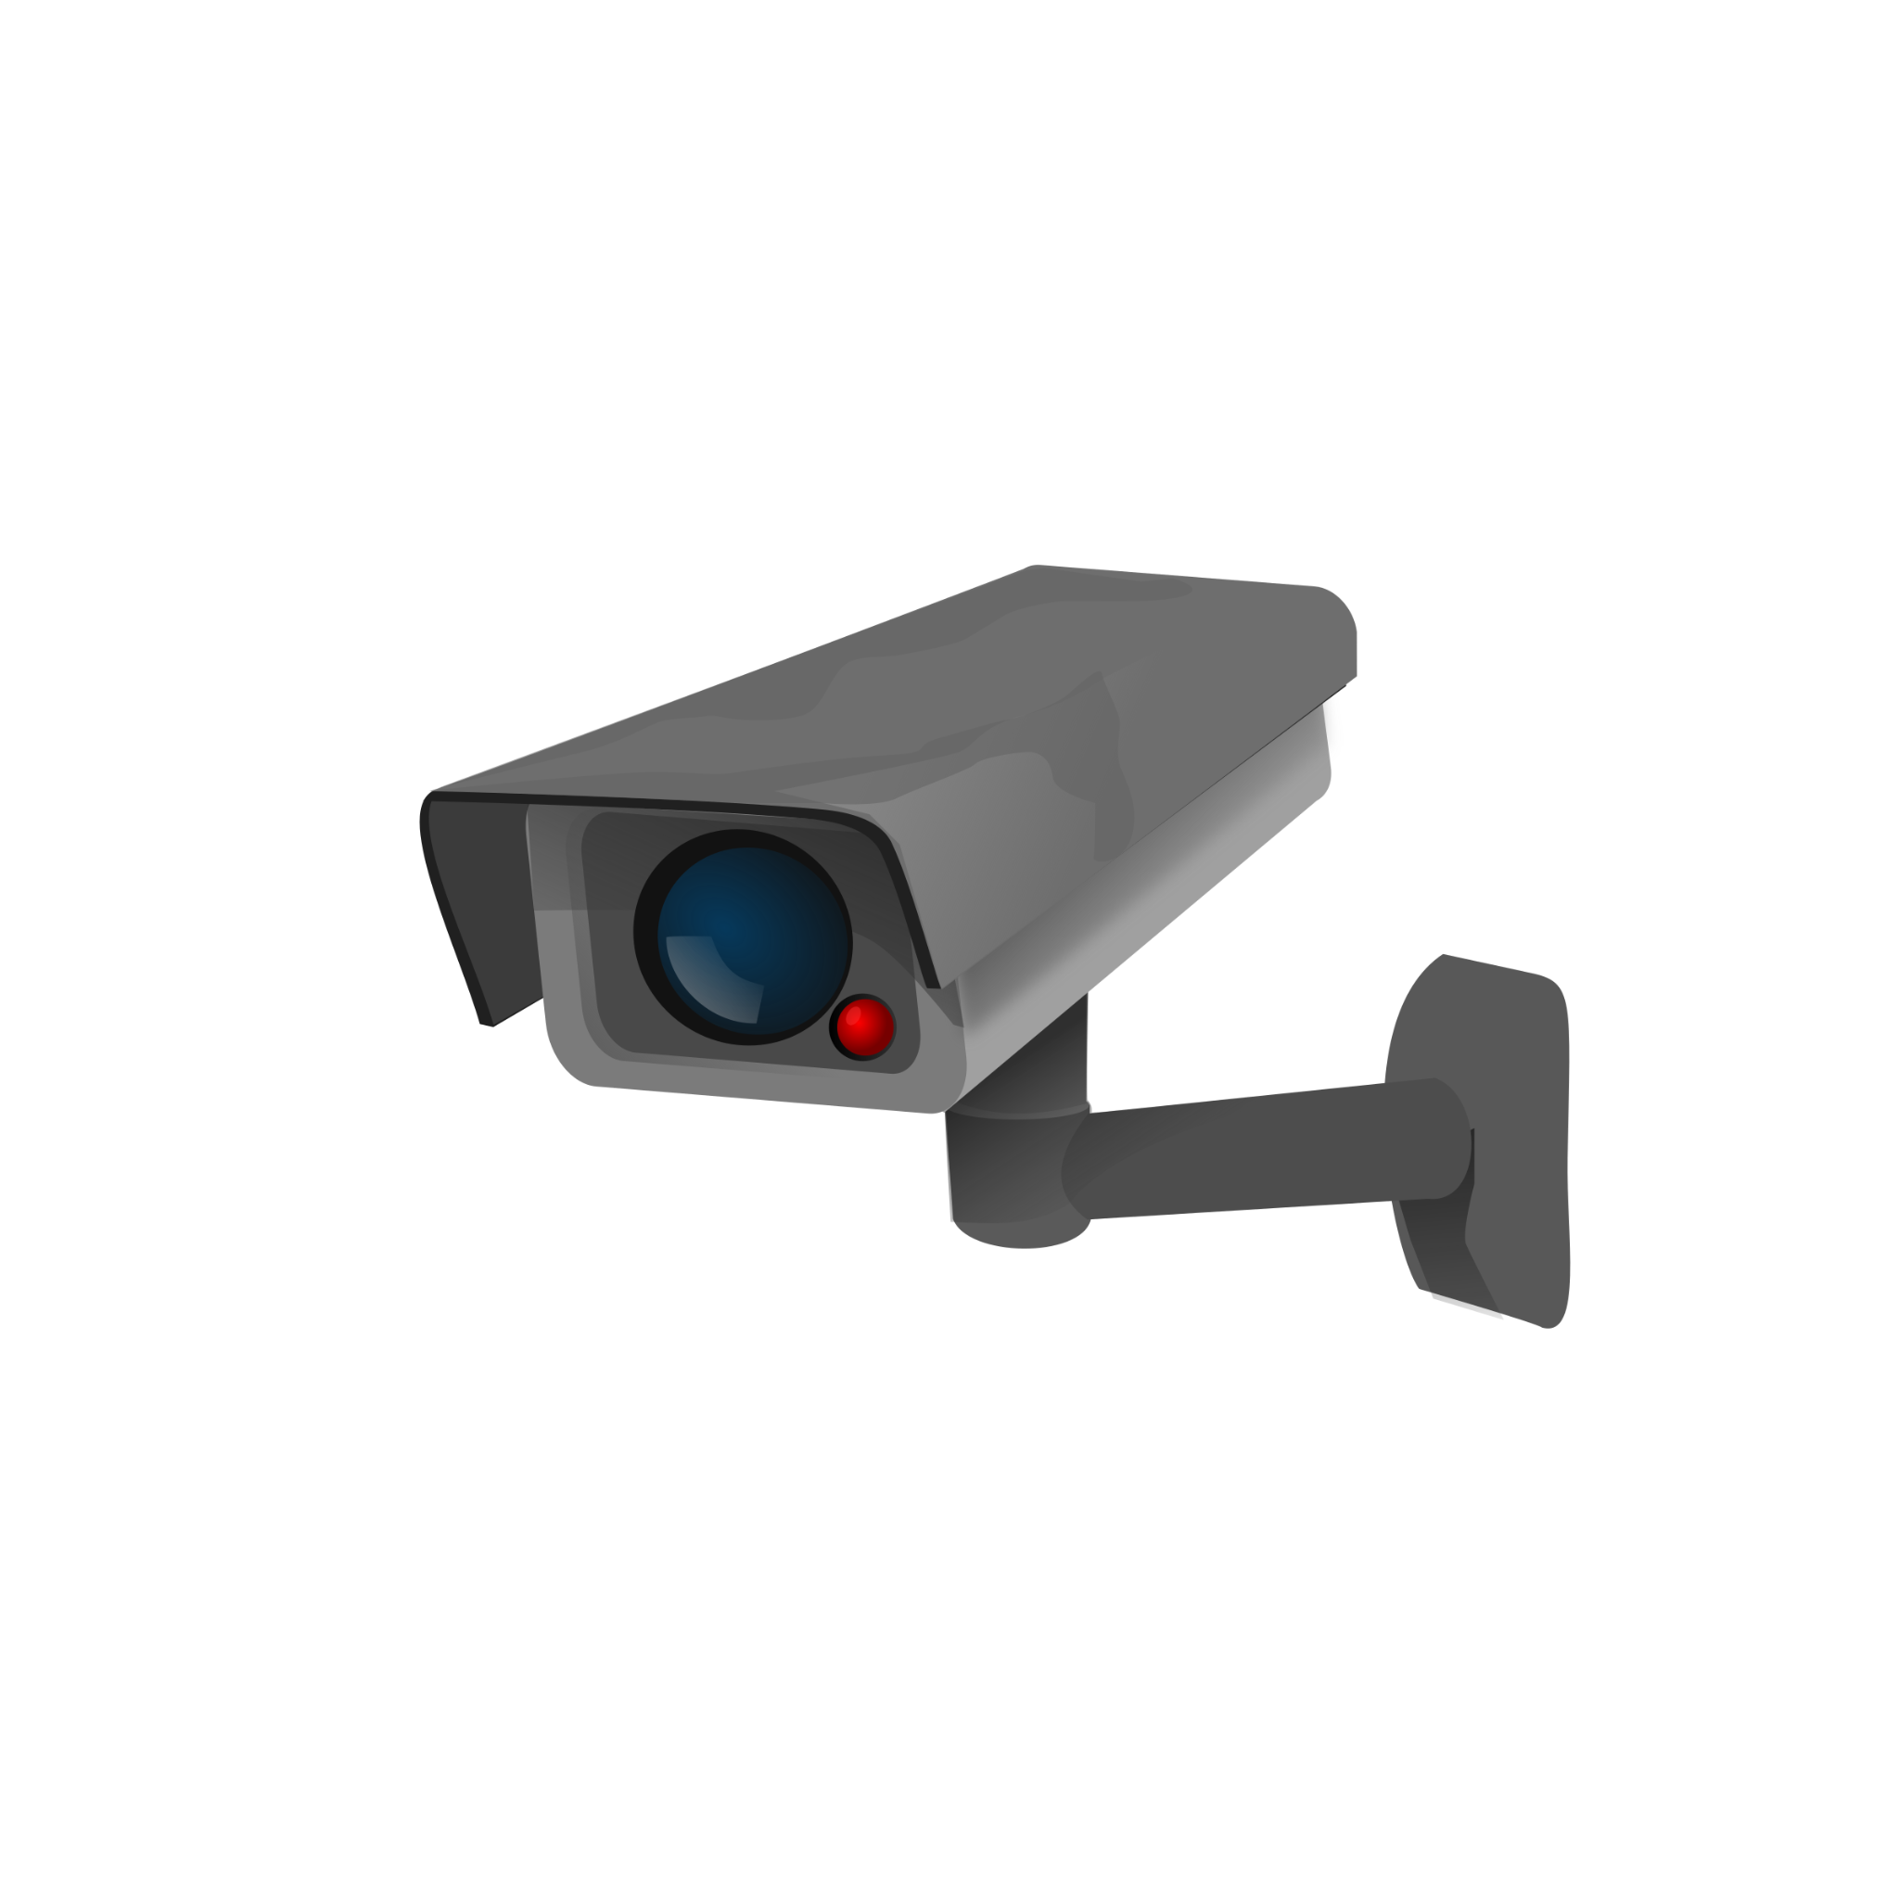

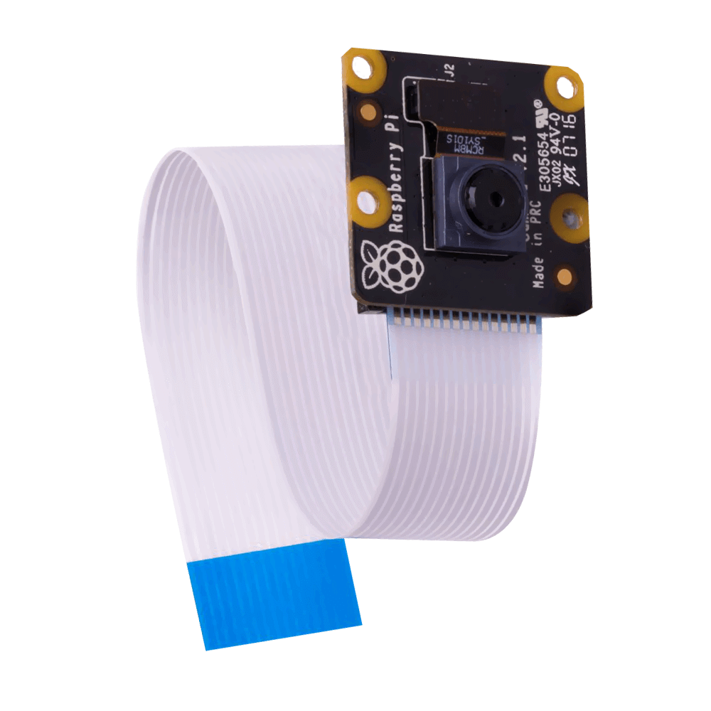
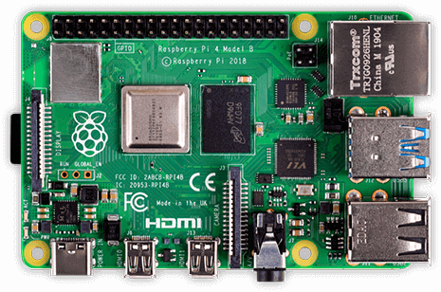


Visitor-Counter
Stefan Düx | Jessica Isabella Görög | Dominic Grabner | Rebekka Tscheppen | Lukas Varga
Visitor-Counter | Gruppe 29 | BIF3 | Innovation Lab 1 | “the Observer”

Slide 2
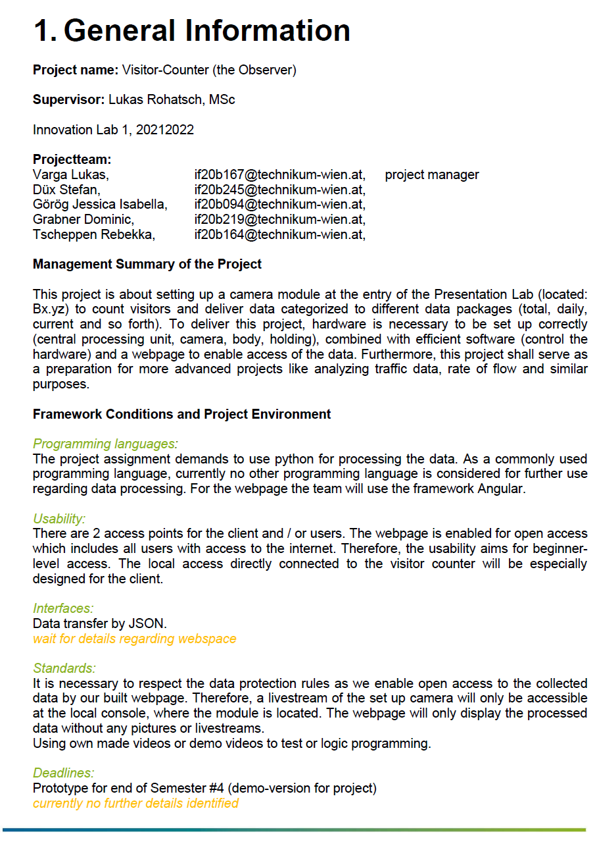
Description
data recording + analysis via raspberry pi 4 + camera module
person recognition to count visitors at Presentation Lab (FH Technikum)
adapted with interface, web-application and further data processing

Slide 3
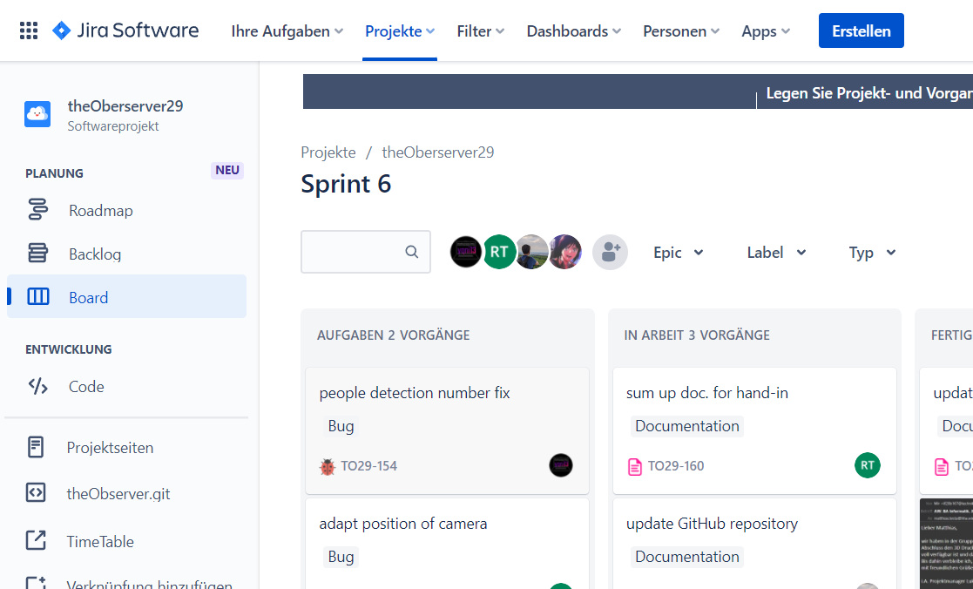
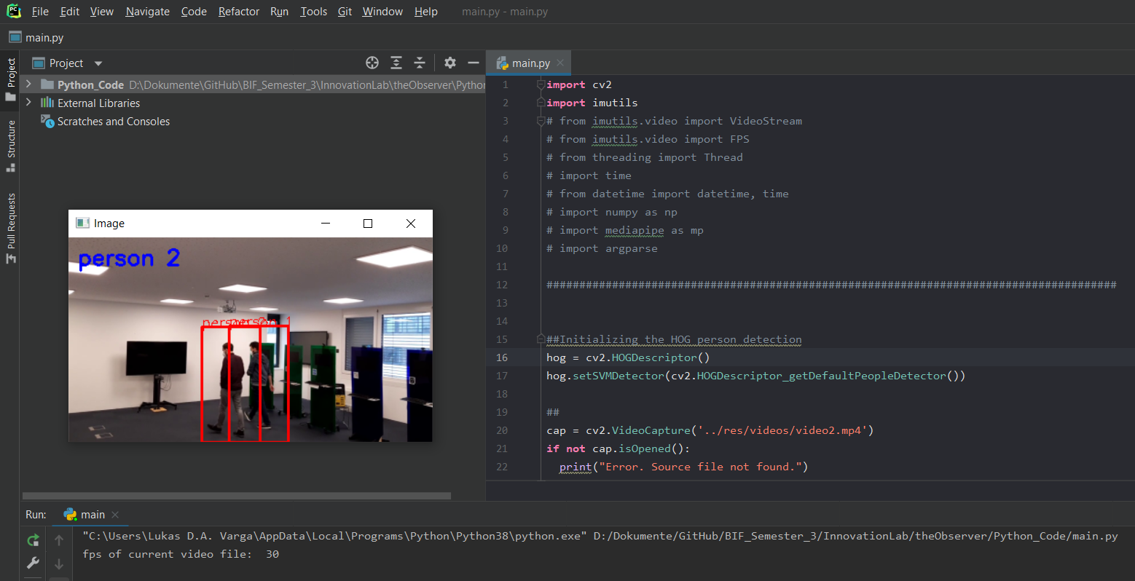
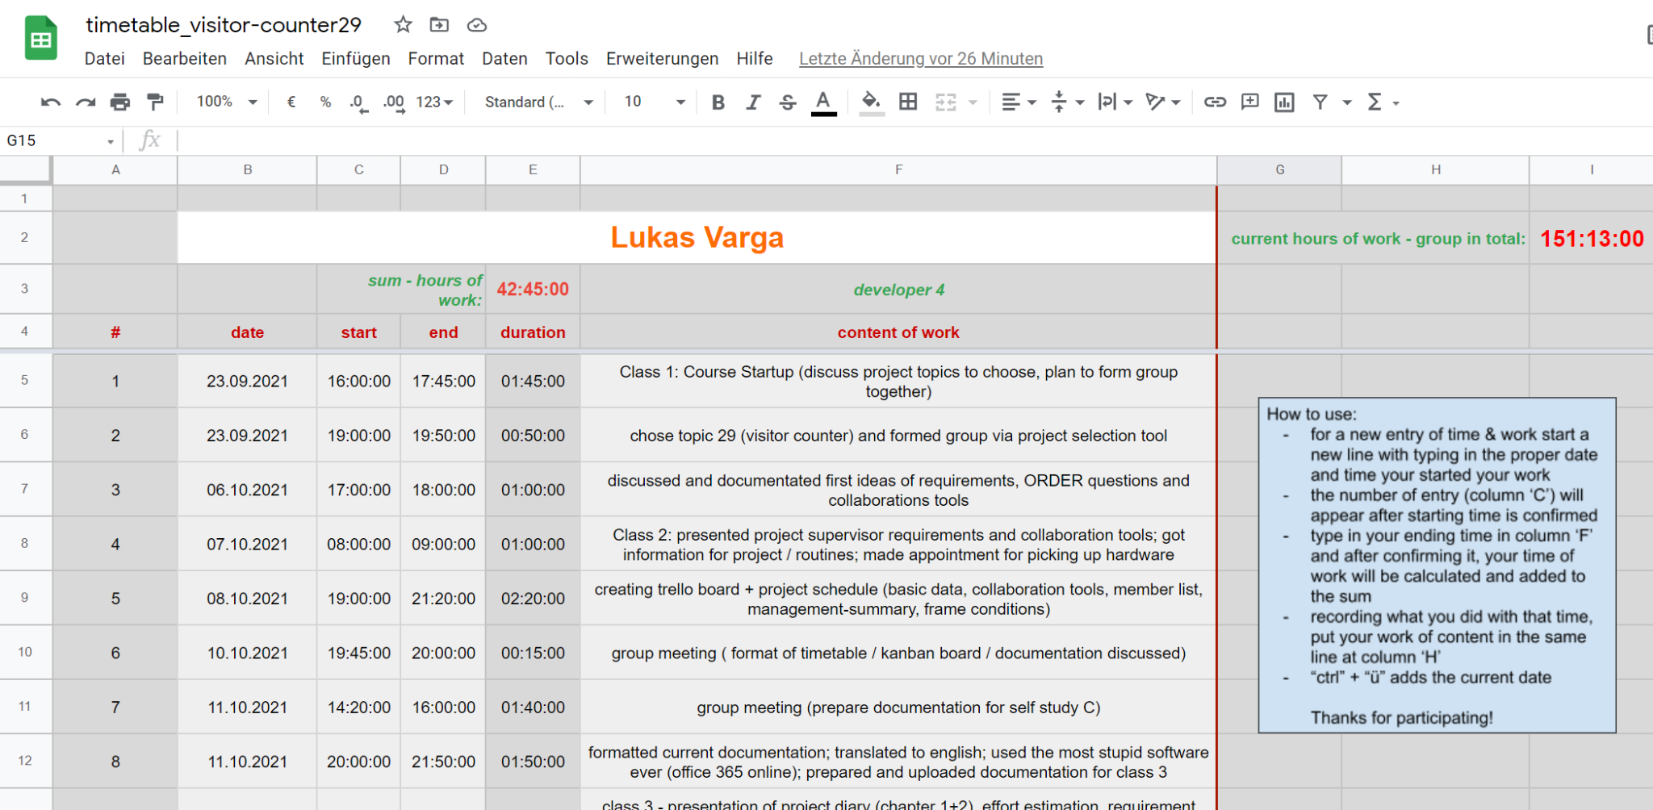
Collaboration Tools
Communication: Discord
Documentation: Jira (Atlassian)
Timetable: Google Sheets
IDE: JetBrains - PyCharm
Source Code: GitHub

Slide 4
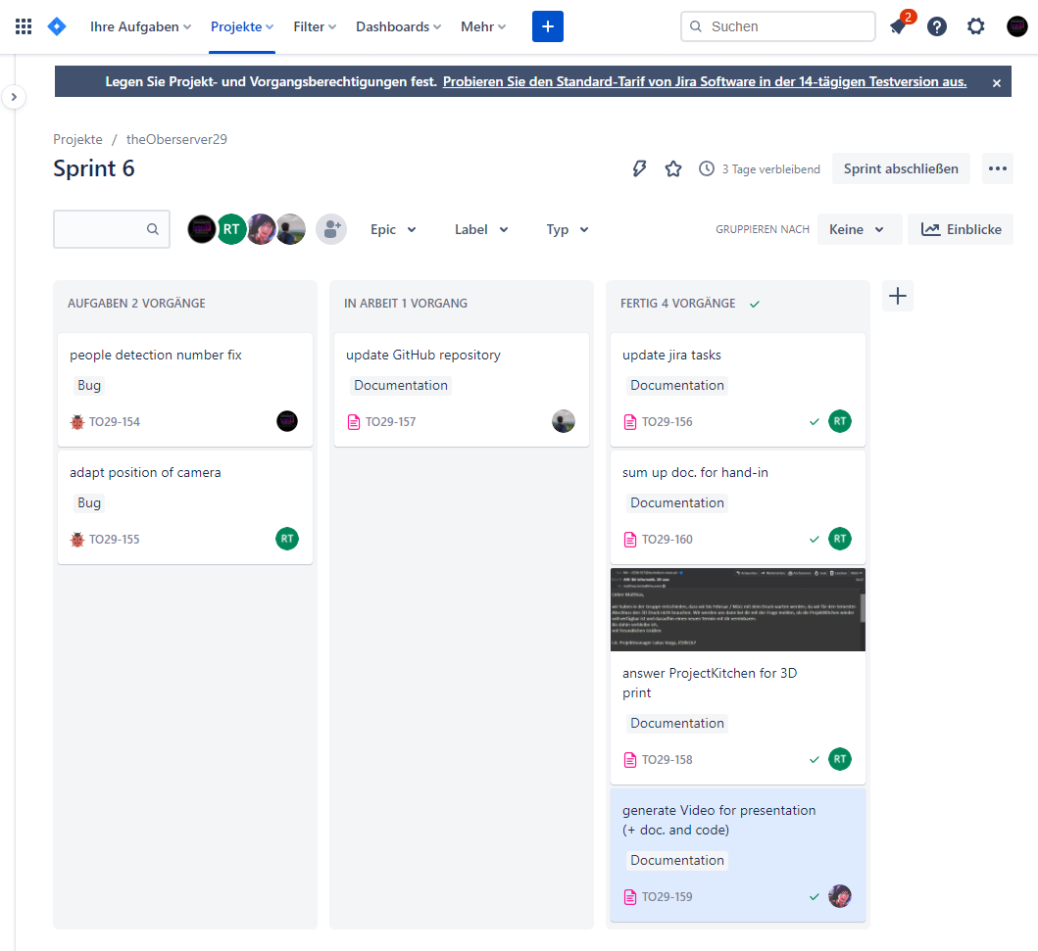
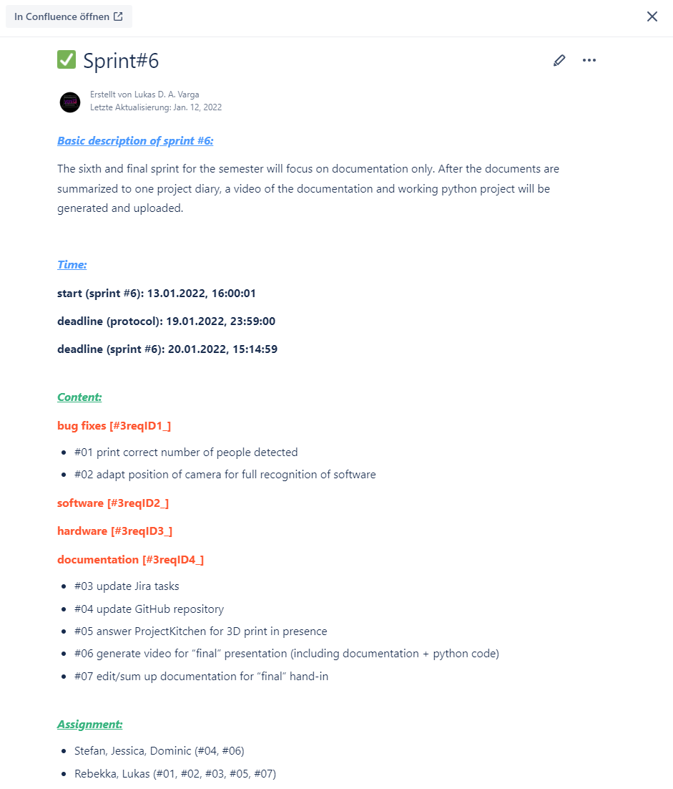
Jira - tracking work (1)

Slide 5
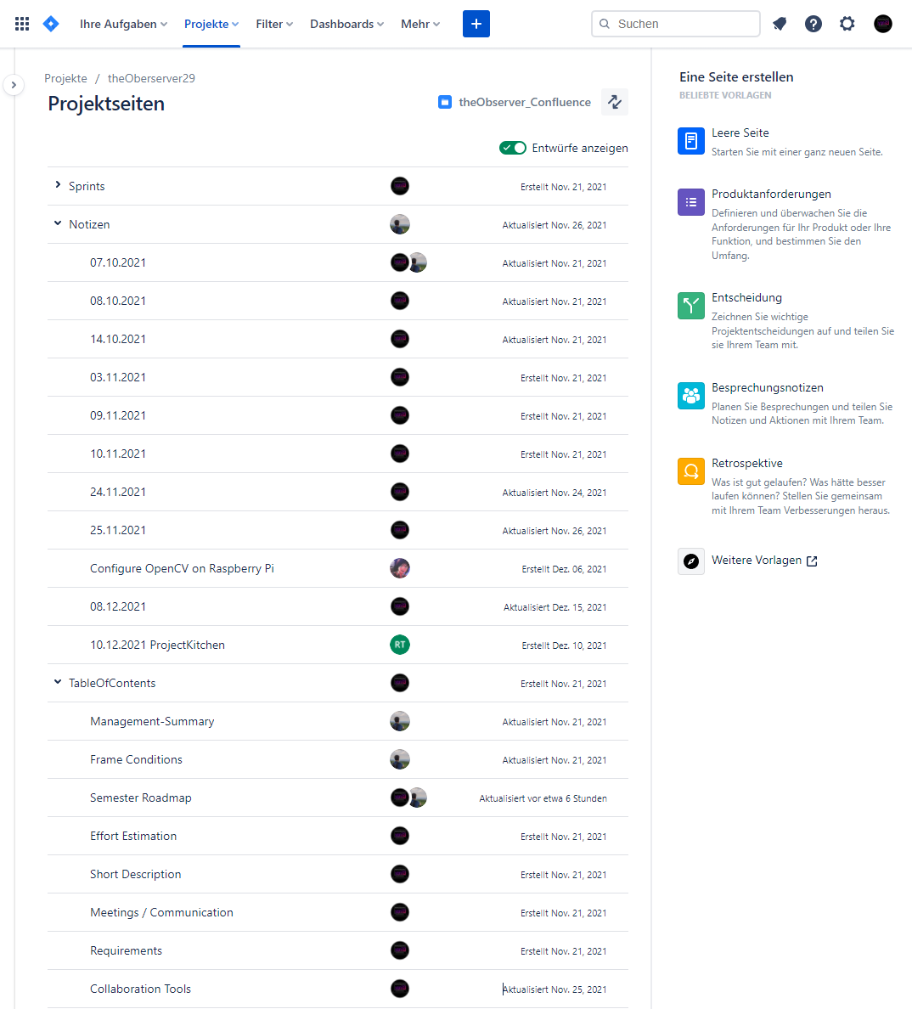
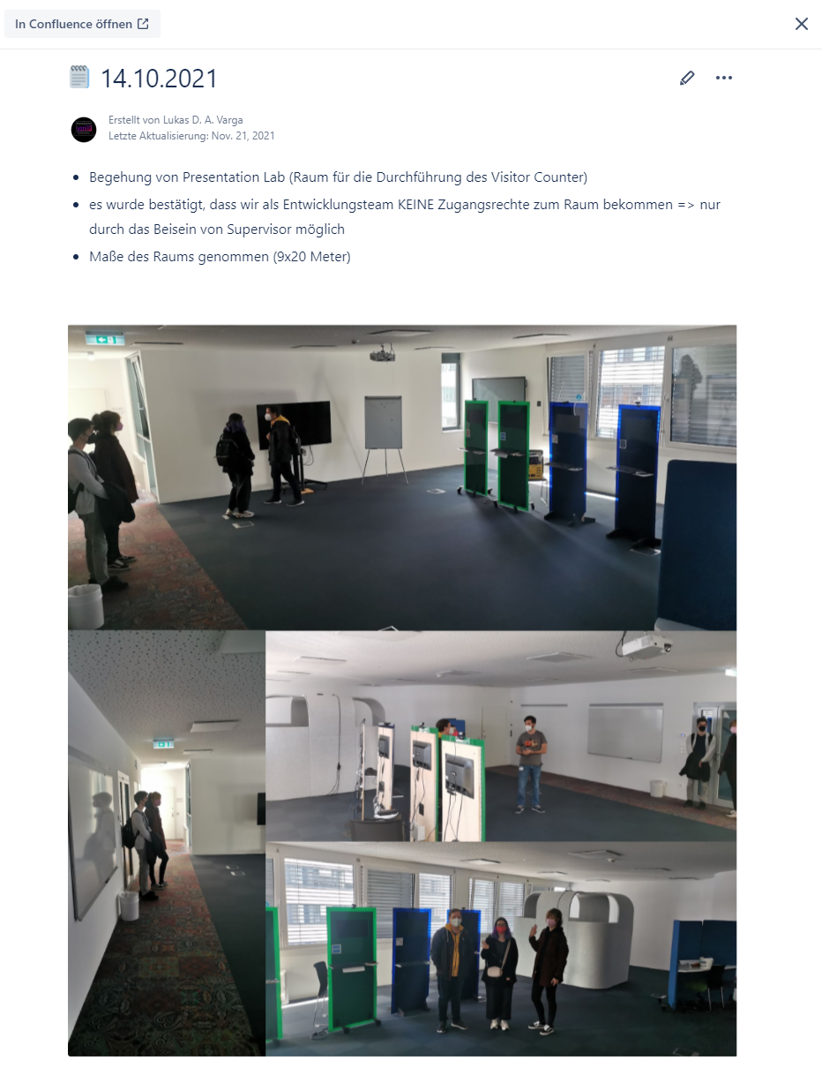
Jira - tracking work (2)

Slide 6
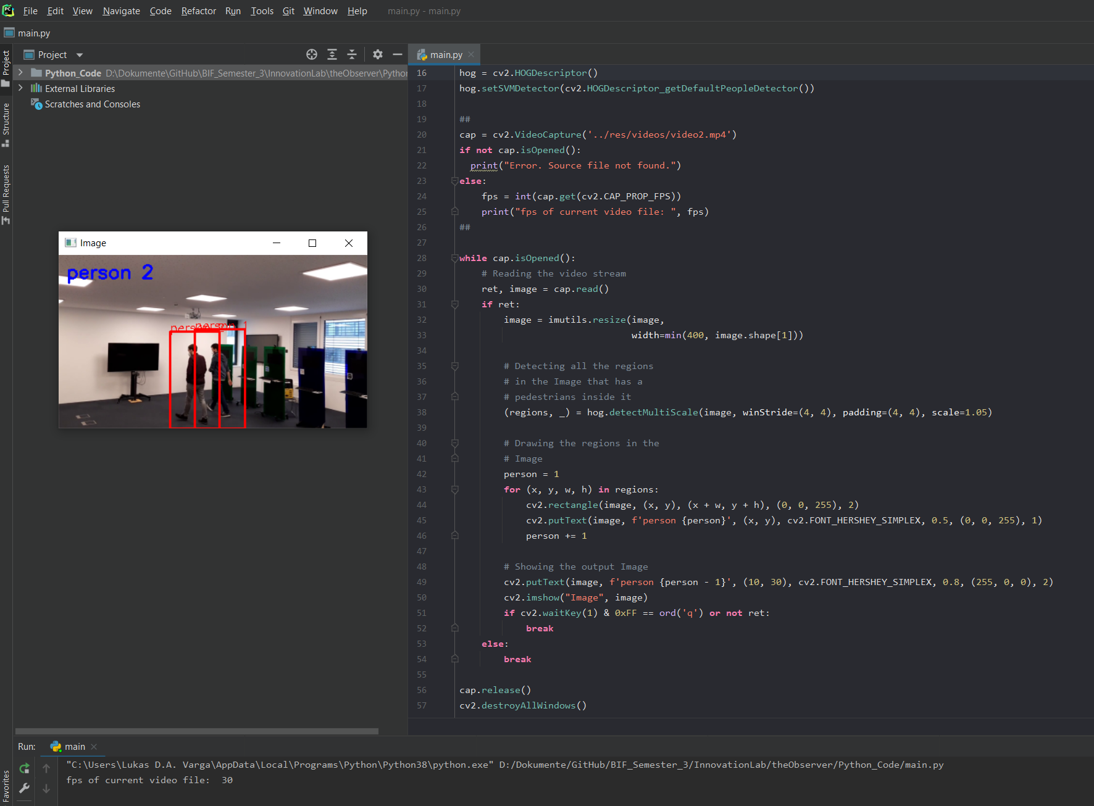
Python - processing person recognition
using pre-trained library for recognition
currently only detects fully scaled people
can process video or livestream

Slide 7
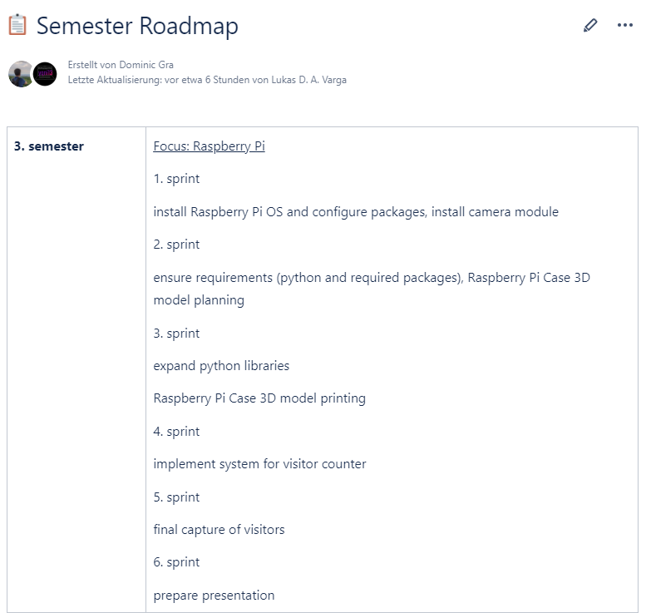
Status
raspberry pi 4 + camera module working well
additional element (PoE - Power over Ethernet) defect and will be replaced
software & packages installed
system for recognition implemented (first version)
3D case planned but print delayed due to Covid-19

Slide 8
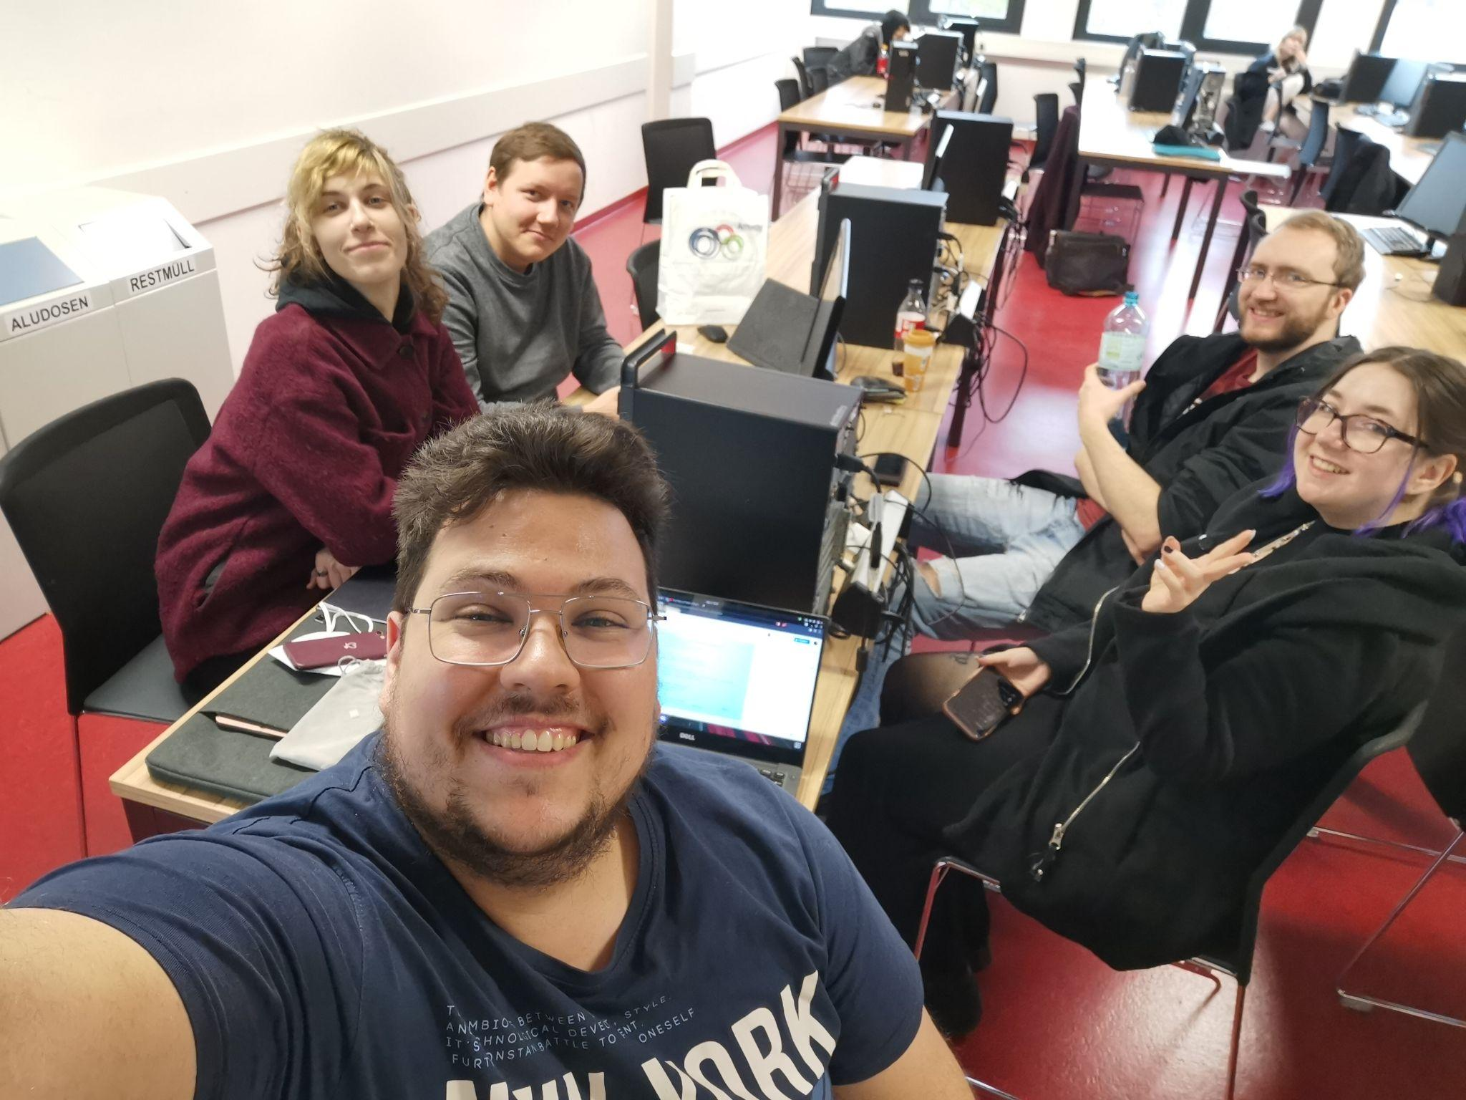
End of current phase
1 of 3 semesters done
start of upcoming phase #2 in late february 2022
same team, more quality
Stefan Düx | Jessica Isabella Görög | Dominic Grabner | Rebekka Tscheppen | Lukas Varga
Visitor-Counter | Gruppe 29 | BIF3 | Innovation Lab 1 | “the Observer”

