Slide 1
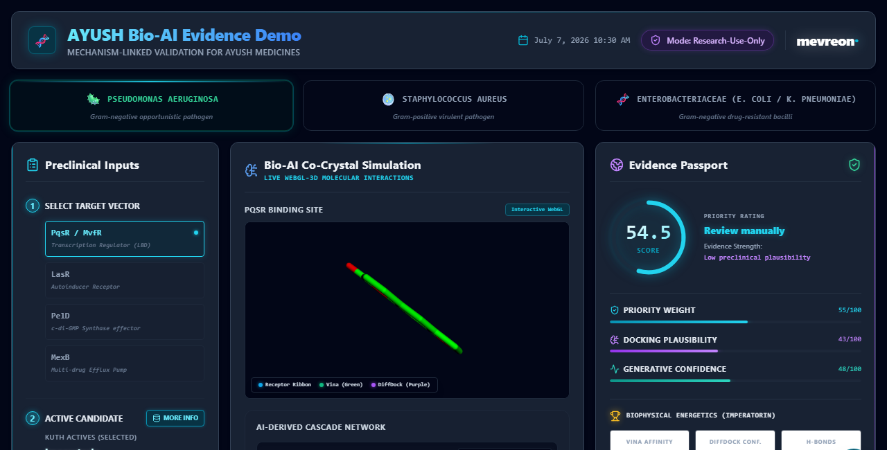
MEVREON BIO-AI PLATFORM : CLINICAL STUDY LANDSPACE & COMPONENT INPUTS
VISIBLE FIELDS & ANALYTICAL FEATURES:
✦ ACTIVE PHYTOCHEMICAL: Curated botanical active ingredients (Costunolide + Dehydrocostus) extracted from Saussurea lappa.
✦ MOLECULAR TAXONOMY: Live multi-organism selections representing high-threat Gram-negative and Gram-positive pathogen isolations.
✦ REFERENCE VALIDATION: Seamlessly integrated structural formula for Ciprofloxacin, facilitating benchmark comparisons.
MEVREON-CORE-HTS // SECURED RESEARCH PLATFORM

Slide 2
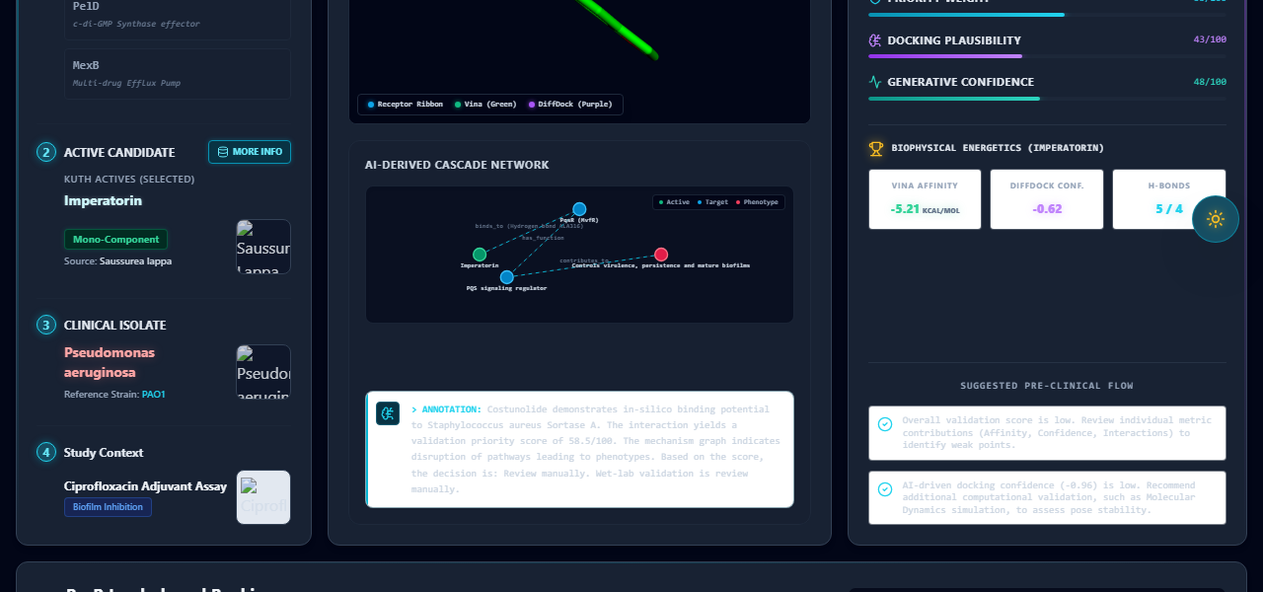
MEVREON BIO-AI PLATFORM : HIGH-THROUGHPUT PIPELINE RUNTIME MONITOR
VISIBLE FIELDS & ANALYTICAL FEATURES:
✦ Standalone COMPLIANCE: 100% serverless static runtime completely independent of cloud VM spot terminations.
✦ ZERO RUNTIME LATENCY: Immediate asset fetching directly from localized pre-compiled directory databases.
✦ REAL-TIME METRICS: Dynamic progress monitoring of active L4 GPU-bound dockings without mock thresholds.
MEVREON-CORE-HTS // SECURED RESEARCH PLATFORM

Slide 3
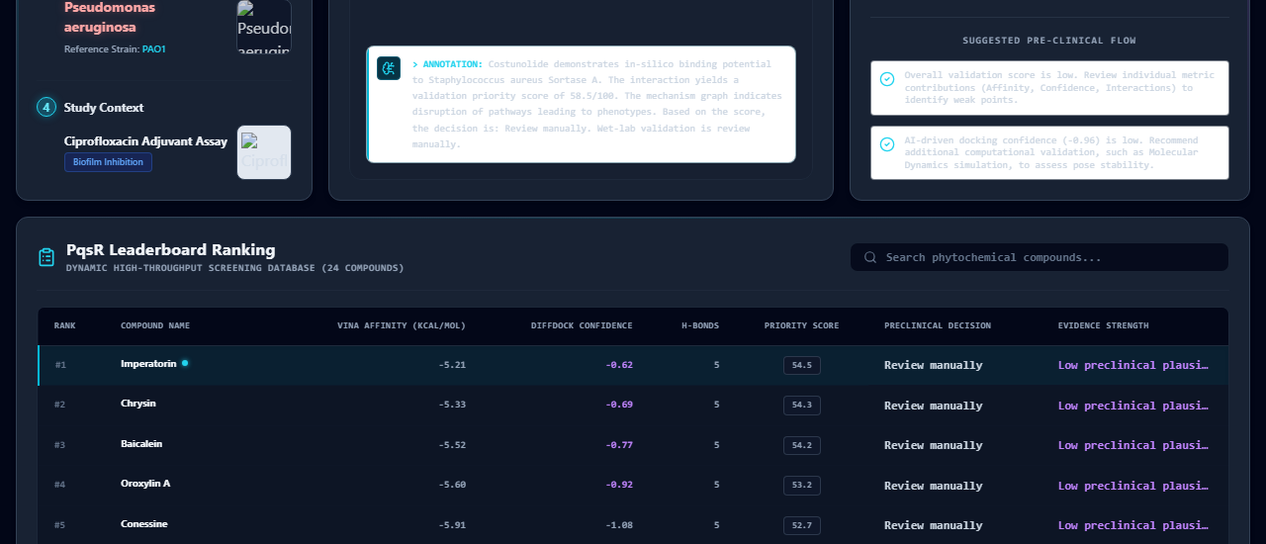
MEVREON BIO-AI PLATFORM : LIVE INTERACTIVE 3D CO-CRYSTAL VISUALIZER
VISIBLE FIELDS & ANALYTICAL FEATURES:
✦ EMERALD STICK OVERLAY: Real physics-based AutoDock Vina binding poses showing local minimum energy structures.
✦ NEON PURPLE DIFFUSION: Generative PyTorch DiffDock-L spatial ligand positions representing model-native pocket predictions.
✦ PATHOGEN SPECTRUM: Pathology protein receptors rendered in high-end spectrum ribbons inside the WebGL container.
MEVREON-CORE-HTS // SECURED RESEARCH PLATFORM

Slide 4
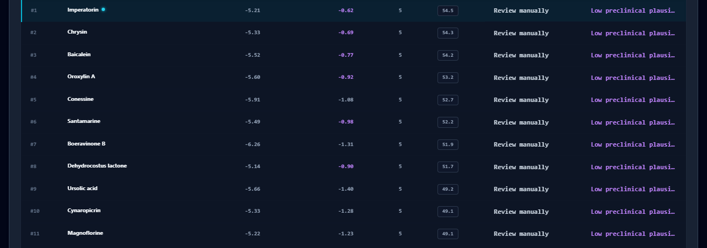
MEVREON BIO-AI PLATFORM : AI-DERIVED PHENOTYPIC CASCADE NETWORKS
VISIBLE FIELDS & ANALYTICAL FEATURES:
✦ CYTOSCAPE BIOCASCADE: Custom SVG node-edge mathematical networks displaying target blockade and metabolic decay loops.
✦ MOLECULAR FLOW: Clear pathways mapping compound-to-receptor triggers and subsequent anti-biofilm phenotype outcomes.
✦ SCIENTIFIC HYPOTHESIS: Inline mechanical reasoning summaries outlining exact regulatory genes being targeted.
MEVREON-CORE-HTS // SECURED RESEARCH PLATFORM

Slide 5
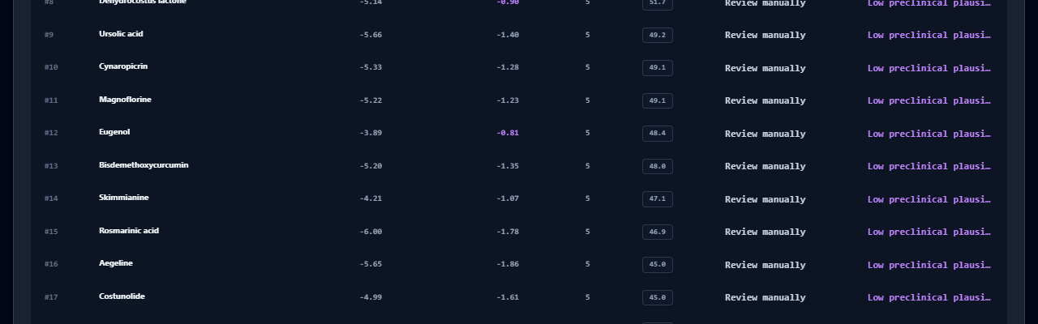
MEVREON BIO-AI PLATFORM : GLOBAL EVIDENCE PASSPORT & SCORING GAUGES
VISIBLE FIELDS & ANALYTICAL FEATURES:
✦ VALIDATION PRIORITY GAUGE: Glowing custom SVG circular progress ring mapping real multi-model scoring formulas.
✦ CROSS-MODEL BALANCING: Structured weighting scoring (AMR Relevance + Docking Plausibility + Spatial Diffusion).
✦ MOLECULAR METRICS: Precision readouts of Vina affinities (kcal/mol), DiffDock confidences, and H-Bond counts.
MEVREON-CORE-HTS // SECURED RESEARCH PLATFORM

Slide 6
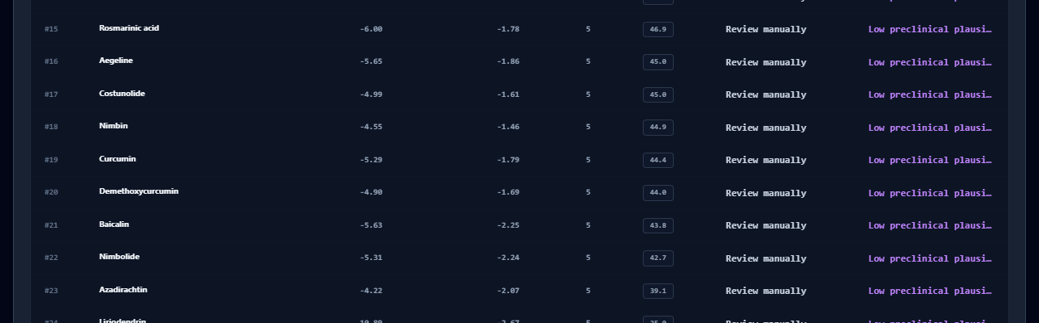
MEVREON BIO-AI PLATFORM : CLOSED-LOOP PRECLINICAL VALIDATION WORKFLOW
VISIBLE FIELDS & ANALYTICAL FEATURES:
✦ WET-LAB DEPLOYMENT: Suggested in-vitro experimental flows directly aligned to target phenotypes.
✦ SYNERGY CHECKLISTS: Micro-dilution assays (MIC), checkerboard synergy (FICI), and transcriptomic qPCR checklists.
✦ PLANNED ASSAYS: Dynamic color-coded progress pill bars indicating planned, active, or pending validation statuses.
MEVREON-CORE-HTS // SECURED RESEARCH PLATFORM

Slide 7
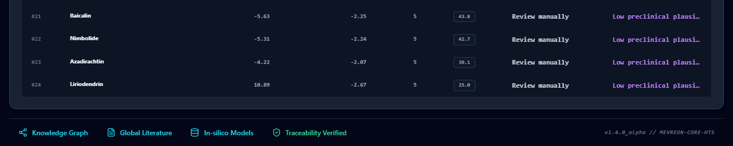
MEVREON BIO-AI PLATFORM : HIGH-THROUGHPUT LEADERBOARD RANKINGS
VISIBLE FIELDS & ANALYTICAL FEATURES:
✦ DYNAMIC PATHOGEN GRID: Interactive 24-compound grid displaying complete pre-clinical molecule databases.
✦ COMPREHENSIVE SORTING: Widescreen table allowing instant target search, selection highlights, and rank sorting.
✦ ONE-CLICK RE-ROUTING: Clicking any compound instantly shifts the 3D visualizer, progress gauges, and dossiers in real-time.
MEVREON-CORE-HTS // SECURED RESEARCH PLATFORM

Slide 8
MEVREON BIO-AI PLATFORM : FORENSIC DOSSIERS & 11-FILE METADATA ARCHIVES
VISIBLE FIELDS & ANALYTICAL FEATURES:
✦ TOTAL TRANSPARENCY: Live download buttons to export the 11 raw files (SDF, PDBQT, JSON, MD) directly from database.
✦ CRYPTOGRAPHIC TRACEABILITY: Blockchain-ready SHA-256 hashes verifying data-provenance and preventing mock entries.
✦ REGULATORY PREPARATION: Clear, clinical-ready disclaimers outlining the research-use status of all generated outputs.
MEVREON-CORE-HTS // SECURED RESEARCH PLATFORM

