Slide 1

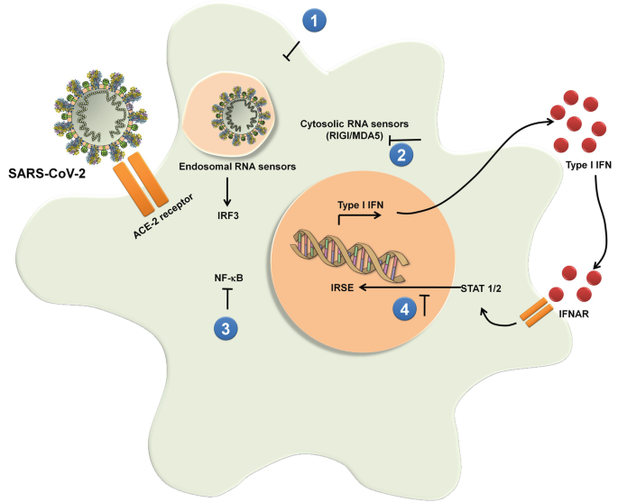

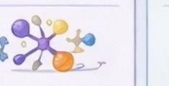

From AYUSH, Pathogen, and Host Biology to Ranked Anti-Infective Decisions
MEVREON
Mevreon unifies AYUSH evidence, AMR pathogen biology, and host-response signals into one explainable anti-infective ranking decision
Parallel biological signals
PATIENT, PATHOGEN & AYUSH INPUTS
Host-Response & Infection Severity Modulation
Combination
Safety & Efficacy
Target &
Pathway Relevance
Drug–Target
Plausibility
RANKED
THERAPY OUTPUTS
ESKAPE
pathogens
Will this AYUSH regimen reduce infection burden or improve host-response biology?
Which AYUSH–antimicrobial combination has the best benefit-risk balance?
Which resistance mechanisms, virulence drivers, or biofilm pathways matter most here?
Does the AYUSH candidate or combination still fit the pathogen and host biology?
Ranked AYUSH candidates/combinations
Antimicrobial Resistant
(AMR) patients
Evidence-linked biological rationale
Multi-drug resistance
(MDR)
Regulatory readiness
✓ Host-response score
✓ Efficacy score
✓ Key pathways
✓ Genotype/phenotype fit
Faster clinical translation
Genomics
Metabolomics
Transcriptomics
✓ Severity / recurrence risk flag
✓ Safety risk flag
✓ Resistance clues
✓ Binding plausibility
Harmonize inputs • Calibrate evidence • Rerank AYUSH options • Quantify uncertainty
MEVREON FUSION LAYER
Clinical Context
Resistant Types
Prior Therapy &
Response
Multi-omics Integration
Ranked outputs
Comorbidities
Clinical profiling
of patients
Fusion
Candidate Regimens
NLEAM-Based AYUSH Library
Regimen A (AYUSH)
Regimen B (Antibiotics)
Explainable AI-based anti-infective prioritization
Regimen C (Combination)
Notes:
This architecture represents the translational layer of the original proposal, where standardized AYUSH candidates, AMR pathogen biology, clinical profiling, and selected host multi-omics are fused into an explainable ranking engine for AYUSH-only and AYUSH–antimicrobial combination decisions.

Slide 2
From Patient Biology to Ranked Therapy Decisions
MEVREON
Mevreon unifies parallel biological signals into one explainable treatment decision
Parallel biological signals
PATIENT &
TREATMENT INPUTS
Immunotherapy
Response
Combination
Safety & Efficacy
Target &
Pathway Relevance
Drug–Target
Plausibility
RANKED
THERAPY OUTPUTS
ESKAPE
pathogens
Will this therapy
disseminate to
AMR severity?
Which combination
has the best
benefit-risk balance?
Which tumor
drivers matter
most here?
Does the drug
still fit the biology?
Antimicrobial Resistant
(AMR) patients
NLEAM validation
Regulatory readiness
Multi-drug resistance
(MDR)
✓ Efficacy score
✓ Key pathways
✓ Mutation impact
Faster clinical translation
Genomics
Metabolomics
Transcriptomics
✓ Safety risk flag
✓ Resistance clues
✓ Binding plausibility
Clinical Context
MEVREON FUSION LAYER
Resistant Types
Prior Therapy &
Response
Multi-omics Integration
Ranked outputs
Comorbidities
Clinical profiling
of patients
Fusion
Candidate Regimens
NLEAM-Based AYUSH Library
Regimen A (AYUSH)
Regimen B (Antibiotics)
Explainable AI-based therapy prioritization
Regimen C (Combination)

