Slide 1
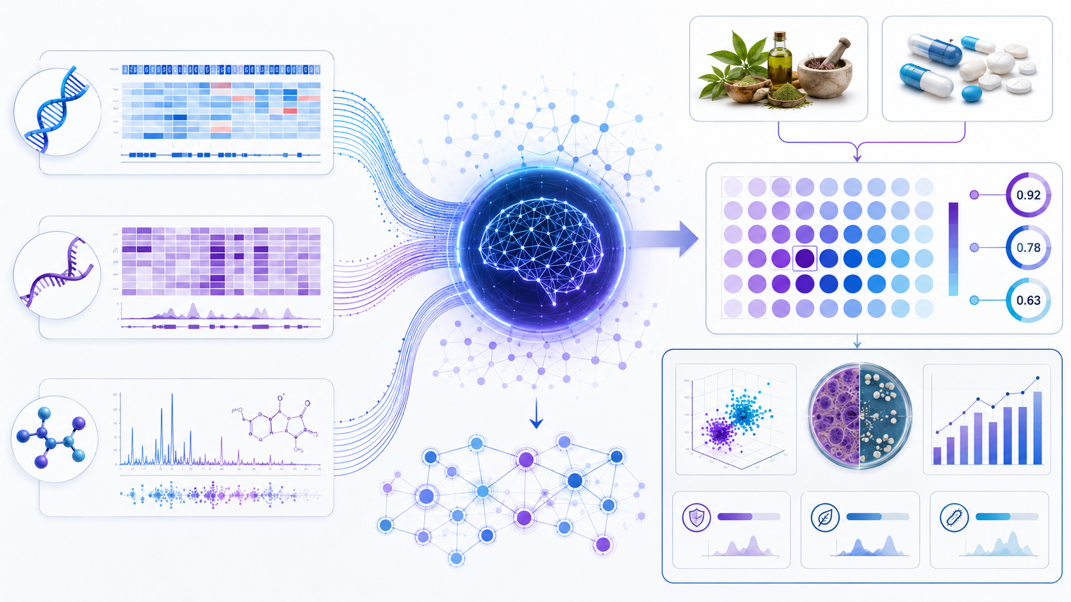
Materials & Methods
ESKAPE Multi‑Omics & AYUSH Adjunct Discovery Program
Six-objective translational workflow integrating WGS, RNA‑Seq, LC/GC‑MS, in vitro AYUSH bioactivity screening, AI modeling, and in vivo multi‑omics.
Goal: build an India-specific clinical isolate repository and discover AYUSH–antibiotic combination signatures for MDR ESKAPE pathogens.
Enterococcus faecium • Staphylococcus aureus • Klebsiella pneumoniae • Acinetobacter baumannii • Pseudomonas aeruginosa • Enterobacter spp.

Slide 2
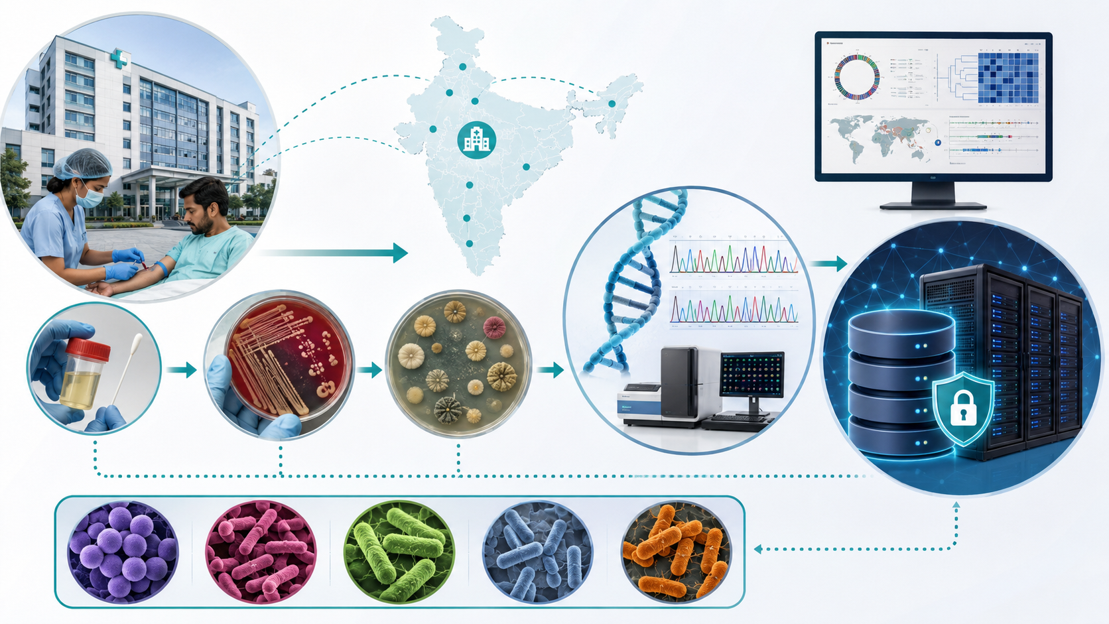
Six-objective study architecture
From hospital MDR isolates to AI-prioritized AYUSH–antibiotic regimens and translational biomarkers
Clinical WGS repository
01
500 MDR isolates, resistome, mobilome and phylogeny
RNA‑Seq atlas
02
Untreated vs antibiotic vs AYUSH exposure signatures
Metabolome atlas
03
LC‑MS/GC‑MS pathway and biomarker shifts
Bioactivity screen
04
MIC, biofilm inhibition and synergy matrix
Multimodal AI
05
Predict efficacy and prioritize combinations
Common design principle
In vivo translation
Every sample carries a common isolate ID, exposure metadata, QC status, phenotype readouts and omics feature matrices.
06
Host–pathogen biomarkers in mouse model
Primary endpoint: ranked compound–pathogen response matrix
Secondary endpoint: biomarker signatures for treatment response
Clinical ESKAPE multi-omics + AYUSH-adjunct discovery program
02

Slide 3
Objective 1 — Clinical Genomic Surveillance
OBJ 1
Collect, culture, sequence, and annotate 500 MDR ESKAPE clinical isolates from tertiary-care hospitals
Wet-lab methods
Data analytics & QC
Prospective isolate collection with source, ward, antibiogram and de-identified metadata
Read QC, de novo assembly, contamination/completeness checks and species confirmation
Species confirmation by MALDI/biochemical methods plus AST-linked resistance phenotype
ARG, plasmid, integron, transposon and virulence annotation using curated databases
WGS library preparation; Illumina short-read sequencing with optional long-read plasmid closure
Core-genome phylogeny, MLST/cgMLST, pan-genome clustering and outbreak relatedness
Defined deliverable
India-specific WGS repository of 500 ESKAPE isolates with full resistome, mobilome and phylogenomic classification.
Clinical ESKAPE multi-omics + AYUSH-adjunct discovery program
03

Slide 4
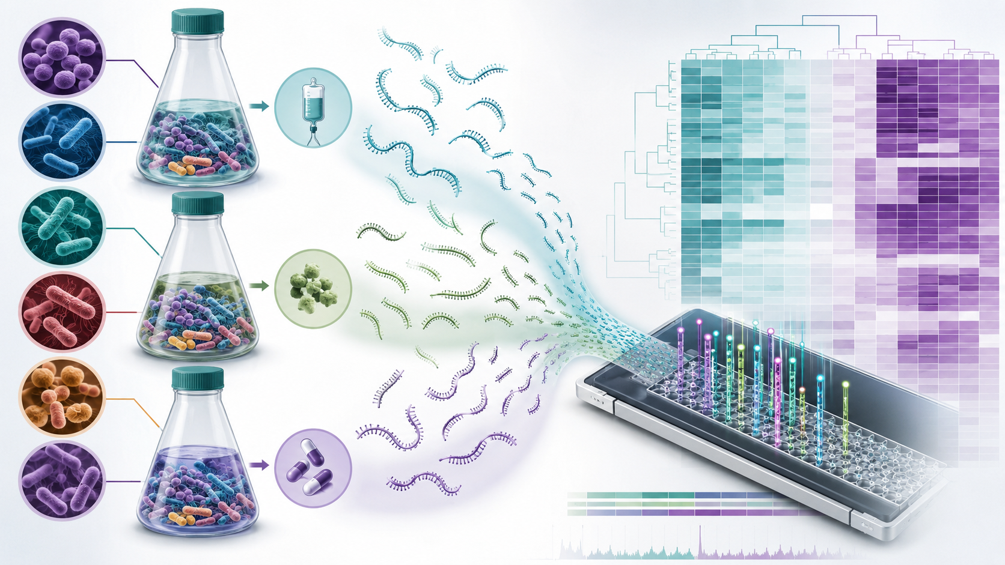
Objective 2 — Transcriptomic Profiling
OBJ 2
RNA‑Seq of representative isolates under untreated, sub‑MIC antibiotic, and AYUSH compound exposure
Wet-lab methods
Data analytics & QC
Select isolates spanning six species, major resistance classes and WGS-defined lineages
FastQC/read trimming, host/rRNA depletion checks, genome-guided alignment and gene counts
Three exposure arms: normal growth, sub-MIC conventional antibiotic, AYUSH bioactive compound
Differential expression, pathway enrichment and stress-response module analysis
Time-matched RNA stabilization, rRNA depletion and stranded bacterial RNA‑Seq libraries
Compare AYUSH-modulated signatures against antibiotic-induced response programs
Defined deliverable
Condition-specific transcriptome atlases and gene modules perturbed by AYUSH compounds versus conventional antimicrobials.
Clinical ESKAPE multi-omics + AYUSH-adjunct discovery program
04

Slide 5
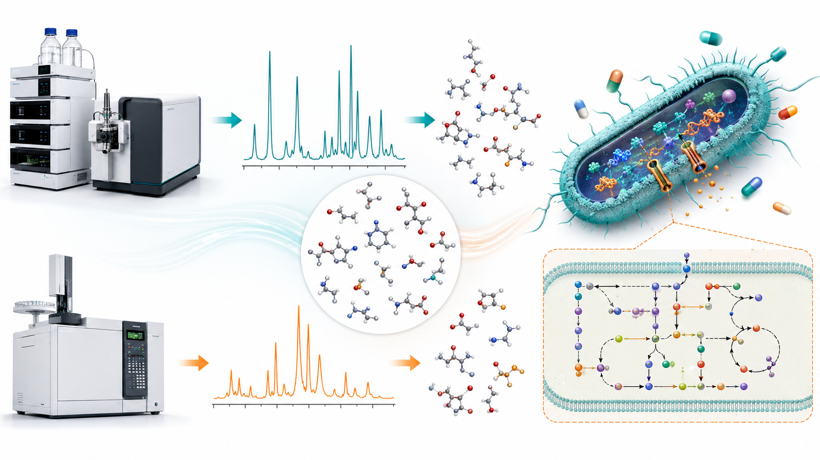
Objective 3 — Metabolomic Characterization
OBJ 3
Untargeted and targeted LC‑MS/GC‑MS profiling to reveal metabolic and virulence-linked shifts
Wet-lab methods
Data analytics & QC
Matched cultures from untreated, antibiotic-treated and AYUSH-treated conditions
Peak picking, alignment, normalization, batch correction and QC pooled-sample monitoring
Quenched biomass plus extracellular metabolite extraction with internal standards
Metabolite annotation, pathway mapping and differential abundance testing
Untargeted LC‑MS/GC‑MS, followed by targeted validation of selected pathway metabolites
Integrate metabolites with DE genes to identify disrupted biosynthetic nodes
Defined deliverable
Comparative metabolite datasets identifying AYUSH-responsive metabolic signatures and candidate biomarkers for treatment monitoring.
Clinical ESKAPE multi-omics + AYUSH-adjunct discovery program
05

Slide 6
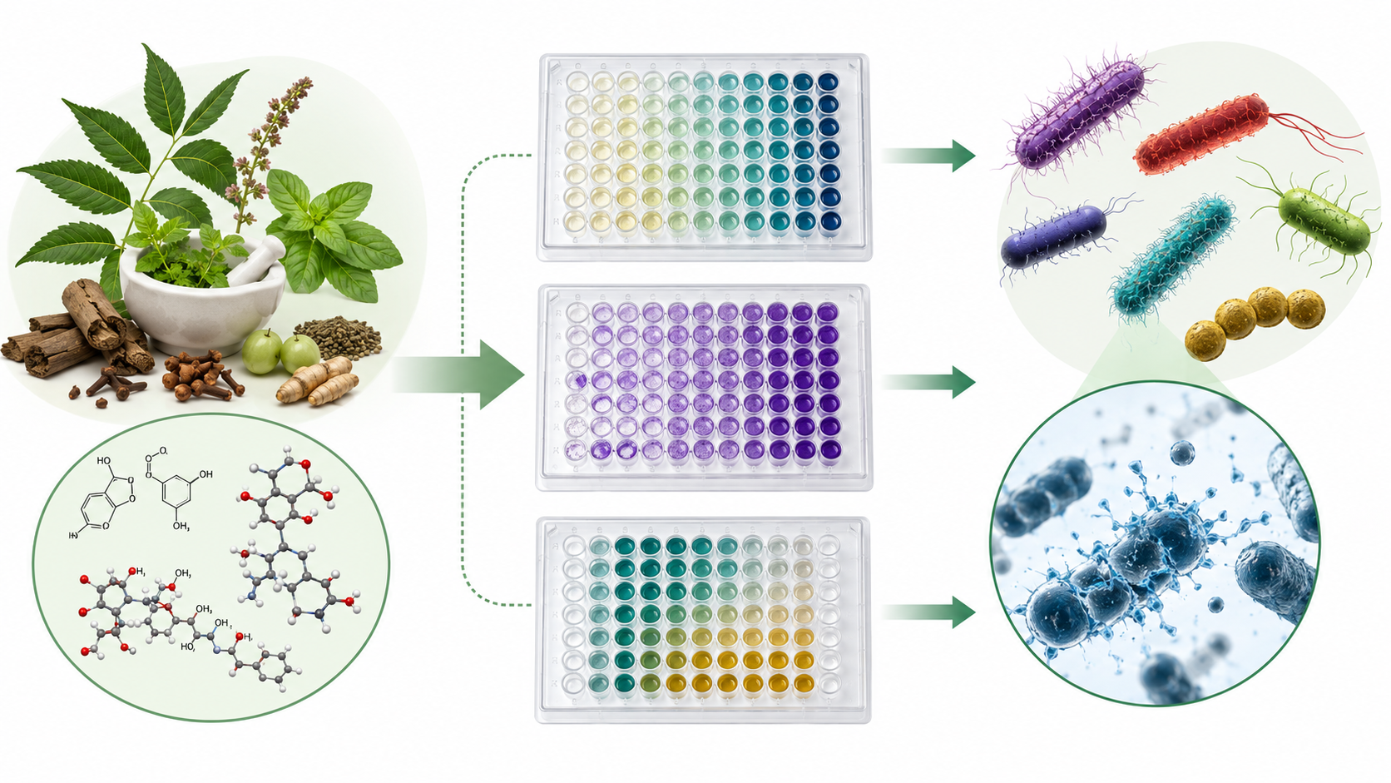
Objective 4 — AYUSH Compound Bioactivity Screening
OBJ 4
Screen 30–50 curated AYUSH-derived phytochemicals against MDR clinical isolates of all ESKAPE species
Wet-lab methods
Data analytics & QC
Curated compound library from Ayurveda, Unani and Siddha pharmacopoeias; purity and solubility tracked
Activity matrix by species, genotype, resistance phenotype and exposure concentration
Broth microdilution MIC/MBC assays across representative MDR isolate panels
FICI/bliss-style synergy analysis with reproducibility thresholds and cytotoxicity flags
Crystal-violet biofilm assay, viable biofilm counts and checkerboard antibiotic synergy
Rank compounds by potency, biofilm inhibition, synergy and multi-species breadth
Defined deliverable
Validated AYUSH compound–ESKAPE activity matrix with MIC, anti-biofilm potency and synergy indices.
Clinical ESKAPE multi-omics + AYUSH-adjunct discovery program
06

Slide 7
Objective 5 — AI-Guided Multimodal Integration
OBJ 5
Develop a web-accessible model integrating genomics, transcriptomics, metabolomics and phenotypic response data
Wet-lab methods
Data analytics & QC
Create common isolate–condition–compound data model and harmonized feature tables
Nested cross-validation, species-stratified test splits and calibration analysis
Inputs: ARGs, plasmids, SNP/cgMLST, expression modules, metabolites, MIC/biofilm/FICI outcomes
Feature attribution to identify genotypes, pathways and metabolites linked to response
Train interpretable ML models and multimodal embeddings for compound-response prediction
Prioritize AYUSH–antibiotic combinations for each species/resistance profile
Defined deliverable
Validated multimodal AI prototype that predicts AYUSH compound efficacy and prioritizes combination regimens.
Clinical ESKAPE multi-omics + AYUSH-adjunct discovery program
07

Slide 8
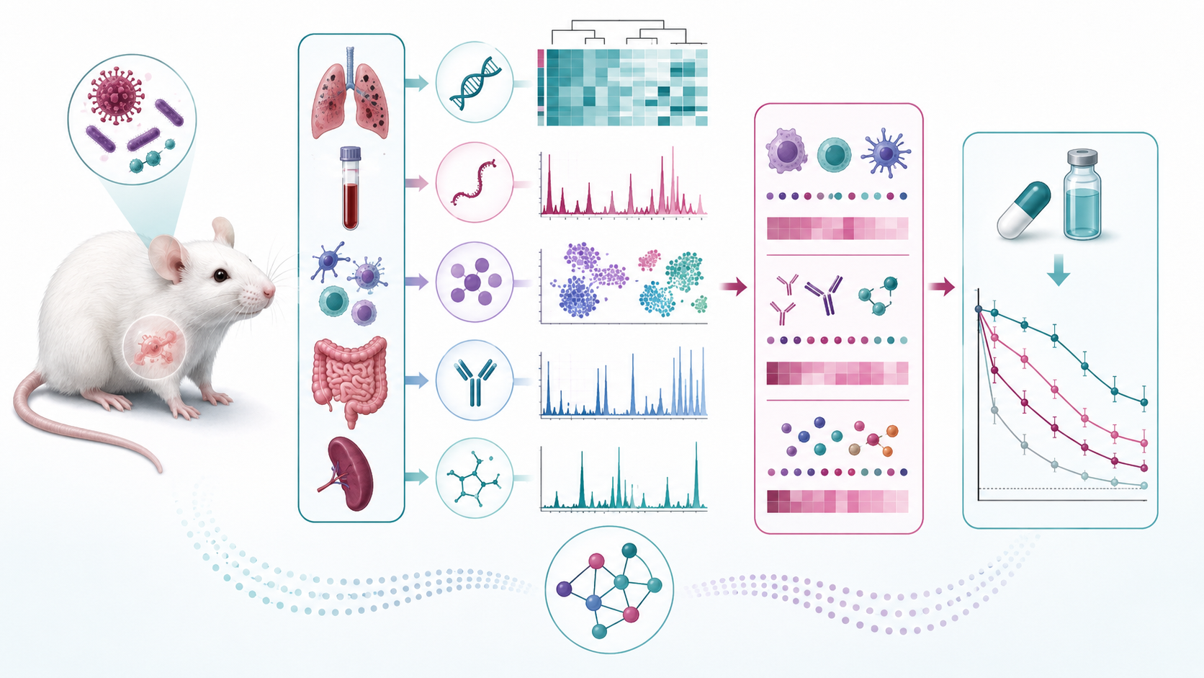
Objective 6 — In vivo Multi‑Omics & Translational Signatures
OBJ 6
Pair pathogen omics with infected mouse host transcriptomics/metabolomics under adjunct treatment protocols
Wet-lab methods
Data analytics & QC
Establish infection models with selected MDR isolates and treatment arms
Integrate host inflammation, pathogen burden, survival/clinical score and omics signatures
Collect infected tissue, blood/serum and pathogen load measurements at defined timepoints
Identify response-linked biomarker panels and compare with in vitro prediction outputs
Profile host transcriptome/metabolome alongside recovered pathogen phenotypes and omics
Generate translational signatures to guide future patient stratification assays
Defined deliverable
Proof-of-concept translational dataset and candidate multi-omics biomarkers for AYUSH-adjunct response prediction.
Clinical ESKAPE multi-omics + AYUSH-adjunct discovery program
08

Slide 9
Cross-cutting quality, governance and final outputs
Standardized metadata, assay QC, reproducible bioinformatics and model validation across the six objectives
Isolate ID
Wet-lab QC
Omics matrices
Response labels
AI model
Repository contents
• WGS assemblies, ARG/mobilome/virulome tables and phylogenomic labels
• RNA‑Seq count matrices, DE results and pathway modules
• LC‑MS/GC‑MS feature tables, annotated metabolites and pathway shifts
• MIC/MBC, biofilm inhibition and synergy matrices
• AI-ready multi-omics feature store plus web prototype outputs
Final grant-facing outputs
Validation logic
1. India-specific WGS repository
2. Transcriptome + metabolome atlases
3. Ranked AYUSH activity matrix
4. Multimodal AI prediction prototype
5. In vivo response-linked biomarker panel
Assay reproducibility → cross-omics concordance → phenotype prediction → in vivo translational confirmation.
Study-ready for grant submission, partner onboarding and assay SOP finalization.
Clinical ESKAPE multi-omics + AYUSH-adjunct discovery program
09

