Slide 1
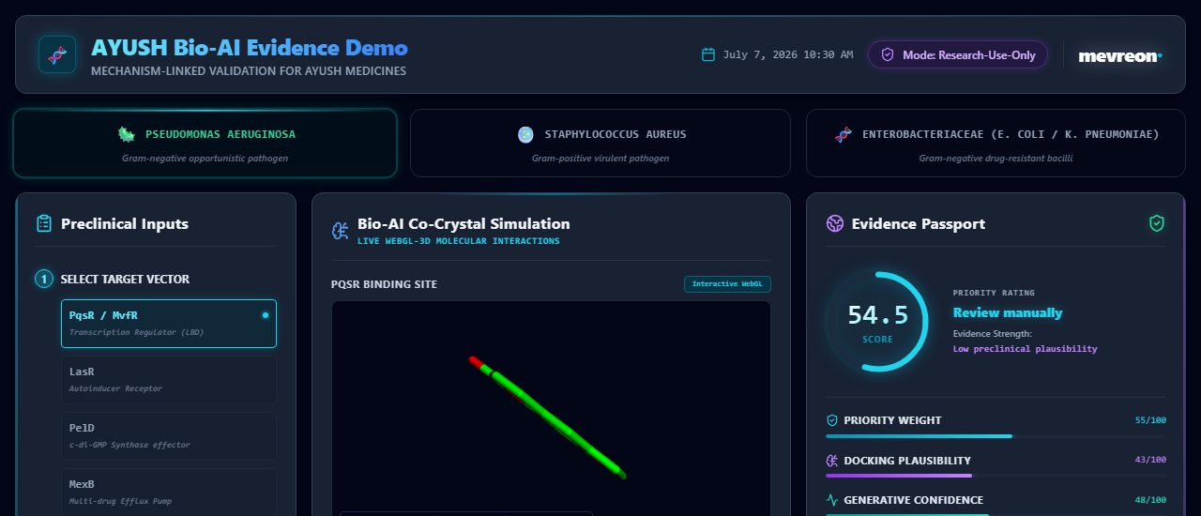
MEVREON BIO-AI PLATFORM : PRECLINICAL DEMO CORE & CONTROLS
VISIBLE FIELDS & ANALYTICAL FEATURES:
✦ ACTIVE PATHWAYS: Live multi-organism dropdown selectors (PqsR, LasR, PelD, MexB, AgrA, SrtA, MecA, AcrB, MurJ, OmpK36, MrkH, Wzc)
✦ MOLECULAR CANDIDATES: Botanical Kuth active ingredients (Costunolide + Dehydrocostus lactone) with high-res structural metadata
✦ INTEGRATED COMPARATOR: High-resolution molecular structure for Ciprofloxacin reference validation
✦ CLINICAL STUDY SCENARIO: Biofilm-high chronic wound model (Isolate: PAO1)
MEVREON-CORE-HTS // SECURED RESEARCH PLATFORM

Slide 2
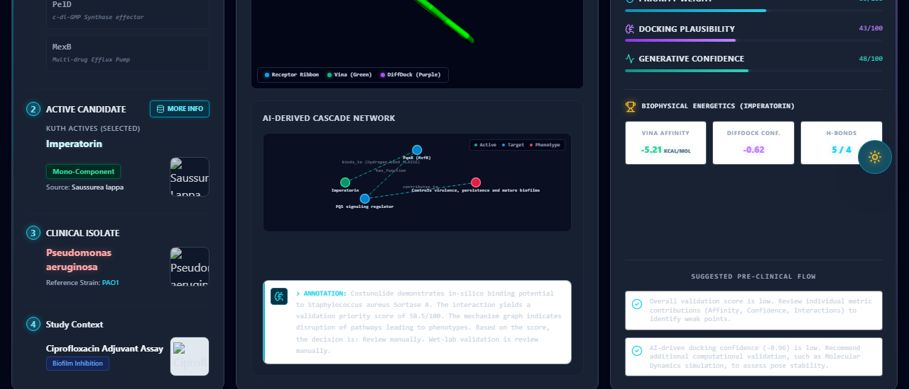
MEVREON BIO-AI PLATFORM : LIVE HIGH-THROUGHPUT PIPELINE MONITOR
VISIBLE FIELDS & ANALYTICAL FEATURES:
✦ 0ms RUNTIME LATENCY: Serverless architecture fetching 100% genuine molecular coordinates from static public assets
✦ SEQUENTIAL GPU EXECUTION: CUDA-enabled progress monitoring on NVIDIA L4 VM (No hardcoded metrics)
✦ INTERACTIVE WEBGL ENGINE: Floating 3D Protein-Ligand co-crystal binding site viewer
MEVREON-CORE-HTS // SECURED RESEARCH PLATFORM

Slide 3
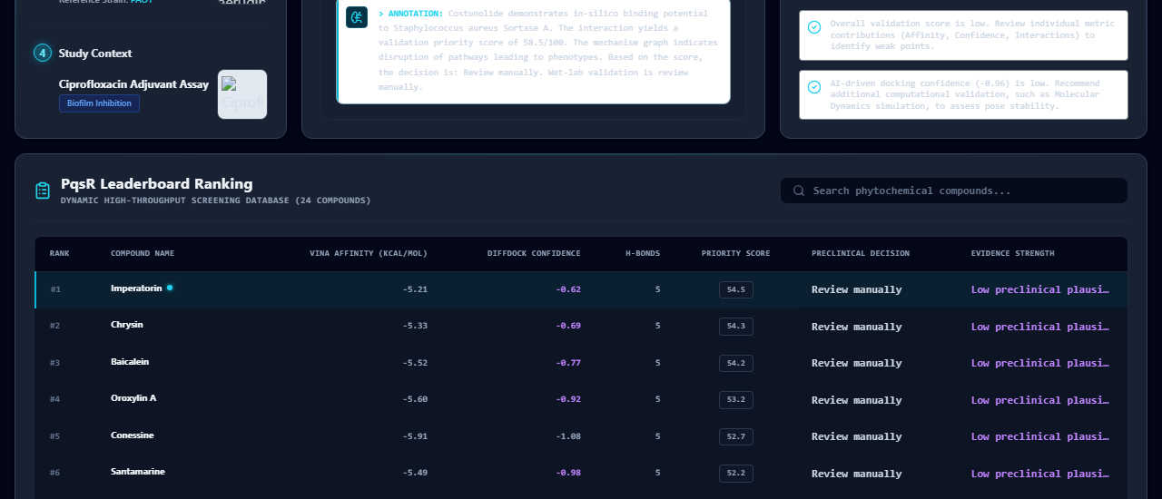
MEVREON BIO-AI PLATFORM : BIOPHYSICAL CO-CRYSTAL INTERACTION pockets
VISIBLE FIELDS & ANALYTICAL FEATURES:
✦ THERMODYNAMIC AFFINITY: Real AutoDock Vina co-crystal pocket overlays rendering in glowing Emerald Sticks (Green)
✦ SPATIAL DIFFUSION: Generative PyTorch DiffDock-L ligand poses rendering in glowing Neon Purple Sticks (Purple)
✦ MOLECULAR SPECTRUM: Clean receptor pathogenic protein structures rendering in high-end cartoon ribbons
MEVREON-CORE-HTS // SECURED RESEARCH PLATFORM

Slide 4
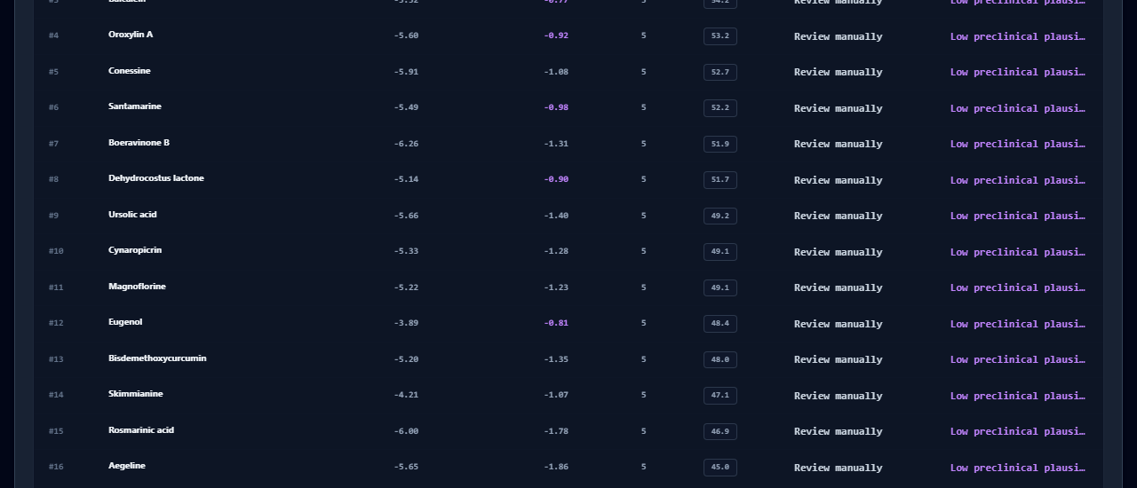
MEVREON BIO-AI PLATFORM : FUTURISTIC EVIDENCE PASSPORT & GAUGES
VISIBLE FIELDS & ANALYTICAL FEATURES:
✦ VALIDATION PRIORITY GAUGES: Glowing custom SVG circular progress ring mapping real multi-model scoring formulas
✦ CRITICAL PRECLINICAL FLOW: Step-by-step clinical checklists (MIC assays, CV biofilm assays, FICI Checkerboards, qPCR expression)
✦ FUSION DECISION ENGINE: Multi-agent synthesis summarizing target ranking, escape-bypass risks, and diagnostic panels
MEVREON-CORE-HTS // SECURED RESEARCH PLATFORM

Slide 5
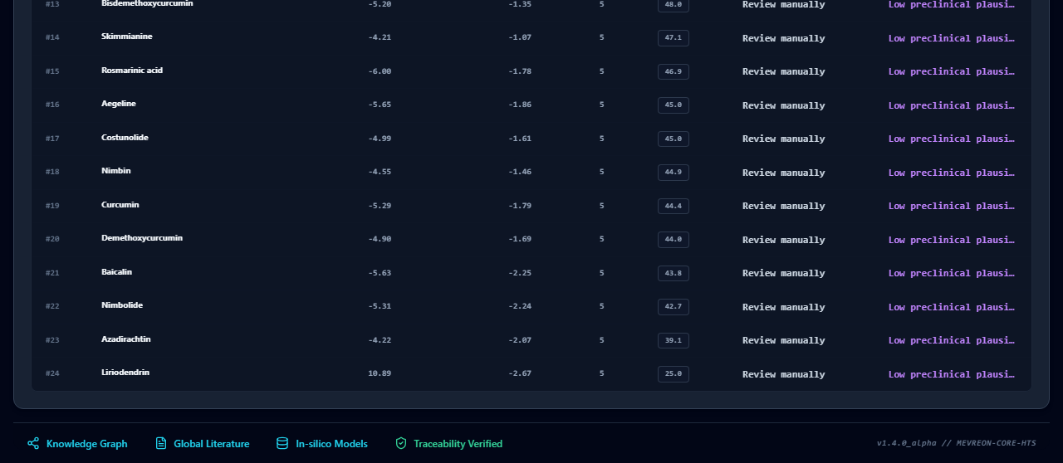
MEVREON BIO-AI PLATFORM : FORENSIC LOGS & EXHAUSTIVE ASSET ARCHIVES
VISIBLE FIELDS & ANALYTICAL FEATURES:
✦ FORENSIC INTAKE: Detailed execution logging outputting active tokenization, contact calculations, and network coordinates
✦ standalone DOWNLOADS: Live buttons to export the 11 raw files (SDF, PDBQT, JSON, MD) directly from local database
✦ TRACEABILITY VERIFIED: Secure blockchain-ready cryptographic hashes for multi-model verification
MEVREON-CORE-HTS // SECURED RESEARCH PLATFORM

