Slide 1

Pact
The merchant’s agent
for every deal
Notes:
Opening. Let the title sit for a beat before speaking.
Imagine you own an audio store. It’s eleven at night. You’ve closed the doors. But someone is still asking for a deal. The customer hasn’t visited your website. She’s sent her agent. Who answers for your store? That’s why we built Pact.
Source: pact/README.md, pact/agents/zoowork_merchant.py. Original glass illustration generated for this presentation, not a manufacturer asset. Visual direction inspired by the restrained product focus of https://www.apple.com/apple-events/ and spatial topic navigation described at https://support.prezi.com/hc/en-us/articles/360003478254-Prezi-Present-FAQ.

Slide 2

Shopper agents
are arriving
Who speaks for the store?
Notes:
Advance to the white headphones. Introduce the shopper as an illustrative character.
Let’s call our shopper Maya. She wants great headphones, and she has three hundred dollars. Her agent can search for a price. It can ask for better terms. But to reach a deal, it needs someone on the other side who can actually negotiate.
Source: pact/README.md, pact/scenario.py. Headphone image is an original AI-generated illustration in pact/web/assets, not an official product photograph.

Slide 3
Your store
has a voice
18%
Merchant Agent
Negotiates inside the rules you set
minimum profit
Aria Audio demo policy. Private product and deal costs stay with the merchant.
Notes:
Point to 18%. Explain it in everyday language.
On the other side is Sam, the owner of Aria Audio. Sam wants the sale. He also needs to protect his business. In our demo, he sets an eighteen percent minimum after product and deal costs. His merchant agent can negotiate within that rule. The private costs stay with the store.
Source: pact/scenario.py MerchantState, pact/engine.py net_revenue and margin_pct, pact/agents/zoowork_merchant.py.

Slide 4

“Sony XM5.
Under $300.”
$300
$250
spending limit
ask me above
Notes:
Give the audience a moment to distinguish the two limits.
Maya gives her agent two different instructions. Three hundred dollars is the most she’ll spend. Above two hundred and fifty, the agent has to ask her first. That difference matters. A deal can fit the budget and still need permission.
Source: pact/scenario.py ShopperState and pact/web/index.html boundaryForm.

Slide 5
One request.
Two merchants.
$299.99
Aria Audio
Silver. Next-day delivery. 45-day returns.
Illustrative preset deal. The shopper compares fit as well as price.
Notes:
Reveal the large price. Slow down for the terms.
Now the agents work. Maya’s agent compares two merchants. Aria has more stock in silver, so its agent can offer a better deal on that color. In this preset, they settle on two hundred ninety-nine dollars and ninety-nine cents, next-day delivery, and forty-five-day returns. That’s thirty dollars below Aria’s list price.
Source: pact/hunt.py fit and snapshot, pact/engine.py offer_fit, demo screenshot captured from the local fallback run on 2026-10-03.

Slide 6
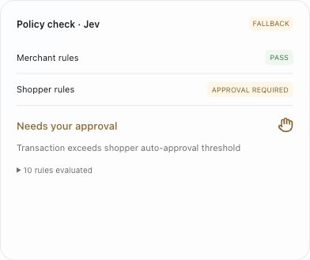
Agreement
needs authority
$299.99
Inside the $300 budget
Above the $250 approval limit
Notes:
Pause briefly after the first sentence. This is the central reveal.
They have an agreement. They don’t yet have permission to spend. Pact checks the merchant’s rules and Maya’s boundaries. The price fits her three-hundred-dollar budget, but it crosses her two-hundred-and-fifty-dollar approval limit. So Pact stops and asks her.
Source: pact/gate.py local_decision and evaluate, pact/jev.py evaluate, actual demo screenshot.

Slide 7
You approve
$299.99
Then Pact
acts
purchase permission
Checkout and inventory reservation are simulated. No payment is taken.
Notes:
Keep the words You approve visible. Do not imply a real payment.
Maya sees the terms. She can review the negotiation. When she approves, Pact can act. For this hackathon, checkout and inventory reservation are simulated. No real payment is taken. The thing we’re demonstrating is the control: the agent waits for the permission it needs.
Source: pact/deal.py approve and execution, pact/web/index.html showDecision and showDone, actual demo screenshot.

Slide 8
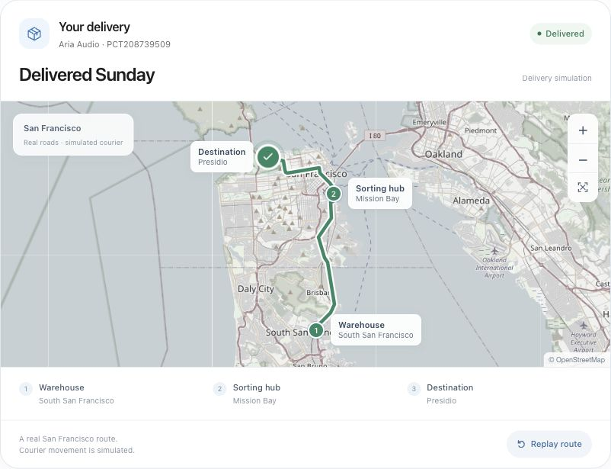
The deal
keeps moving
Delivery stays
in the same thread
Real road geometry. Simulated tracking events and courier movement.
Notes:
Point to the route. Save the animated replay for the live demo.
The conversation continues after checkout. Delivery updates stay with the deal, and Maya can follow the journey. This map follows real San Francisco roads. The tracking events and courier are simulated, so the demo stays easy to present.
Source: pact/deal.py tracking, pact/web/assets/delivery-map.js, pact/DEMO.md, actual demo screenshot. Map data © OpenStreetMap contributors, https://www.openstreetmap.org/copyright.

Slide 9
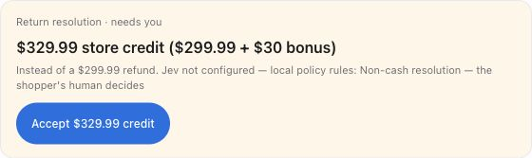
Even when
plans change
$30
store-credit bonus
Illustrative return negotiation. Non-cash resolution requires human approval.
Notes:
Introduce the second act. Emphasize that store credit needs a new decision.
Then Maya tries the headphones. They’re uncomfortable, and she asks for a refund. The agents negotiate again, in the same room. The demo proposes store credit with a thirty-dollar bonus. That changes what Maya receives, so Pact asks for her approval again.
Source: pact/deal.py returns, pact/engine.py return logic, pact/jev.py return authority, pact/scenario.py max_goodwill and store_credit_min_bonus, actual demo screenshot.

Slide 10
Conversion.
With profit protected.
18%
19.7%
merchant minimum
in the illustrated deal
Demo model after product and deal costs. Conversion uplift still needs a pilot.
Notes:
Return the focus to the merchant. Make the evidence limit explicit.
For Sam, the goal is to convert a customer while protecting what the store keeps. Our illustrated deal leaves nineteen-point-seven percent after the model’s product and deal costs, above his eighteen-percent minimum. This is demo arithmetic. A merchant pilot still needs to prove the conversion benefit.
Source: pact/scenario.py MerchantState, pact/engine.py net_revenue and margin_pct. Values correspond to the captured illustrative Aria deal.

Slide 11
Built to act
ZooWork
Jev
Merchant runtime
Authority gate
BAND
Tavily + Moss
Agent negotiation rooms
Price checks and memory
Configured services run live. Each unavailable integration shows a labeled fallback.
Notes:
Name the services once, tied to what each does.
ZooWork gives the merchant agent a runtime. BAND gives the agents their negotiation rooms. Jev checks authority. Tavily checks competitor prices, and Moss carries memory forward. The product shows which services are live and which use a fallback. The rules still apply when a service is unavailable.
Source: pact/README.md integration table, pact/agents/zoowork_merchant.py, pact/agents/merchant_tools.py, pact/band.py, pact/gate.py, pact/jev.py, pact/tavily.py, pact/memory.py.

Slide 12
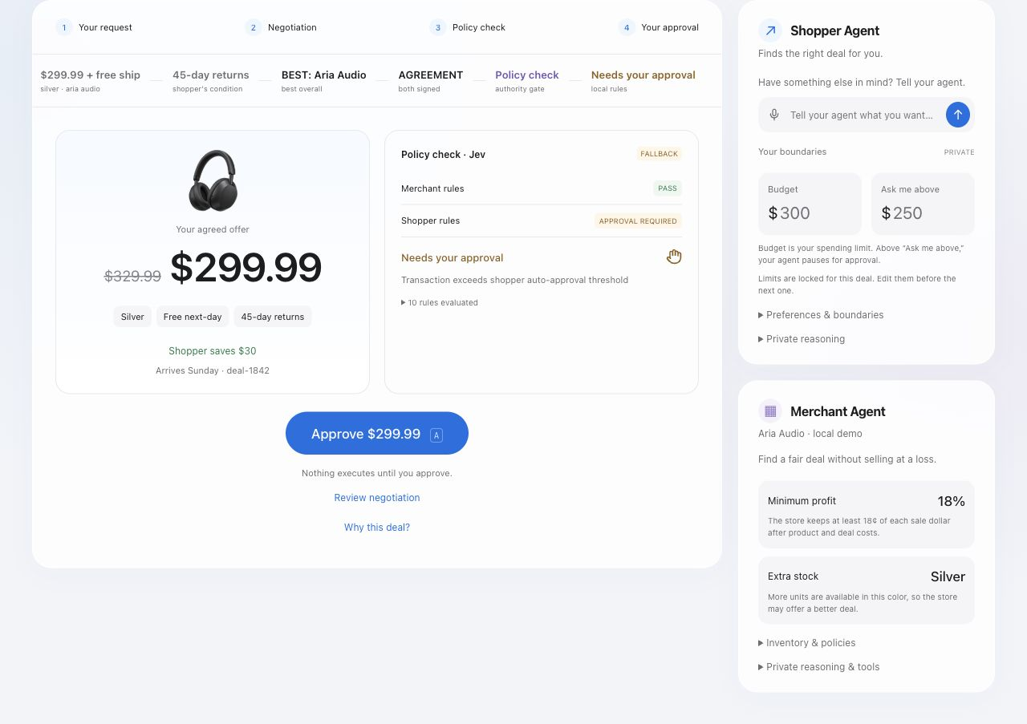
Pact, in action
A request.
An offer.
Your decision.
Open the live demo
Notes:
Switch to the running product for the one-minute demo. If the app is unavailable, stay on the screenshot and walk through the same steps.
Let’s watch Maya’s deal happen. Here is her three-hundred-dollar budget, and here is the ask-me limit. I’ll start the preset. The agents compare offers and negotiate the terms. Now the authority gate pauses for Maya. I’ll approve. The simulated order completes, and the delivery journey appears. One request became a deal, with the store’s rules and the shopper’s permission intact.
Source: pact/DEMO.md and actual demo screenshot.

Slide 13
Pact
Your rules.
Your agent. Your call.
Notes:
Return to the glass artwork. Leave the closing on screen for questions.
At the beginning, Sam’s store was closed and an agent was waiting for an answer. Now the store has a voice. Maya can approve a deal she understands. Sam can keep the rules that protect his business. That’s Pact. Your rules. Your agent. Your call.
Source: pact/README.md and pact/DEMO.md. Original brand artwork. Visual direction references: https://www.apple.com/apple-events/ and https://support.prezi.com/hc/en-us/articles/360003478254-Prezi-Present-FAQ.

