Slide 1
26TH DIGITAL BLUE ECONOMY SUMMIT · EXPERIMENTAL PAPER
ParaSail
Predictive Advisory and Retrieval-Augmented System Advancing Informed Livelihoods
A geospatial decision support system for sustainable fishing, marine conservation and coastal livelihood resilience
Hard conservation constraints
Explainable by retrieval
Adaptable by LoRA fine-tuning
Grounded AI assistant (local)
Anantha Krishnan AS · Naipunnya School of Management, Cherthala, India · September 2026
Notes:
ParaSail fuses live ocean data, species models and conservation rules into one explainable advisory. Interactive deck: the contents slide links to every section; ☰ CONTENTS returns to it from any slide.

Slide 2
CONTENTS
What this deck covers
1
Problem, gap, objectives
2
Architecture and data
The information gap is architectural, not algorithmic
Six layers, open inputs, telemetry, resilient ingestion
3
The advisory engine
4
Geospatial constraints
Dual-collection retrieval, scoring under hard constraints
Ocean-masked zones and real protected-area boundaries
5
Grounded AI assistant
6
Validation
Local VLM, guardrails in code, honest availability
Six test families, gates G1-G6, end-to-end evidence
7
Deployment and impact
8
Conclusion
Hardware tiers, zero marginal cost, who benefits
The five summit questions in one pass
Tap any card to jump to that section; the CONTENTS link on each slide returns here.
Notes:
Interactive contents - each card is a hyperlink to its slide. Use it to jump during Q&A.

Slide 3
THE PROBLEM
☰ CONTENTS
The gap is architectural, not algorithmic
35.5%
11 Mt
~3×
~492 M
of assessed stocks fished beyond sustainable levels
of plastic entering the ocean every year
projected growth of plastic flows by 2040
people supported by small-scale fisheries
FAO SOFIA 2023
UNEP 2023
UNEP 2023
FAO 2023
Tool class | Weather | Fish context | Legality | Explainability
Weather applications | ✓ | – | – | –
PFZ-style advisories | – | ✓ | – | –
Habitat / SDM studies | – | ✓ | – | –
Static regulations | – | – | ✓ | –
ParaSail (this work) | ✓ | ✓ | ✓ | ✓
Objectives RO1-RO9: fuse live open data · model movement with habitat fallback · enforce MPAs and closures as hard constraints · attach regulations to every advisory · adapt locally via LoRA · expose API + dashboard · validate every layer · align with blue-economy principles · ground a conversational layer.
Sources: FAO SOFIA 2023; UNEP Turning off the Tap 2023; OECD 2022. PFZ: INCOIS potential fishing zone advisories.
03
Notes:
No existing tool class covers more than one column. ParaSail occupies all four - constraints before scores, and the justification attached to the output. The gap is architectural: nobody has fused these sources.

Slide 4
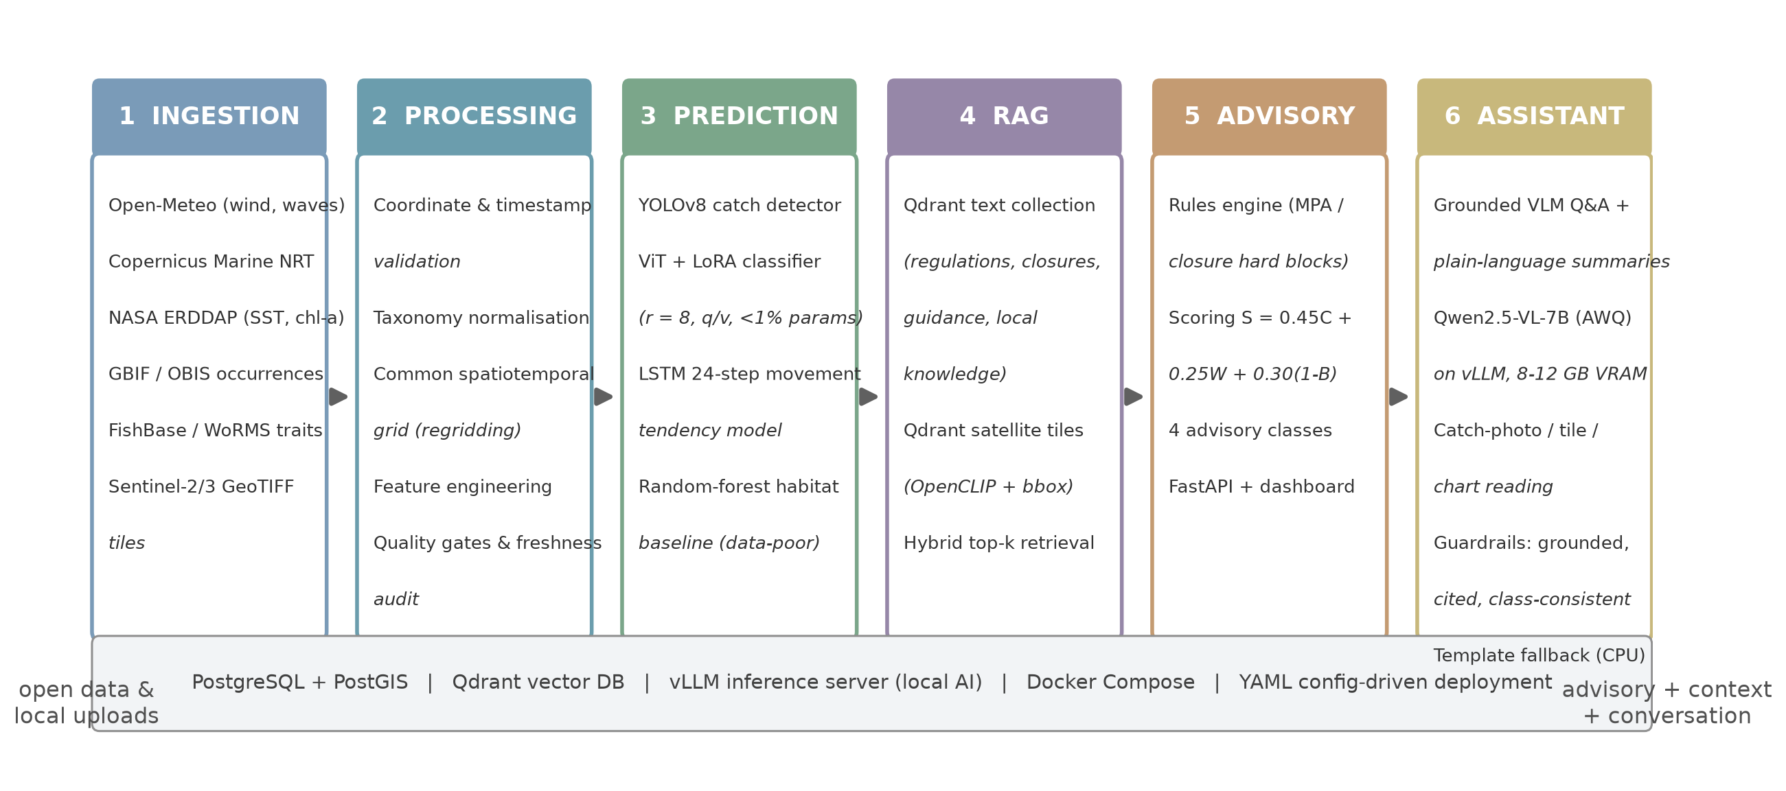
SYSTEM · ARCHITECTURE AND DATA
☰ CONTENTS
Six layers, one advisory
Open data in
Open-Meteo — hourly met + marine forecasts
Copernicus Marine — daily SST and currents
NASA ERDDAP — SST, chlorophyll-a fields
GBIF / OBIS — historical occurrences
FishBase / WoRMS — taxonomy and traits
Sentinel-2 / 3 — multispectral tiles
Resilience by design
Freshness contracts per source
Caching with explicit age flags
Offline contingency — advisories continue from cached fields
Quality gates, WoRMS normalisation
Every layer independently replaceable; region, species, closures and weights are YAML configuration, not code.
Station telemetry: 13 parameters in three groups (weather · sea · station health), fetched in independent groups so one unsupported variable degrades only its own group - and the same live set is what the assistant analyses.
All sources open-licensed or publicly documented; operating cost negligible at pilot volumes.
04
Notes:
Walk the six layers, then the two boxes: what comes in (six open sources) and how it survives outages (contracts, caching, age flags). The telemetry strip matters - the assistant reasons over the full live station set, not just the scoring inputs.

Slide 5
SYSTEM · RETRIEVAL AND SCORING
☰ CONTENTS
Every advisory carries its own justification
Collections (Qdrant)
Regulations, closure calendars, guidance and local knowledge; OpenCLIP embeddings of satellite tiles with spatial metadata.
Hybrid top-k retrieval
Bounding-box + temporal pre-filter, then vector search - so context is relevant to this place and this day.
Advisory + cited context
Passages and tiles attached to every recommendation and shown next to the score.
S = 0.45·C + 0.25·W + 0.30·(1 − B)
PROCEED
S ≥ 0.75
C catch likelihood · W weather safety · B bycatch risk — monotonic in every input, weights owned by governance.
PROCEED WITH CAUTION
0.60 ≤ S < 0.75
DELAY OR RELOCATE
0.40 ≤ S < 0.60
DO NOT FISH
S < 0.40
Hard rule: constraints run before scoring. Inside an active MPA or seasonal closure the advisory is DO NOT FISH regardless of score - no weight configuration can legalise an illegal trip.
Explainability is the retrieval of verifiable sources - not generated prose. New sources plug in as chunked documents; the corpus grows per region and no model is retrained.
Scalable by design: adding a regulation, a guidance note, a satellite pass or a whole regional corpus is an ingestion job - not a re-training project.
05
Notes:
Dual-collection retrieval over rules and satellite tiles, hybrid pre-filtering, and citations attached to the output. Scoring is a weighted sum - but constraints run first, so the legality guarantee does not depend on weights. Adding knowledge is an ingestion job, not retraining.

Slide 6
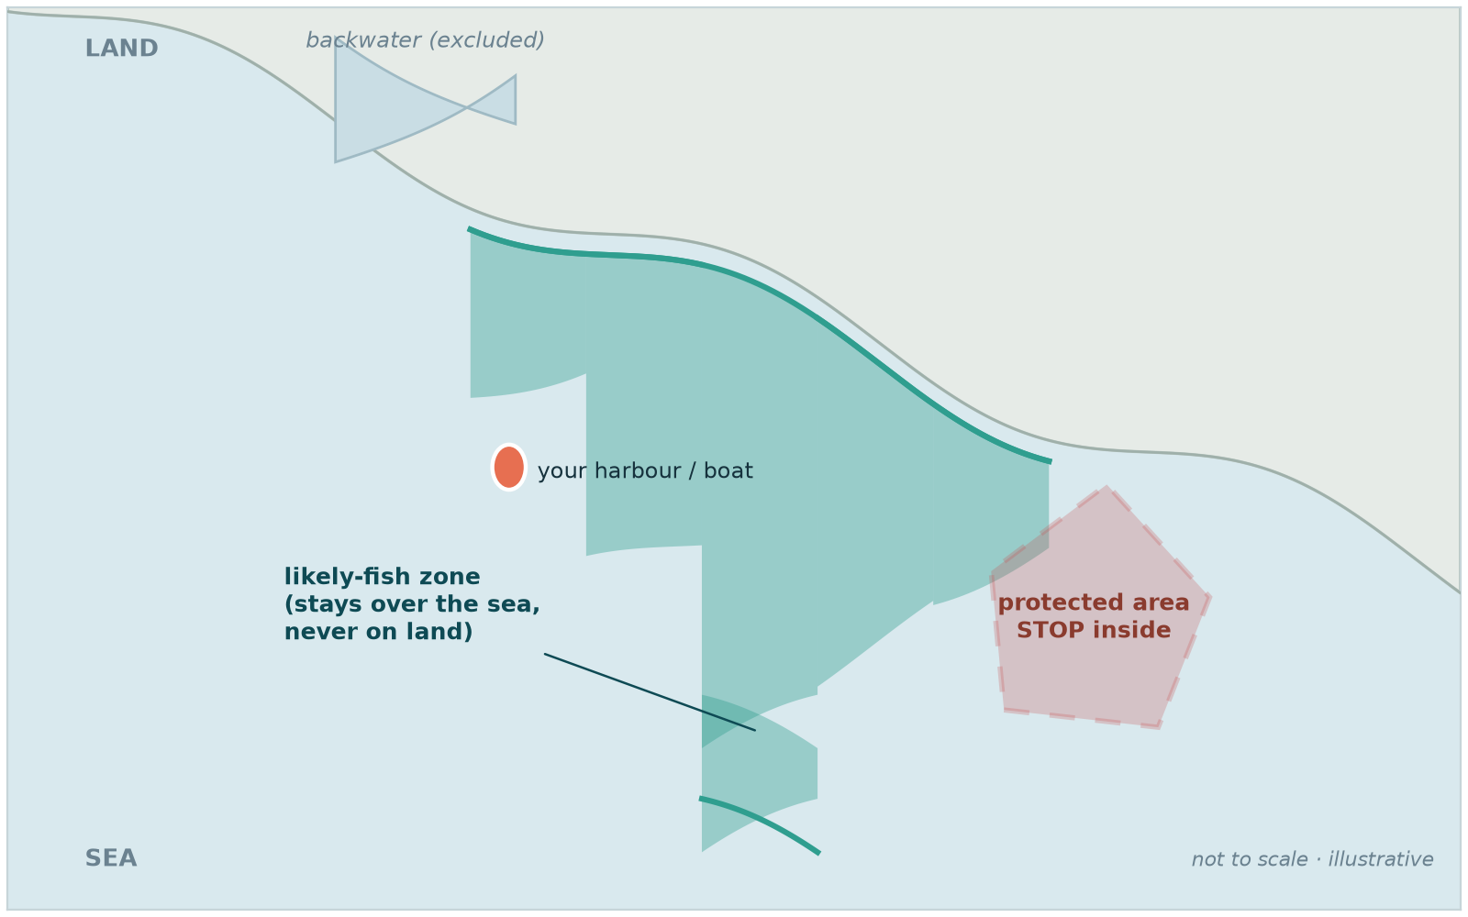
SYSTEM · GEOSPATIAL CONSTRAINTS
☰ CONTENTS
Constraints with real geometry
1
Ocean mask (GSHHG)
Shoreline data unioned over the India box; a grid cell counts as sea only where the mask and the marine model agree. Lagoons and backwaters fall on the land side, so a zone can never sit over land.
2
Real protected boundaries
16 real Indian MPA polygons loaded into PostGIS. The guard is ST_Contains and fail-closed: an unreachable registry blocks the request instead of clearing it.
3
Fine grid, honest fallback
0.03° cells (about 3.3 km) traced into boundary polygons. The fallback chain is strictly sea-only, and if nothing qualifies there is no zone rather than a guess.
Illustrative schematic: blocky advisory cells clipped to the sea side, and a protected area that forces STOP.
Shoreline: GSHHG (Wessel & Smith, public domain) · Protected areas: OpenStreetMap contributors (ODbL) · Satellite embeddings: OpenCLIP.
06
Notes:
The geometry is the point. Zones are clipped by a real ocean mask so they cannot cover land or lagoons; protected areas use real boundaries; and the conservation guard fails closed - if the registry is unreachable, nothing is cleared.

Slide 7
SYSTEM · CONVERSATIONAL LAYER (P7)
☰ CONTENTS
A grounded local assistant - it never decides
Inputs (grounding only)
Advisory JSON with live telemetry · top-k retrieved passages · optional image (catch photo, tile, chart) · question + language
Inputs (grounding only)
Advisory JSON with live telemetry · top-k retrieved passages · optional image (catch photo, tile, chart) · question + language
Local VLM + runtime registry
Four tiers switch quality to hardware: 3B laptop (Ollama) → 7B AWQ (vLLM) → 7B (Ollama) → 72B AWQ (vLLM). Each tier probed at startup; uninstalled models refused with exact install command.
Guardrails (in code)
Citations must resolve to retrieved passages · the advisory class is authoritative · refusal over invention · backend named on every answer
Guardrails (in code)
Citations must resolve to retrieved passages · the advisory class is authoritative · refusal over invention · backend named on every answer
Output: structured plain-language explanations (separate checkable points), cited answers, image readings - generated in English and pivoted through translation into ten coastal languages with vernacular fish names. If the GPU is down, a deterministic template assembles the same schema from the same data.
Structured output
Honest availability
Telemetry-fed
Translated, not guessed
Summaries return separate points, not a paragraph
Every registry model is probed; an uninstalled one is refused with the exact install command
The live station set is part of the grounding payload
One English generation, then a translation pivot - small models reason better in English
T5 asserts class consistency, citation integrity, cache, fallback and backend naming; T6 asserts rate limits, 401/403 role gates, headers and body caps.
07
Notes:
One self-hosted VLM serves summaries, grounded Q&A and image reading. Guardrails are code: citations must resolve, the verdict is authoritative, refusal beats invention, the backend is always named. The four recent additions: structured points, honest model availability, telemetry in the grounding payload, and an English-generation + translation pivot.

Slide 8
VALIDATION
☰ CONTENTS
Validated end to end
T1 Live fetch
T2 Rule enforcement
T3 Scoring behaviour
T4 Retrieval relevance
T5 Assistant behaviour
T6 Security behaviour
✓
Live fetches reliable
Graceful degradation under outage, with explicit age flags
✓
Closure blocks exact
June sardine request returns DO NOT FISH with the reason
✓
Scoring monotonic
In every input; class thresholds land exactly as configured
✓
Retrieval relevant
Top-k context attached to every advisory on the dashboard
✓
Zones never over land
Ocean-masked zones stayed at sea at Kochi, Chennai and Mangaluru
✓
Assistant guarded
Citations resolve; verdicts hold; template fallback exact; availability honest
✓
Service hardened
Rate limits 429; 401/403 role gates; security headers on every response
✓
Pilot-ready
Installable PWA, offline shell, documented hardware tiers and cost model
Test families map one-to-one onto phase gates G1-G6; the suite runs offline (--skip-live) and against live services.
08
Notes:
Six test families, six gates, and the eight findings on the right. Every capability claim in this deck is tied to a test - including the assistant's grounding (T5) and the service's security posture (T6).

Slide 9
DEPLOYMENT AND IMPACT
☰ CONTENTS
Local AI on one GPU - no API bills
Tier | Hardware | Model / profile | Sustains
1 · Laptop | RTX 4050 Laptop, 6 GB | Parasail A1(2.5)-VL-3B (qwen2.5vl:3b) · Q4 · 6k ctx · Ollama · 1-2 concurrent | Personal use, demos
2 · Pilot | RTX 3060/4070, 12 GB | Qwen2.5-VL-7B-AWQ · 8k ctx · vLLM · 8 concurrent | Thousands of requests/day
3 · Recommended | RTX 4090 / NVIDIA L4, 24 GB | Qwen2.5-VL-7B-AWQ · 16k ctx · vLLM · 32-64 concurrent | Tens of thousands/day
4 · Regional | 2-4× L4/A10G + LB, or A100 40 GB | Qwen2.5-VL-72B-AWQ replicas + semantic cache · vLLM | Millions of requests/year
$0 per question
Self-hosted inference: the marginal cost of an answer is electricity.
~$16-55k/yr avoided
Per-token billing for 10k questions/day at commercial API rates.
~$2k once + $315/yr
The recommended 24 GB tier: one GPU plus power, owned outright.
Who benefits: fishers save fuel and avoid fines · the ocean gets its closures respected automatically · communities keep their knowledge in a lasting library · authorities get decisions anyone can audit.
Hardened for public traffic: rate limits, API-key RBAC, security headers, audit log; ships as an installable PWA with an offline app shell.
09
Notes:
Four hardware tiers, from a 6 GB laptop to multi-GPU regional deployments, and the economics that justify self-hosting: at 10,000 questions a day, commercial per-token APIs would cost 16-55k a year against a 2,000-dollar GPU plus power.

Slide 10
CONCLUSION
☰ CONTENTS
Conservation, legality and safety are built into the objective function - ParaSail cannot recommend an illegal trip under any configuration.
Primary alignment: SDG 14 (Life Below Water) · supporting: SDG 2 · 8 · 9 · 13
The five mandatory summit questions
Q1 · Problem No real-time, integrated, explainable advisory system for sustainable fishing in data-poor regions.
Q2 · Importance Livelihoods, food security, marine conservation and safety meet at one information gap.
Q3 · Technology Geospatial AI (YOLOv8, ViT + LoRA, LSTM, random forest), dual-collection RAG, a self-hosted Qwen2.5-VL assistant on vLLM with a runtime model registry, open live APIs, FastAPI + PostGIS + Qdrant; hardened with rate limiting and RBAC, shipped as a PWA.
Q4 · Evidence Open environmental, biodiversity and satellite data; regulation datasets; a working system validated by six test families across six gates.
Q5 · Contribution A production-grade platform issuing sustainability-scored, explainable, conversational advisories with conservation enforced as a hard constraint - on local AI, at zero marginal cost.
Thank you · Anantha Krishnan AS · Naipunnya School of Management, Cherthala, India · 26th Digital Blue Economy Summit
10
Notes:
Close on the normative claim - constraints inside the objective function - then the five mandatory questions in one pass, and invite questions. ☰ CONTENTS jumps back to the hub.

