Slide 1
26TH DIGITAL BLUE ECONOMY SUMMIT · EXPERIMENTAL PAPER
ParaSail
Predictive Advisory and Retrieval-Augmented System Advancing Informed Livelihoods
A geospatial decision support system for sustainable fishing, marine conservation and coastal livelihood resilience
Hard conservation constraints
Explainable by retrieval
Adaptable by LoRA fine-tuning
Grounded AI assistant (local)
Anantha Krishnan AS · Naipunnya School of Management, Cherthala, India · September 2026
Notes:
ParaSail - one system fusing live ocean data, species models and conservation rules into a single explainable advisory. The name is a backronym: Predictive Advisory and Retrieval-Augmented System Advancing Informed Livelihoods.

Slide 2
THE PROBLEM · CONTEXT
The blue economy under pressure
35.5%
11 Mt
~3×
~492 M
of assessed stocks fished beyond sustainable levels
of plastic entering the ocean every year
projected growth of plastic flows by 2040
people supported by small-scale fisheries
FAO, State of World Fisheries 2023
UNEP, Turning off the Tap 2023
UNEP, Turning off the Tap 2023
FAO, Illuminating Hidden Harvests 2023
Rebuilding stocks under sound management pays; what is missing is the real-time information infrastructure for coastal actors to act on it.
Sources: FAO SOFIA 2023; UNEP 2023; OECD Global Plastics Outlook 2022; Cheung et al. 2010.
02
Notes:
Frame the crisis: overfishing share at record high, plastic flows tripling by 2040, half a billion livelihoods at stake. Land on the gap: information infrastructure, not willingness.

Slide 3
THE PROBLEM · CONSEQUENCES
Four harms of planning fishing blind
01
Economic
Fuel, time and labour wasted on blind search for shifting fish distributions.
02
Ecological
Fishing pressure concentrates on spawning grounds, sensitive habitats and protected zones.
03
Safety
Small vessels put to sea without granular marine wind and wave guidance.
04
Institutional
Weather apps, habitat studies, AIS analytics and regulations never speak to one another.
03
Notes:
Four harms of the status quo: economic waste, ecological concentration of effort, avoidable safety risk, and institutional fragmentation. The fourth is the root cause of the first three.

Slide 4
THE GAP
Existing tools are fragmented
Tool class | Weather | Fish context | Legality | Explainability
Weather applications | ✓ | – | – | –
PFZ-style advisories | – | ✓ | – | –
Habitat / SDM studies | – | ✓ | – | –
AIS fleet analytics | – | – | – | –
Static regulations | – | – | ✓ | –
ParaSail (this work) | ✓ | ✓ | ✓ | ✓
No existing tool class fuses weather, fish context, legality and explanation — the gap is architectural, not algorithmic.
PFZ: Potential Fishing Zone advisories (INCOIS). SDM: species distribution models.
04
Notes:
Each existing tool class covers one column at most. ParaSail is the first to occupy all four: constraints before scores, explanations attached to outputs.

Slide 5
OBJECTIVES
What ParaSail sets out to do
RO1
Fuse live open data into one quality-controlled geospatial model
RO5
Adapt locally via custom ingestion and LoRA fine-tuning
“Recommend safe, legal and ecologically responsible fishing windows — with the justification attached.”
RO2
Model aggregation and movement tendency, with habitat fallback
RO6
Expose a production-style API and visual dashboard
RO3
Enforce MPAs and closures as hard constraints
RO7
Evaluate via live-fetch, rule, scoring and retrieval tests
Eight objectives, each mapped to a validation test family (T1–T4).
RO4
Attach regulations, guidance and local knowledge to every advisory
RO8
Align with blue-economy principles end to end
05
Notes:
Primary objective decomposed into eight verifiable objectives. The mission statement on the left is the one-line version used with pilot communities.

Slide 6
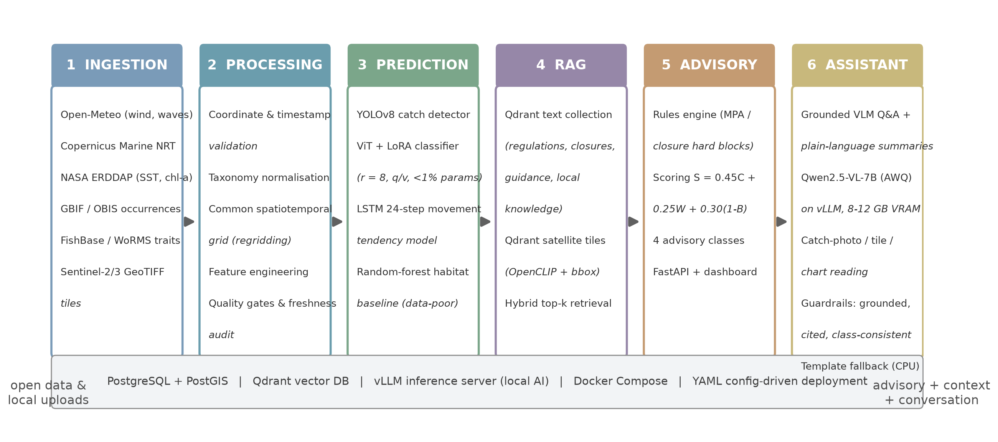
SYSTEM · ARCHITECTURE
Six layers, one advisory
Every layer is independently replaceable and configured through YAML — region, species, closures, models and score weights are data, not code.
06
Notes:
Walk left to right: ingest open APIs and satellite archives, normalise onto a common grid, predict with mixed model families, retrieve regulations and local knowledge, then apply constraints before scoring.

Slide 7
SYSTEM · INGESTION AND PROCESSING
Live open data, normalised and audited
Source | Content | Cadence
Open-Meteo | Hourly meteorological and marine forecasts | Hourly
Copernicus Marine | Near-real-time ocean analysis (SST, currents) | Daily
NASA ERDDAP | SST and chlorophyll-a fields | Daily
GBIF / OBIS | Historical species occurrences | Corpus
FishBase / WoRMS | Taxonomy, traits, seasonality | Corpus
Sentinel-2 / Sentinel-3 | Multispectral satellite tiles | Per pass
Resilience by design
Freshness contracts per source
Response caching with age tracking
Offline contingency: advisories continue from cached fields, with explicit age flags
Quality gates and taxonomy normalisation (WoRMS identifiers)
All sources open-licensed or publicly documented; operating cost negligible at pilot volumes.
07
Notes:
Ingestion wraps every provider behind one interface with freshness contracts. Under outage the system degrades gracefully: cached fields plus age flags, never silence.

Slide 8
SYSTEM · PREDICTION
Model selection: mixed families, deliberate trade-offs
Task | Selected model | Why this one
Catch-image detection | YOLOv8n (Ultralytics) | Real-time on modest hardware; mature toolchain
Species classification | ViT-B/16 + LoRA (r = 8) | Fine-grained accuracy at under 1% trainable parameters
Movement tendency (24 h) | Two-layer LSTM (hidden 128) | Short-horizon sequences for data-rich species
Habitat suitability | Random forest | Interpretable fallback for data-poor taxa
Text embeddings | all-MiniLM-L6-v2 | Fast 384-dimensional sentence embeddings
Satellite tile embeddings | OpenCLIP ViT-B/32 | Similarity search over unlabelled tiles
Assistant: summaries, Q&A, image reading | Qwen2.5-VL-7B (AWQ 4-bit) on vLLM | One open-source VLM for all assistant jobs; 8-12 GB VRAM; batched local serving — no per-token API costs
Selection criterion is coastal deployability, not leaderboard position — every model runs on mid-range hardware.
08
Notes:
One representative per family: detector, fine-grained classifier, sequence model, tabular baseline, plus the embedding models that power retrieval. The optional LLM only summarises retrieved context.

Slide 9
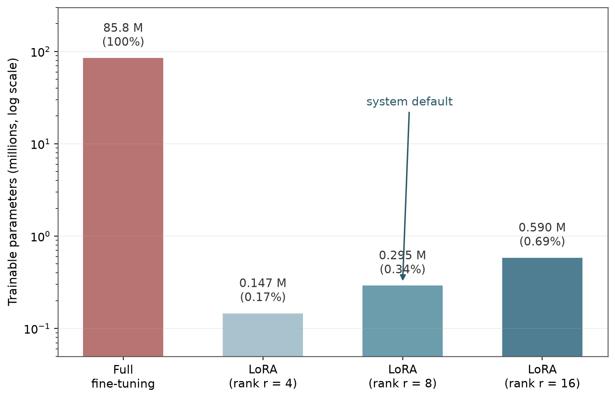
SYSTEM · FINE-TUNING
Local adaptation at 0.34% of the parameters
W = W₀ + BA
Rank r = 8 updates on the query and value projections of all 12 encoder blocks
0.29 M of 85.8 M parameters trainable (0.34%) on ViT-B/16
Training converges within mid-range GPU memory
New regions and species adapted through configuration and lightweight fine-tunes — no code edits
Trainable-parameter counts derived from the ViT-B/16 architecture; LoRA per Hu et al., ICLR 2022.
09
Notes:
LoRA freezes pretrained weights and learns low-rank additive updates. Under one percent trainable keeps adaptation within a mid-range GPU budget - the difference between a lab artifact and a deployable regional system.

Slide 10
SYSTEM · RETRIEVAL-AUGMENTED EXPLANATION
Every advisory carries its own justification
Text collection (Qdrant)
Regulations, closure calendars, conservation guidance, local ecological knowledge
Advisory + cited context
Passages and tiles attached to every recommendation — the dashboard shows them next to the score
Hybrid top-k retrieval
Bounding-box + temporal pre-filter, then vector search
Satellite collection (Qdrant)
OpenCLIP tile embeddings with bounding-box and acquisition metadata
Explainability is the retrieval of verifiable sources — not generated prose.
Scalable by design: new sources plug in as chunked documents — no model retraining; the corpus grows per region.
10
Notes:
Two Qdrant collections: text (rules and knowledge) and satellite tiles. Hybrid retrieval pre-filters by space and time, then ranks by similarity. The output is an advisory with its citations attached. Scalability: new regulations, guidance, satellite passes and whole regional corpora are added by chunking, embedding and upserting - knowledge lives in the corpus, not the weights, so no model retraining is ever needed.

Slide 11
SYSTEM · CONVERSATIONAL LAYER (P7)
A grounded AI assistant explains - it never decides
Inputs (grounding only)
Live advisory JSON · top-k retrieved passages · optional image (catch photo, tile, chart) · user question + language
Qwen2.5-VL-7B (AWQ)
Single open-source VLM, Apache 2.0 · 4-bit weights ≈ 6.9 GB · served locally on vLLM with continuous batching
Guardrails (in code)
Citations must resolve to retrieved passages · verdict is authoritative · refusal over invention · backend named on every answer
Output: plain-language summary or cited answer + backend ID + authoritative verdict. If the GPU is down, a deterministic template path assembles the same schema from the same data — the website never goes dark.
Multilingual and scalable by design: answers in ten coastal languages, vernacular fish names, localised Problem/Answer self-explanations, ocean news translated into the reader's language (English pivot); a runtime model registry switches quality against hardware (3B laptop "> 72B datacenter).
T5 asserts: class consistency, citation integrity, cache, fallback, backend naming. T6 asserts: rate limits, 401/403 role gates, security headers, body cap.
11
Notes:
The assistant layer: one self-hosted vision-language model serves summaries, grounded Q&A and image reading. The guardrails are code, not prompts: citations must resolve, the advisory class is authoritative, refusal beats invention, every answer names its backend, and a deterministic template path covers GPU-less deployments. Validation family T5 asserts each guarantee.

Slide 12
SYSTEM · PRODUCTION DEPLOYMENT
Local AI on one GPU - no API bills at any traffic
Tier | Hardware | Model / profile | Sustains
L · laptop | RTX 4050 Laptop, 6 GB | Qwen2.5-VL-3B, Q4 · 6 k ctx · 1-2 concurrent | Personal use, demos
1 · pilot | RTX 3060/4070, 12 GB | 7B AWQ · 8 k ctx · 8 concurrent | Thousands of requests/day
2 · recommended | RTX 4090 / NVIDIA L4, 24 GB | 7B AWQ · 16 k ctx · 32-64 concurrent | Tens of thousands/day
3 · regional | 2-4× L4/A10G + LB, or A100 40 GB | 7B AWQ replicas + semantic cache | Millions of requests/year
$0 per question
Self-hosted inference: the marginal cost of an answer is electricity.
~$16-55k/yr avoided
Per-token billing for 10k questions/day at commercial API rates.
~$2k once + $315/yr
The recommended 24 GB tier: one GPU plus power, owned outright.
Hardened for public traffic: per-endpoint rate limits, API-key RBAC (public/officer/admin), security headers, audit log; ships as an installable PWA with an offline app shell (tailnet deployment guide). Serving: vLLM + AWQ, semaphore + summary cache.
12
Notes:
The economic argument for self-hosting: at 10,000 questions per day, commercial per-token APIs would cost 16-55k dollars a year; the recommended tier is a 2,000-dollar GPU plus electricity. Four validated hardware tiers, from a 6 GB laptop (3B model) to multi-GPU regional deployments, ship with the reference implementation.

Slide 13
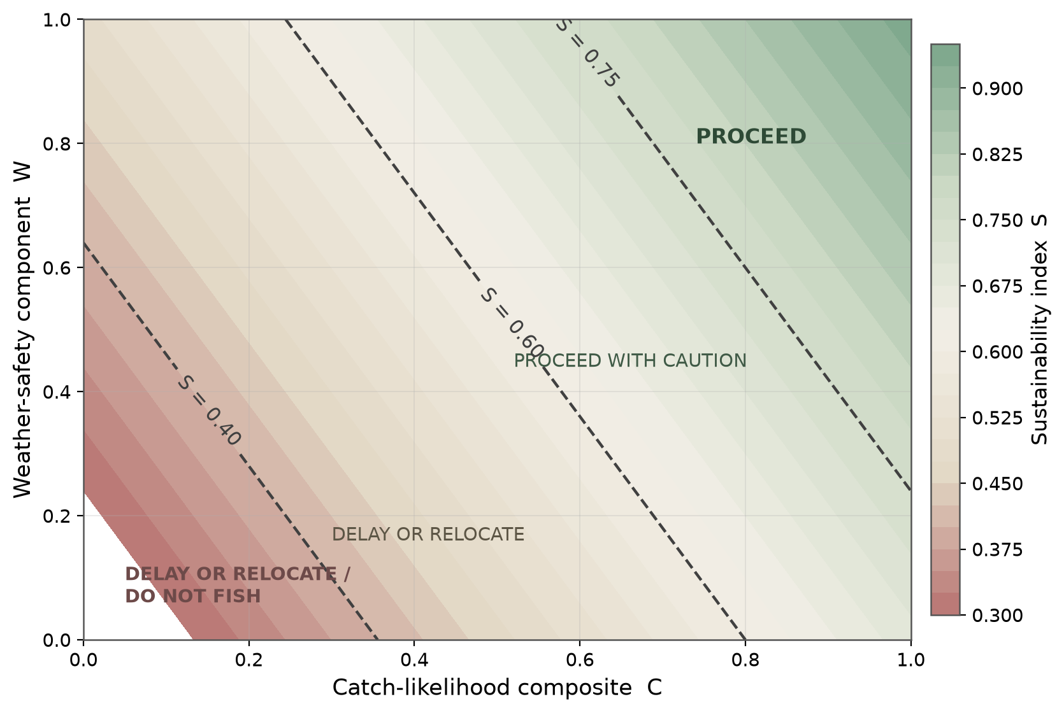
SYSTEM · ADVISORY
One transparent sustainability index
S = 0.45·C + 0.25·W + 0.30·(1 − B)
PROCEED
S ≥ 0.75
PROCEED WITH CAUTION
0.60 ≤ S < 0.75
DELAY OR RELOCATE
0.40 ≤ S < 0.60
DO NOT FISH
S < 0.40
Hard rule: inside an active MPA or seasonal closure, the advisory is DO NOT FISH — regardless of score. Weights are configuration, owned by governance, not hidden constants.
Surface shows S over catch likelihood (C) and weather safety (W) at bycatch risk B = 0.20.
13
Notes:
Scoring is a weighted sum: catch 45%, weather safety 25%, ecological term 30%. Monotonic in every input, thresholds fixed at 0.40/0.60/0.75. Constraints run before scoring - no weight configuration can legalise an illegal trip.

Slide 14
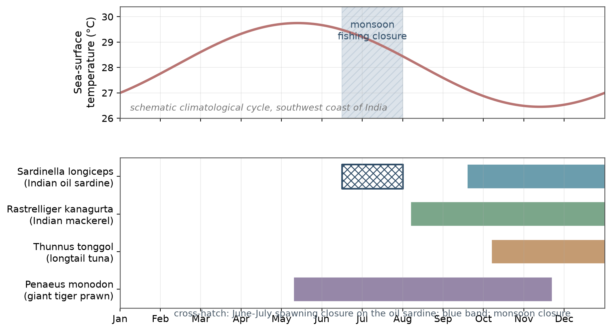
CASE STUDY
Southwest coast of India
Why this coast
Active closure regime: June–July monsoon closure, spawning protection for the oil sardine
A network of marine protected areas enforced as hard constraints
Sardine and mackerel fisheries dominate — and fluctuate strongly year to year
Four coastal cities anchor the live-fetch validation tests
Registry: Sardinella longiceps, Rastrelliger kanagurta, Thunnus tonggol, Penaeus monodon — the prawn exercises the data-poor habitat fallback.
Calendar is the schematic configured for the case study; landings context: ICAR-CMFRI.
14
Notes:
The case study concentrates every challenge: closures, protected areas, volatile small pelagics, and a data-poor high-value taxon. Cross-hatch marks the June-July spawning closure on the sardine.

Slide 15
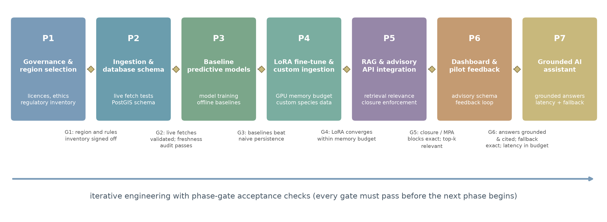
METHODOLOGY
Phase-gate engineering, test-driven acceptance
T1 Live fetch
T2 Rule enforcement
T3 Scoring behaviour
T4 Retrieval relevance
T5 Assistant behaviour
T6 Security behaviour
15
Notes:
Seven phases, each closed by a gate that must pass before the next begins. Gates map one-to-one onto the five test families - every capability claim is tied to a test, including the assistant's grounding and guardrail guarantees (T5).

Slide 16
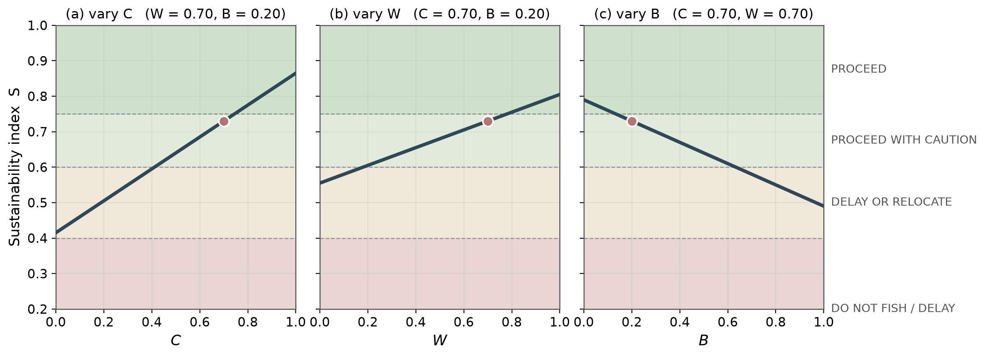
RESULTS
Validated end to end
Live fetches reliable
Graceful degradation under outage, with explicit age flags
Closure blocks exact
June sardine request returns DO NOT FISH with the reason
Scoring monotonic
In every input; class thresholds land exactly as configured
Retrieval relevant
Top-k context attached to every advisory on the dashboard
Assistant guarded
Citations resolve; verdicts hold; template fallback exact
Service hardened
Rate limits 429; 401/403 role gates; headers on every response
Panels: one-at-a-time sweeps over C, W and B (markers = baseline point); illustrative of the configured function.
16
Notes:
Six findings: reliable live ingestion; exact rule enforcement; monotonic scoring; topically relevant retrieval; guarded assistant behaviour (T5); and a hardened service (T6) - rate limits, role gates, headers. Panels show the monotonicity sweeps from test family T3.

Slide 17
CONCLUSION
Conservation, legality and safety are built into the objective function — ParaSail cannot recommend an illegal trip under any configuration.
Primary alignment: SDG 14 (Life Below Water) · supporting: SDG 2 · 8 · 9 · 13
The five mandatory summit questions
Q1 · Problem No real-time, integrated, explainable advisory system for sustainable fishing in data-poor regions.
Q2 · Importance Livelihoods, food security, marine conservation and safety all meet at this one information gap.
Q3 · Technology Geospatial AI (YOLOv8, ViT + LoRA, LSTM, random forest), dual-collection RAG, a self-hosted Qwen2.5-VL-7B assistant on vLLM with a runtime model registry, open live APIs, FastAPI + PostGIS + Qdrant; hardened with rate limiting and RBAC, shipped as an installable PWA.
Q4 · Evidence Open environmental, biodiversity and satellite data; regulation datasets; a working system validated by five test families.
Q5 · Contribution A production-grade platform issuing sustainability-scored, explainable, conversational advisories with conservation enforced as a hard constraint - on local AI, within 8-12 GB VRAM, at zero marginal cost.
Thank you · Anantha Krishnan AS · Naipunnya School of Management, Cherthala, India · 26th Digital Blue Economy Summit
17
Notes:
Close on the normative claim: constraints inside the objective function, trust earned through explainability and local adaptation. Then the five mandatory questions in one pass.

