Slide 1
AAI-590 CAPSTONE PROJECT
Autonomous Investment
Research Agent
A multi-agent AI pipeline that collects, cleans, and analyzes market, macro, filings, and news data — then generates an investment research report end-to-end.
Yahoo Finance
SEC EDGAR
FRED
NewsAPI
University of San Diego | Shiley-Marcos School of Engineering | AAI-590-IN2
Team: Saurav Kumar Subudhi · Jasmeet Kaur · Manasa Sai Karaka

Slide 2

THE PROBLEM
Equity research is manual, slow,
and scattered across sources
WHY IT MATTERS
4
An analyst covering one ticker has to pull price history, macro context, SEC filings, and breaking news from four unrelated systems — then manually reconcile and write it up.
disconnected data
sources per ticker
Fragmented data
6
Prices, filings, macro series, and headlines live in four separate systems with no shared schema.
No repeatable process
research stages an
agent can automate
Every analyst cleans and engineers features their own way — nothing is standardized or automated.
Slow turnaround
Goal: one pipeline, one interface, always current.
By the time a report is compiled by hand, the market context has already moved on.
02

Slide 3




DATA SOURCES
Four sources, one unified pipeline
Yahoo Finance
SEC EDGAR
FRED
NewsAPI
Daily OHLCV history + a near-real-time price snapshot via yfinance.
10-K/10-Q filings and XBRL financial facts, no API key required.
CPI, unemployment, Fed funds rate, treasury yields, consumer sentiment.
Recent headlines for company-specific news context.
Built new: FRED and SEC EDGAR loaders did not exist in the original codebase — only listed as intended sources.
03

Slide 4
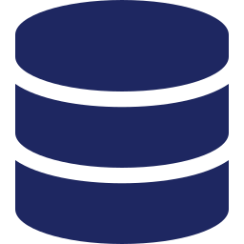






SYSTEM ARCHITECTURE
From raw data to a research report,
in six stages
Data
Collection
Data
Cleaning
EDA
Feature
Engineering
Correlation
Analysis
Multi-Agent
Report
Implemented as a LangGraph state machine — each node runs independently and degrades gracefully if an API key is missing, rather than failing the whole run.
04

Slide 5
STAGES 1–2
Data Collection & Cleaning
Collection
Cleaning
Parameterized loaders for any ticker/date range (no more hardcoded "AAPL")
Near-real-time price snapshot via yfinance fast_info
Ticker → CIK resolution for SEC EDGAR lookups
NewsAPI key bug fixed — original code never actually read the env var
De-duplicate & sort DatetimeIndex; drop fully-empty rows
Forward-fill short gaps (holiday mismatches), capped at 3 days
Z-score outlier flagging on daily returns — flagged, not silently dropped
Macro series resampled to daily and forward-filled for alignment with price data
05

Slide 6
STAGES 3–4
EDA & Feature Engineering
ENGINEERED FEATURES
SMA / EMA
10, 20, 50, 200-day windows
RSI (14)
overbought / oversold signal
MACD
trend + momentum crossover
Bollinger Bands
20-day, 2σ envelope
EDA
Volatility
Candlestick price/volume charts, return-distribution histograms, and descriptive statistics rendered live per ticker.
annualized, 10/20/30-day
Lag features
lagged returns for modeling
06

Slide 7

STAGE 5
Correlation Analysis
Cross-asset and stock-vs-macro correlation, computed on demand for any basket.
AAPL
MSFT
GOOGL
AMZN
AAPL
1.00
0.78
0.71
0.65
Also correlates price action against macro indicators
MSFT
0.78
1.00
0.74
0.69
10-Yr Treasury Yield
-0.42
Fed Funds Rate
-0.35
GOOGL
0.71
0.74
1.00
0.72
CPI (Inflation)
-0.18
AMZN
0.65
0.69
0.72
1.00
Consumer Sentiment
0.31
Unemployment Rate
-0.27
Sample daily-return correlation matrix
07

Slide 8


STAGE 6
Multi-Agent AI Pipeline
A LangGraph state machine chains five specialized agents into one research report.
Market Agent
News Agent
Macro Agent
SEC Agent
Report Agent
Trend, RSI momentum, and volatility read from the engineered feature matrix.
De-duplicated recent headlines; degrades to a clear message if no key is set.
Latest FRED readings — rates, inflation, sentiment — for market backdrop.
Most recent filing + key XBRL facts (revenue, net income, assets).
Synthesizes all four into one report — optionally narrated by Claude.
Each node try/excepts independently — a missing NewsAPI or FRED key degrades one node, not the whole report.
08

Slide 9







DELIVERY
One Streamlit app, seven tabs
Everything above is wired into a single interactive frontend — no notebooks, no CLI required.
Live Quote
Data Collection
Data Cleaning
Auto-refreshing price snapshot via st.fragment(run_every=...)
Raw Yahoo Finance, FRED, SEC, and NewsAPI pulls
Before/after view + outlier & null report
EDA
Feature Engineering
Correlation
Candlesticks, volume, return distributions
Live indicator charts + CSV export
Cross-asset & macro heatmaps
Multi-Agent Report
One-click pipeline run + downloadable report
09

Slide 10
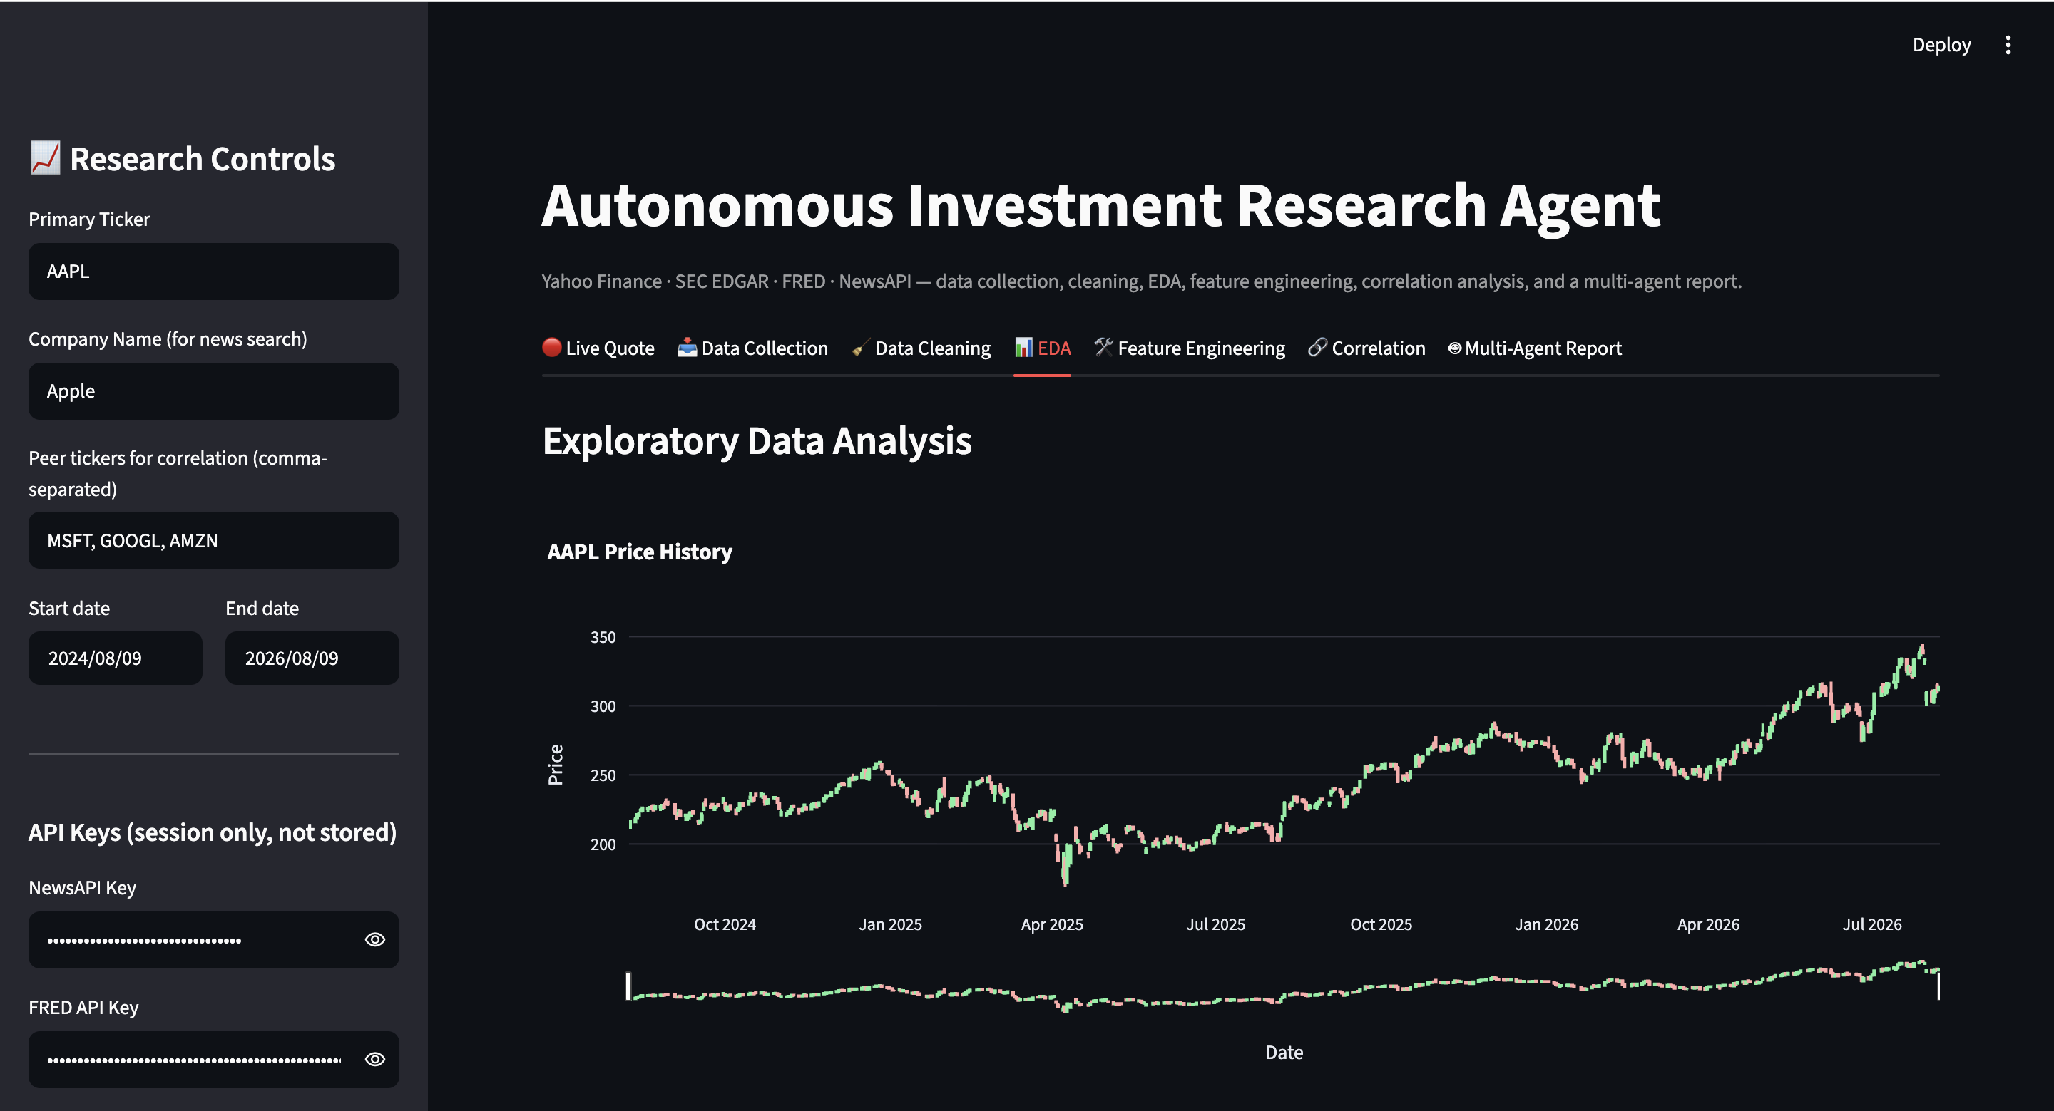
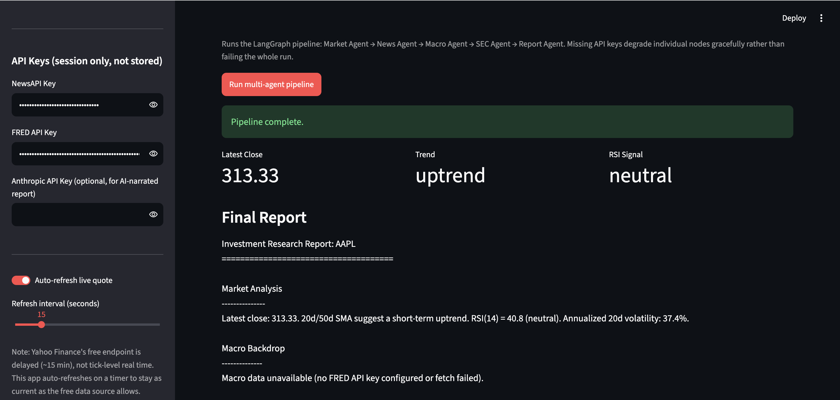
VALIDATION
Live run on real AAPL data
The app deployed and pulled live Yahoo Finance data end-to-end — EDA candlestick chart and a completed multi-agent report run, both shown below unedited.
Multi-Agent Report tab — pipeline completed
$313.33
Uptrend
40.8
37.4%
EDA tab — live AAPL candlestick + volume
Latest Close
20d/50d SMA
RSI(14) — neutral
Annualized Volatility
Macro tab correctly showed "data unavailable" instead of crashing — no FRED key was set for this run, confirming the graceful-degradation design.
10

Slide 11
ENGINEERING DELTA
What the repo claimed vs. what existed
Component
Original State
Now
Streamlit frontend
Did not exist
Built — 7-tab app
FRED integration
Listed only, no code
Built — fred_loader.py
SEC EDGAR integration
Listed only, no code
Built — sec_edgar_loader.py
Data cleaning
Listed only, no code
Built — outlier flagging, gap-fill
Feature engineering
Listed only, no code
Built — SMA/RSI/MACD/BB/vol
NewsAPI key handling
Bug: key never actually read
Fixed + graceful error handling
11

Slide 12

NEXT PHASE
Where this goes from here
True real-time data
Headline sentiment
SEC full-text search
Yahoo's free tier is ~15-min delayed. A paid feed (Polygon, IEX, Alpaca) + websockets would enable tick-level updates.
Score tone with FinBERT rather than just listing titles, so the Report Agent can quantify bullish/bearish news flow.
Wire up efts.sec.gov to search filing text for terms like "guidance" or "impairment", not just recent filings.
Backtesting harness
Persistence layer
Smarter orchestration
Score whether RSI/MACD signals historically preceded favorable moves, instead of only describing current state.
A parquet/SQLite warehouse to cut redundant API calls across sessions and track drift over time.
Conditional LangGraph routing — e.g. skip the SEC node for non-US tickers — instead of one fixed linear path.
12

Slide 13
AAI-590 CAPSTONE PROJECT
Thank You
Autonomous Investment Research Agent — data collection through multi-agent reporting, in one app.
github.com/unrivalle/AAI-590_project_work
AAI-590-IN2 · Saurav Kumar Subudhi · Jasmeet Kaur · Manasa Sai Karaka

