Slide 1
Group 2
Members’: -2
KALISA Augustin 25RP21655
IRUMVA Emerance 25RP19623
MUGABO Patrick 25RP20010
Multi-Campus Education Data Preprocessing Pipeline
| Rwanda Polytechnic – Huye College |
February 12, 2026

Slide 2
Data Pipeline Workflow
1. Collection
& Loading
2. Data
Cleaning
3. Trans-
formation
6. Feature
Engineering
4. Integration
5. Reduction
Data Sources: 3 Campuses
For each campus with 3 files in csv and excel
• Rwanda Polytechnic Huye (RPH): 1545 students, 283 enrollments, 792 assessments
• Rwanda Polytechnic Kigali (RPK): 50 students, 250 enrollments, 835 assessments
• Rwanda Polytechnic Musanze (RPM): 50 students, 250 enrollments, 894 assessments

Slide 3
Data Cleaning Pipeline
1. Missing Data: Imputed using mode for categorical (gender, program), median for numerical (marks), and forward-fill for attendance
2. Duplicate Removal: Eliminated 135 duplicate student IDs and 16273 duplicate assessment records using Student_ID + Course_Code keys
3. Outlier Treatment: Removed 1509 invalid marks (values < 0 or > 100) using Boxplot (IQR) method
4. Format Standardization: Unified gender (M/F), level (L4/L5/L6), semester (SEM1/SEM2), and date formats (YYYY-MM-DD)
5. Data Validation: Applied regex cleaning for names, trimmed whitespace, standardized course codes across campuses

Slide 4
Data Transformation & Encoding
Scaling: Standardized continuous features (attendance rates, cumulative marks) using StandardScaler
Encoding: One-hot encoding applied to Campus_Name, Program, and Assessment_Type for ML readiness
Binning: Created performance bands - Fail (<40), Pass (40-59), Credit (60-69), Distinction (70-79), High Distinction (80-100)
Date Engineering: Converted all dates to ISO format, extracted academic year and semester information
Categorical Mapping: Unified inconsistent values (e.g., 'L4'/'Level 4' → ‘Level 4', 'SEM1'/'Semester 1' → ' 'Semester 1 ')

Slide 5
Integration & Reduction
DATA INTEGRATION
DIMENSIONALITY REDUCTION
Merged 3 campus datasets:
Students → Courses → Assessments
Integration Keys:
• Student_ID (primary)
• Course_Code + Academic_Year
• Campus_ID for tracking
Conflict Resolution:
• Standardized course codes
• Unified name spellings
• Preserved data lineage
Original: 44 columns
Final: 38 columns (13.6% reduction)
Removed Columns:
• 4 metadata fields (file paths)
• 2 redundant identifiers
• 0 high-missing columns
Kept all essential features:
• Student demographics
• Academic performance
• Engineered features

Slide 6
Feature Engineering (12 New Features)
Date-Time Features (3): assessment_month, assessment_weekday, is_weekend_assessment
Student Performance (5): student_course_count, student_avg_mark, student_max_mark, student_fail_count, student_total_credits_earned
Risk Flags (2): is_at_risk (avg_mark < 50 OR fail_count ≥ 2), low_attendance_flag (attendance < 75%)
Category Labels (2): student_category (High Performer/Regular/Struggling/At Risk), performance_band (Fail/Pass/Credit/Distinction)
All features engineered for predictive modeling and student intervention strategies

Slide 7
Before vs After Metrics
BEFORE CLEANING DATA
AFTER CLEANING DATA
Total Records: 75401 assessments
Missing Values:
• 1160 missing gender records
• 3610 missing marks
• 7683 missing attendance rates
• 933 missing course codes
Data Quality Issues:
• 135 duplicate students
• 16273 duplicate assessments
• 1509 invalid marks (outliers)
• Inconsistent formats across campuses
Total Records: 56896 assessments
Missing Values: 0 (100% resolved)
• Gender: standardized to M/F
• Marks: imputed using median
• Attendance: filled with mode
• Course codes: standardized
Data Quality Improvements:
• Zero duplicates
• All marks within 0-100 range
• Unified date formats (ISO 8601)
• 933 records removed/corrected

Slide 8
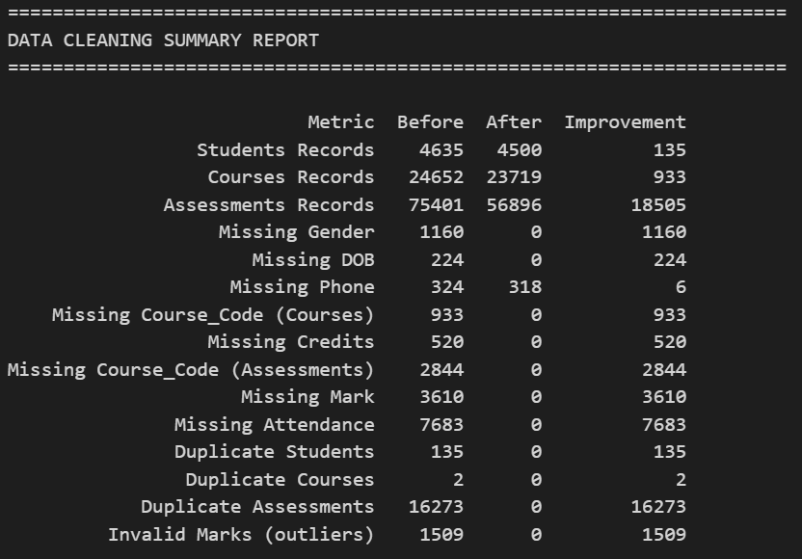
Before vs After Metrics cont’

Slide 9
Final Gold Dataset Preview
Dataset Statistics
Total Students: 4635 (across 3 campuses)
Total Courses: 10 unique courses
Total Enrollments: 24652 course registrations
Total Assessments: 56896 assessment records
Data Quality Metrics
Missing Values: 0 (100% complete)
Duplicate Records: 0 (all removed)
Invalid Values: 0 (all corrected)
Data Integrity: 100% validated
Output Files
gold_integrated.csv: Combined all campus data
gold_features.csv: with 38 features
This Output files each contain total records :56896 records

Slide 10
Key Insights from Cleaned Data
Insight 1: Campus Performance Variation
Rwanda Polytechnic Musanze leads with an average mark of 71.3 and lowest at-risk population (26%), while Kigali shows the highest intervention need with 40% at-risk students and an average of 63.1. This 8.2-point performance gap suggests successful teaching practices at Musanze that could be replicated across other campuses.
Insight 2: Critical Student Intervention Required
44.4% of students are categorized as 'At Risk' with average marks below 50, while only 8.3% are 'High Performers'. The performance distribution shows 34% in Credit band (60-69) and 41% in Distinction (70+). Software Engineering and Mechanical Engineering programs have the highest concentration of at-risk students, requiring immediate targeted academic support and tutoring interventions.

Slide 11
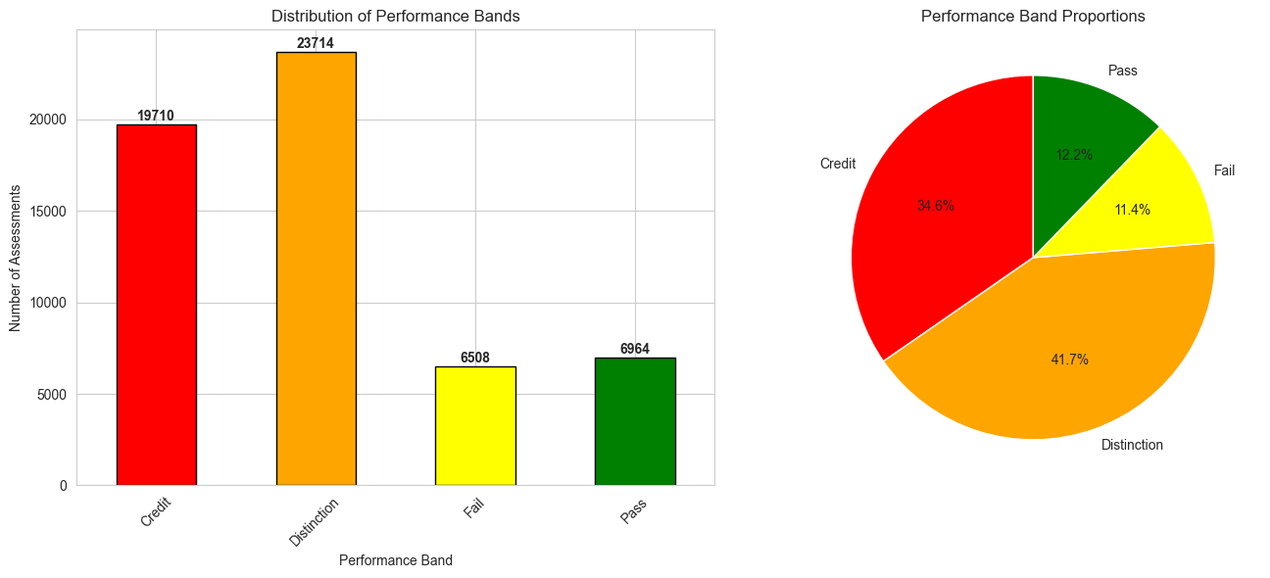
Binning - Performance Bands

Slide 12
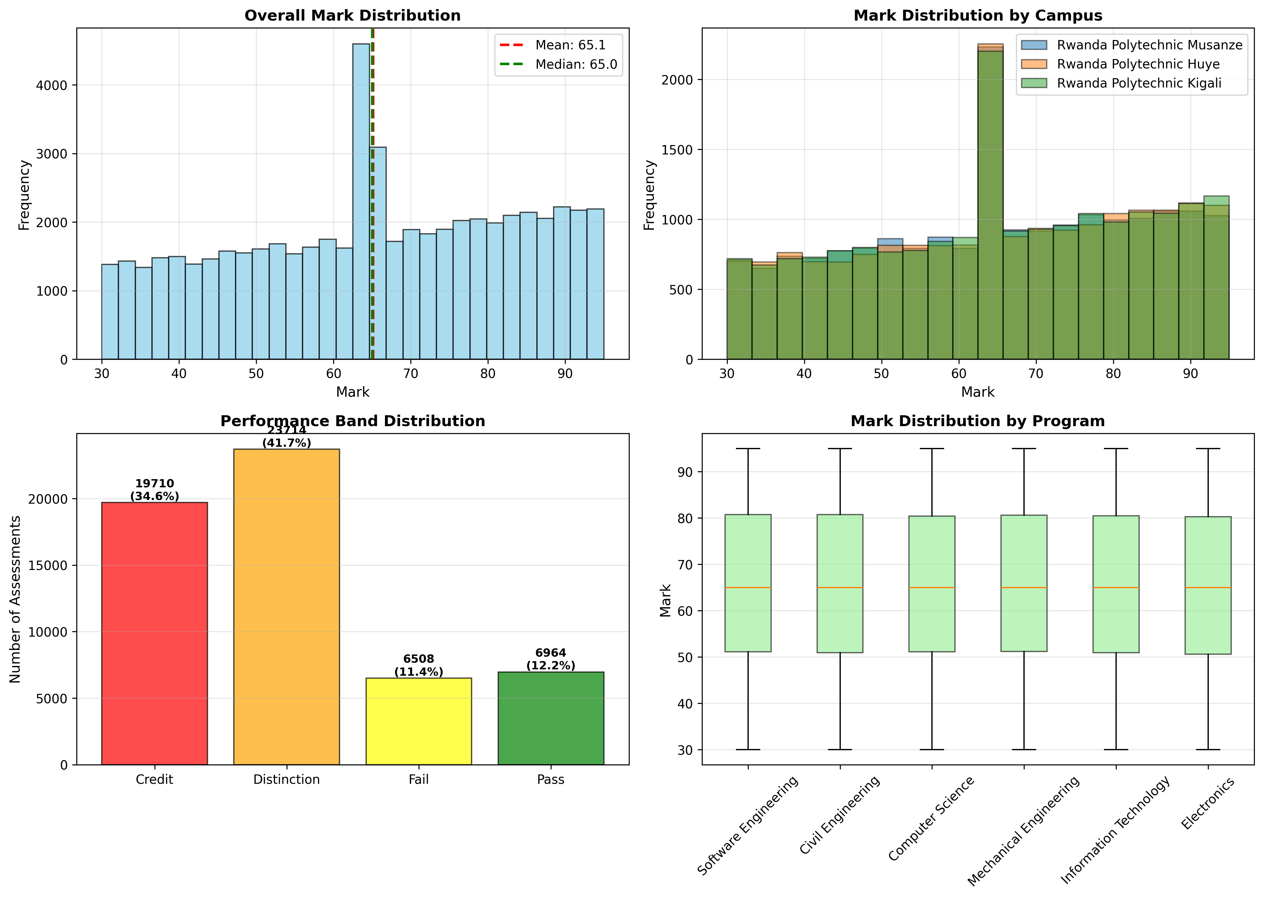
Visualization 1: Mark Distribution Analysis
Overall average mark: 64.6 | Performance bands show 34.6% Credit, 41.7% Distinction | Campus comparison reveals variation

Slide 13
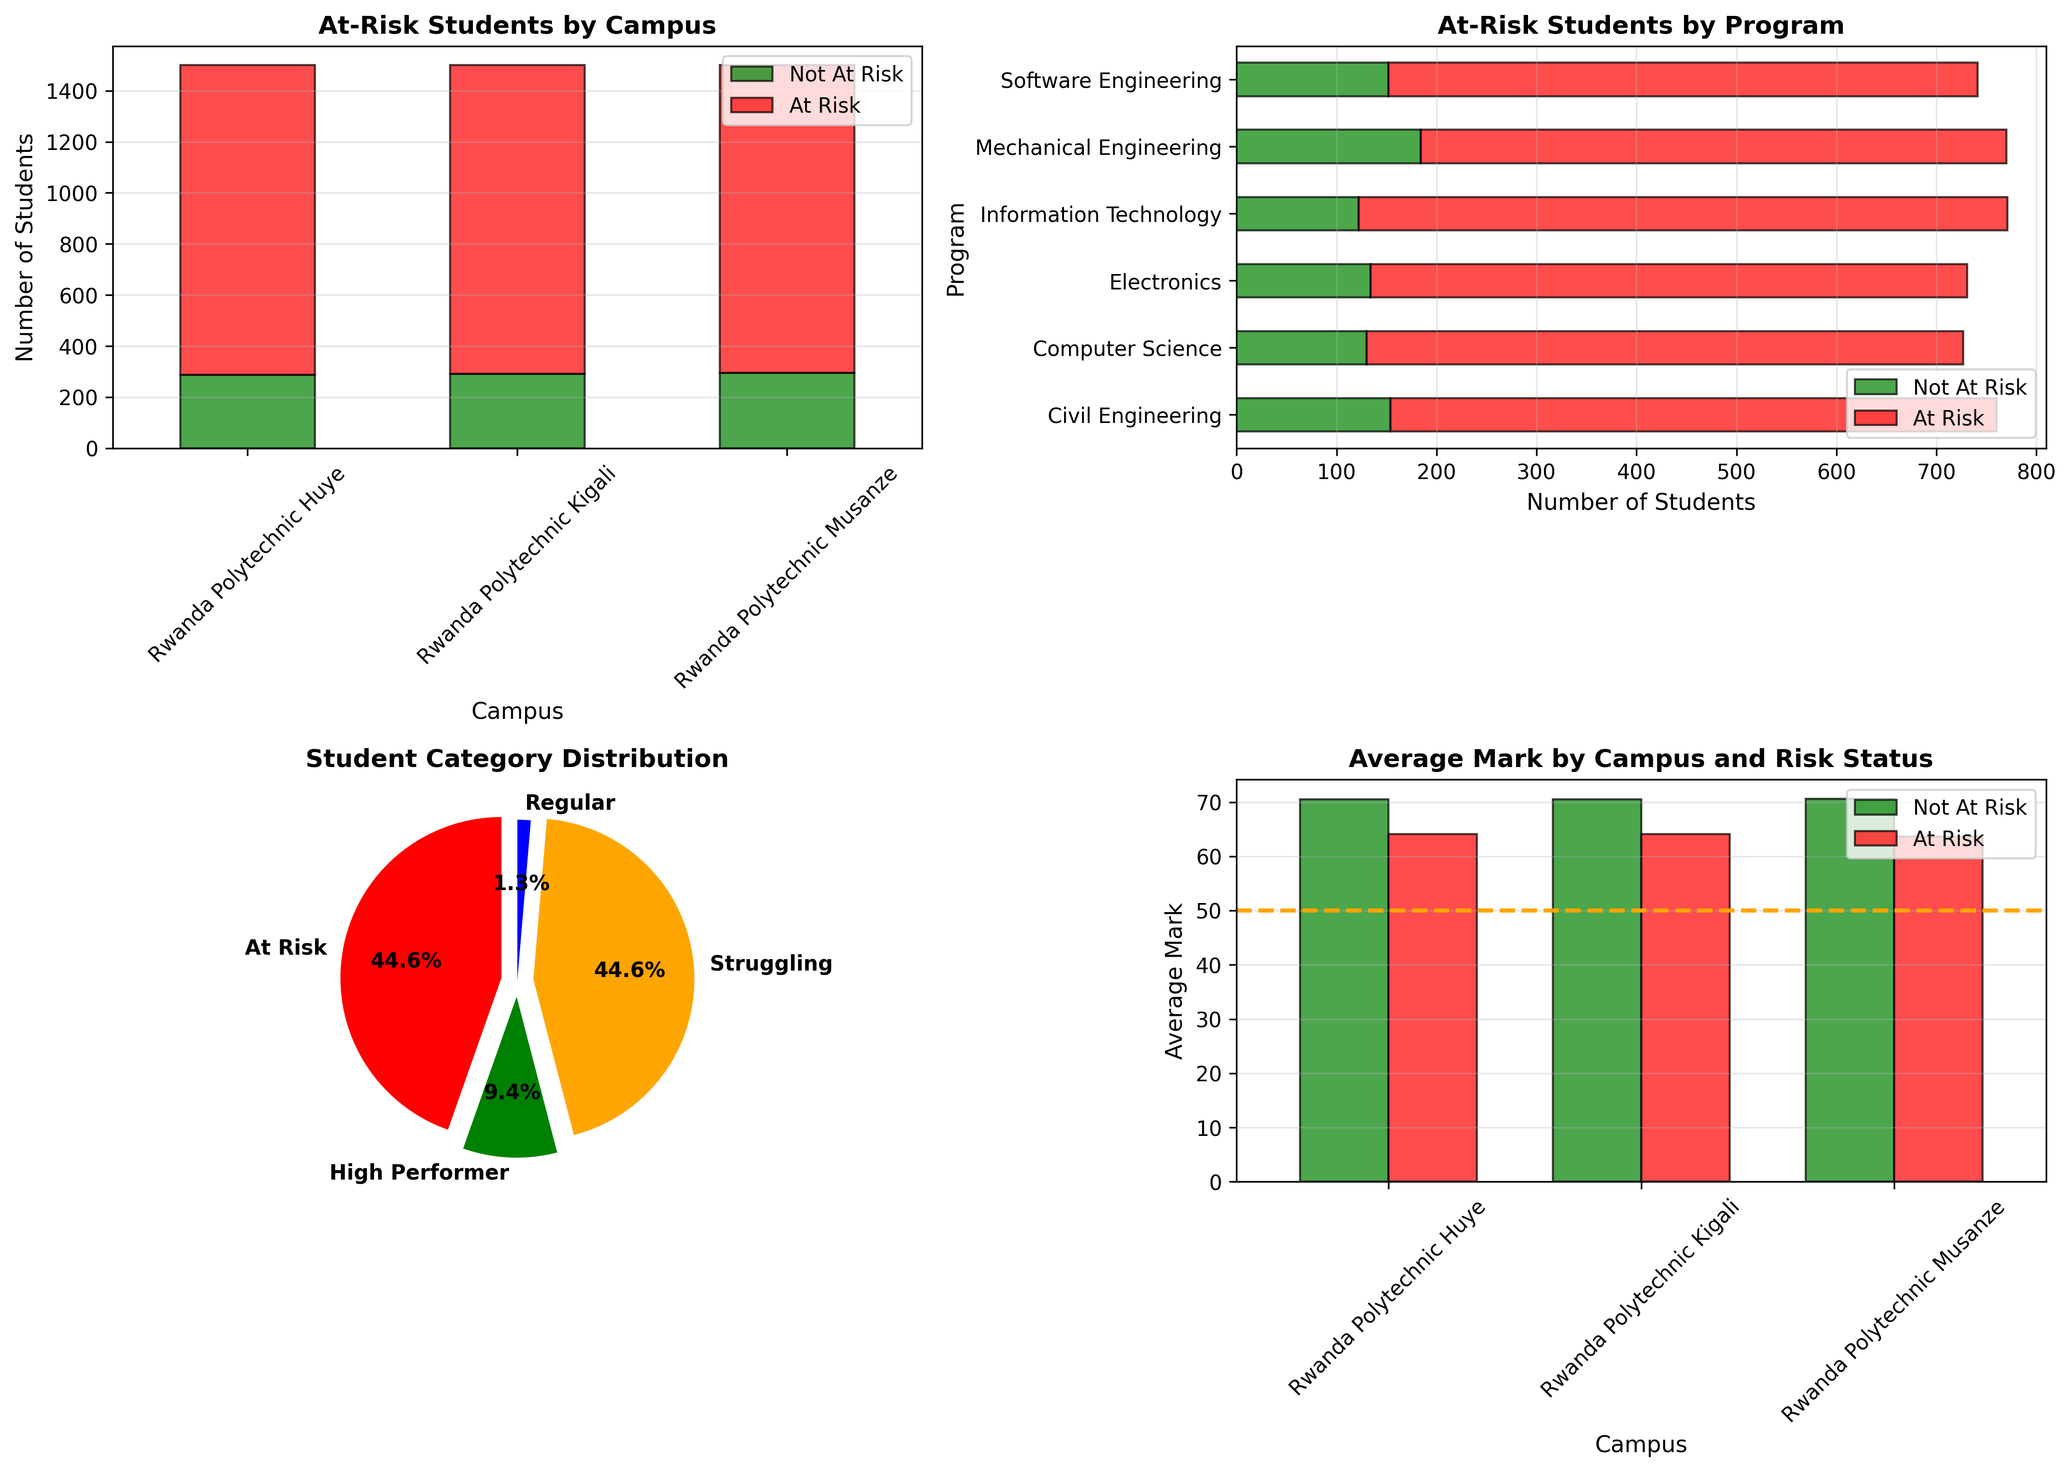
Visualization 2: At-Risk Student Analysis
44.6% students identified as At Risk | Software Engineering shows highest risk concentration | Campus-level intervention priorities

Slide 14
Thank you!

