Slide 1
Design and Optimization of a Blended Wing Body UAV Using AI-Driven Surrogate Modeling and CFD Analysis
Dr. Muhammad Shoaib Naseem, M Uns Haider Shah, M Nasih Ul Hassan, Rimsha Zubair, Ayman Afzal
Presented By: Muhammad Uns Haider Shah

Slide 2
Introduction & Research Goal
Introduction:
Blended Wing Body (BWB) UAVs offer high aerodynamic efficiency by integrating the wing and fuselage.
Limited propulsion power at small scales restricts endurance.
Research Goal:
Increase UAV endurance using a low‑power propulsion system through surface topology optimization using AI‑driven geometry optimization.

Slide 3
Significance
Key Impact:
Extended gliding time without propulsion provides critical extra seconds in emergencies.
Enhances occupants’ safety by allowing longer unpowered flight for controlled emergency landings.
Potential to save lives and improve overall aerospace safety

Slide 4
Motivation for Surrogates
Full-fidelity CFD: minutes-to-hours per run
Large design space: span, sweep, twist, taper, airfoils…
Goal: Millisecond evaluations to drive rapid optimization

Slide 5
Workflow Overview
Sample 50 wing geometries data
Preprocess data (normalization, train/test split)
Train MLP surrogate
Predict performance
Optimize geometry via AI loop

Slide 6
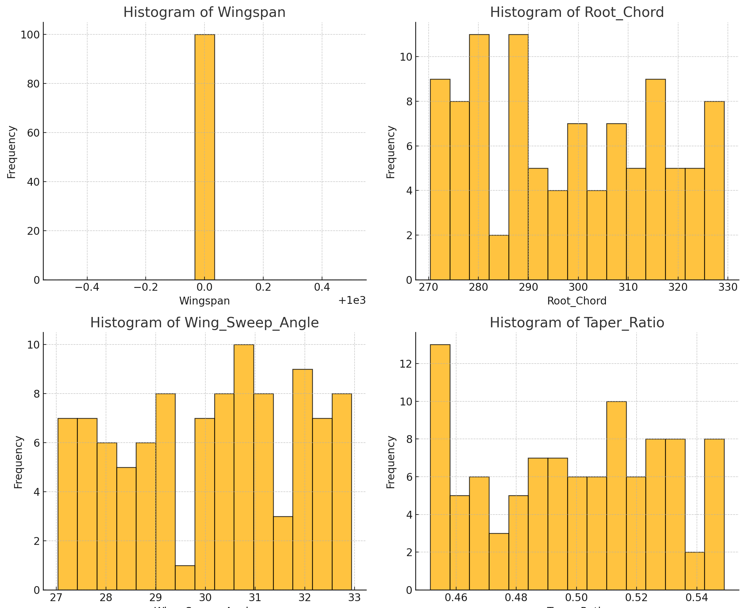
Dataset & Features
Inputs (m=10): span, root & tip chords, quarter-chord sweep, taper, twist, 3 airfoil IDs
Outputs: L/D, drag coefficient, required power
Latin-Hypercube sampling ensures space-filling

Slide 7
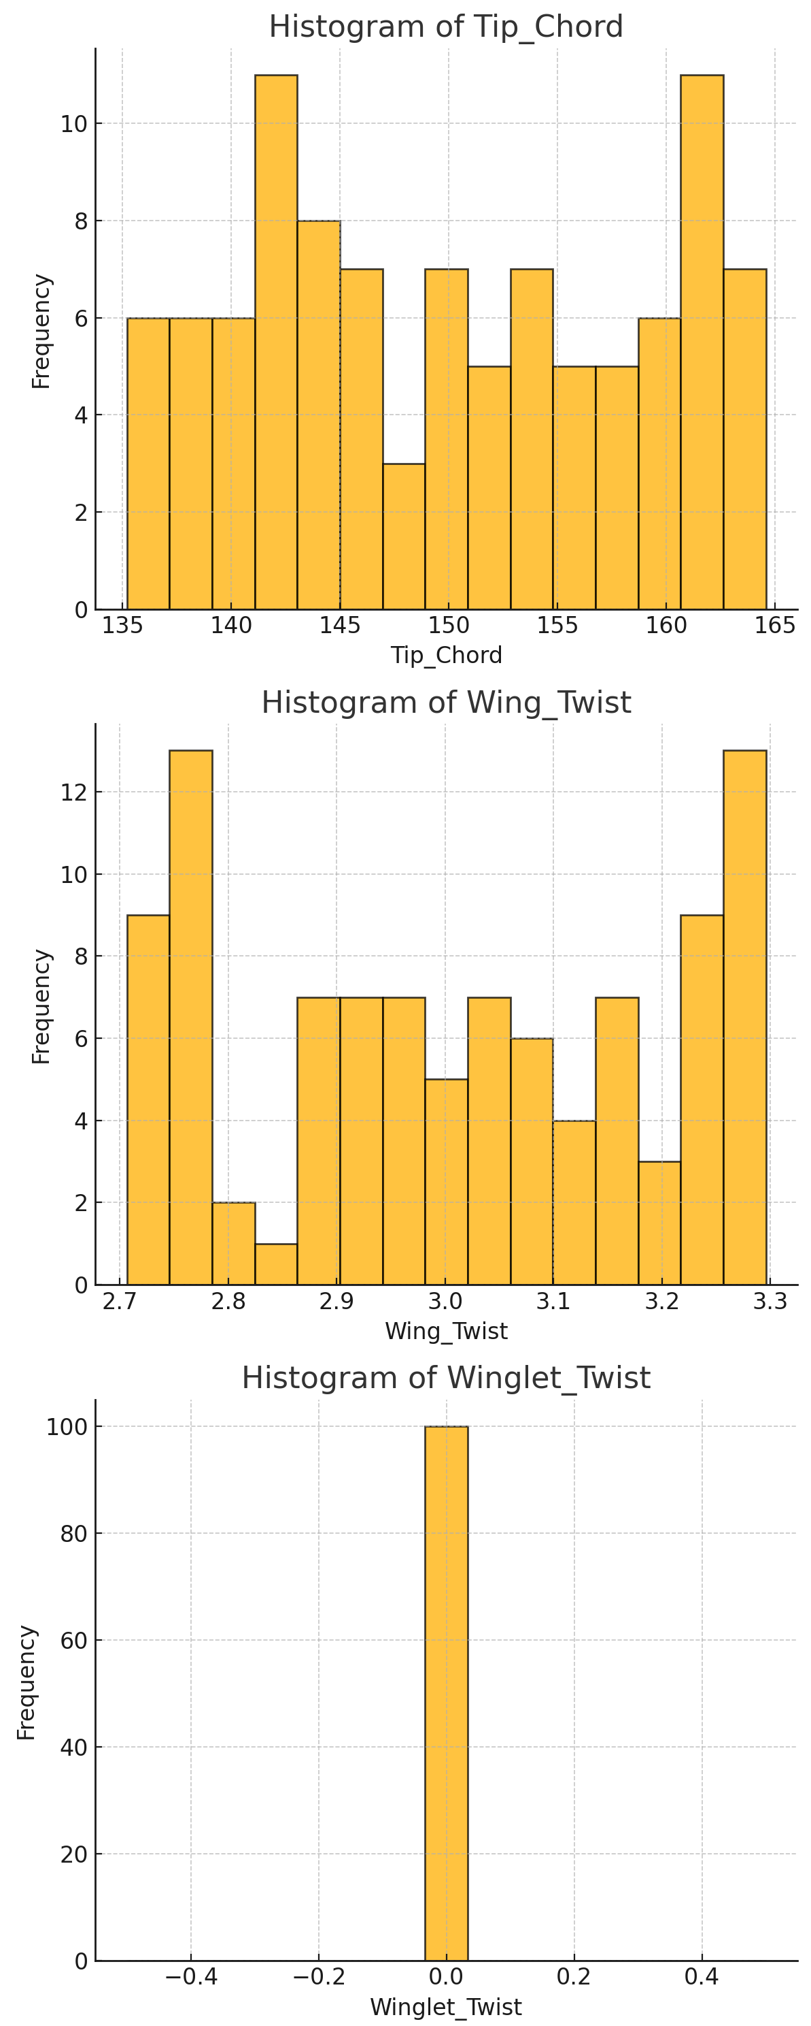
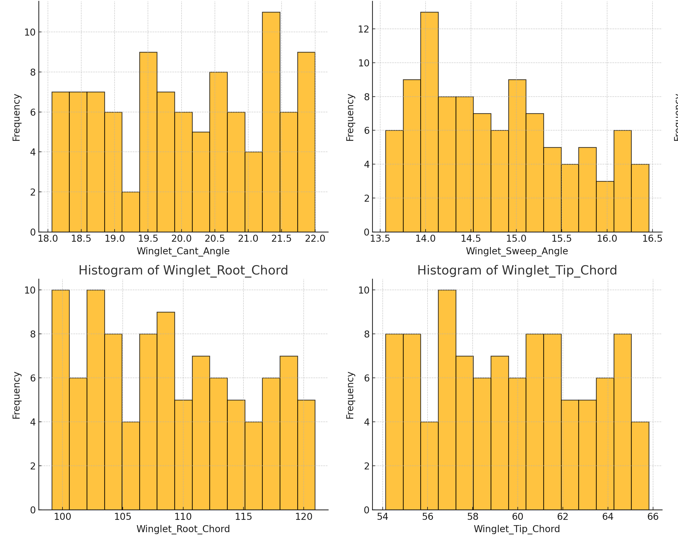

Slide 8
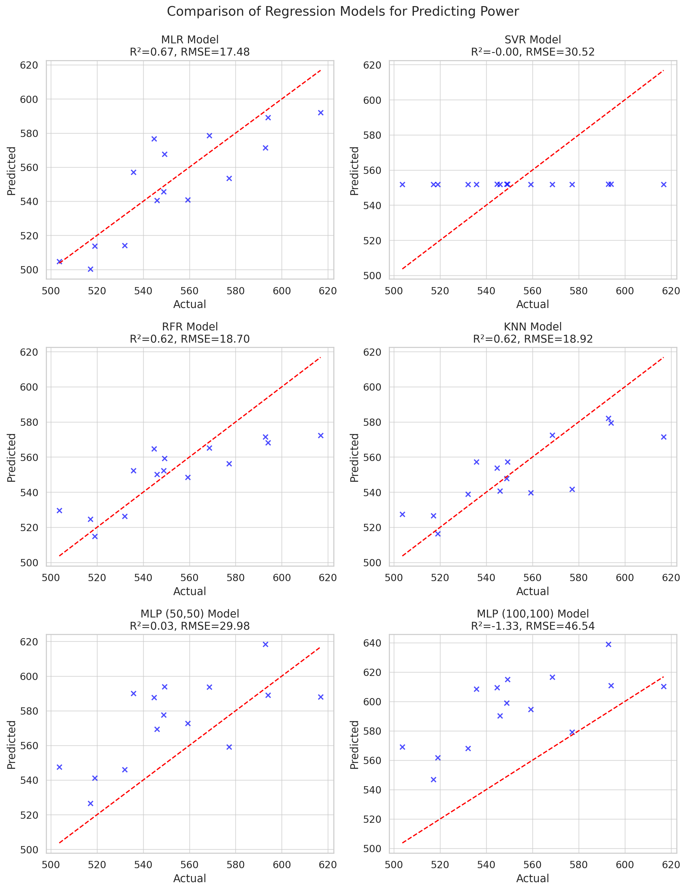
Model Comparison
MLP (2×50 neurons) best: RMSE<0.02, R²>0.98
Nonlinear models outperform linear baseline

Slide 9
MLP Architecture
Layers: Input → 50 neurons → 50 neurons → Output
Activation: ReLU
Solver: Adam

Slide 10
Rapid Design Exploration
Time Comparison:
CFD run: ~30 min
Surrogate eval: <0.001 s
Enables 10⁴–10⁵ candidates in the same time

Slide 11
Integration with Optimization
Genetic Algorithm or Bayesian Optimizer
Surrogate as objective function
Final top candidates validated by CFD

Slide 12
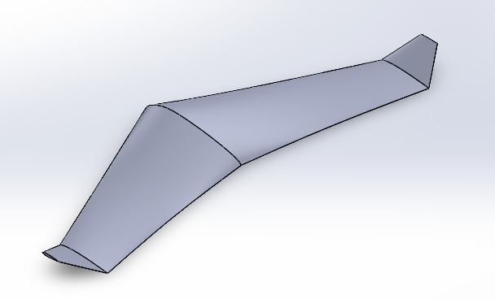
Initial CAD Model

Slide 13
Parameters for Final Design
Airfoil Selection:
Root/Center: Selig S1223
Mid: NACA 1408
Wing: NACA 0012
Wingspan:1.0 m
Root Chord: ~0.30 m
Tip Chord: ~0.15 m
Wing Sweep Angle (Λ): 20°–35°
Taper Ratio(λ): ~0.5
Aspect Ratio= 6–8
Wing Twist (θ): ±0°–±3°
Blending Region: Defined via spline/Bezier curves

Slide 14
Winglet Parameters
Winglet Root : ~0.10–0.12 m
Winglet Tip : ~0.05–0.07 m
Winglet Sweep: 10°–20°
Winglet Cant Angle: 15°–30°
Winglet Twist: ±0°–±2°

Slide 15
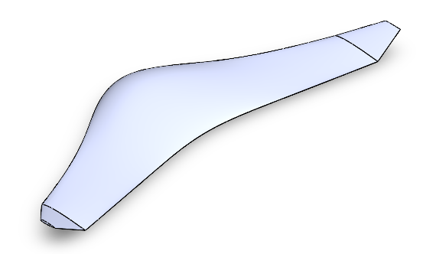
Final CAD Model

Slide 16
CFD Simulation Setup
Solver & Physics
3D, steady pressure‐based RANS
SST k–ω turbulence with heat transfer enabled
Flow Conditions
Free-stream velocity:
1) 30 m/s (Mach 0.088)
2) 240 m/s (Mach 0.7)
Inlet far-field: T = 300 K, turbulence intensity = 5 %, viscosity ratio = 10
Boundary Conditions
Pressure-farfield inlet/outlet
No-slip, adiabatic aluminum walls
Symmetry on vertical side planes

Slide 17
CFD Key Aerodynamic Results @ 30 m/s
Lift Coefficient (C_{L})= 0.44
Drag Coefficient (C_{D}) = 0.004
Lift-to-Drag Ratio (L/D) ≈ 110

Slide 18
CFD Key Aerodynamic Results @ 240 m/s
Lift Coefficient (C_{L})= 0.04
Drag Coefficient (C_{D}) = 0.004
Lift-to-Drag Ratio (L/D) ≈ 10

Slide 19
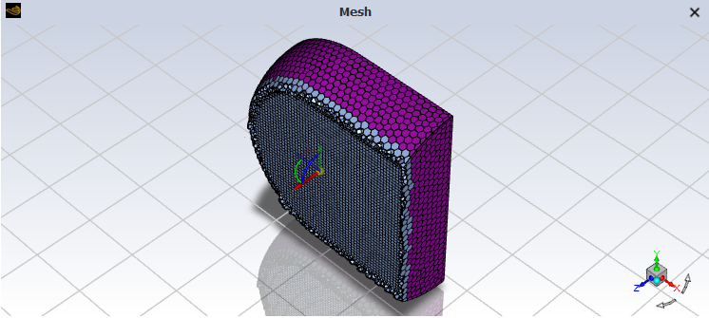
volume mesh

Slide 20
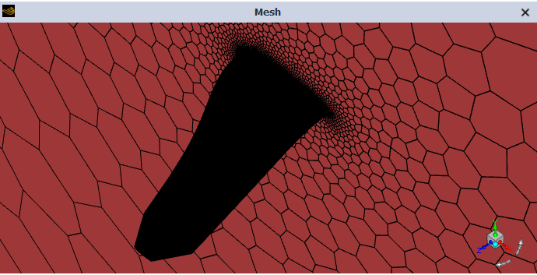
wing mesh

Slide 21
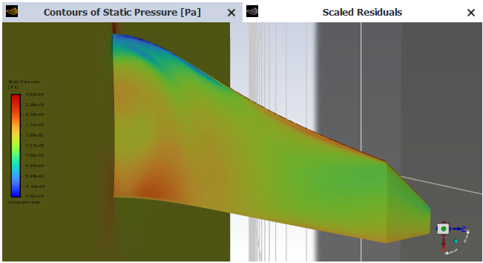
Pressure Lower

Slide 22
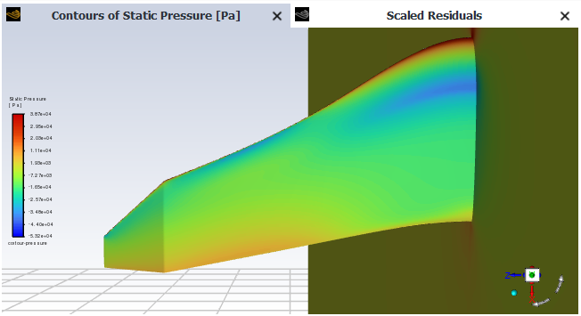
Pressure Upper

Slide 23
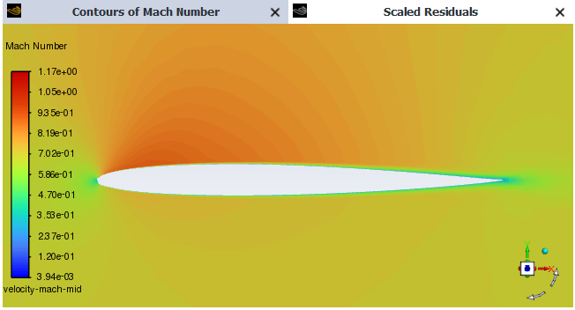
Velocity mach (mid)

Slide 24
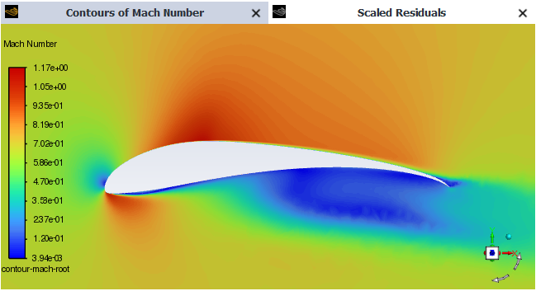
Velocity mach (root)

Slide 25
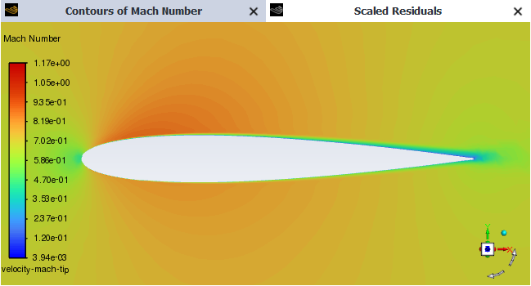
Velocity mach (tip)

Slide 26
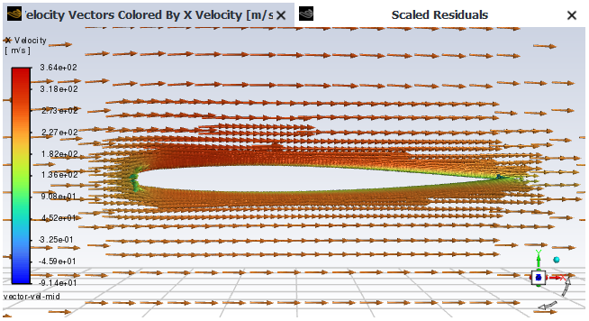
Velocity Vector (mid)

Slide 27
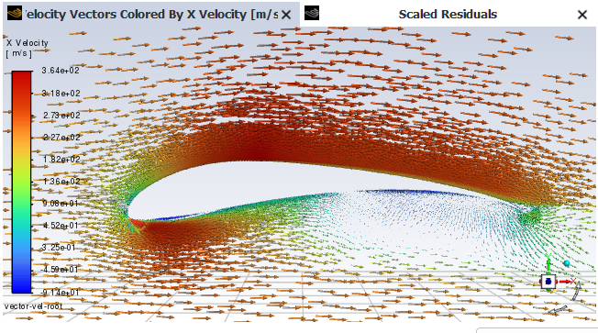
Velocity Vector (root)

Slide 28
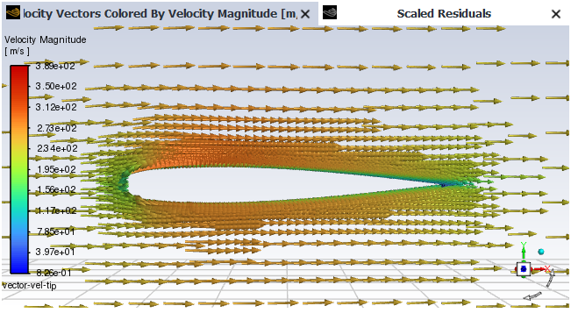
Velocity Vector (tip)

Slide 29
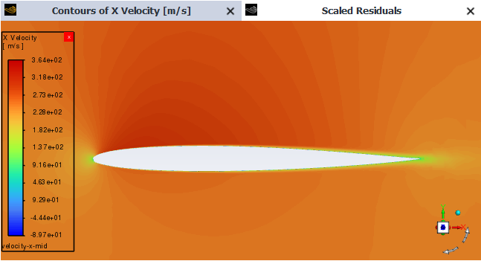
Velocity X (mid)

Slide 30
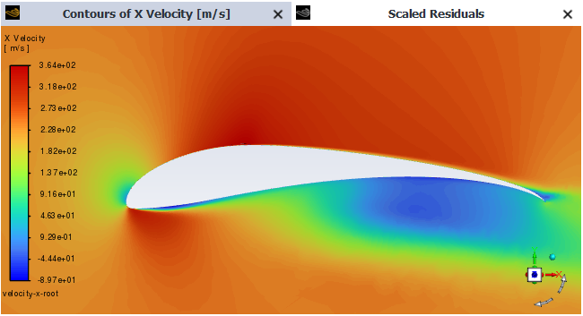
Velocity X (root)

Slide 31
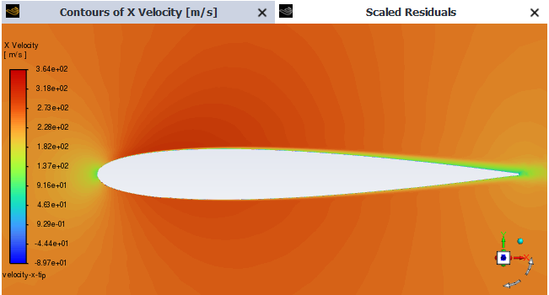
Velocity X (tip)

Slide 32
Lift-to-Drag Ratio Comparison at 30 m/s (Mach 0.088)
High-performance gliders: L/D 30–60
Light single-engine aircraft (e.g., Cessna 172): L/D 9–12
Long-endurance UAVs: L/D 12–20
Commercial airliners L/D 12–16
Military jets: L/D 5–8

Slide 33
Lift-to-Drag Ratio Comparison at 30 m/s (Mach 0.088)
For designed UAV: L/D is 110
Surpasses High-performance gliders, typical UAVs and light aircrafts.
Efficiency will be nearly matching high-performance gliders, enabling extended endurance or reduced power requirements in real world conditions.

Slide 34
Lift-to-Drag Ratio Comparison at 240 m/s (Mach 0.7)
High-performance UAVs (jet-powered)
• L/D ≈ 8–15
• For Designed UAV = 10

Slide 35

Q&A

