Slide 1

Florida Atlantic University
College of Business
Amazon
Instructor: Dr. Sofia Johan (LLB, LLM in International Economic Law, PhD in Law and Finance)
Associate Professor of Finance

Slide 2
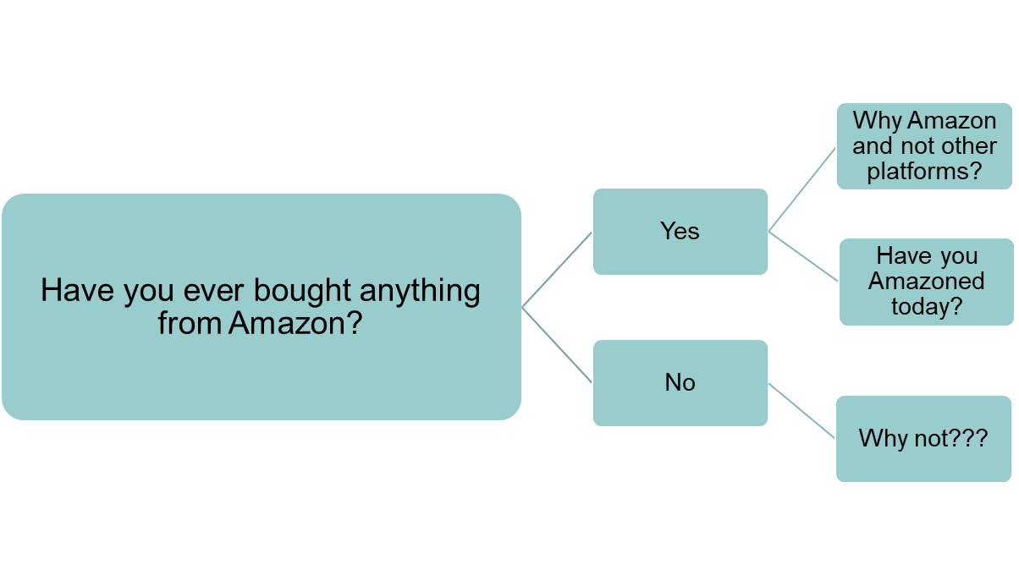
Have you ever bought anything from Amazon?

Slide 3
We are analyzing this case to determine the following:
Amazon’s historical performance.
Disparity between cash flow and net income.
What did Amazon do with the cash flow that it generated between 2014 and 2016?
Future growth strategy.

Slide 4
Historical Performance: Qualitative (Business Model)
Think about where Amazon started out. They were an online bookshop.
Think about Amazon’s retail innovations like the Prime membership program and 1-Click shopping.
Think about Amazon’s new product and service development like the Kindle, Alexa, and Amazon Web Services
Amazon is now the largest cloud company in the Universe…assuming there is no other intelligent life elsewhere

Slide 5
Historical Performance: Quantitative (Financial Analysis)
Look at Exhibit 1: Growth in cash from operations and net income since 2010
Carry out ratio analysis from data in Exhibit 2.
  Profitability Ratio (Gross Profit Margin, Return on Assets, Return on Equity)
  Liquidity Ratio (Current Ratio, Quick Ratio)
  Leverage Ratio (Debt to Equity)
  What are main takeaways? In comparison to comparable companies/retail industry?

Slide 6
Performance: Quantitative (Financial Analysis)
Let's now focus on the relationship between the cash flow and income statements.
Why is Amazon’s cash flow from operations higher than its net income (Really, really look at the operating section of the cash flow statement (Exhibit 2).
Remember in finance, CASH IS KING.
We look at 3 main reasons.

Slide 7
1. Depreciation and Amortization
Look at increase between 2014 and 2016 (Exhibit 2)
Recall that depreciation and amortization do not represent CASH FLOWS OUT but is an expense for tax purposes. That accounting entry is just meant to categorize the use of assets over their useful lives. But cash does not leave the house!!
Now look at the Balance sheet. What from the balance sheet reaffirms that Amazon’s depreciation and amortization increased between 2014 and 2016? Hint: increase in Amazon’s PP&E over this period.

Slide 8
2. Stock Based Compensation
Look at increase between 2014 and 2016 (Exhibit 2)
When I worked in VC we used to say give employees stock options and a fancy title and they will work for peanuts.
Recall that stock-based compensation is measured at fair value as of award/grant date and then expensed over time as the employee earns the compensation.
Do you see a parallel between the accounting for PPE & stock-based compensation? Hint: This also represents a non-cash expense that is intended to spread out the costs of previously-issued stock options.

Slide 9
3A. Working capital accounts (Unearned revenue).
Look at cash flow statement especially entries related to unearned revenue: 1. additions to unearned revenue and 2. amortization of previously unearned revenue.
Recall that unearned revenue (a balance sheet liability) arises when a customer pays for a product/service that a company will deliver
Think of Prime membership.
Additions to unearned revenue occur when you pay upfront for the Prime membership, and amortization of previously unearned Prime revenue occurs over the following year when Amazon provides the benefits you paid for.

Slide 10
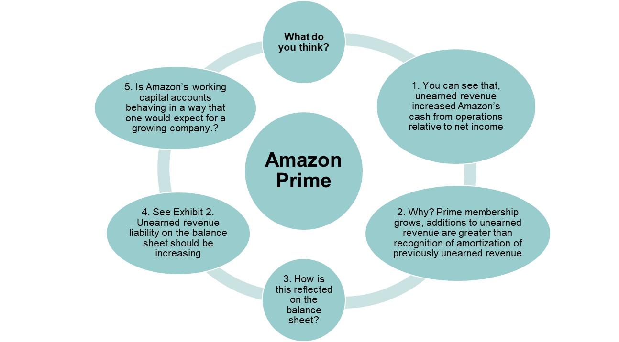
3A. Working capital accounts (Continued).

Slide 11
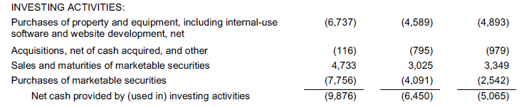
What did Amazon do with all this cash?
Look at the investing section of Amazon’s cash flow statement (Exhibit 2)
Amazon has had significant expenditures on PP&E and other long-term assets. Also, there are also smaller cash investments in business acquisitions. Lastly, there are cash inflows and outflows related to purchases and sales of marketable securities.
Note however that these are Amazon’s cash management activities and not investments in its operations….but are they?
See Exhibit 6. Amazon defines free cash flow in its non-GAAP cash flow disclosures as cash from operations less investments in PP&E and other assets but excluding purchases/sales of marketable securities.

Slide 12
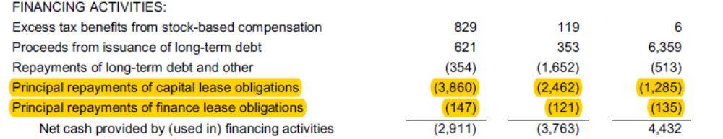
What did Amazon do with all this cash?
Look again at the cash flow statement and you will find cash outflows related to principal payments on different types of leases
Amazon has had significant cash flows under financing activities but there is an operational aspect to them as they represent payments for leased assets.
See Exhibit 6. Another of Amazon’s non-GAAP cash flow disclosures subtracts principal payments on leases from free cash flows.

Slide 13
What it would take for Amazon to reach $20 billion in net income within five years?
Is it continued growth? What does that even mean from a quantitative perspective?
How much growth Amazon would need to reach $20 billion in net income assuming its net income margin remained constant at its 2016 level? The answer is 8-9 times, which would imply annual Amazon revenue of roughly $1 trillion. Is this possible?
Recall that industry data provided in the case suggest that worldwide growth in ecommerce retail over this period would only reach 150%. Amazon would have to dramatically increase its market share to achieve target growth rate.
What does data tell you about other market segments?

Slide 14
What would it take for Amazon to reach $20 billion in net income within five years?
If not growth then what about contraction (slowing down)? What does that even mean from a quantitative perspective?
If Amazon slowed investments in longer-term initiatives, how would this affect Amazon’s net income and cash flow?
Would lower investments in PP&E increase free cash flows and lower depreciation and amortization expense? How low can you go? Is zero (0) an option? Let's say Amazon reduces 2016 amount of $8 billion to $2 billion would a $6 billion pre-tax savings be enough to reach $20 billion in net income?
Can Amazon reduce any other expenses? See Exhibit 3.
Is this a route to take? That’s what you have to figure out….

Slide 15
You will work in a group of not more than 4 members will submit a 2-5 page report (single spaced, APA) that answers the following questions:
1. How has Amazon performed leading up to its 20-year-anniversary as a public company? Over the long-term? In the near-term? Compute financial ratios from Amazon’s 2014-16 financial statements provided in the case and report the main takeaways
2. Why was Amazon’s 2014-16 cash flow from operations higher than its net income?
3. What did Amazon do with the cash flow that it generated between 2014 and 2016?
4. Articulate a pathway for Amazon to get from $2 billion to $20 billion in net income between 2016 and 2021 as envisioned by the Barron’s article cited in the case?

Slide 16
Key Takeaways
At the end of our discussion of this case I hope that:
You are able to have a greater appreciation of the layout and terminology of the cash flow statement.
You are able to appreciate the difference between net income and cash flow from operations.
Cash flow from operations is a disciplining device on managers – financial statement users usually ask whether net income is backed up by cash flow..and I hope you are able to have a greater appreciation how this is applied in real companies lie Amazon. I want you to be able to analyze financials of any company to identify anomalies in accounting such as increasing revenues with no corresponding increases in cash flows (and vice versa)

