Slide 1
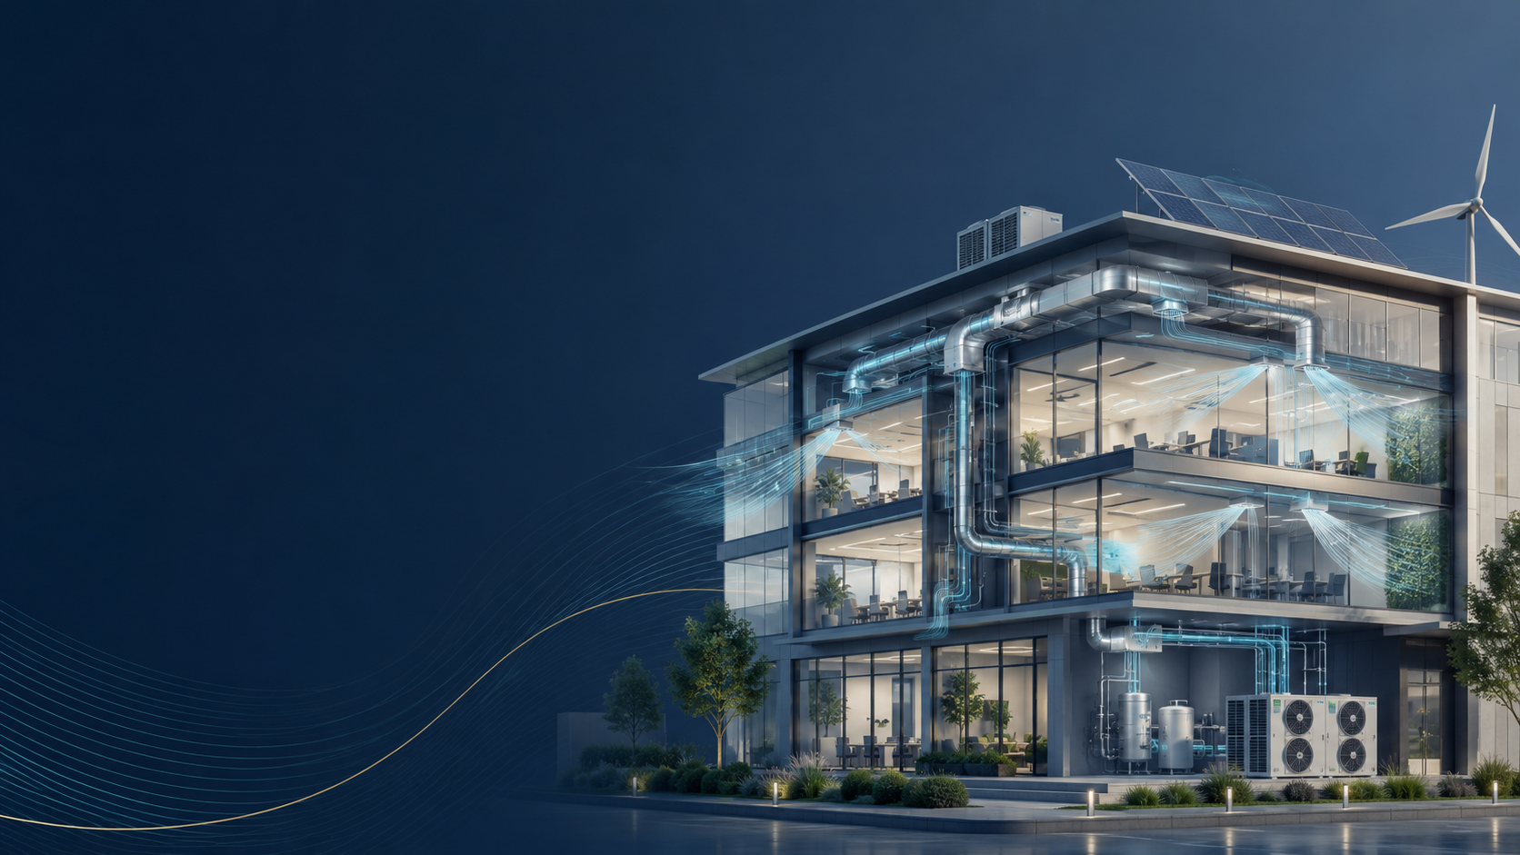
CAWNPORE ENGINEERING SERVICES
CAWNPORE
ENGINEERING SERVICES
Your Climate. Our Commitment.
Professional HVAC solutions for commercial, residential and industrial environments.
Established 2021
Headquarters: Kanpur
Pan-India Operations
CAWNPORE ENGINEERING SERVICES
01

Slide 2

Company Snapshot
A Kanpur-based HVAC engineering partner built around comfort, air quality and energy efficiency.
2021
Kanpur
Pan-India
Founded
Headquarters
Operations
Industry
Business Areas
Brand Promise
HVAC - Heating, Ventilation and Air Conditioning solutions.
Commercial HVAC
Residential HVAC
Industrial HVAC
Energy-efficient
climate-control solutions.
Reliable engineering, tailored comfort, improved air quality and sustainable system performance.
“Your Climate. Our Commitment.”
CAWNPORE ENGINEERING SERVICES
02

Slide 3
Mission, Vision & Values
The company’s operating direction, service philosophy and core standards.
Mission
Vision
Values
Deliver exceptional HVAC solutions that enhance comfort, improve air quality and optimize energy efficiency while exceeding customer expectations through innovation and service excellence.
Be India’s most trusted HVAC service provider, recognized for technical expertise, customer-centric delivery and sustainable practices shaping climate-control technology.
Guided by integrity, excellence, innovation, sustainability and a deep commitment to customer satisfaction in every engagement.
Quality
Sustainability
Innovation
Customer Focus
Uncompromising standards
Eco-friendly solutions
New technologies and methods
Exceeding expectations
CAWNPORE ENGINEERING SERVICES
03

Slide 4
HVAC Solutions Across Segments
One service platform for commercial, residential, industrial and sustainable climate-control needs.
Commercial
Residential
Offices, retail spaces, malls and institutions
Comfortable, productive environments.
Homes and residential complexes
Comfort, indoor air quality and efficiency.
Industrial
Sustainable
Manufacturing and production facilities
Heavy-duty systems, ventilation and process cooling.
Energy-efficient climate-control solutions
Reduced operational cost and environmental impact.
Tailored engineering + reliable installation + lifecycle service = dependable climate performance.
CAWNPORE ENGINEERING SERVICES
04

Slide 5
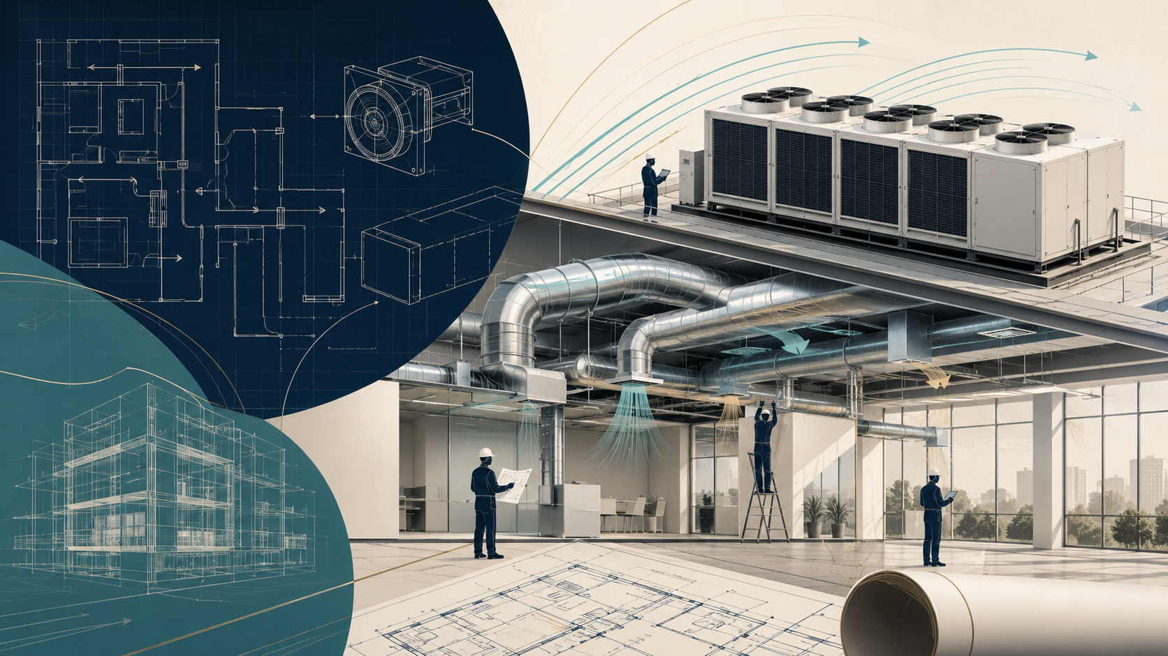
Core Services
Comprehensive HVAC capabilities from design to maintenance and modernization.
1
HVAC Design & Engineering
Load calculations, system selection, energy modelling and detailed engineering drawings.
2
Installation & Commissioning
Equipment installation, ductwork, piping, testing and balancing.
3
Maintenance & Repair
Preventive maintenance, emergency repair and performance optimization.
4
Retrofitting & Upgrades
System modernization, efficiency upgrades and refrigerant conversion.
5
Specialized HVAC
Industrial process cooling, clean rooms, ventilation and residential IAQ systems.
CAWNPORE ENGINEERING SERVICES
05

Slide 6
Technical Capability Map
Key execution areas included in the company’s HVAC delivery model.
Design
Energy
Installation
Load calculations
System selection
Engineering drawings
Energy modelling
Optimization
Efficiency upgrades
Ductwork & piping
Equipment installation
Commissioning
Validation
Specialized
Service
System testing
Balancing
Performance checks
Clean-room HVAC
Process cooling
Industrial ventilation
Maintenance plans
24/7 emergency repair
Modernization
CAWNPORE ENGINEERING SERVICES
06

Slide 7

Industries Served
Tailored climate-control solutions for diverse environments and operating requirements.
Retail & Malls
Healthcare
Manufacturing
Commercial Offices
Residential Developments
Schools, Colleges & Government
Pharmaceutical Clean Rooms
Data Centres
Hotels
Food Processing Facilities
CAWNPORE ENGINEERING SERVICES
07

Slide 8
Why Choose Us
Strengths that support reliable delivery, responsive service and long-term value.
Pan-India Reach
Expert Team
Nationwide coverage with local expertise and rapid response.
Certified engineers, technicians and specialists with continuous training.
Energy Efficiency
24/7 Customer Support
Solutions focused on reduced operational costs and green-building standards.
Emergency response, query handling and assistance whenever needed.
Timely Delivery
Quality Assurance
On-time completion without compromising quality.
Rigorous control processes across installation and service.
Competitive Pricing
Transparent, value-based pricing with no hidden costs.
CAWNPORE ENGINEERING SERVICES
08

Slide 9
Major Clients
Selected organizations served across healthcare, retail, housing, manufacturing, aviation and entertainment.
MES Hospital, Udhampur
Varun Beverages
Bhavani Pharmaceuticals
Mogambo
Hospital
Beverage Industry
Healthcare
Game Zone
Z Square Mall
Emaar Housing / Gomti Greens
Ester Industries, Uttarakhand
Rajkot Airport
Retail
Housing Development
Manufacturing
Aviation
Client base reflects cross-sector capability: healthcare, commercial spaces, residential development, manufacturing and aviation.
CAWNPORE ENGINEERING SERVICES
09

Slide 10
Leadership & Contact
Experienced professionals leading marketing, technical strategy and company operations.
Aditya Singh
Sudhir Prajapati
Co-Founder & Marketing Head
Co-Founder & Chief Technical Officer
10+ years of HVAC industry experience, especially in Sales & Marketing, with focus on service quality and customer satisfaction.
10+ years of experience across Product Development, Design and Supply Chain Management, supporting strategic development and efficient operations.
+91 8318554343 • aditya@ceservices.co.in
+91 9350875423 • sudhir @ceservices.co.in
Cawnpore Engineering Services • Kanpur • Pan-India HVAC Solutions
CAWNPORE ENGINEERING SERVICES
10

