Slide 1
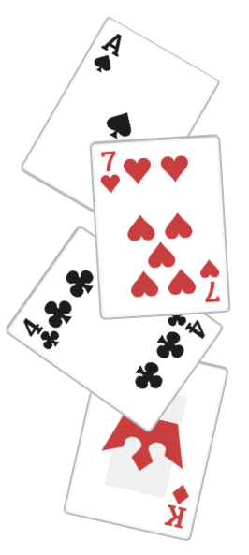
Durak is the most well known and popular card game in Russia and Ukraine.
Durak, meaning fool, is the title given to the loser of the game - the last player to get rid of their cards.
The game can be played by two to six players and uses a deck of 36 or 52 cards.

Slide 2

At the start of the game a card is placed face up on the table; its suit becomes the trump suit. The rest of the deck is placed on top of this card crosswise.
Then each player is dealt a hand of six cards.
The player with the lowest trump card goes first.

Slide 3
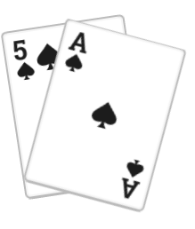
During each turn there’s one or more attackers and a defender. One at a time the attackers place cards on the table which the defender tries to beat.
A card which is not a trump can be beaten by playing a higher card of the same suit, or by any trump. A trump card can only be beaten by playing a higher trump.

Slide 4
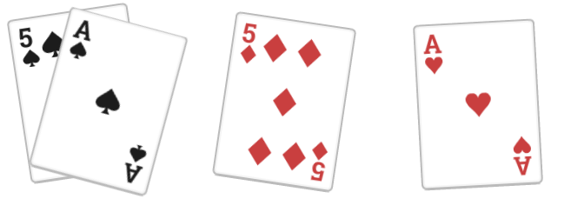
After the first card has been played, the attackers may only play cards with the same values as cards already on the table.
Attackers may play up to 5 cards until the first discard, and 6 after. This number is also limited by the amount of cards in the defender’s hand at the start of the turn.

Slide 5
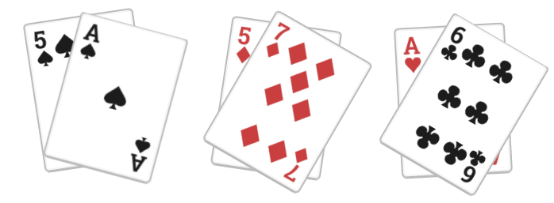
If the defender beats every card on the table and the attackers don’t to play any more, every card on the table is put in the discard pile.
If the defender doesn’t beat off the attack, the attackers get to follow up with more cards. After that, the defender takes the cards on the table.

Slide 6
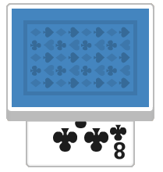

Once the cards are taken or discarded off the table, all players who have fewer than 6 cards draw cards from the top of the deck until it is empty or they have 6 cards again.
The attackers draw first in order, the defender draws last. Once the draw phase is over, the next turn begins.

Slide 7
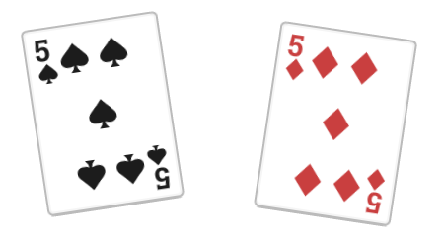
If the transfer rule is in play, right after the first attack of the turn the defender may play a card of the same value to force the next player to become the defender.
This is only possible if the next player has enough cards in hand to defend.

