Slide 1
Electricity BilLing System (EBS) - Presented by Ritik Grover
Presented to : Respected Panel (Neeraj Kaushik Sir, Mamta Punia Mam)

Slide 2
INTRODUCTION
Electricity Billing System is a desktop based application developed in Java programming language.
The project aims at serving the department of electricity by computerizing the billing system.
It mainly focuses on the calculation of Units consumed during the specified time and the money to be paid to electricity offices. This computerized system will make the overall billing system easy, accessible, comfortable and effective for consumers.

Slide 3
OBJECTIVE
We, the owners of our project, respect all customers and make them happy with our service.
The main aim of our project is to satisfy customer by saving their time by payment process, maintaining records, and allowing the customer to view his/her records and permitting them to update their details.

Slide 4
What does our project do ?
To keep the information of Customer.
To keep the information of consuming unit energy of current month.
To keep the information of consuming unit energy of previous month.
To calculate the units consumed every month regularly.
To generate the bills adding penalty and rent.
To save the time by implementing payment process online.

Slide 5
Problem Statement : -
The manual system is suffering from a series of drawbacks. Since whole of the bills is to be maintained with hands the process of keeping and maintaining the information is very tedious and lengthy to customer. It is very time consuming and laborious process because, staff need to be visited the customers place every month to give the bills and to receive the payments.
For this reason, we have provided features Present system is partially automated(computerized), existing system is quite laborious as one must enter same information at different places.

Slide 6
Proposed Solution :-
This project system excludes the need of maintaining paper electricity bill as all the electricity bill records are managed electronically.
Administrator doesn't have to keep a manual track of the users. The system
automatically calculates fine.
Users don't have to visit to the office for bill payment.
There is no need of delivery boy for delivery bills to user's place. o Thus, it saves human efforts and resources.

Slide 7
Technologies used : -
Language Used - Core Java
Concept Used - Swing
IDE Used – Eclipse
Database Used - MySQL

Slide 8
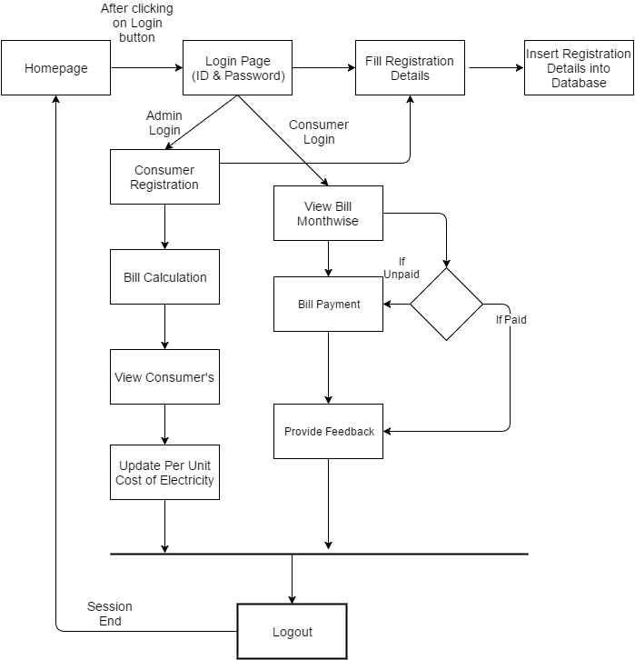
ARCHITECTURE

Slide 9
METHODOLOGY
Login:
This program will allow the admin to enter the username and password.
If the entered credentials are correct, then the login will be successful otherwise need to be signup.
New_customer:
This program will allow the admin to enter the customer details and automatically generates unique meter number.
If customer name, address, city, state, email and phone number is entered, insert the values into emp table

Slide 10
.
Customer_details :-
This program will allow the admin to view customer details.
If we need to print the particulars that has been viewed click onto print option.
Deposit_details :-
This program will allow the admin to view bill details. If we need to sort the particulars based on meter_no and month.
If we need to search the particulars that has been viewed click onto search option.
If we need to print the particulars that has been viewed click onto print option.

Slide 11
.
Calculate_bill :
This program will allow the admin to calculate total bill when units consumed are inserted where meter_no and month is selected.
insert the values into bill else print error
Generate_bill :
This program will allow the customer to generate bill when meter_no and month is selected.
Generate the details by clicking on Generate_bill button.
Pay_bill:
This program will allow the customer to view bill details and redirects to pay. The bill where status will be updated.
If we need to cancel the particulars that has been viewed click onto back option.
If we need to pay the bill amount that has been viewed click onto pay option.

Slide 12
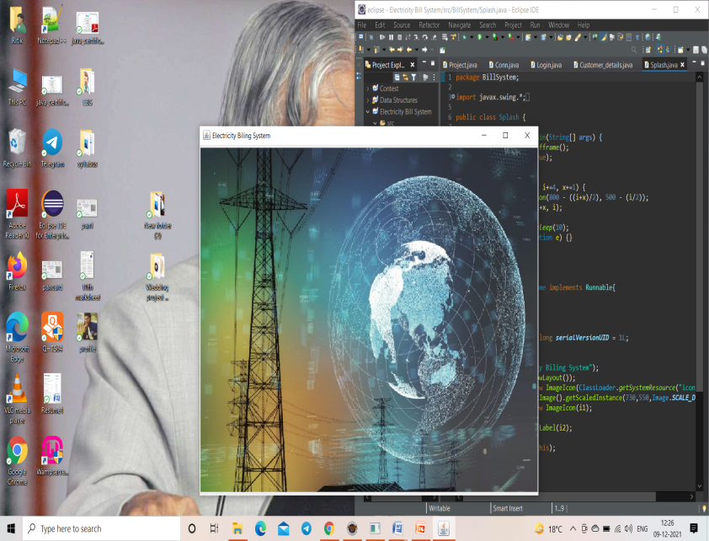
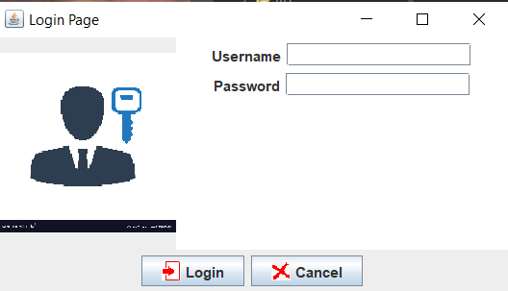
Screenshots Of Implementation

Slide 13
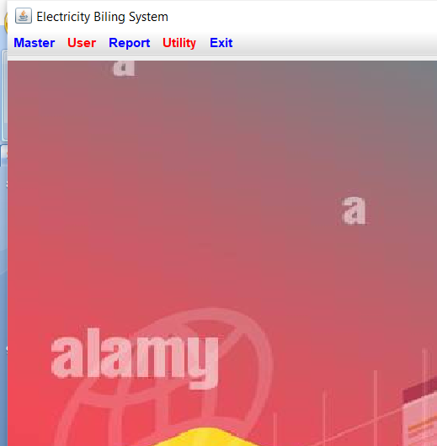
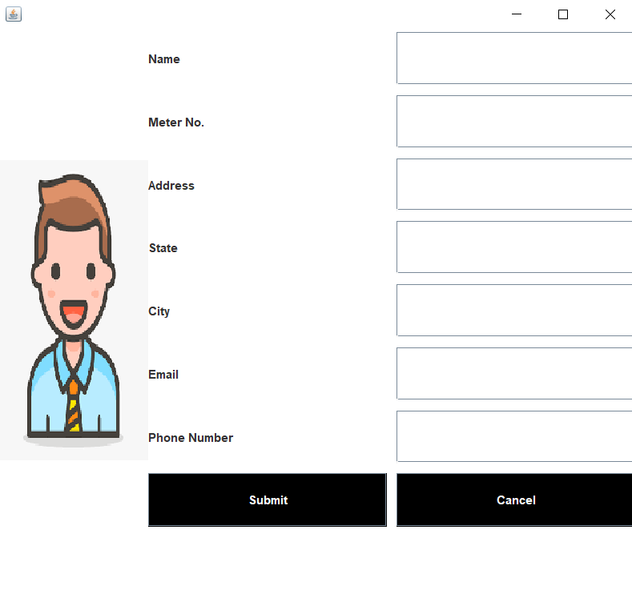
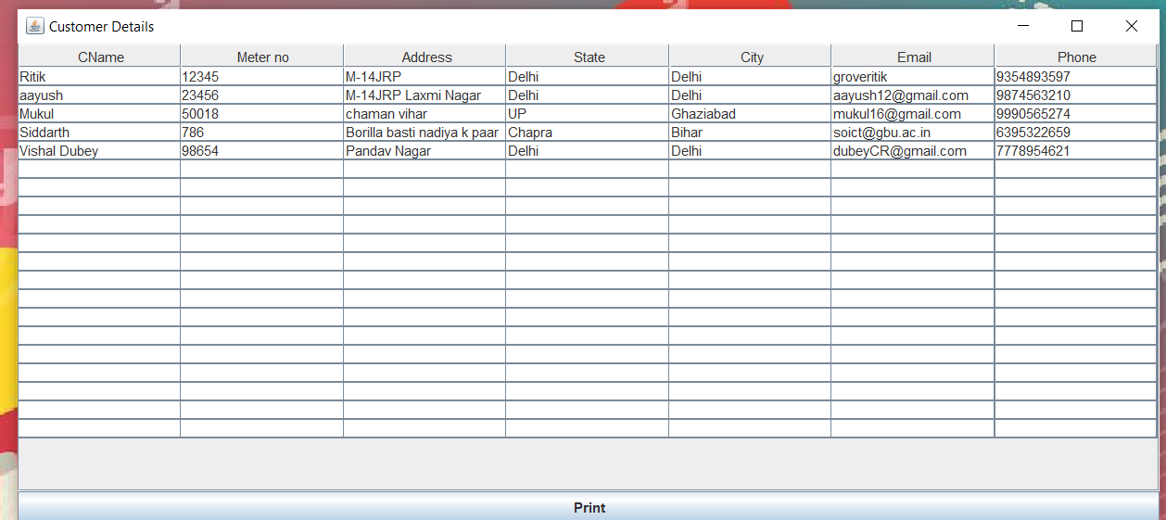
.

Slide 14
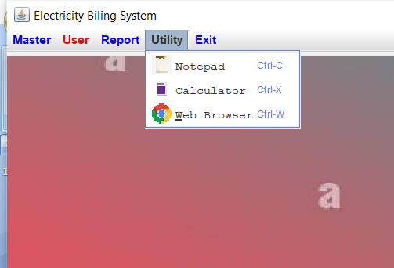
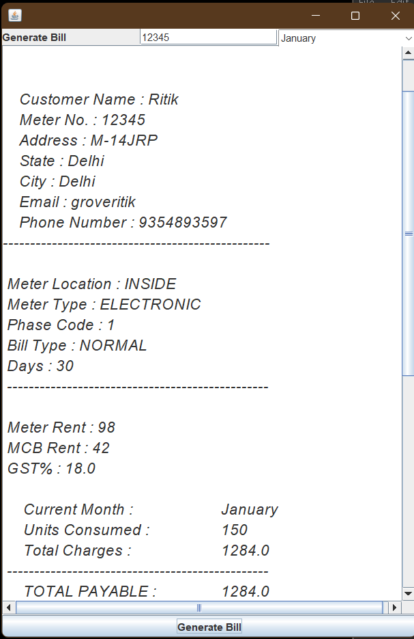
.

Slide 15
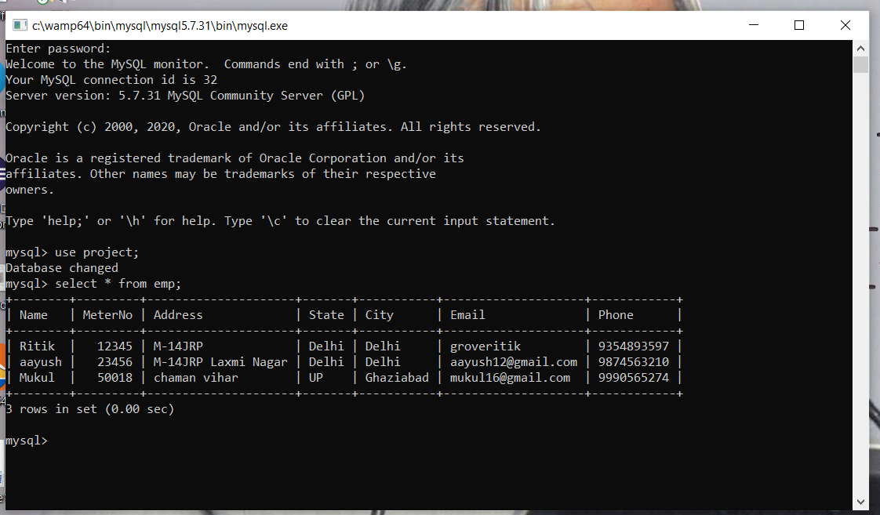
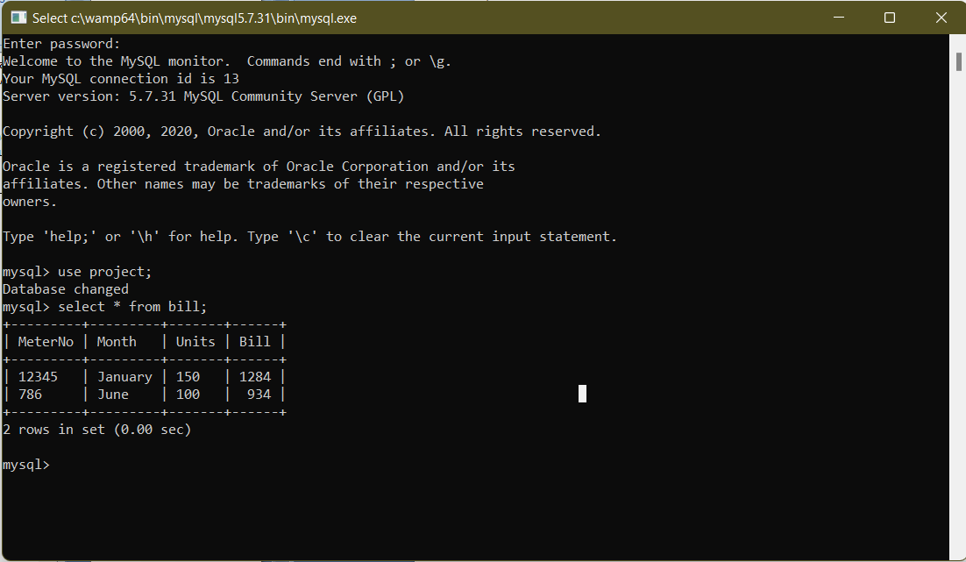
DATABASE USED :-.
.

Slide 16
Future Scope :-
A new software system to modernize the electricity billing procedure is required. This electricity billing system project would replace the existing traditional and analog type of electricity billing system ensuring security, ease and comfort in billing.
It meets the current user demands, and new features can be easily integrated into the system in future as per user requirements.

Slide 17
.
THANK
YOU

