Slide 1
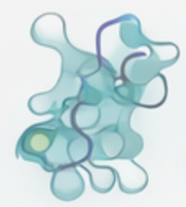
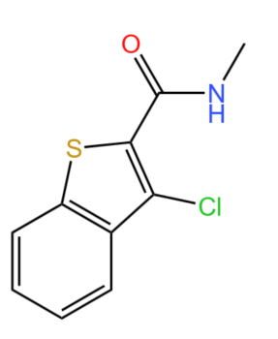




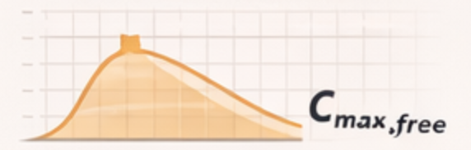




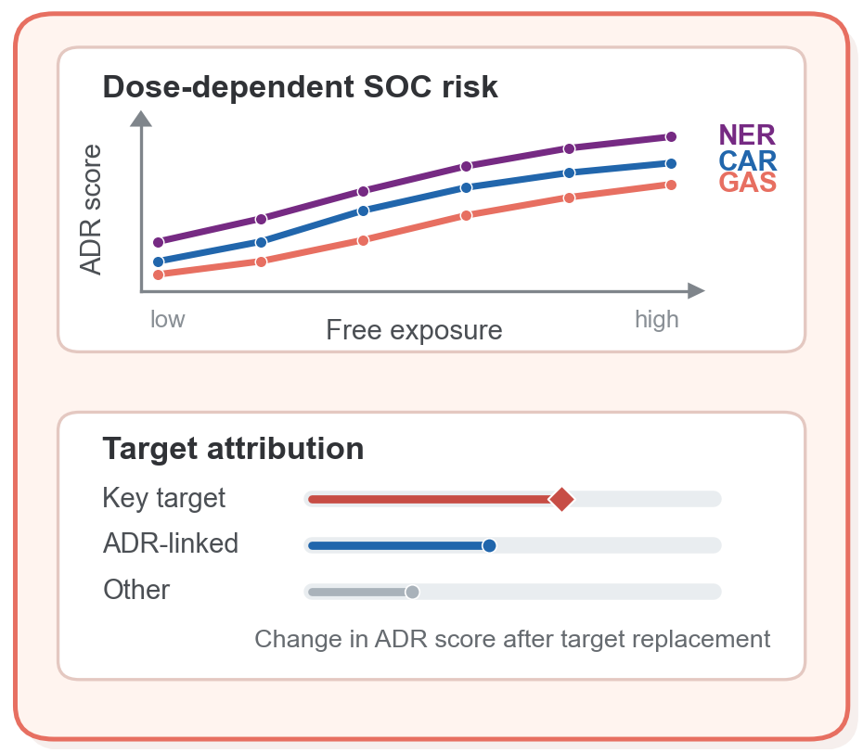
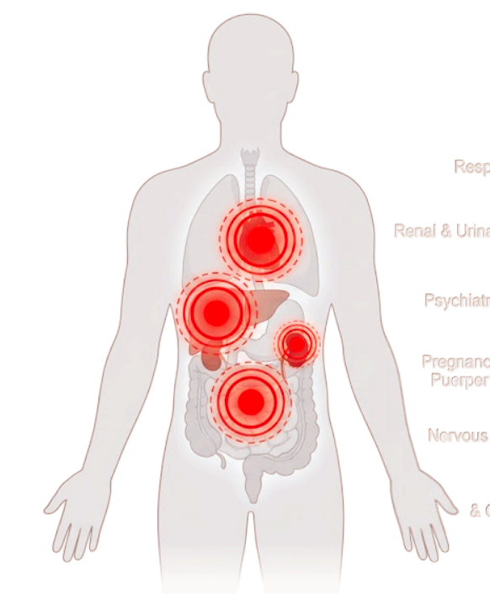
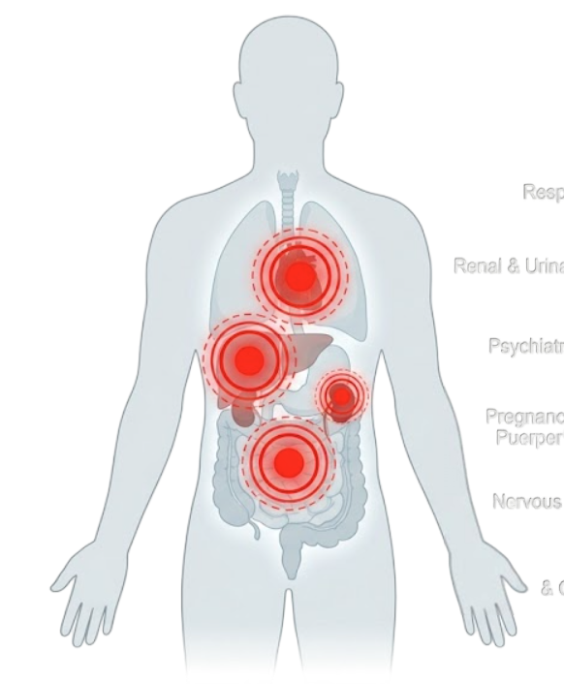
Off-target activity profiling
Free systemic exposure
Safety targets
ESM2
Compounds
Motif-level Message Passing
Q
K
V
MFRQEQRGPG...
Bilinear
Attention
C_{max}
Drug Dose Dictionary
CNC(=O)c1sc2ccccc2c1Cl
GNN
PPB%
Compounds
7 protein families, 194 safery targets
C_{max,free} = (1-PPB%)×C_{max}
Exposure-aware framework for ADR risk assessment
Drug fearture
ADR type

Slide 2
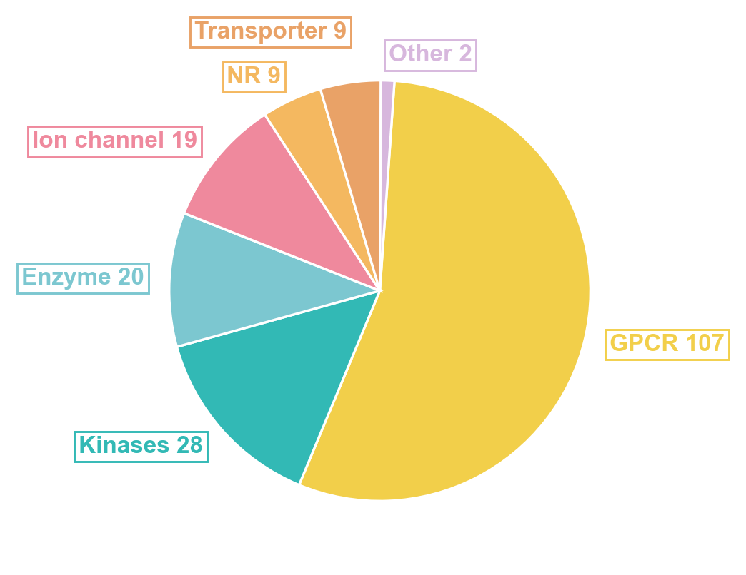
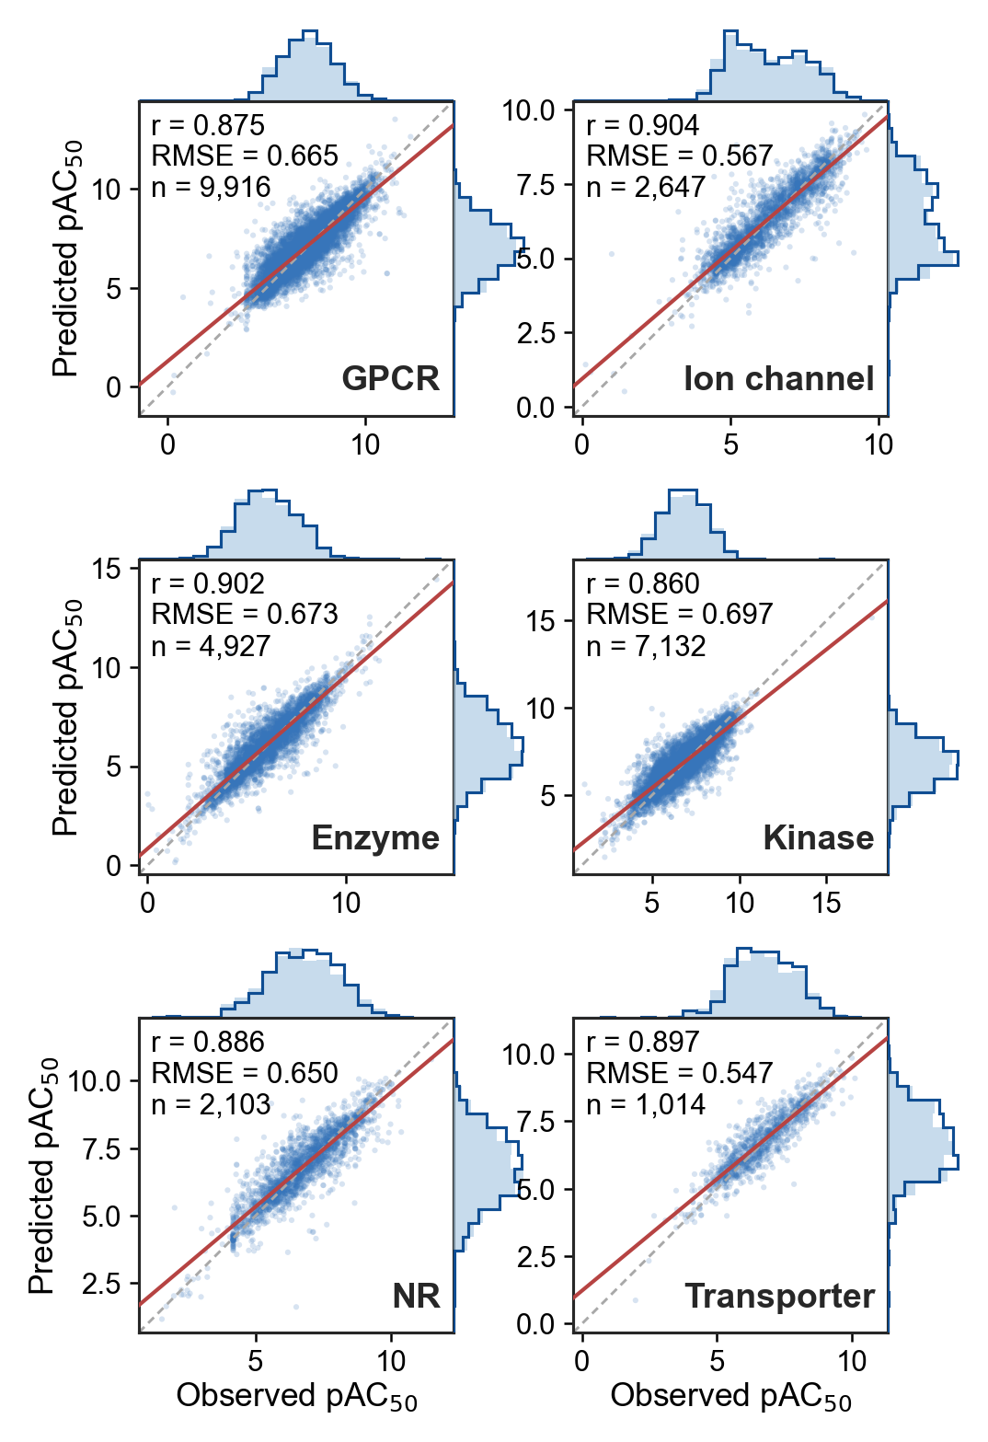
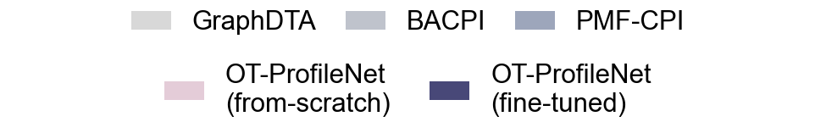
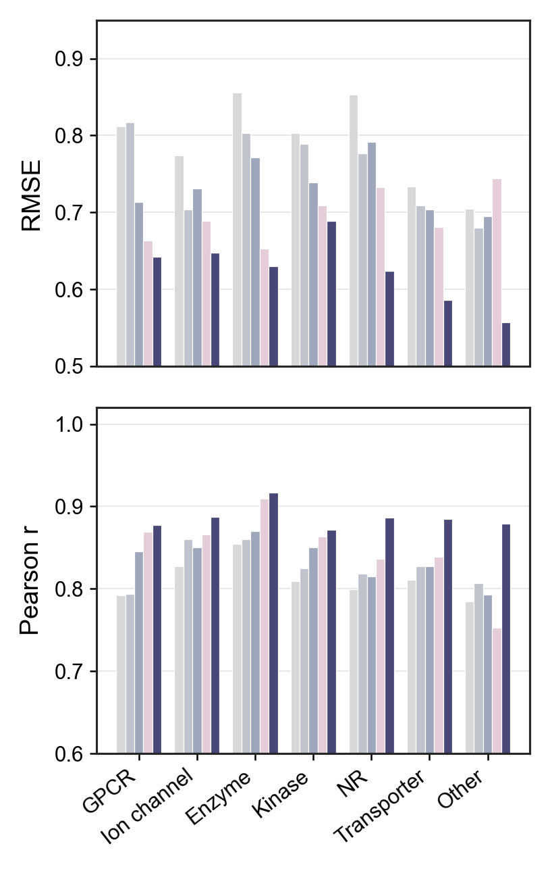
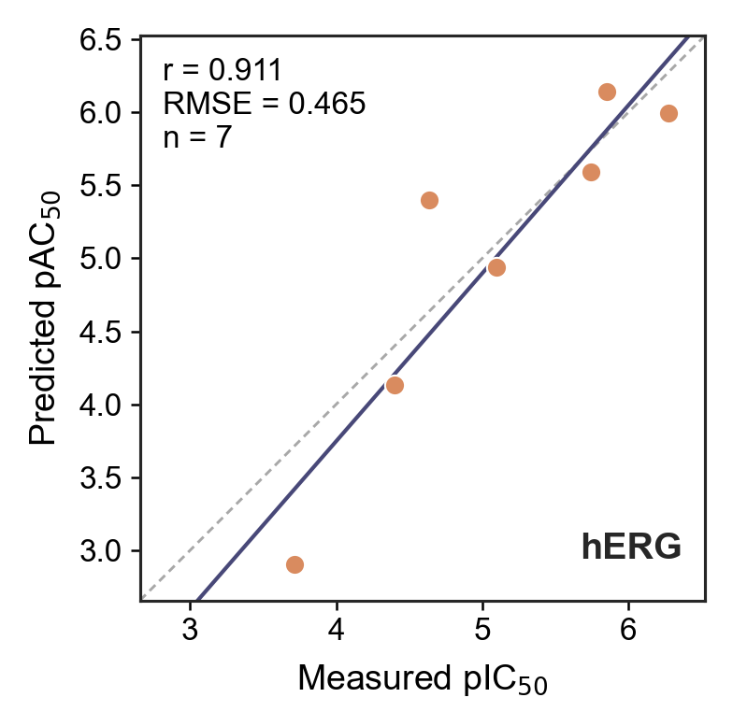
a
b
Target type | Targets num | Compounds num | Compound-target pairs num
GPCR | 107 | 5.098 | 4.941
Ion channel | 19 | 6.274 | 5.992
Enzyme | 20 | 5.740 | 5.591
Kinase | 28 | 5.853 | 6.144
NR | 9 | 4.638 | 5.398
Transporter | 9 | 4.398 | 4.131
Other | 2 | 3.714 | 2.907
c
d
e
f
Off-Target Affinity Prediction for hERG-Related Drugs
Drug name | Observed pIC₅₀ | Predicted pAC₅₀
Amitriptyline | 5.098 | 4.941
Bepridil | 6.274 | 5.992
Fentanyl | 5.740 | 5.591
Mibefradil | 5.853 | 6.144
Nisoldipine | 4.638 | 5.398
Telithromycin | 4.398 | 4.131
Phenytoin | 3.714 | 2.907

Slide 3
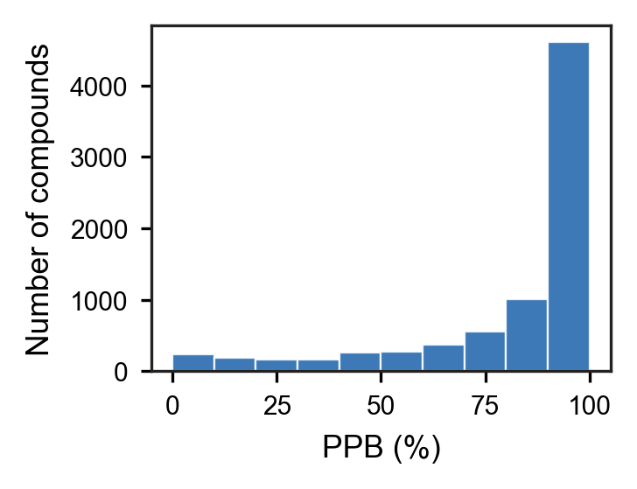
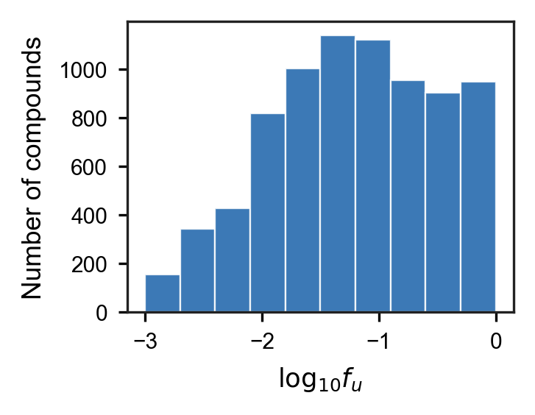
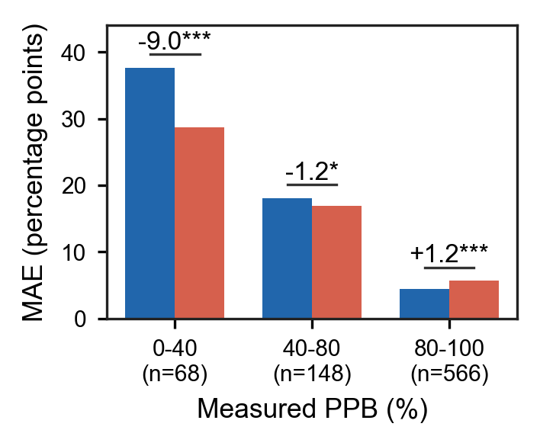
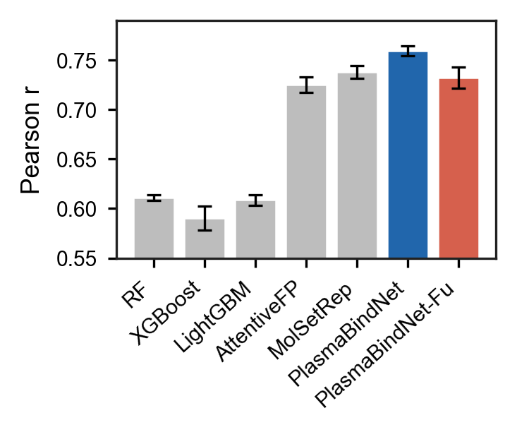
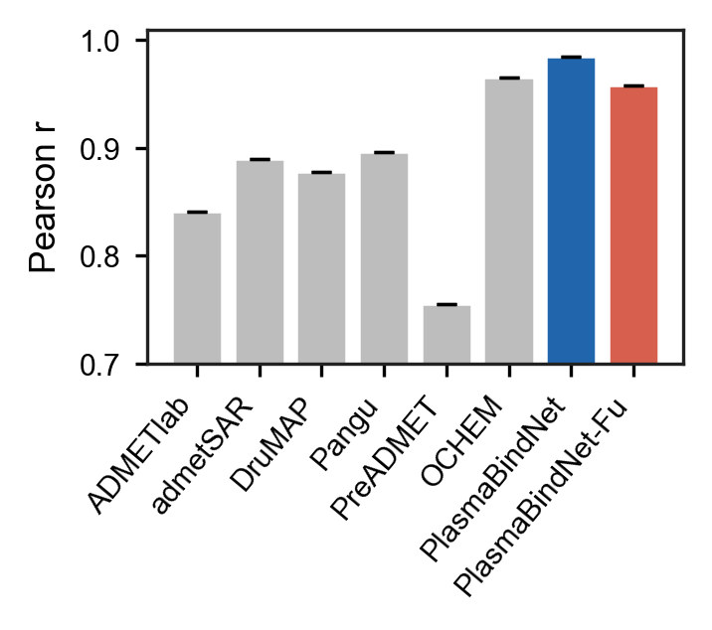
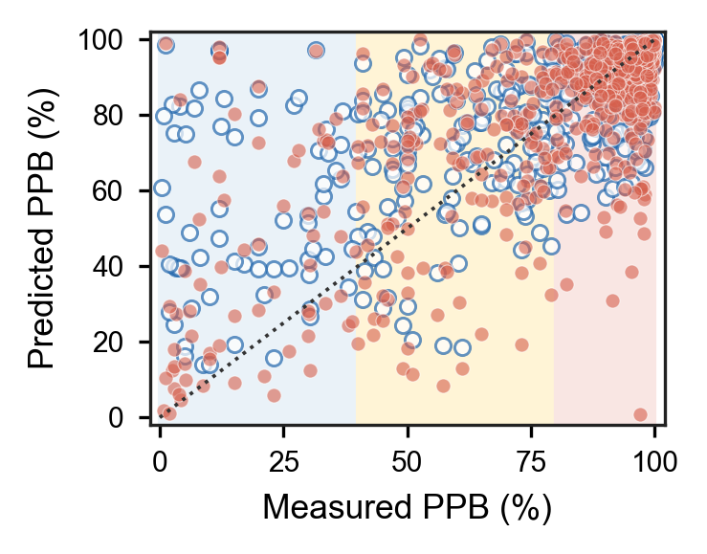

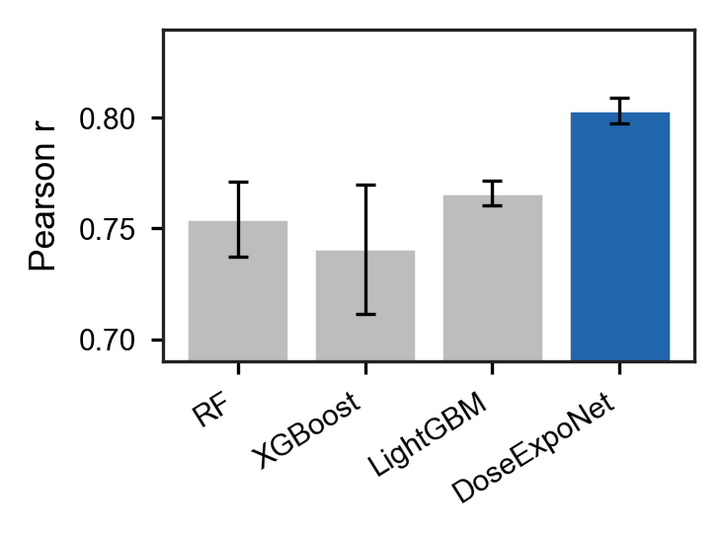
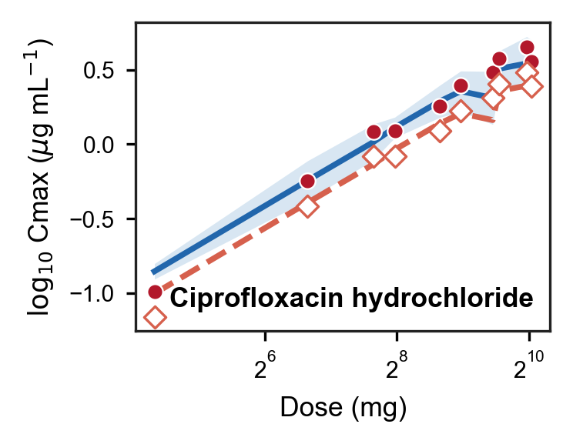
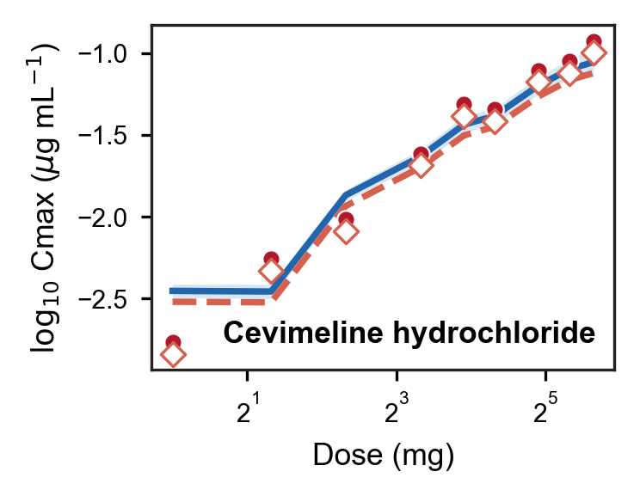
a
b
c
d
e
f
g
h
i

Slide 4
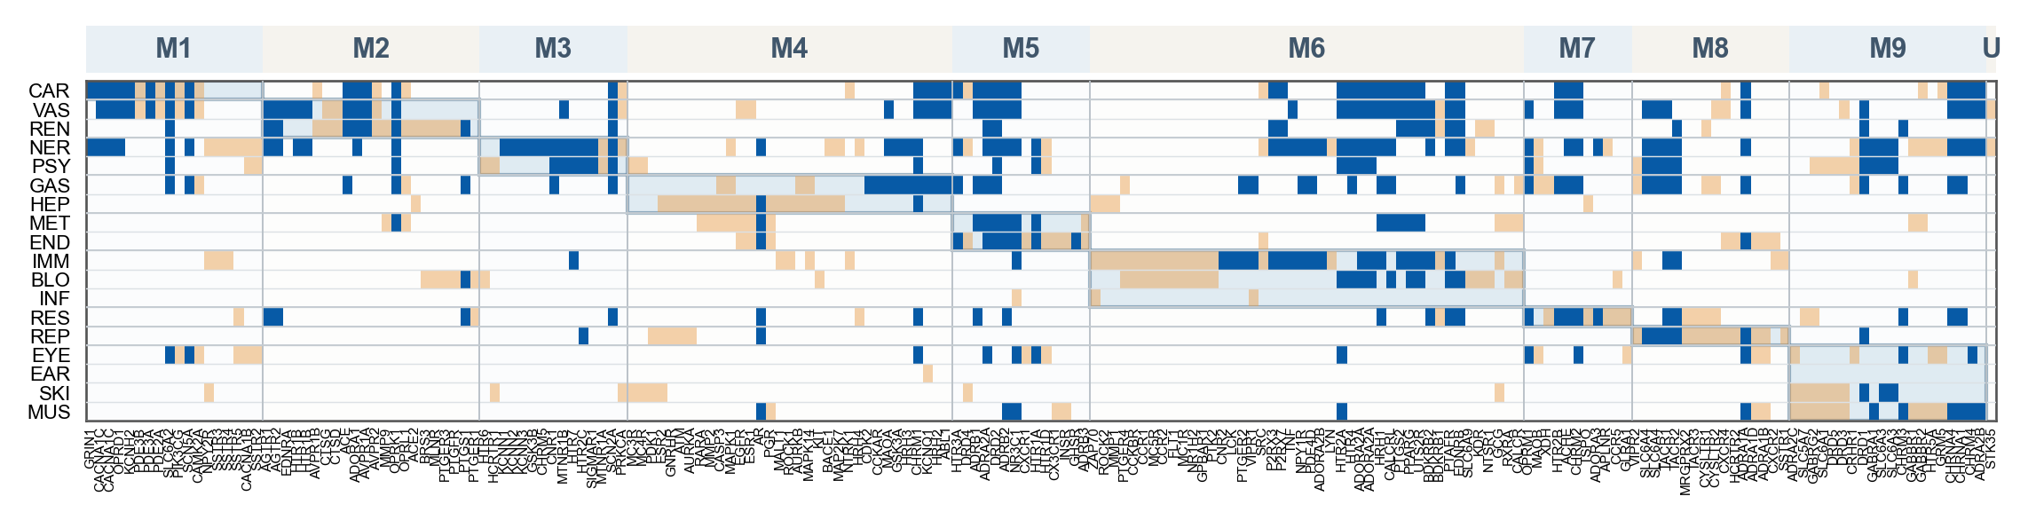




a
b
Feature construction
Drug–SOC representation
SOC-specific prediction
Drug d
Pair
representation
⊕
1 log₁₀(C_{max,free})
Drug encoder
⊕
194 pAC₅₀
Pair
MLP
18 SOC
head
194 log₁₀(C_{max,free} /AC₅₀)
Sigmoid
ADR type a
$$\left|H_{d} −\left.H_{a}\right|\right.$$
SOC index
1–18
Emb-edding
ADR encoder
P(ADR | drug, dose 1, SOC)
P(ADR | drug, dose 2, SOC)
Monotonic pair loss
Dose augmentation training
Binary crossentropy loss
Reference dose | Pseudo-dose multiplier
100 mg/day (1×) | 0.25x | 0.5x | 2x | 4x
Observed positive: 1 | -- | 0.75 | 0.92 | 0.96
Observed negative: 0 | 0.02 | 0.04 | 0.18 | 0.30
Observed ADR labels
18 SOC
CT-ADE dataset
495 train · 64 validation · 57 test drugs
Clinical dose fine-tuning
Dose-aware ADR modeling strategy

Slide 5
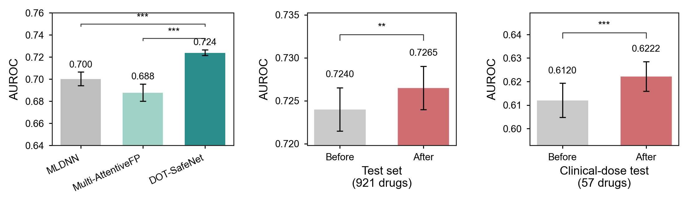
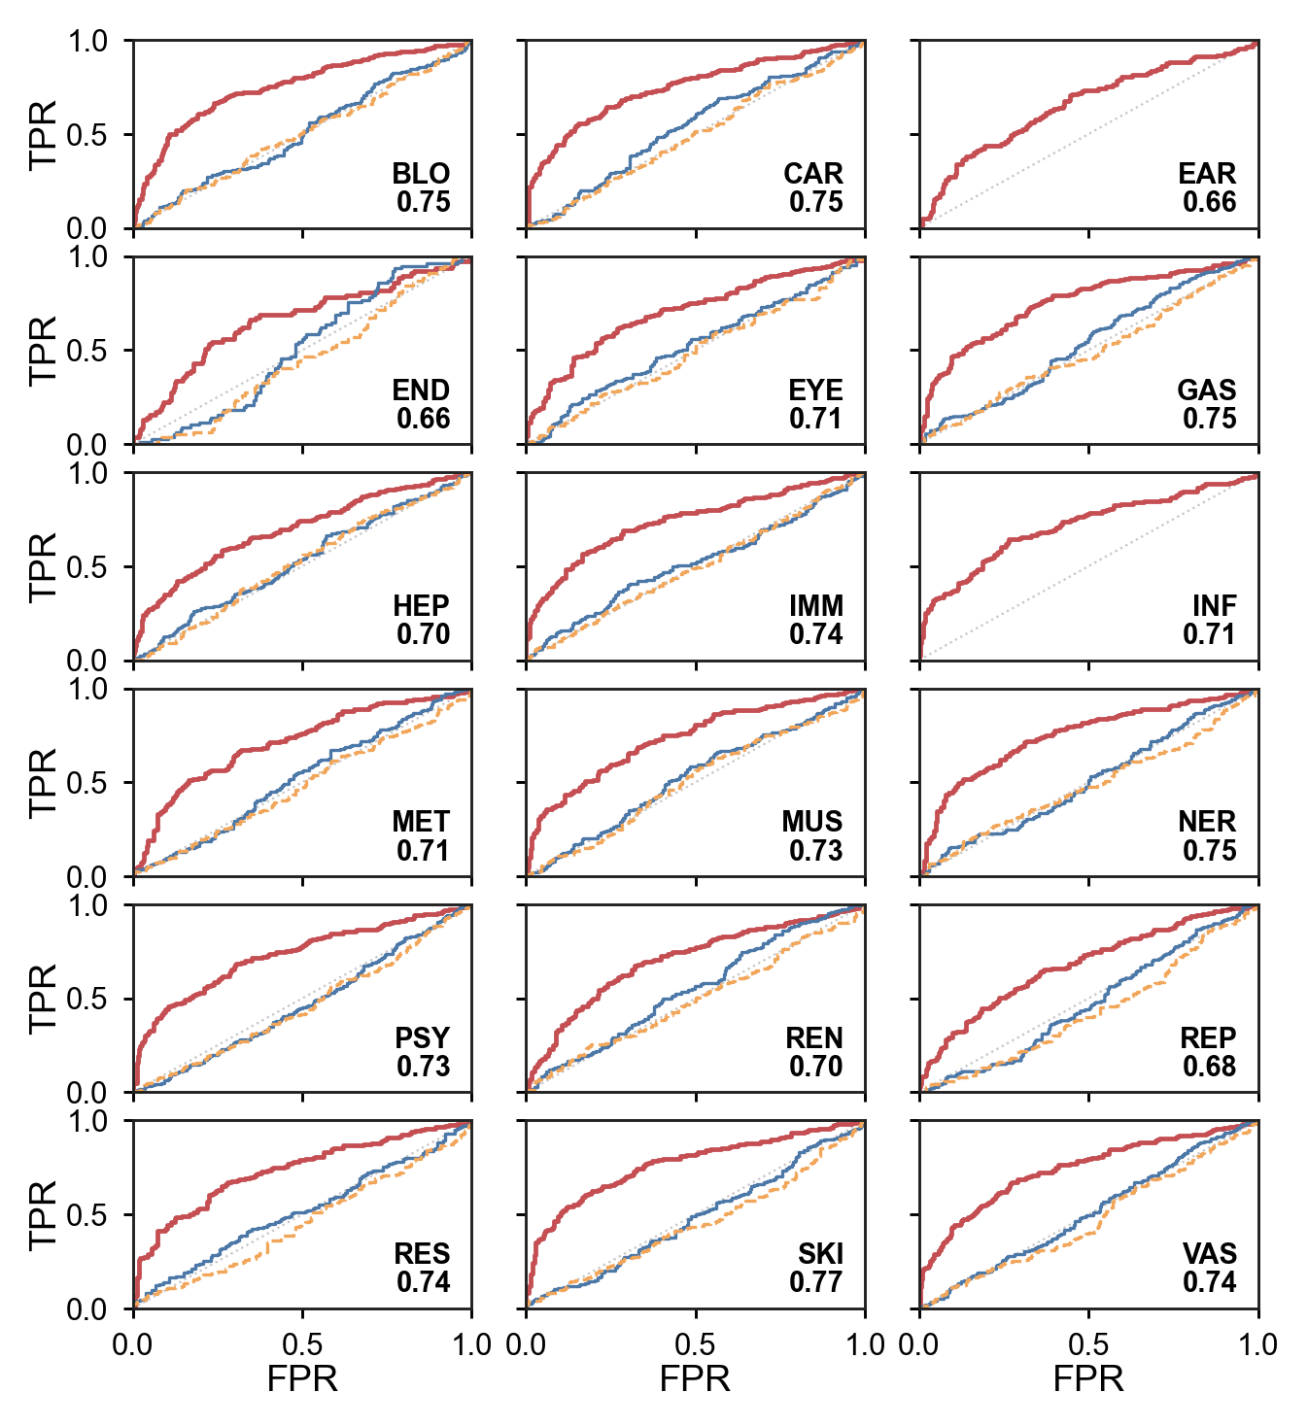
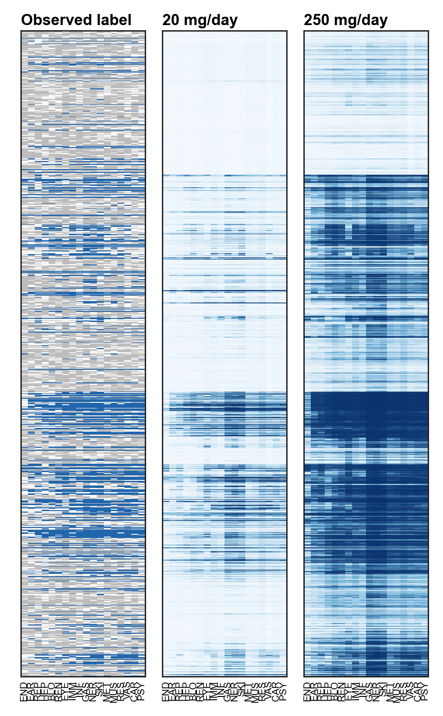
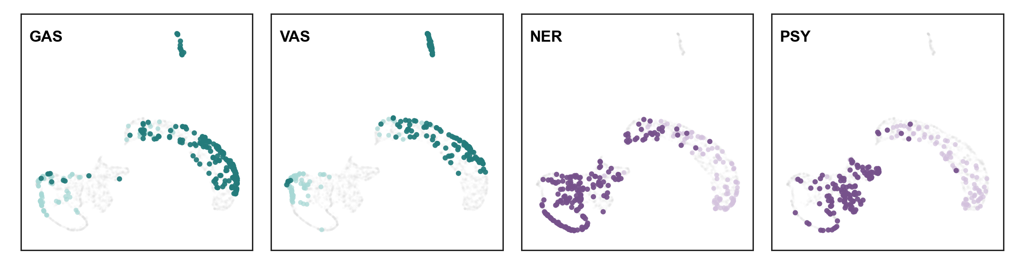
a
b
c
d
e
f
Notes:
DOT-SafeNet能够区分18类SOC，并在隐藏表征中恢复出具有药理和生理联系的ADR组合。
四个部分按“预测性能—SOC区分度—药物层面模式—隐藏表征解释”展开：
Figure 4A：与 MLDNN、Multi-AttentiveFP 比较，证明完整模型的总体AUROC更高。
Figure 4B：分别绘制18类SOC的ROC。DOT-SafeNet平均AUROC约0.721，而单独使用AC50和游离暴露裕度仅约0.513和0.481，支持ADR预测需要靶点活性、暴露和多靶点组合信息。
Figure 4C：并列展示921个测试药物的预测分数和真实标签。它回答模型是否只学习“这个药物ADR很多”，还是能够产生不同的SOC预测模式。
Figure 4D：将真实阳性的药物–SOC组合的8维隐藏向量投影到同一UMAP坐标。每张小图突出一个SOC：浅蓝为该SOC真实阳性，深蓝为真实阳性且预测阳性，灰色为其他SOC阳性组合。
Figure 4D 更适合讲“相关SOC共享隐藏表征区域”，不建议写“互补”。目前四组关系分别是：
GAS–VAS：胃肠与血管ADR共享自主神经、内脏及血管平滑肌调节。标签相关φ=0.693，预测相关r=0.956，共享27个直接关联靶点。
NER–PSY：神经与精神ADR共享单胺能、GABA能、阿片及大麻素药理。φ=0.688，r=0.940，共享21个直接靶点。
IMM–INF：免疫抑制增加感染易感性。φ=0.579，r=0.959，具有明确的生理联系。
CAR–RES：心脏与呼吸ADR共享β肾上腺素能、胆碱能、内皮素、组胺和5-HT调节。φ=0.729，r=0.980，共享12个直接靶点。

Slide 6
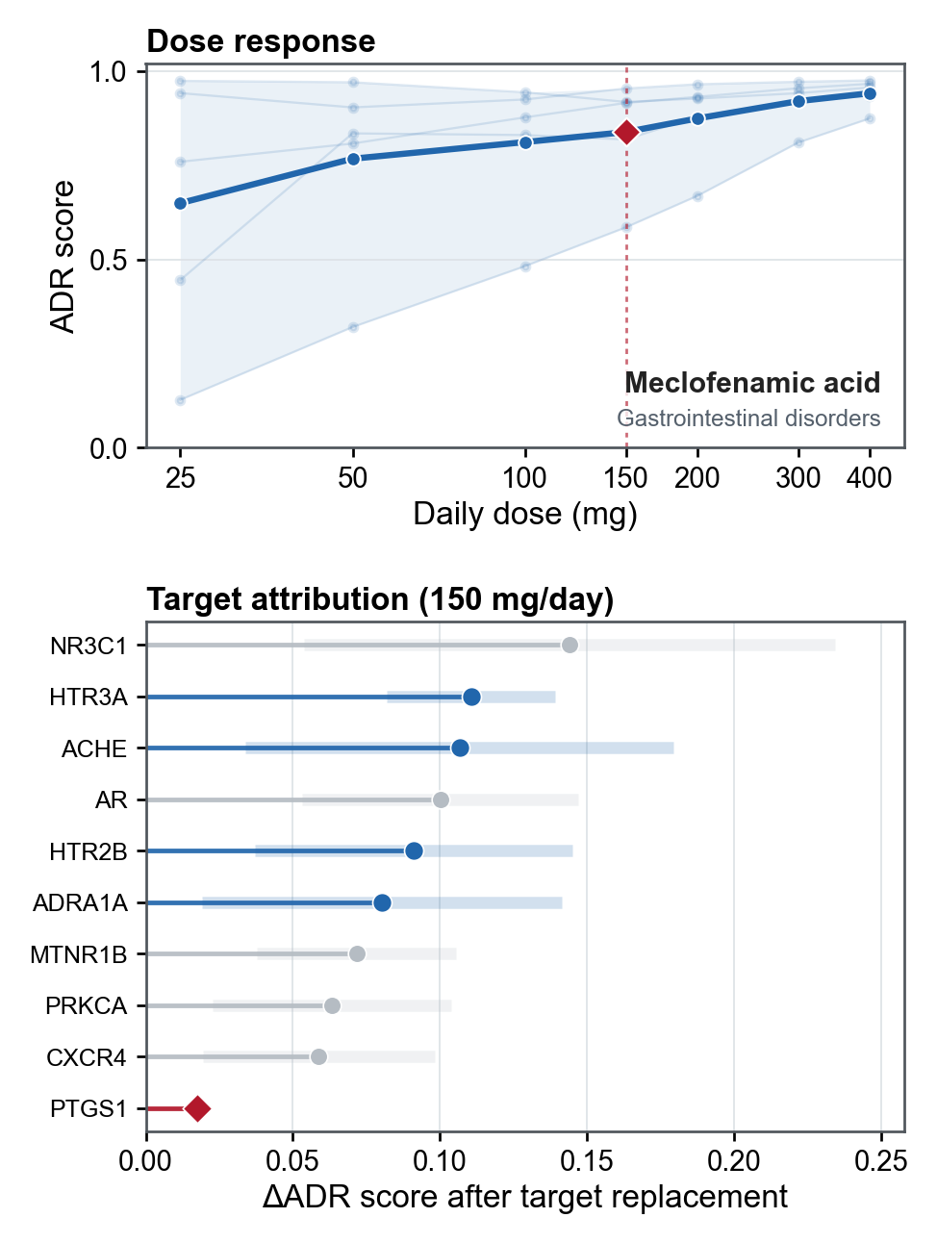
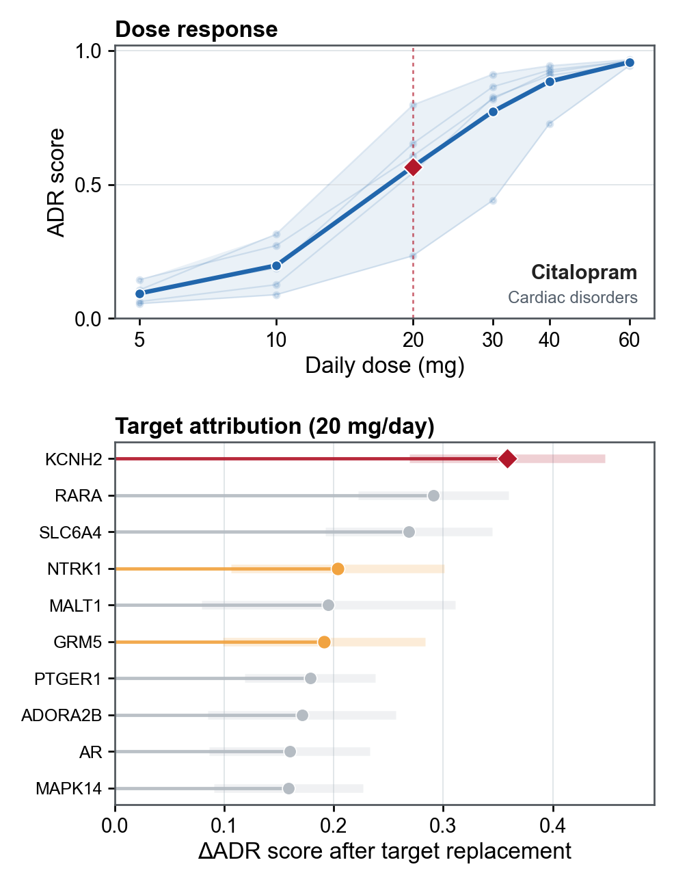
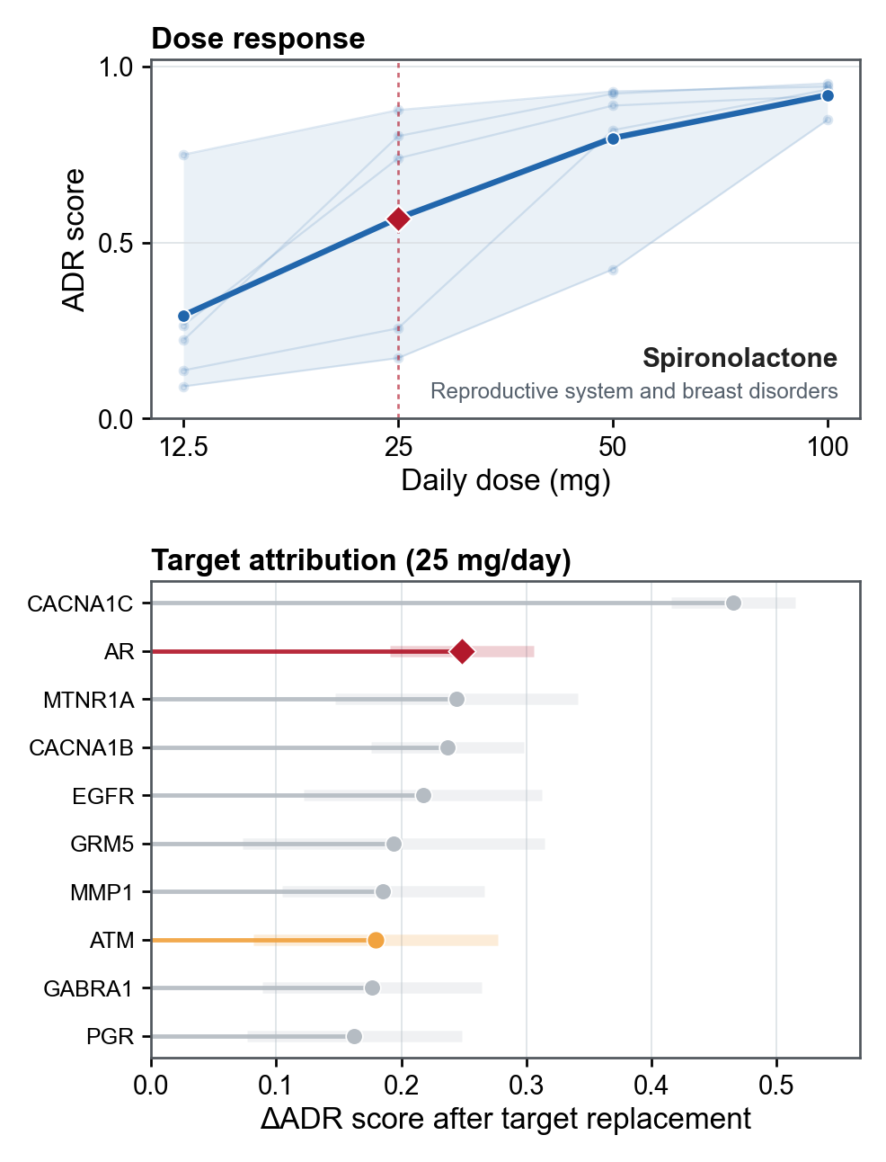
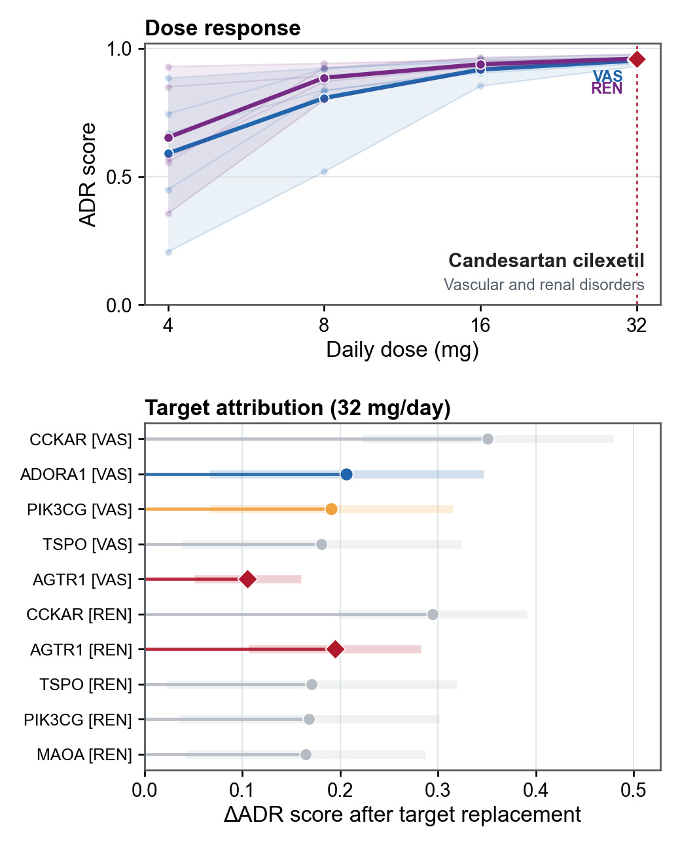
a
b
c
d

Slide 7
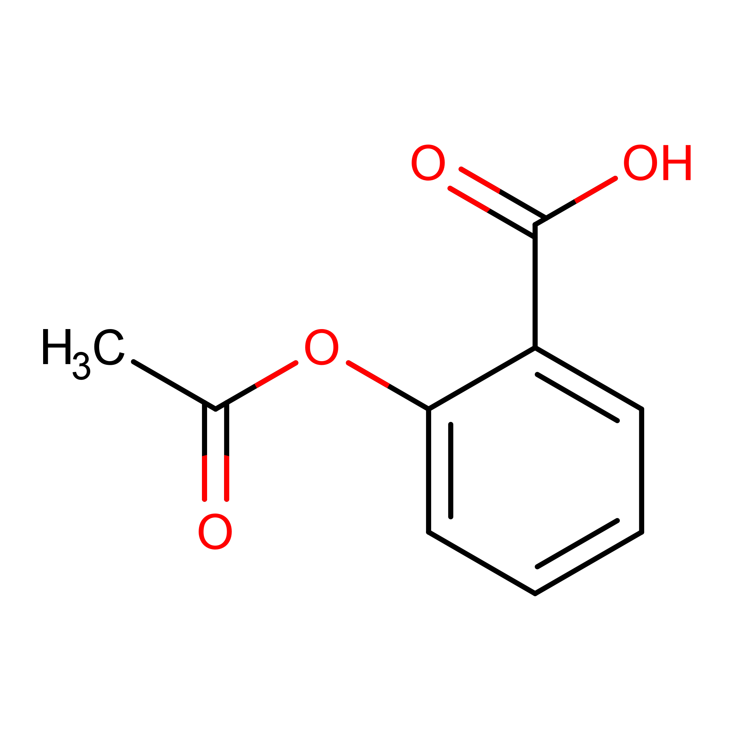

Protein sequence
MFRQEQR...GPGGGTRAT...
Compound SMILES
CC(=O)Oc1ccccc1C(=O)O
ESM2
RDKit
GNN
Layer
Variable
length
$$σ\left(∙\right)$$
X₁
X₂
X₃
...
X_{n}
GNN
Layer
LSTM
LSTM
......
LSTM
$$σ\left(∙\right)$$
y₁
y₂
y₃
...
y_{n}
GNN
Layer
protein representation
drug representation
......
......
Bilinear interaction
Bilinear pooling
...
...
Fully connected regression
Fully connected classification
Interaction / Not interaction
pK
pAC50
Pre-training for Classification
Fine-tuning for Multi-task Regression

Slide 8
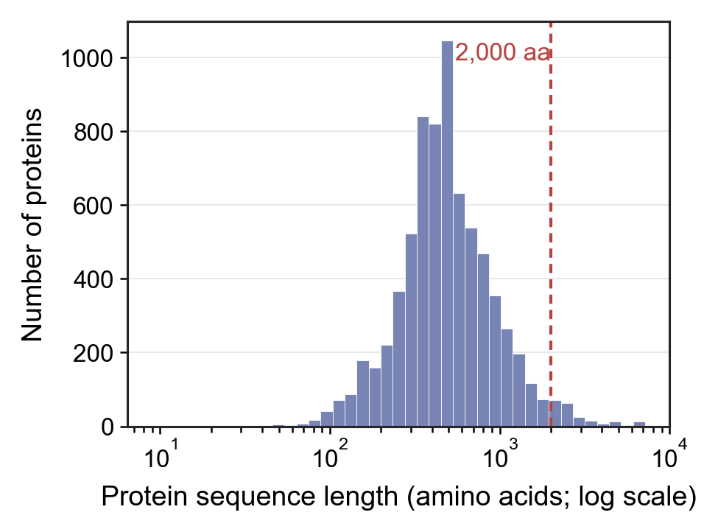
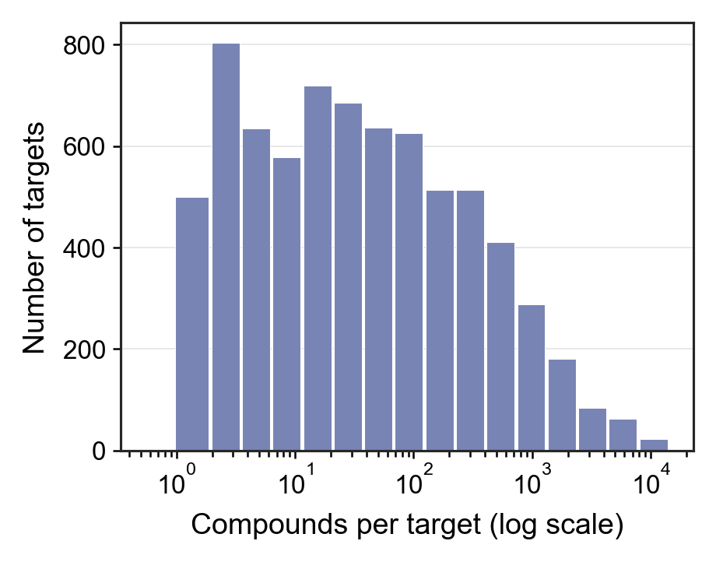
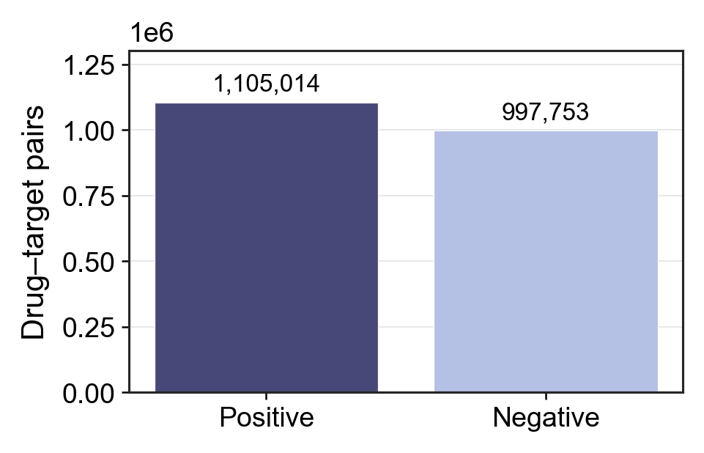
a
b
c
d
Pretraining Data Collection Overview
 | Number
Num of Compound-Protein Pairs | 2102767
Num of Positive pairs | 1105014
Num of Negative pairs | 997753
Num of Proteins | 7258
Num of Compounds | 1255941

Slide 9
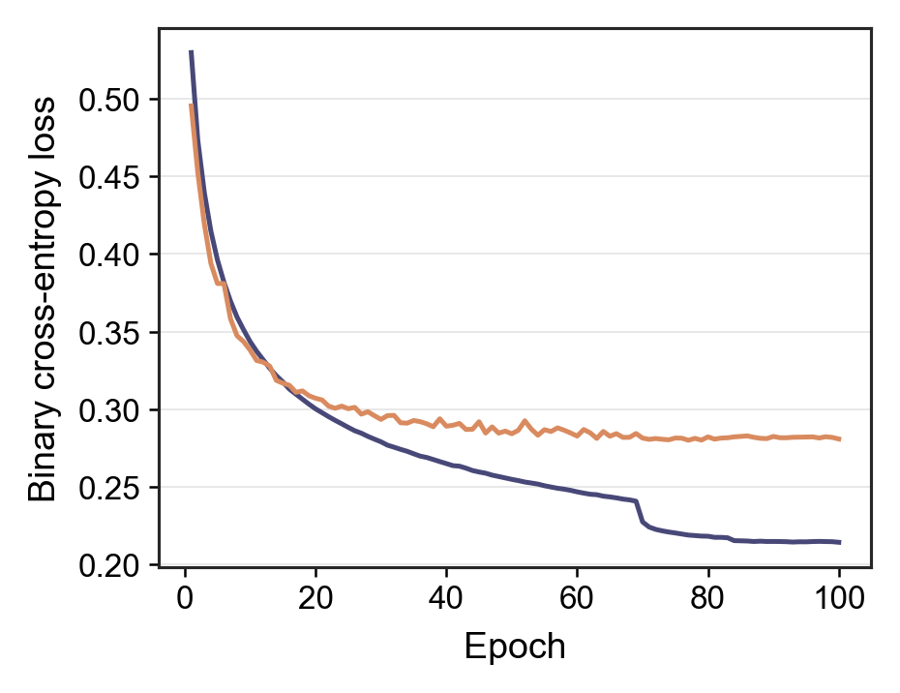
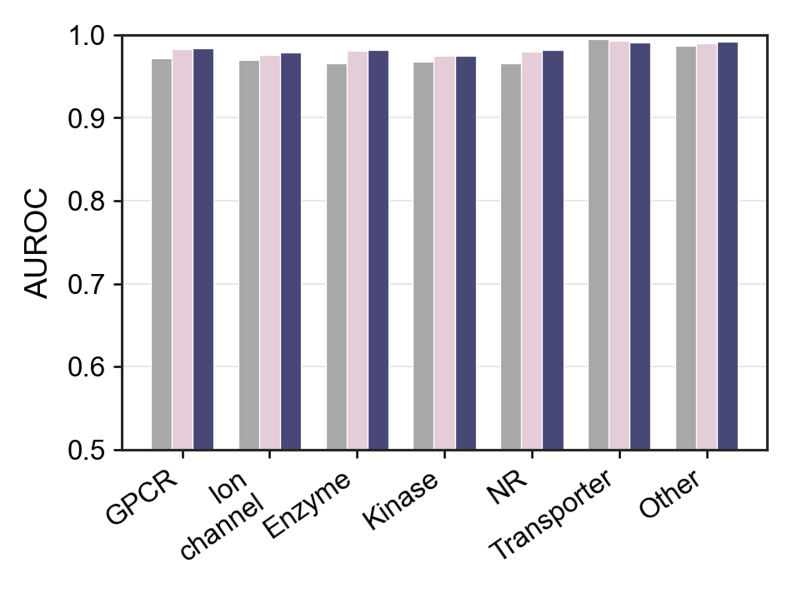
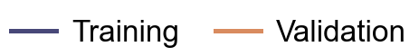
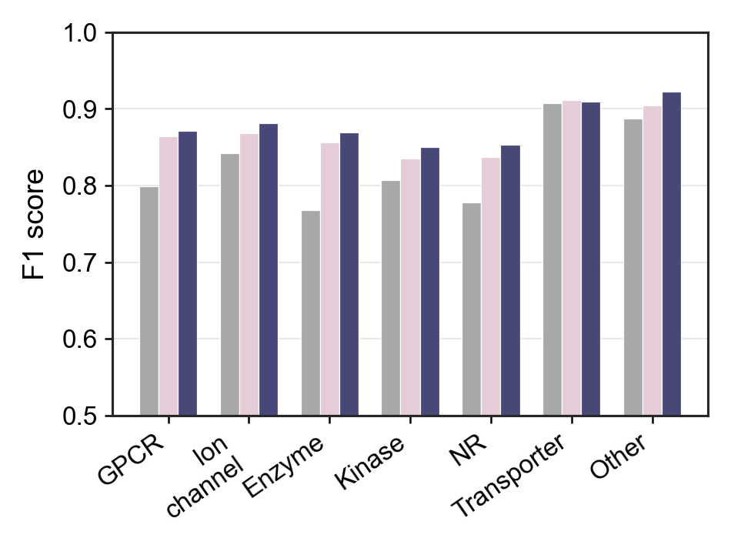
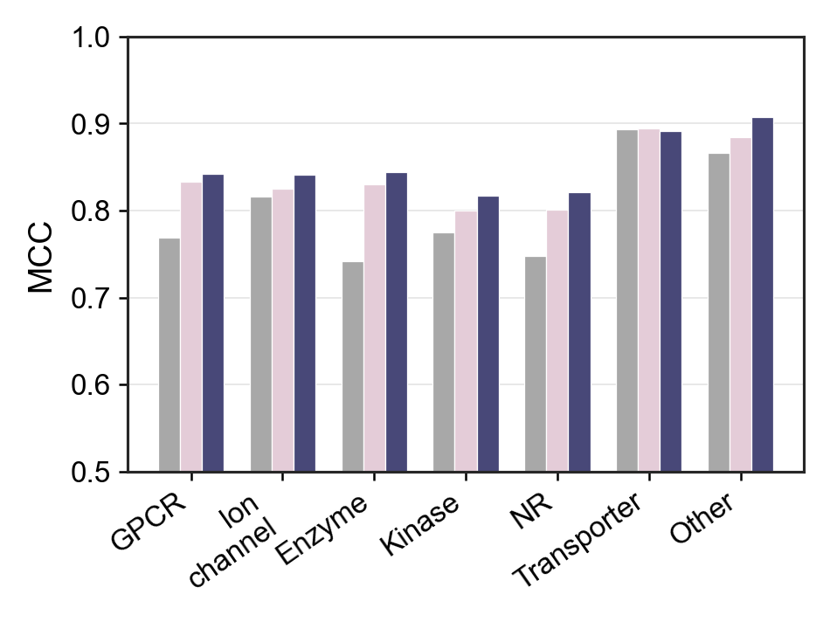
a
b
c
d

Slide 10
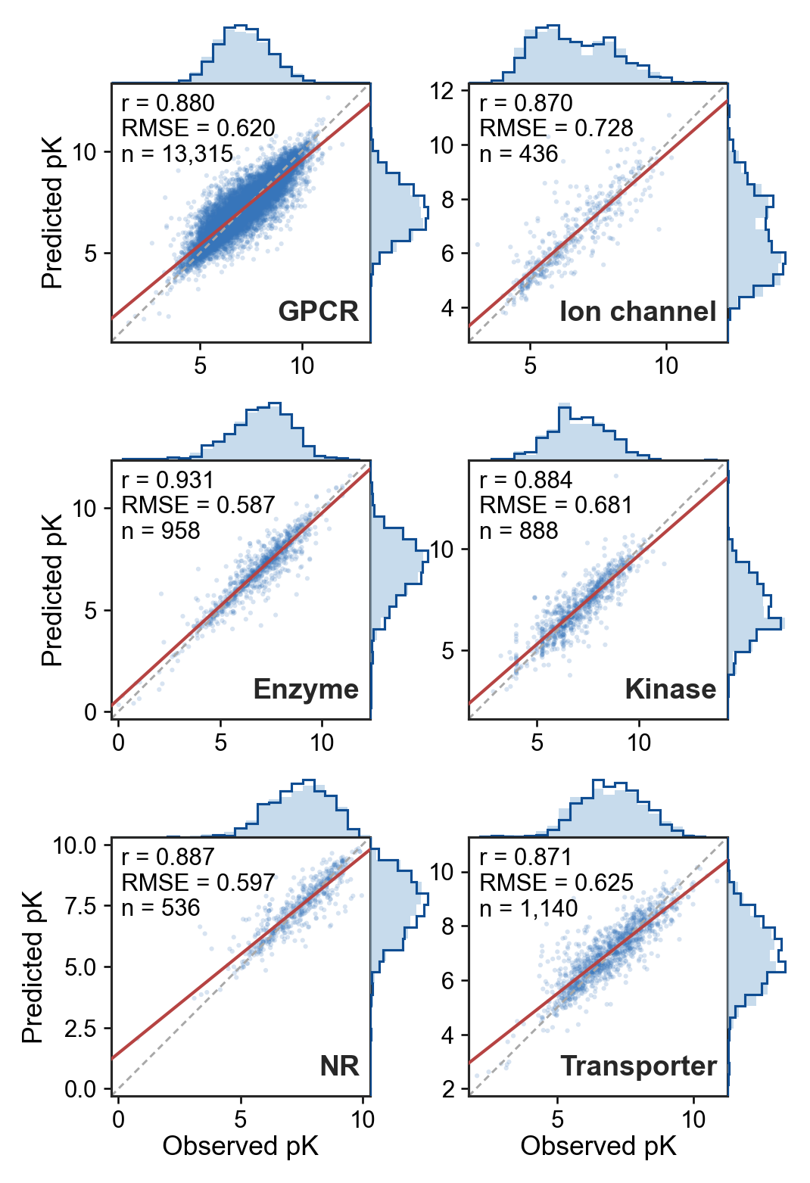
a
b
c
d
e
f

Slide 11




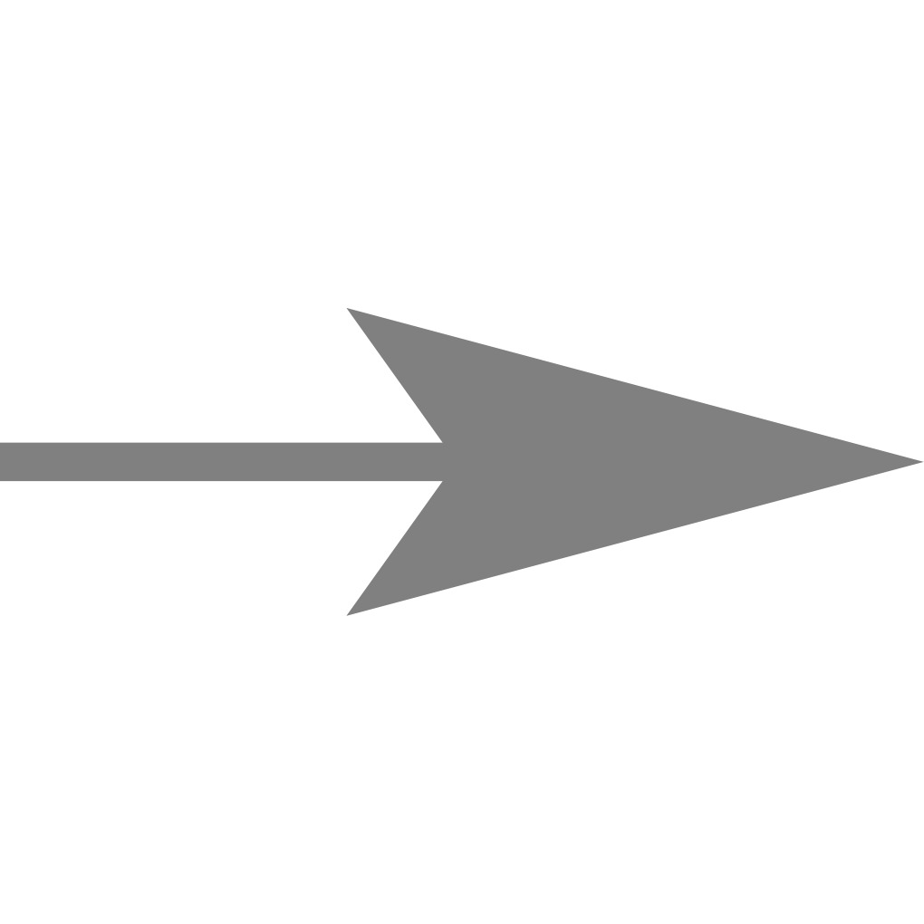
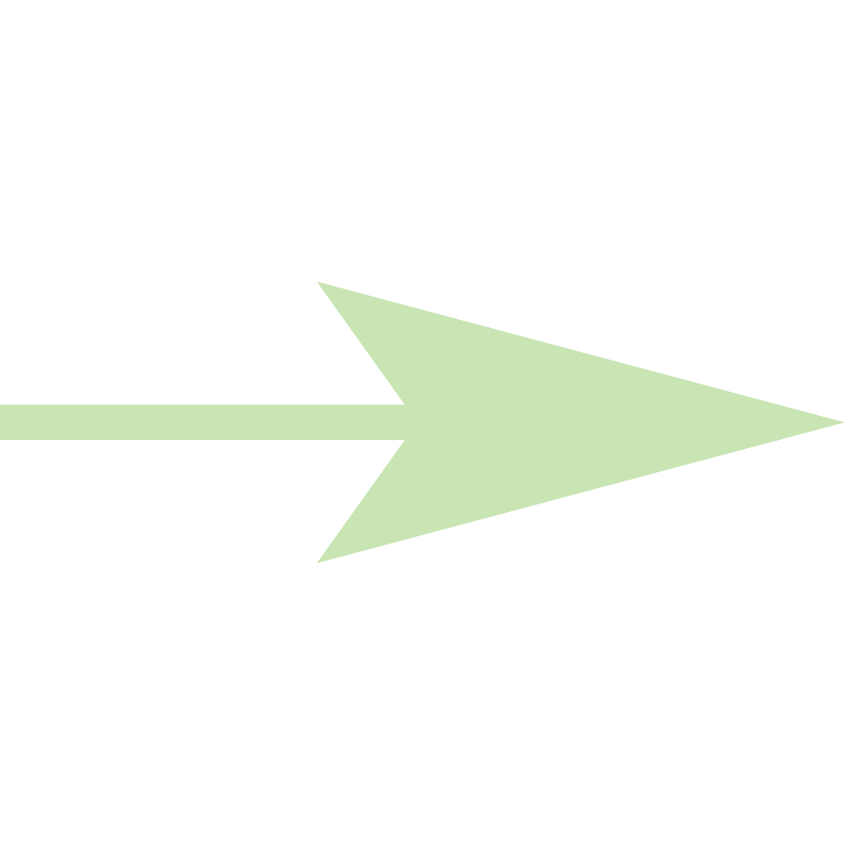

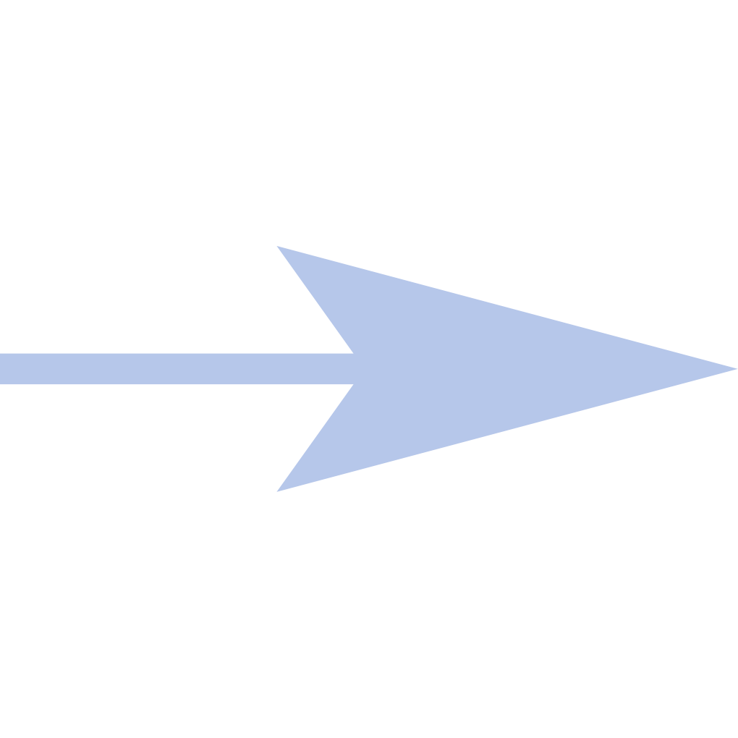
Molecular Graph
Atom-level Message Passing
Tree Decomposition
Motif-level Message Passing
Set
Representation
Molecule
Readout
Task
Prediction
M₁
...
...
PPB%
M₂
...
Molecule Rep
Drug Dose Dict
Durg dose
M₃
...
...
........
........
........
Embedding Layer
M_{m}
...
Dose Rep
...
Cmax
Atom-level
Motif-level
...
$k$ layers
$t$ layers
$l$ layers
Molecular-level
$$M_{m}^{0}$$
Initial motif embedding
Atom
attention
$$C_{v}^{0}$$
Atom
attention
$$C_{v}^{1}$$
Atom
attention
$$C_{v}^{k−1}$$
Atom
attention
Motif
attention
$$C_{m}^{t}$$
Motif
attention
$$C_{m}^{t+1}$$
Motif
attention
$$C_{m}^{t+l−1}$$
Set
Rep
Layer
$$G_{rep}$$
linear
$$h_{v}^{1}$$
.....
.....
$$M_{m}^{t+l}$$
Bioactivity
prediction
$$h_{v}^{0}$$
GRU
GRU
$$h_{v}^{k−1}$$
GRU
$$h_{v}^{k}$$
$$M_{m}^{t}$$
GRU
$$M_{m}^{t+1}$$
GRU
$$M_{m}^{t+l−1}$$
GRU
Initial atom embedding
Final atom embedding
Final motif embedding

Slide 12
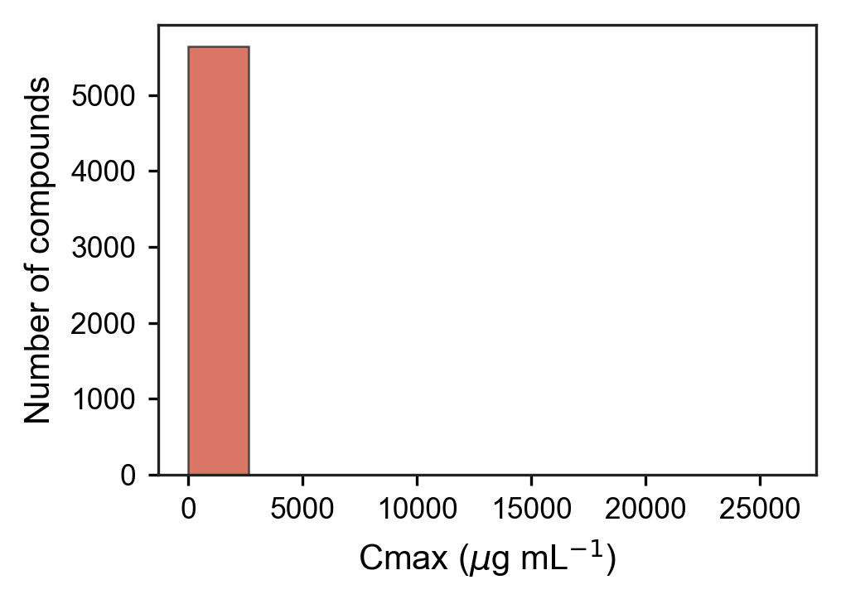
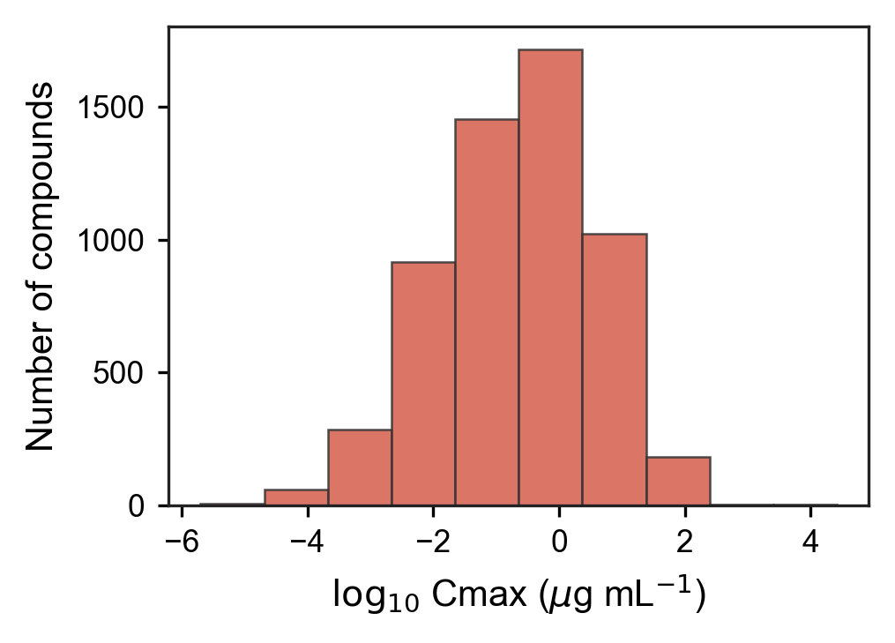
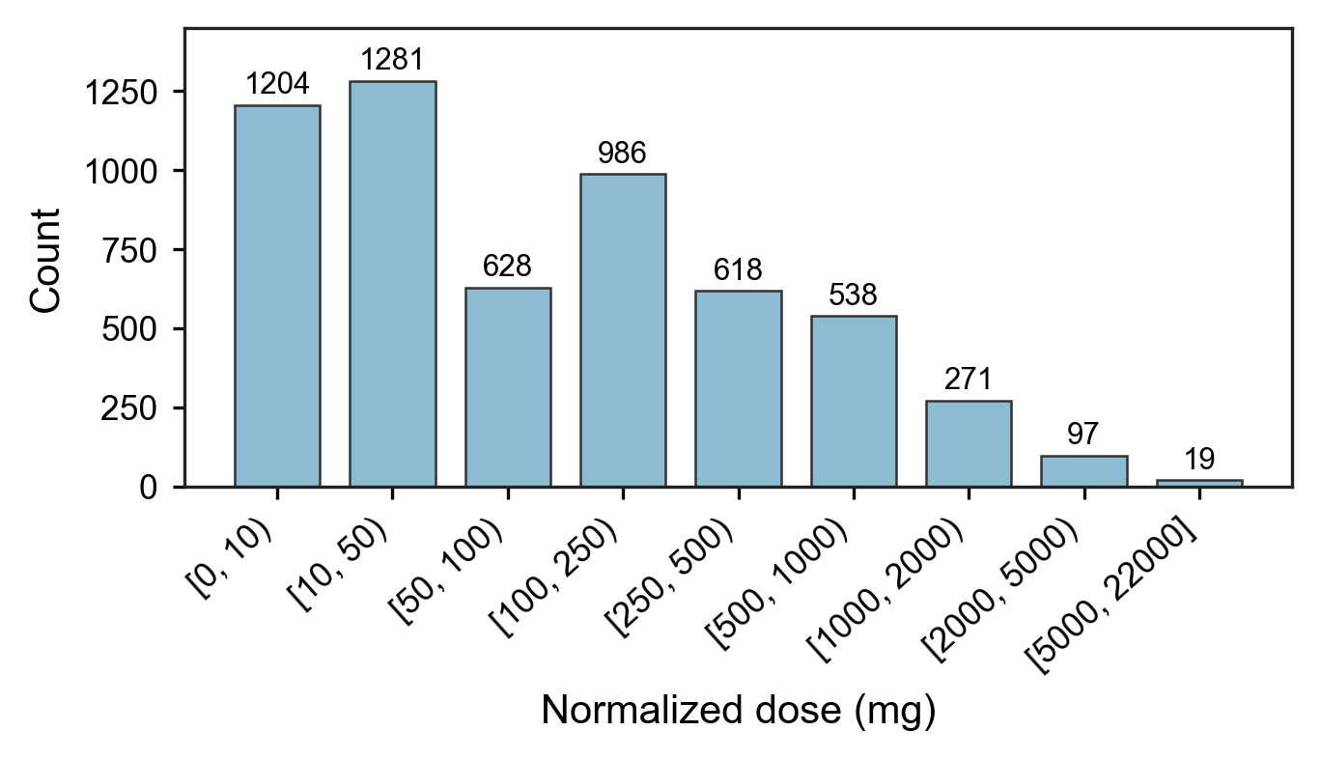
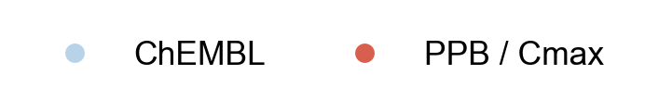
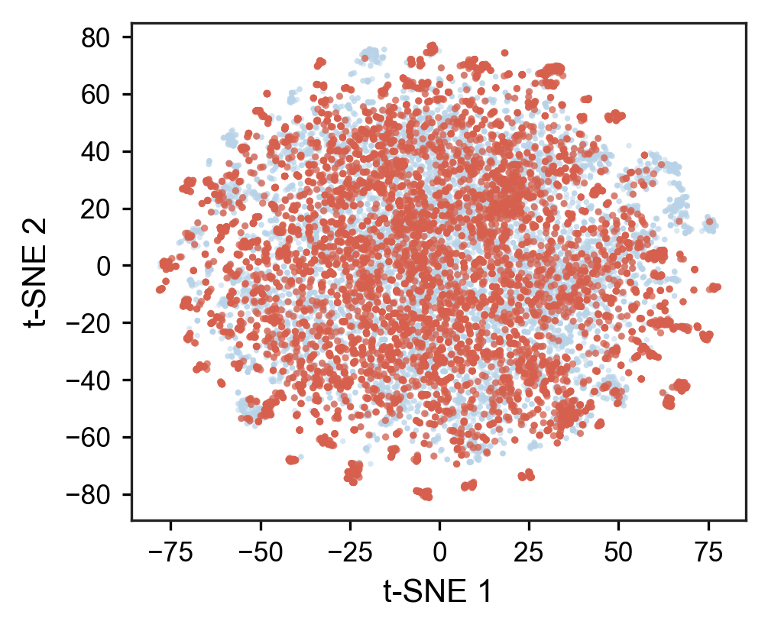
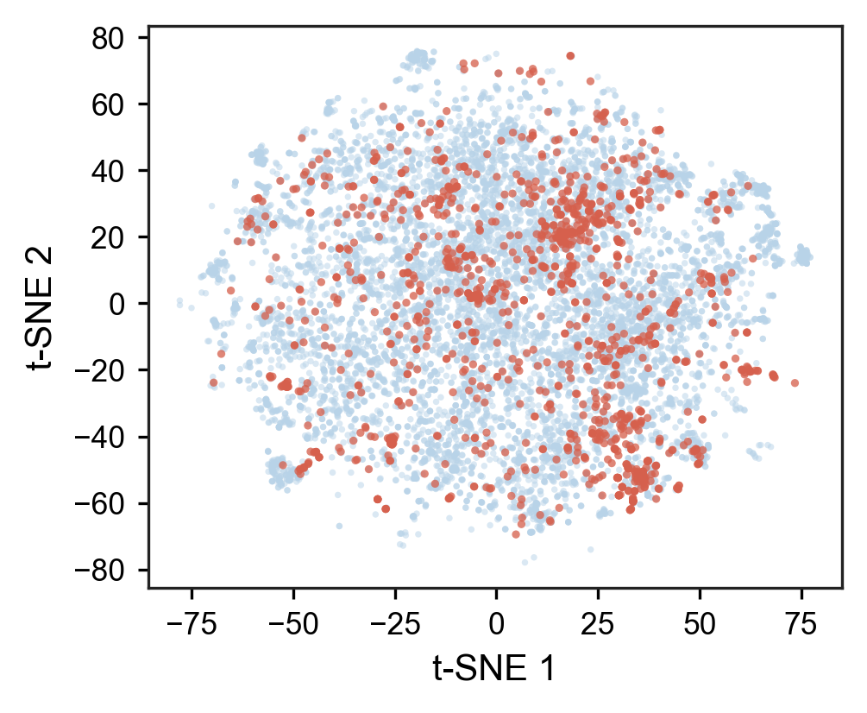
a
b
c
d
 | Data set | N_samples
PPB | Train | 6262
 | Valid | 782
 | Test | 782
C_{max} | Train | 4514
 | Valid | 564
 | Test | 564
e
f

Slide 13
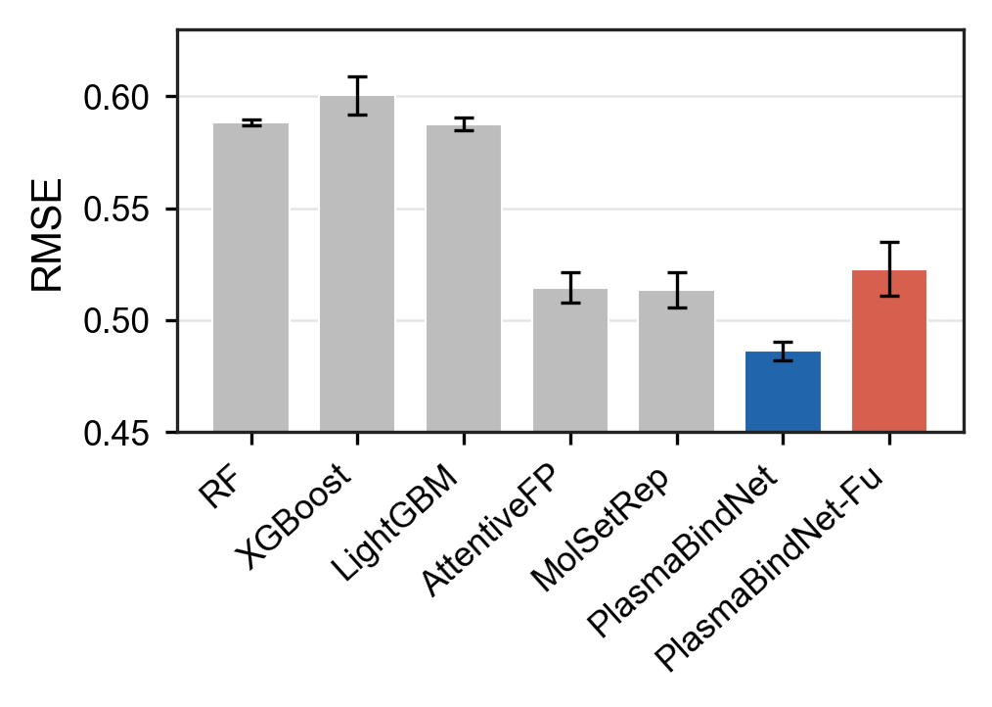
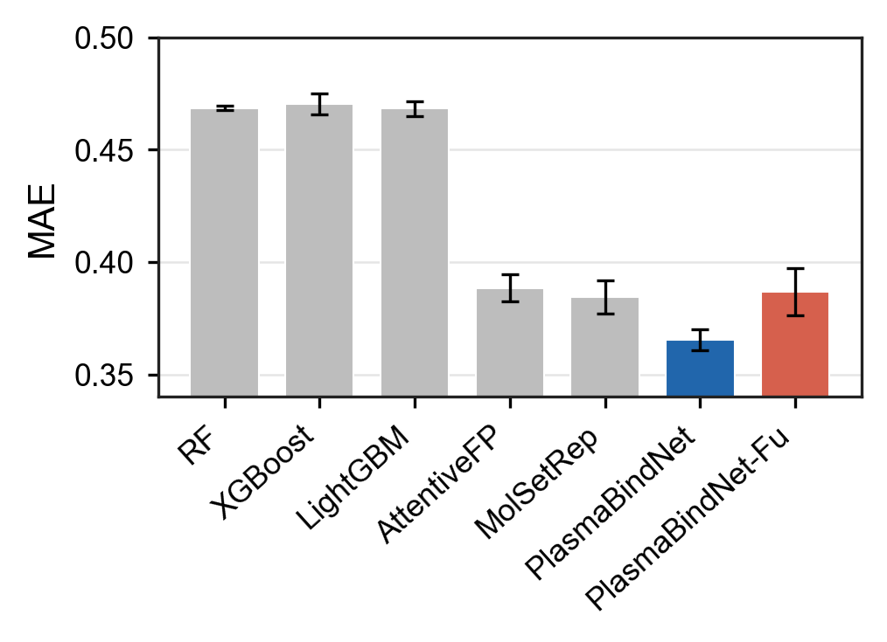

a
b
c
d
e
f

Slide 14


