Slide 1
Intro to computer systems, UNIX, and C.
Computer Systems I – CSC 373
Week 1 – 2023/01/09
Jack Stillwell

Slide 2
AGENDA
Course Overview
Logging into our Linux box
Intro to UNIX/Linux
Overview of UNIX/Linux editors
Intro to C

Slide 3
Course Overview
C Language
Linux box
Homework
Labs
Tests

Slide 4
Logging into our Linux box
Your Environment for this class

Slide 5
How to use ssh – the basics
Windows
Mac/Linux
Install wsl (wsl --install)
Open your wsl in terminal
Look at Mac/Linux step 2
Open terminal
Type ssh user@host
Type your DePaul ID number
CHANGE YOUR PASSWORD
passwd

Slide 6
SSH {User}@{Host}
​Field | Option 1 | Option 2
HOST | cdmcscjsprd01.dpu.depaul.edu
USER | the first 3 characters of your last name (e.g., sti) | the first 2 characters of your last name plus the first character of your first name (e.g., stj)

Slide 7
SSH Commands
SSH (Secure Shell)
$ ssh stu@cdmcscjsprd01.dpu.depaul.edu
SCP (Secure Copy)
​​$ scp stu@cdmcscjsprd01.dpu.depaul.edu:hw1.zip .
SSH Keys and config (out of scope)
$ cd ~; ssh-keygen -t ed25519 -f .ssh/id_csc373
$ ssh-copy-id -i .ssh/id_csc373 stu@cdmcscjsprd01.dpu.depaul.edu
Modify the ssh config so that you have an alias for cdmcscjsprd01.dpu.depaul.edu and it will always know your username for that host, so you can skip the "stu@"

Slide 8
Questions?

Slide 9
The Linux Operating System
A brief introduction to getting around

Slide 10
Recommended Reading
For a more complete introduction, look at these:
http://www.ee.surrey.ac.uk/Teaching/Unix/index.html
https://people.ischool.berkeley.edu/~kevin/unix-tutorial/toc.html

Slide 11
Linux Commands
Command: passwd
$ passwd
Description: Changes a user's password
Changing password for user stu. Current password: New password: Retype new password: passwd: all authentication tokens updated successfully.
Note 1: Please change your password the first time you log in. Note 2: The Linux box is for classwork only and you should not assume privacy. All files on this machine may be read by the Prof.

Slide 12
Linux Commands (cont.)
Command: pwd
$ pwd
/home/stu
Description: echo the present
working directory

Slide 13
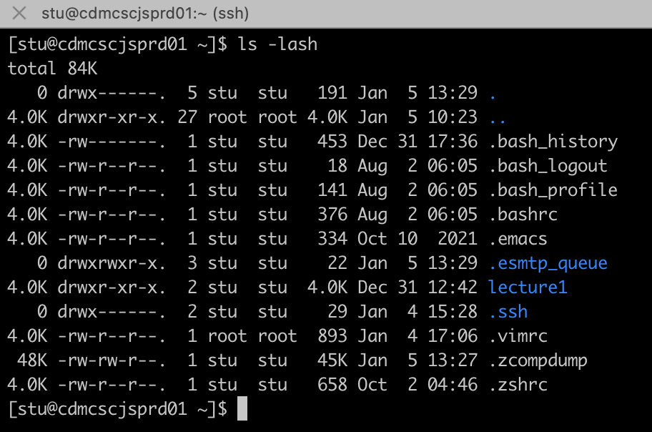
Linux Commands (cont.)
Command: ls
Description: list the contents of a directory
Arguments: list of file or directory names
Options:
-l list
-a all
-s show size
-h human-readable (sizes)
. = current directory
.. = parent directory

Slide 14
Linux Commands (cont.)
Command: cp
WARNING: will delete contents of destination file if it already exists
Options:
-n prevent overwrite (no_clobber)
Description: copy 1 or more files
Arguments: src_file dst_file
or
src_file dst_dir
or
src_file1 src_file2 dst_dir

Slide 15
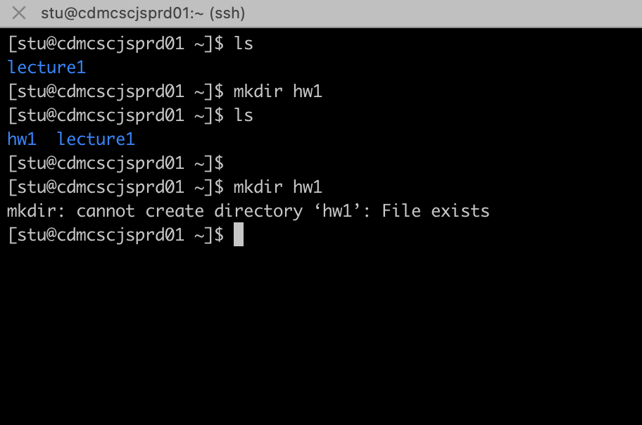
Linux Commands (cont.)
Command: mkdir
Description: make a new directory
Arguments: new_dir_name

Slide 16
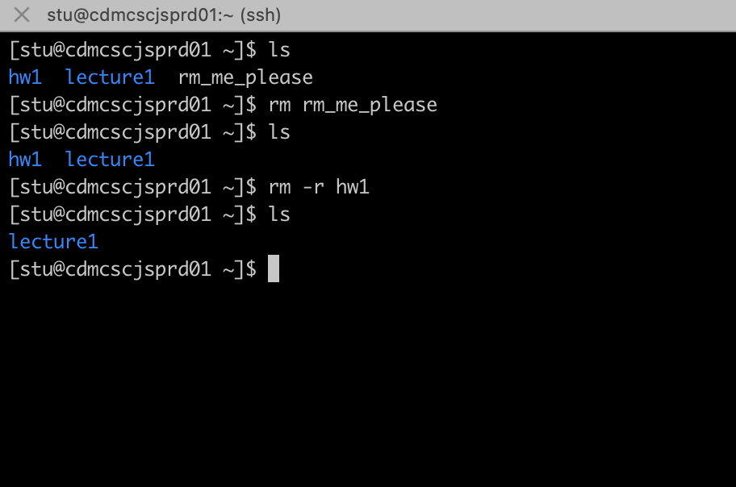
Linux Commands (cont.)
Command: rm
Description: (remove) delete file(s)
Arguments: file list
Options:
-i Ask before removing each file (Good idea since it is not possible to reverse a removal) -r Recursive remove directories and subdirectories in the list. Files will be removed in these directories first and then the directory itself.(Useful but dangerous)

Slide 17
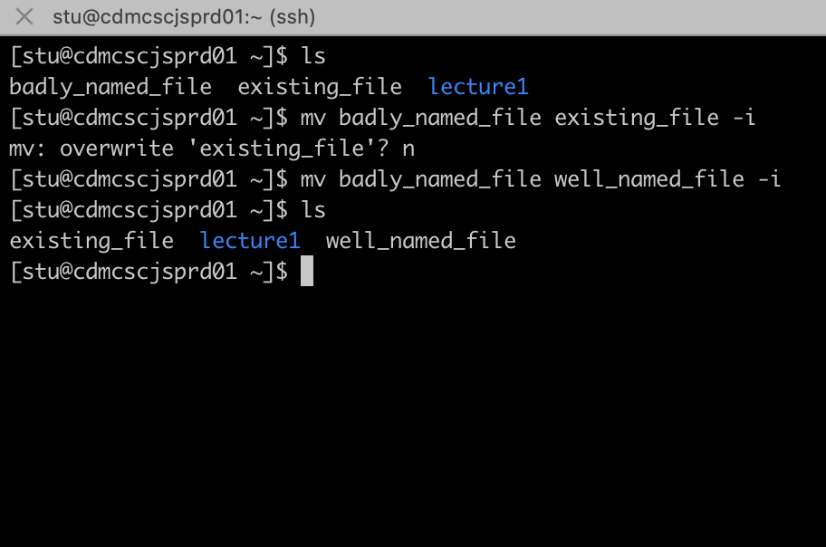
Linux Commands (cont.)
Command: mv
Description: Move/rename a file
Arguments: existing_file new_file
Options:
-i interactive (confirm before overwriting)

Slide 18
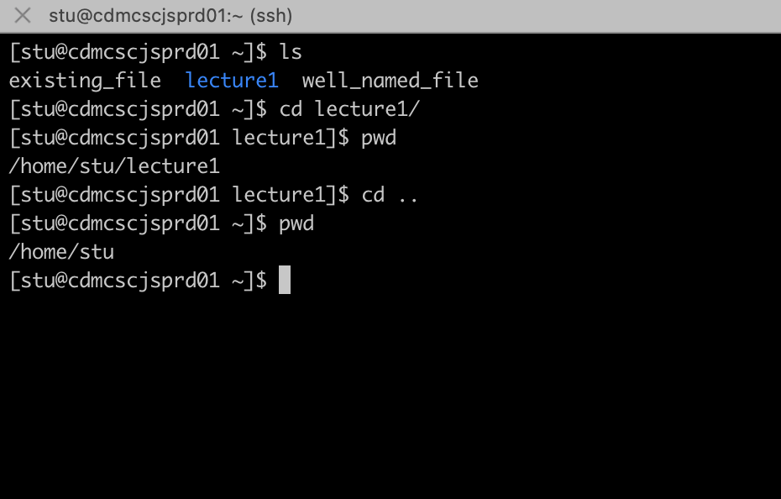
Linux Commands (cont.)
Command: cd
Description: change the working dir
Arguments: target_dir

Slide 19
Viewing a File
​cmd | What is it
more | For files larger than your console window, you will need to scroll: Space bar to move forward one page. b to move backward one page, Enter to move forward one line, / to search for key_word in the text, q to quit.
cat | The command cat gets its name from concatenate: it reads its input file names and writes them to the screen. If you give it more than one file name then cat will first concatenate (hence the name cat) the file contents one after another.
less | Like more but better, with more features and stuff
bat | Like less, but with syntax and stuff (not available on our Linux box)

Slide 20
Questions?

Slide 21
Linux/Unix text Editors
Because sometimes echo and cat aren't enough

Slide 22
PLAN FOR PRODUCT LAUNCH
vim
Makes you cool
emacs
Not usually installed
Is almost always installed
Robust ecosystem
Robust ecosystem
nano
Will get you teased in industry
Just use vscode remote instead

Slide 23
TIMELINE
emacs
http://ergoemacs.org/emacs/emacs.html or http://heather.cs.ucdavis.edu/~matloff/UnixAndC/Editors/Emacs.html
VIM
$ vimtutor
https://vim-adventures.com/
nano
Use the commands at the bottom of the screen
Open a file
$ emacs file.txt
$ vim file.txt
$ nano file.txt

Slide 24
Emacs
Here is a short primer on emacs. To open a file file.c using emacs, type
$ emacs file.c
Emacs will open the file called "file.c" in your current working directory or create one if no file by that name exists in your current working directory. You can start editing know. When you want to save your file, type Ctrl-X Ctrl-S (This means pressing the Ctrl key and pressing x and then s, while still pressing the Ctrl key) To save a file under a different name, type Ctrl-X Ctrl-W To exit emacs, type Ctrl-X Ctrl-C Here is a short list of important emacs editing commands To move the cursor up, down, left, or right use the arrow keys. To delete a character pointed to by the cursor, type Ctrl-D You can also use the Delete or Backspace keys. To cut and paste, move the cursor to the first character of the part you want to cut and paste. Then type Ctrl-SPACE (SPACE is the space bar) Then move the cursor down to the last character of the part you want to cut. Then type Ctrl-W to cut the text. You can then move the cursor to the position where you want to paste, and type Ctrl-Y to paste. You can paste the cut text again and again with Ctrl-Y. To exit the Emacs editor, type Ctrl-X Ctrl-C. You should be able to modify the properties of the VT102 terminal emulator in SSH to customize some of the key bindings.

Slide 25
vim
** To move the cursor, press the h,j,k,l keys as indicated. **
^
k Hint: The h key is at the left and moves left.
< h l > The l key is at the right and moves right.
j The j key looks like a down arrow.
V
Different modes:
Normal – (esc) move around, copy, delete, paste
Insert – (i in normal mode) type things
Visual - (v in normal mode) highlight stuff, copy, cut, paste
Command- (: in normal mode) execute commands
Write a file :w
Write to a new file :w file_name
Quit :q
All the cool kids use vim. Give in to peer pressure.
Disclaimer: I am not great at vim.

Slide 26
vim
Look at vimtutor
https://web.stanford.edu/class/cs107/resources/vim

Slide 27
Questions?

Slide 28
Break

Slide 29
Introduction To C
See also:
http://www.cprogramming.com/tutorial/c-tutorial.html

