Slide 1
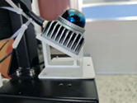
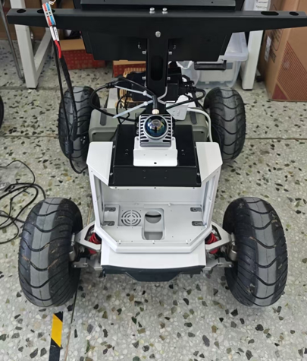
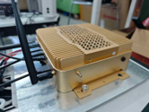

(a) Livox Mid-360 LiDAR
(b) Jetson AGX Orin
(c) Ackermann chassis

