Slide 1
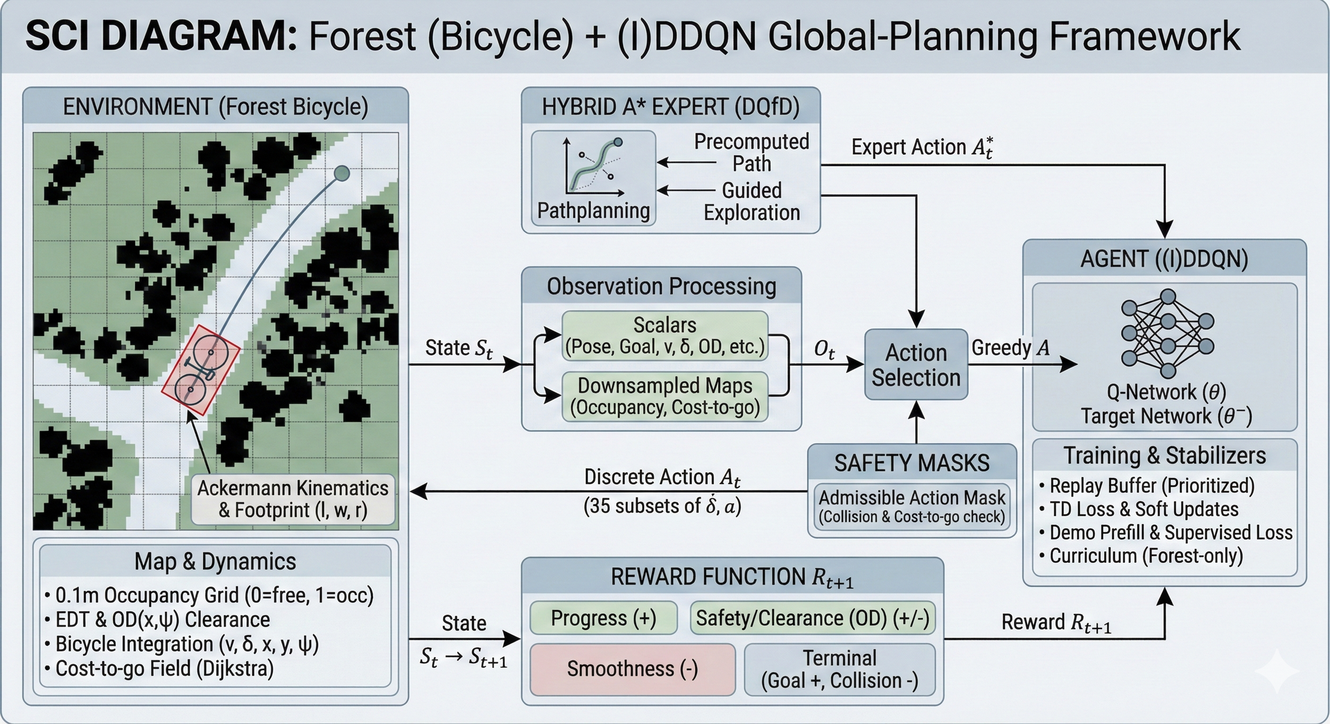
SCIDIAGRAM:F
Forest
(Bicycle)
+
(I)DDQN Global-Planning Framework
ENVIRONMENT
(Forest
Bicycle)
HYBRID
A*
EXPERT
（DQfD)
Precomputed
Expert Action
*
Path
Guided
Pathplanning
Exploration
AGENT
((I)DDQN)
ObservationProcessing
Scalars
State St
(Pose,
Goal,
v, δ,
, OD, etc.)
Ot
Action
GreedyA
Downsampled
Maps
Selection
Q-Network
(θ)
(Occupancy, Cost-to-go)
Target
Network
(θ-)
SAFETYMASKS
Training
&
Stabilizers
Ackermann Kinematics
Discrete
Action
• Replay
Buffer
(Prioritized)
＆Footprint
(I, w, r)
(35 subsets
of δ, a)
Admissible
Action
Mask
TD
Loss
＆
Soft
Updates
(Collision
& Cost-to-go
check)
Supervised Loss
Demo
Prefill
&
Map
&
Dynamics
Curriculum
(Forest-only)
REWARD
FUNCTION
Rt+1
0.1m
Occupancy
Grid
(0=free, 1=occ)
•EDT
&
OD(x，ψ)
Clearance
State
Progress
(+)
Safety/Clearance
(OD)
(+/-)
Reward Rt+1
Bicycle
Integration
(v,δ, x, y, ψ)
St → St+1
Cost-to-go
Field
(Dijkstra)
Smoothness
-
Terminal
(Goal +, Collision
-

