Slide 1
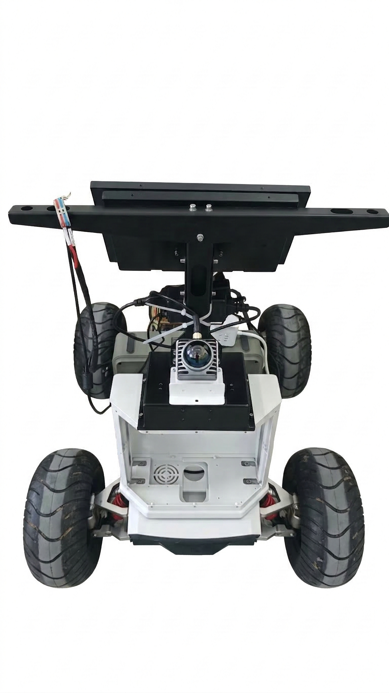
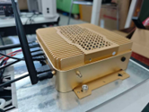
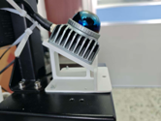

UGV Platform
(a) Jetson AGX Orin
LiDAR
(b) Livox Mid-360 LiDAR
(c) Ackermann Chassis
LiDAR

