Slide 1
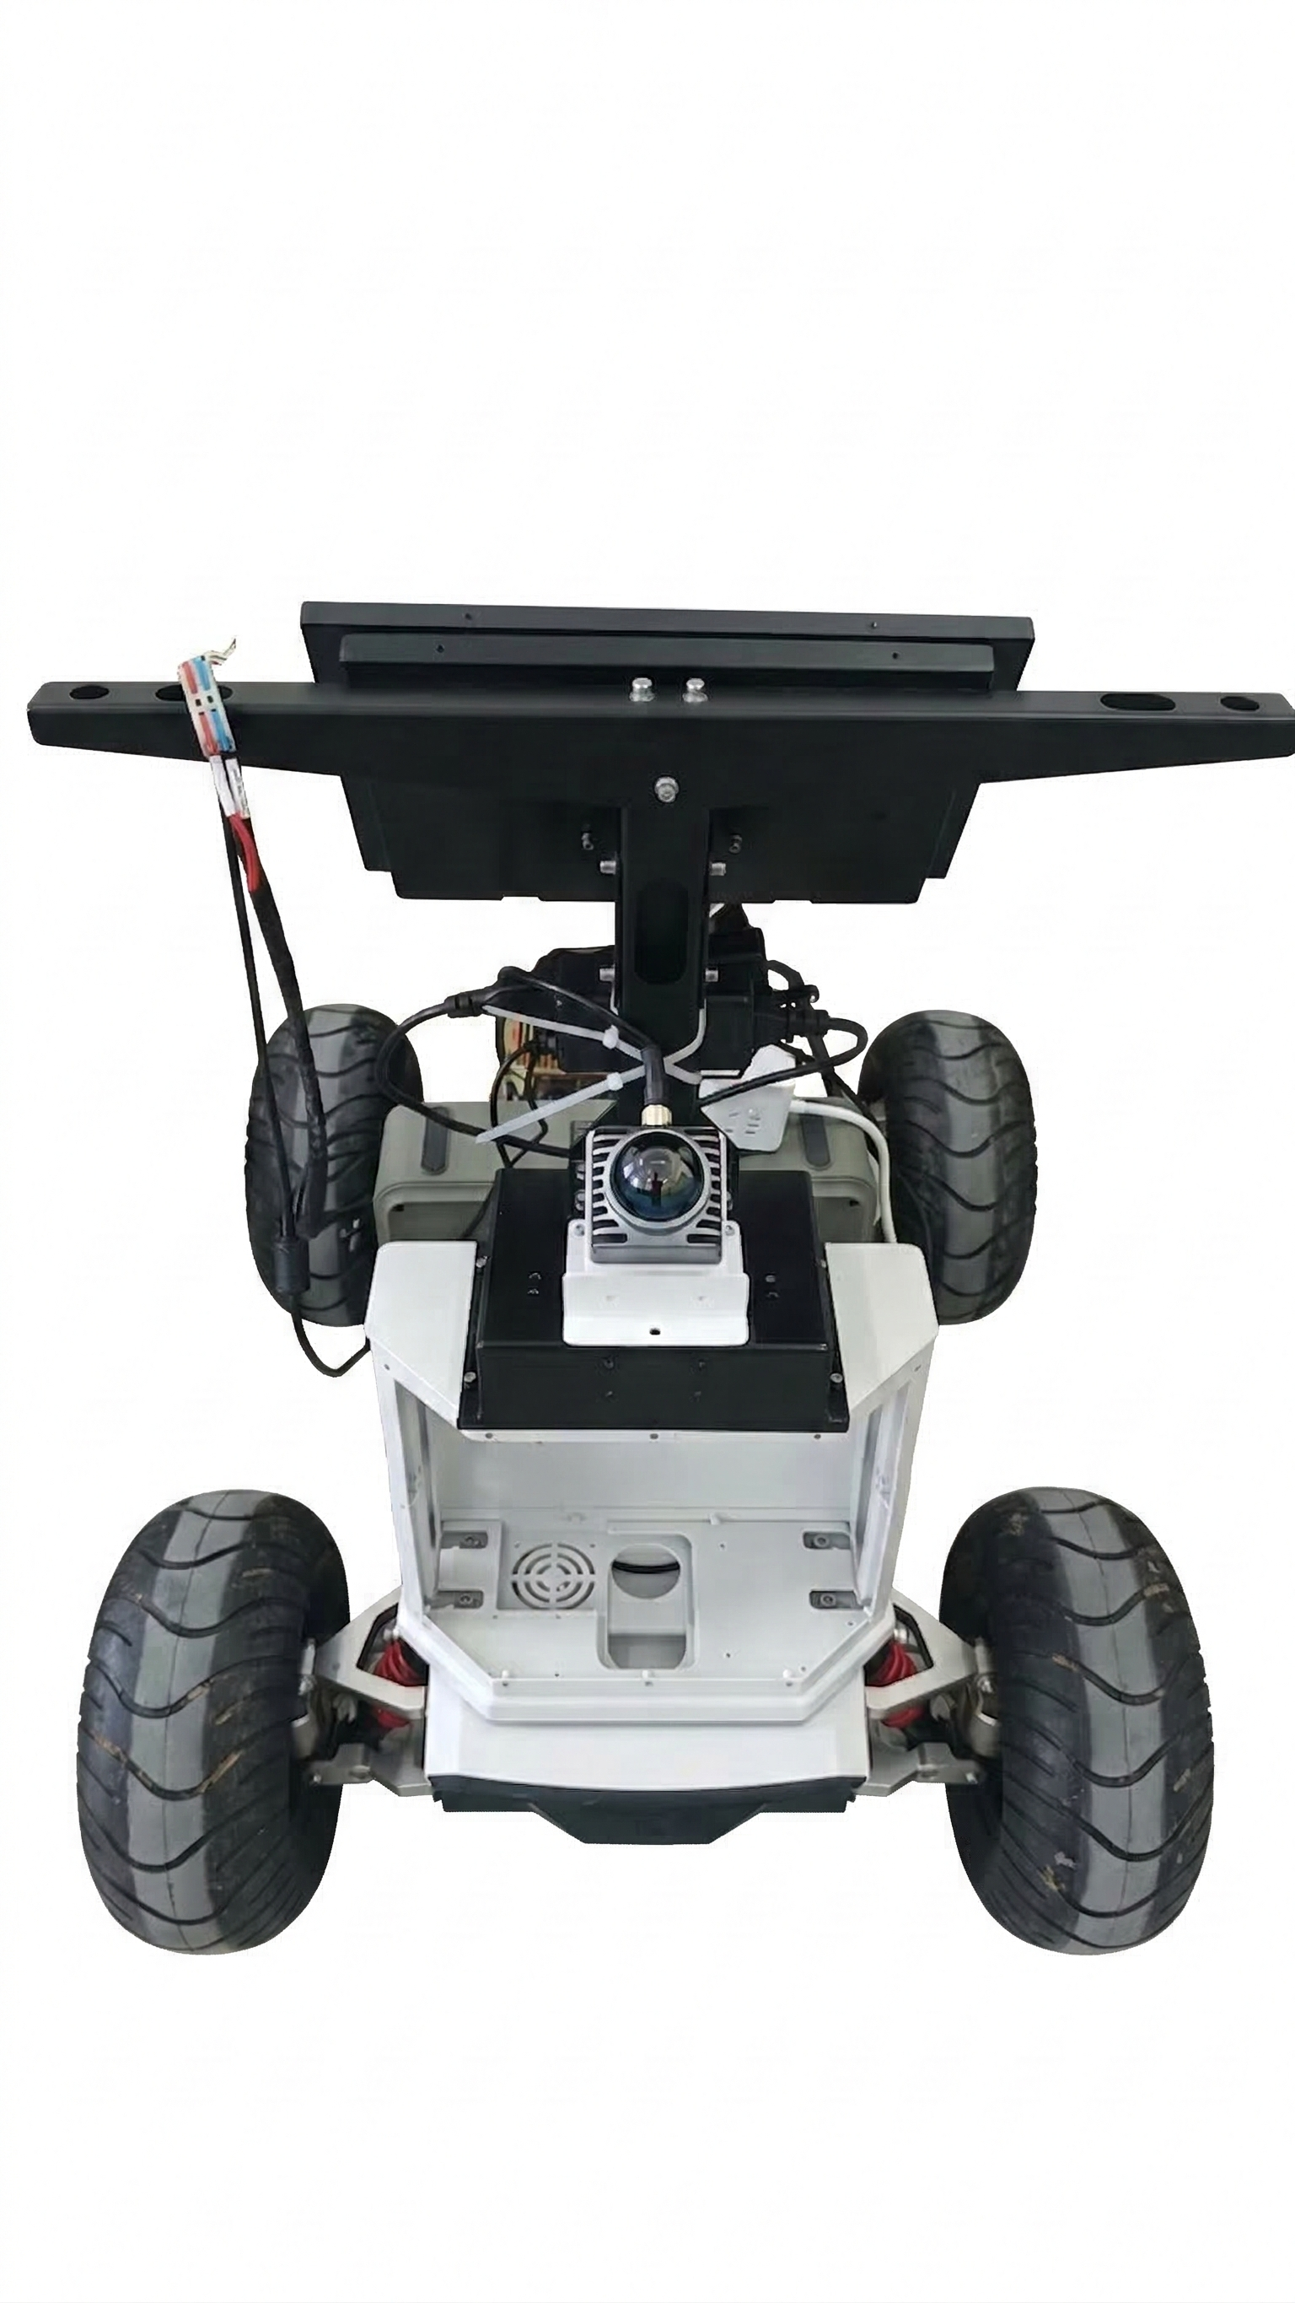
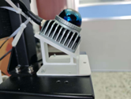
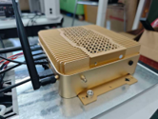

UGV Platform
(a) Livox Mid-360 LiDAR
3D Point Cloud Sensing
(b) Jetson AGX Orin
Onboard AI Computing
(c) Ackermann Chassis
Bicycle Kinematic Model

