Slide 1
Ebola Virus Spread
Masters of Computer Science USU
Jonathan Arndt

Slide 2
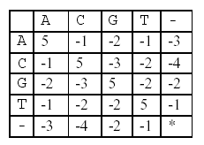
Algorithms
Hirschberg Algorithm for Minimum Edit Distance
Needleman-Wunsch
Divide and Conquer method uses:
O(nm) time
O(min{n,m}) space
Backtracking to see best alignment
Neighbor Joining Algorithm for Tree Construction
Uses the MED score to construct tree
Notes:
Using the Hirschberg Algorithm which finds the optimal sequence alignment between two strings, and the scoring matrix shown to the right, an overall alignment score was calculated which will be used to compare the distance between any given two dna sequences. This algorithm was very useful in using only O of the minimum of n and m where n and m are the lengths of the two dna sequences being compared while still only using O of n m time.
Then backtracking was used to show the optimal alignment. The straightforward algorithm which i used, has a time complexity of O of n cubed, other more heuristical approaches can average better O of n’s.

Slide 3
Data
Paper provided ID of several (93) samples
Scraped for those IDs to get DNA sequences.
http://www.ncbi.lm.nih.gov
Most DNA sequences ~18000 characters long
Notes:
The research paper used, provided an excel table with the id numbers of the samples used as well as a few notes about each sample including it’s coverage, how and where it was collected and the date it was collected on.
The table was then read and used to crawl the ncbi website and search for the dna sequences using the IDs provided. The DNA sequences were then saved and stored for later processing. Most DNA sequences were around 18 thousand characters long.

Slide 4
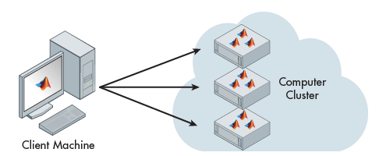
Computing Cluster
Clusters were used to compute the MED between pairwise DNA sequences.
AWS (Amazon Web Service)
400 computers
Notes:
Each comparison took an hour or more so I knew completing the 93 choose 2 combinations would take way too long, i enlisted a computing cluster to divide the work into 400 machines. First a jar file was created for the minimum edit distance algorithm which was then copied to each server, next a batch of jobs to complete were sent. Then i waited for the results and fixed any bugs along the way.
Finally zipped up and copied the results from all the clusters to my computer to be analyzed

Slide 5
Results

Slide 6

Codebase
https://github.com/unsupo/cs-5560
Notes:
This is where all the code I used for this project and class is stored. This includes the program itself which was compiled into a jar and copied over to each of the clusters and given a batch of sequences to complete as well as the algorithms and testing.

Slide 7
References
www.mathworks.com (cluster image)
https://github.com (github image, use of repository)
Dr. Flann for Scoring matrix image
Wiki for some info
https://en.wikipedia.org/wiki/Hirschberg%27s_algorithm
https://en.wikipedia.org/wiki/Neighbor_joining
Research Paper for Data
http://science.sciencemag.org/content/345/6202/1369.long
http://science.sciencemag.org.dist.lib.usu.edu/content/suppl/2014/08/27/science.1259657.DC1
http://www.ncbi.nlm.nih.gov/nuccore (dna sequences)

