Slide 1
Ebola Virus Spread
Jonathan Arndt
Masters of Computer Science USU

Slide 2
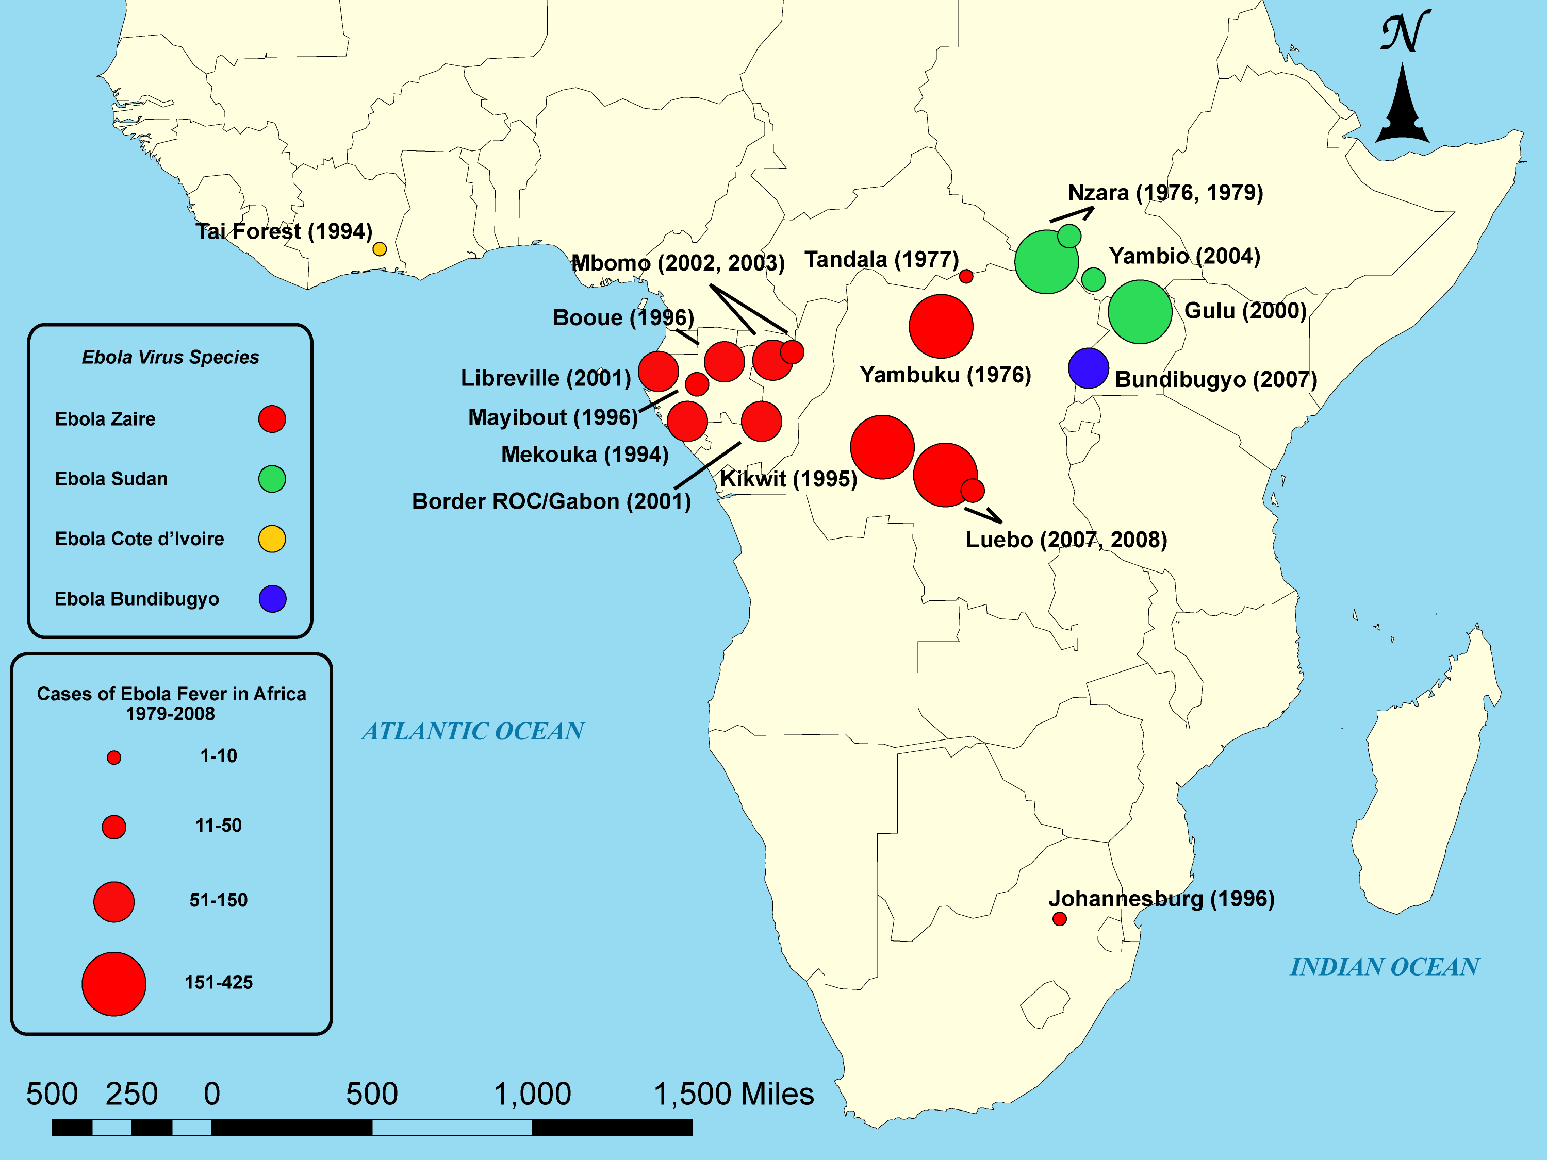
Biological Problem
Determine how and where the virus travels
How and when the virus entered human population
Determine related ancestors, how virus changed
Notes:
Connect the problem to the real world and use some illustrations from the paper to get your point across.
The high rate of mortality in the current Ebola epidemic has made it difficult for researchers to collect samples of the virus and study its evolution. Gire et al. describe Ebola epidemiology on the basis of 99 whole-genome sequences, including samples from 78 affected individuals. The authors analyzed changes in the viral sequence and conclude that the current outbreak probably resulted from the spread of the virus from central Africa in the past decade. The outbreak started from a single transmission event from an unknown animal reservoir into the human population. Two viral lineages from Guinea then spread from person to person into Sierra Leone.

Slide 3
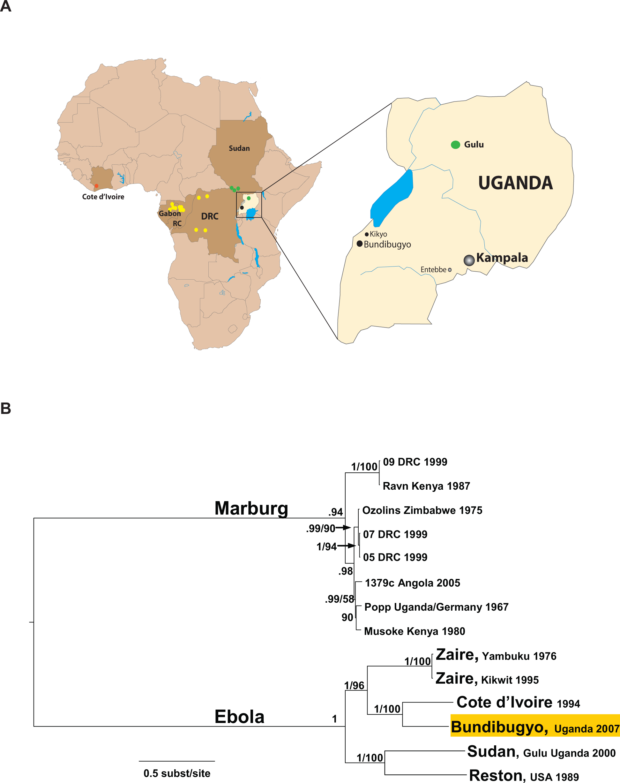
Significance
Can be used to determine and trace ancestry to help determine if similar cures can work for various strains
Determine where and how quickly the virus might spread next
Notes:
Connect the problem to the real world and use some illustrations from the paper to get your point across.

Slide 4
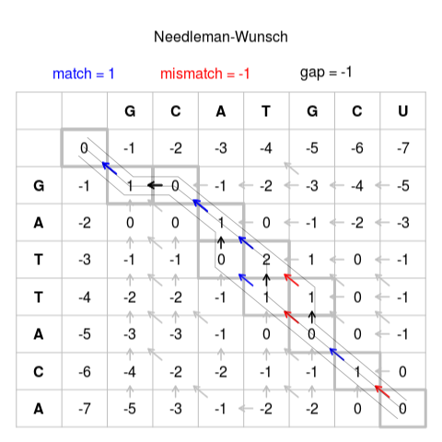
Computer Science Problem
Sequence Alignment
Needleman–Wunsch Algorithm
Phylogenetic tree Induction
Neighbor Joining Algorithm
Notes:
The computer science problem you will be solving and its connection to the biological problem (2 slides). Try to define the problem clearly and refer to existing algorithms we have covered in class if relevant. Again, use illustrations from books/sides/web to illustrate the algorithms.
Sequence alignment can help determine the similarity between two strands of a virus and the Phylogenetic tree helps organize the lineage of the virus.

Slide 5
Connection to Biological Problem
Use Phylogenetic tree to determine the relationships between strands
Induce from this information and the sightings of each strand a geographic mapping and expected locations.
Notes:
The computer science problem you will be solving and its connection to the biological problem (2 slides). Try to define the problem clearly and refer to existing algorithms we have covered in class if relevant. Again, use illustrations from books/sides/web to illustrate the algorithms.

Slide 6
Plan of Action
Develop the algorithms
Neighbor Joining Algorithm
Needleman–Wunsch Algorithm
Test it with example data
Extract real data from various online sources
http://www.ncbi.nlm.nih.gov/
Use it on extracted real data
Analyze results
Write report
Notes:
Your plan of action and schedule (2-4 slides). Here break the task down into subtasks with an estimated schedule. Putting this together will help you recognize if you are being too ambitious. I and yourself would rather have a small project done well than a large project half-baked

Slide 7
Schedule
Action | Date
Algorithms and Testing Complete | 8/7
Extract Real Data | 8/8
Analyze Results | 8/9
Report Complete | 8/11
Notes:
Your plan of action and schedule (2-4 slides). Here break the task down into subtasks with an estimated schedule. Putting this together will help you recognize if you are being too ambitious. I and yourself would rather have a small project done well than a large project half-baked

Slide 8
Sources
https://en.wikipedia.org/wiki/Ebola_virus_disease
http://journals.plos.org/plospathogens/article?id=10.1371/journal.ppat.1000212
https://en.wikipedia.org/wiki/Needleman%E2%80%93Wunsch_algorithm

