Slide 1
Raisin
Group digital_invention
All your WebCMS3 due dates in one place.

Slide 2
Who is it for?
A typical UNSW student enrolled in courses that use WebCMS3 (you)
With trimesters...
Courses are accelerated & due dates arrive surprisingly
Students already have enough commitments to manage
Course outlines can be dense and confusing

Slide 3
Our solution - Raisin
Automatically extracts all due dates from WebCMS3
Assignments
Labs
Project milestones
Exams
Fast and simple process
Export to the calendar service of your choice
Google Calendar
Apple Calendar (iCal)

Slide 4
Raisin Demo

Slide 5
Web Stack
Back-end:
Python
& its many modules
Flask
Front-end:
Jinja2
Materialize CSS

Slide 6
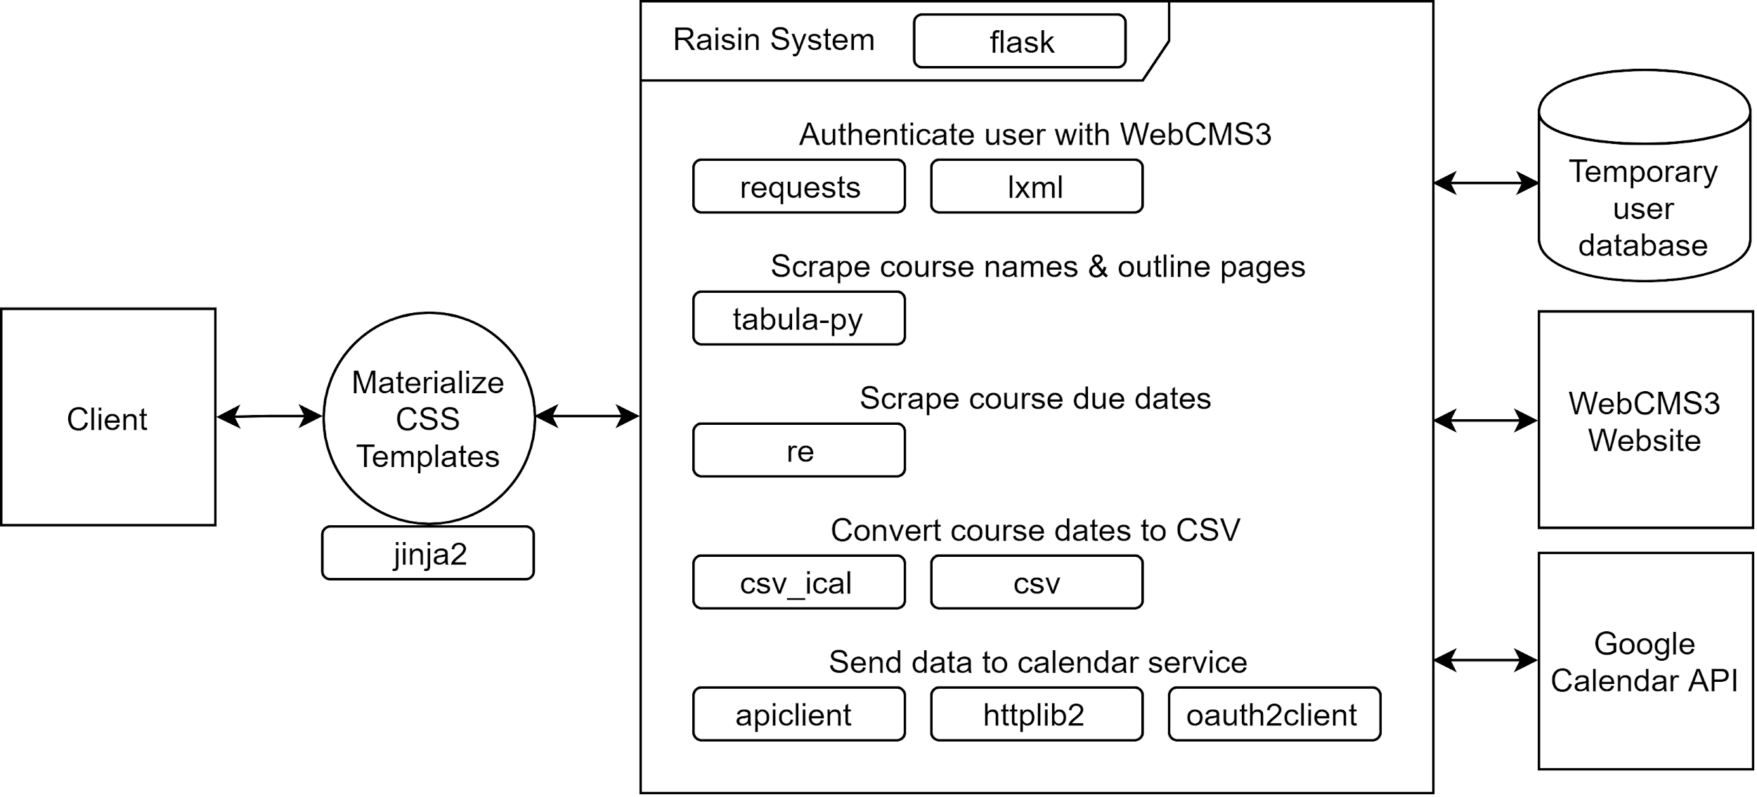
Software Architecture
Client-server
Back-end basically:
Gets course outlines
Extracts due dates
Send data to calendar API

